Slide 1
Identifying Categorizable Linguistic Units

Slide 2
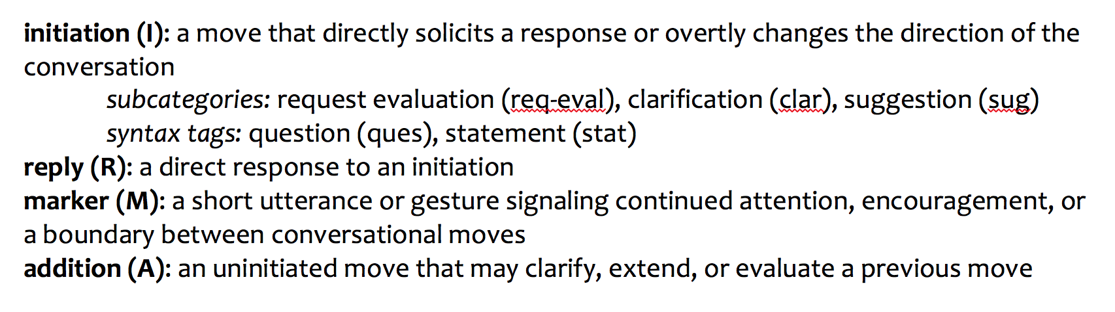
Linguistic Coding System

Slide 3
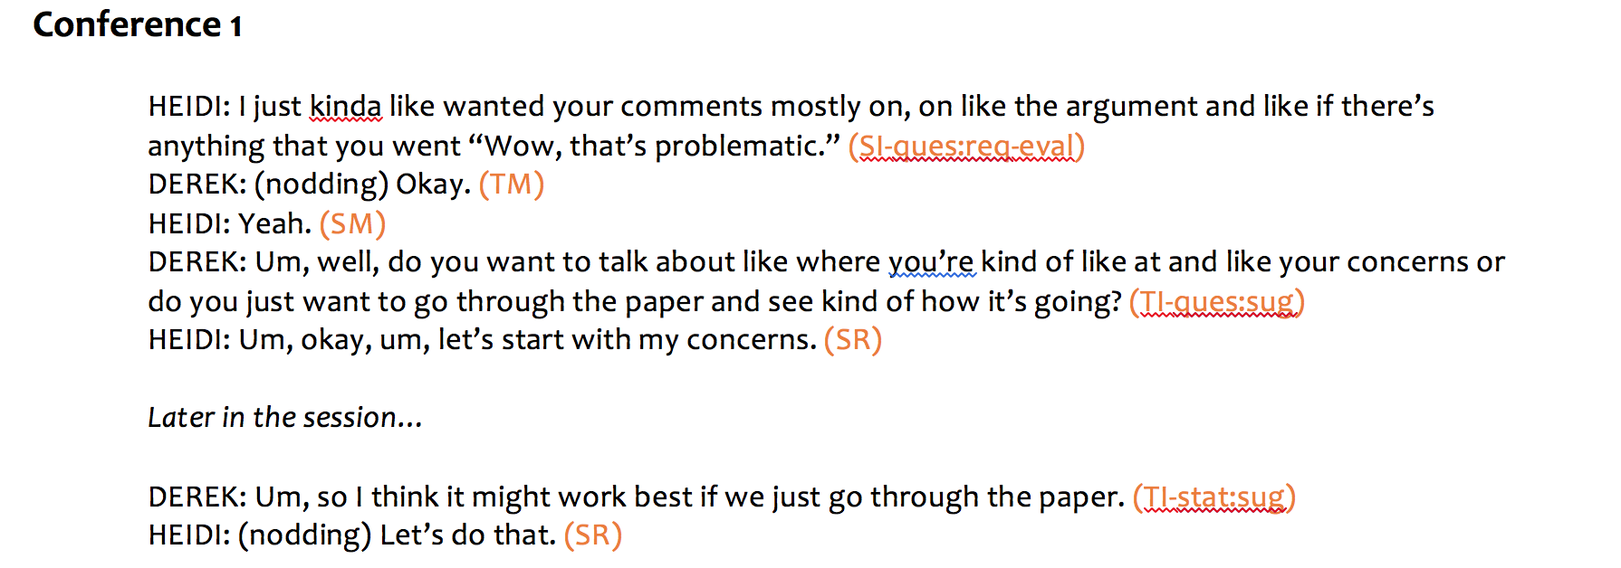
Conference 1

Slide 4
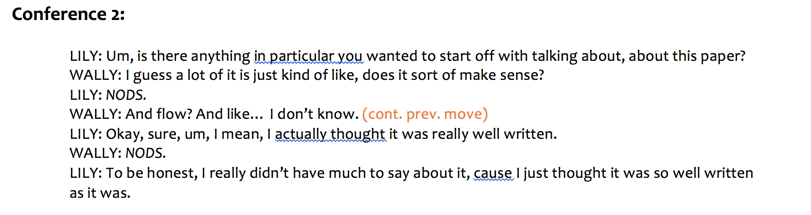
Conference 2

Slide 5
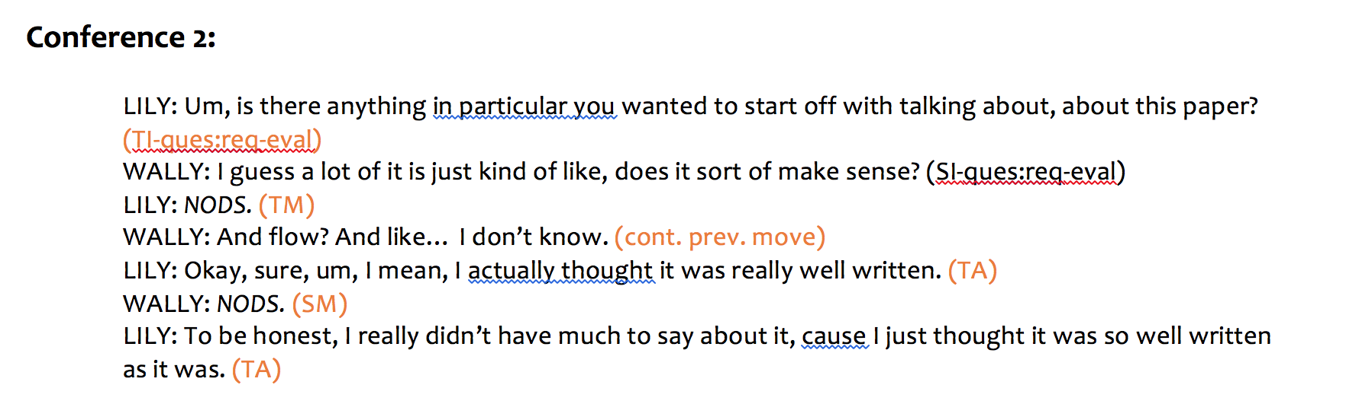
Conference 2

Slide 6
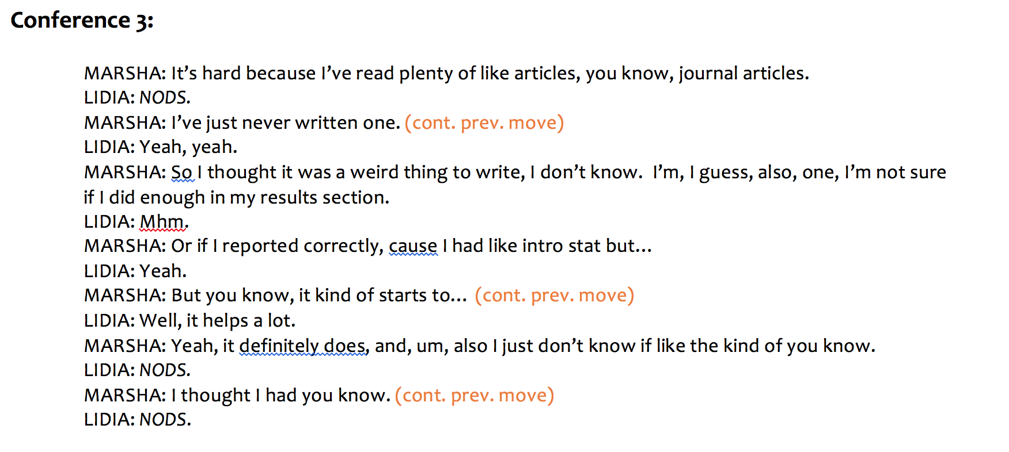
Conference 3

Slide 7
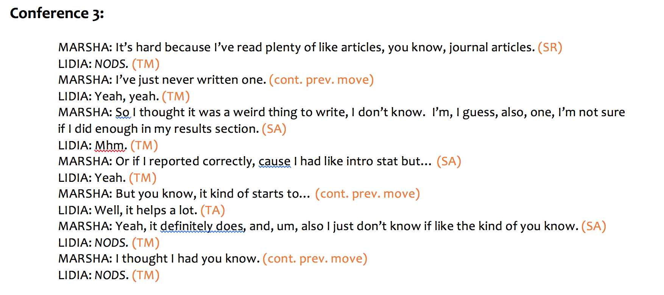
Conference 3

Slide 8
For Discussion
What do you think student engagement looks like?
Are you a directive tutor, a nondirective tutor, or a bit of both? Think about your most successful conferences. Does one of them stand out as being highly directive or highly nondirective? How did student engagement manifest in that session?
How do you encourage productive student engagement?

Slide 9
Wilder, Molly. “A Quest for Student Engagement: A Linguistic Analysis of Writing Center Discourse.” The Oxford Guide for Writing Tutors: Practice and Research. Eds. Lauren Fitzgerald and Melissa Ianetta. Oxford University Press, 2016. 533—546. Print.

