Slide 1

New Media Matters: Tutoring in the Late Age of Print
Jackie Grutsch McKinney
A Presentation by Manny Asencio

Slide 2

Out With The Old, In With The New (Media)
For a long time, the norm for academic writing has been the typical 8.5-by-11-inch, double spaced, thesis-driven texts written on plain white paper

Slide 3
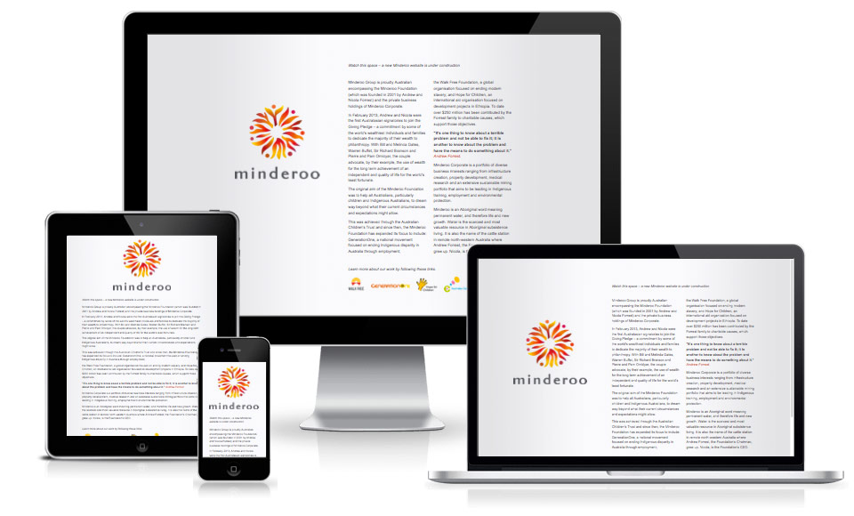
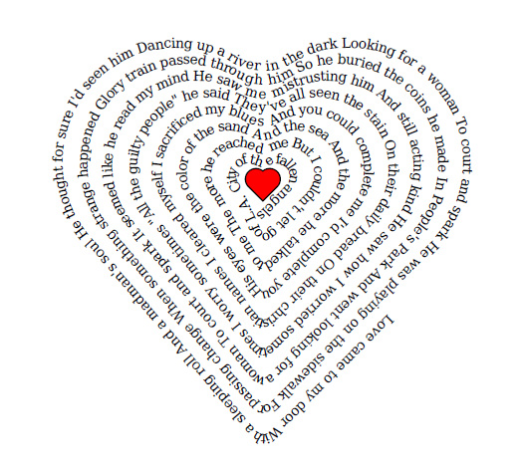
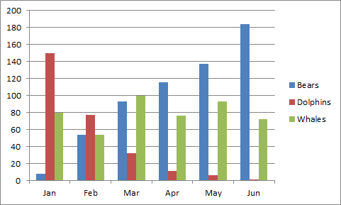
What is New Media?
Cynthia Selfe describes new media texts as “texts created primarily in digital environments, composed in multiple media, and designed for presentation and exchange in digital venues”
Anne Wysocki defines new media as any text that “calls attention to its own materiality”
Cheryl Ball holds that what makes new media “new” is the way in which it deviates from traditional ways of argument

Slide 4
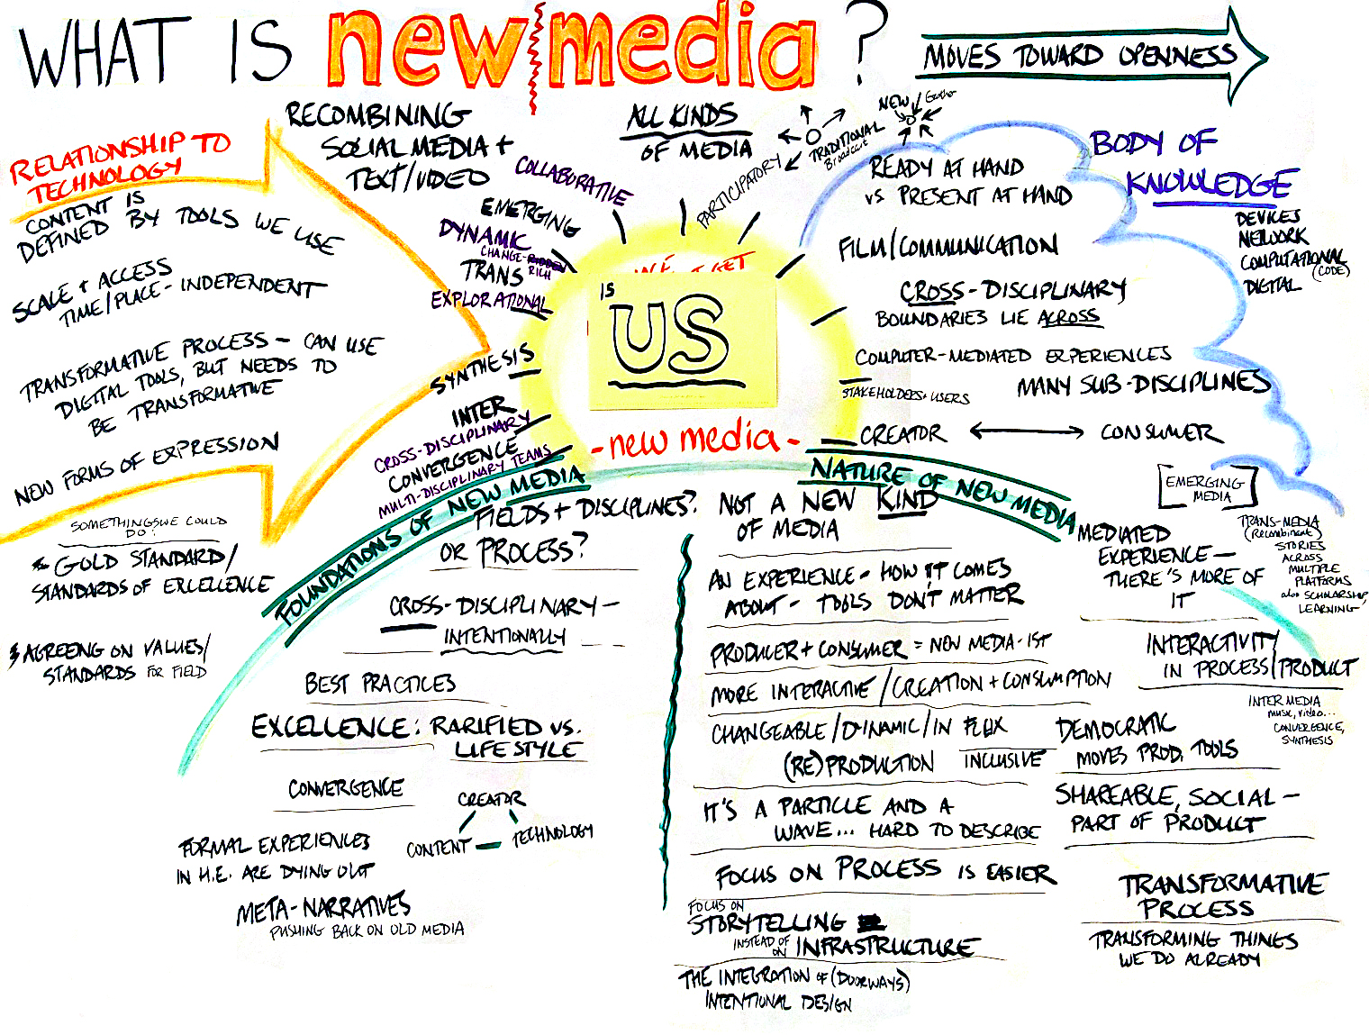
So What Exactly is “New Media”?
A combination of all three!
New Media is distinguishable by its digital-ness, its conscious materiality, and its rhetorical means

Slide 5
Three Reasons Why New Media Matters
New media is writing!
“New” media is not too different from “old” media
If new media is not claimed for writing, it will be assumed to be nothing more than technology

Slide 6

How Do We Tutor New Media?
New media, isn’t really new. It is simply a new way of doing something that we have been doing for a long time
If we can’t get past the novelty of new media, then we can try and look at it from a different perspective
While text isn’t necessarily a requirement for new media, it is usually present, even if just briefly
We should tutor the writer who’s writing it!

Slide 7
How Do We Tutor New Media? (Cont’d)
One of the major differences between new media and traditional means of writing is that whereas traditional writing focuses on the actual text, new media uses other elements to assist the text in getting a point across
As Tutors, one of our jobs when looking at new media texts is to note how well the added elements complement the text
Due to the presence of other elements, the traditional read-aloud method might not always be the most effective way to tutor new media texts. You can’t read aloud images or audio, for example

Slide 8

The Dangers of New Media: Information Overload
There are those who believe that new media is not the writing center’s problem.
Many believe that requiring tutors to learn additional skills and focus on additional types of text will have a negative effect on their tutor efficiency.

Slide 9

Discussion Questions
Is it the writing center’s job to work with new media?
Should writing centers offer special training to familiarize their tutors with non-traditional texts? Is it necessary?

Slide 10
The Bottom Line
New Media isn’t going anywhere
Writing centers must adapt and become used to seeing these kinds of texts more often because it is our job to work with all types of writing
Many writing centers, whether they know it or not, have already began to take steps in this direction and may even already work regularly with new media (such as our own writing center)

Slide 11

Fin

