Slide 1
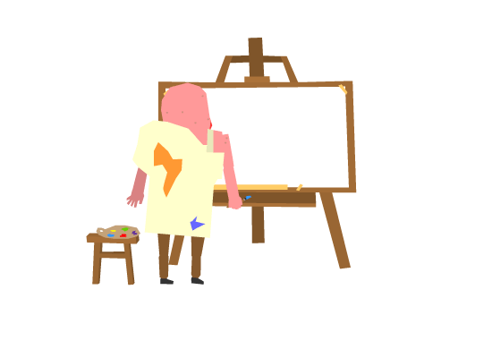
Portrait of the Tutor as an Artist
By Eleanor Faraguna and Steve Sherwood

Slide 2
We have a birthday in the room...

Slide 3
Artistic Elements of Tutoring
Begins with the ability to interact with others
4 main elements:
SURPRISE
CIRCUMSTANCE
IMPROVISATION
FLOW

Slide 4
What is art?
Are we going to let Steve Sherwood define it for us?

Slide 5

Artist or Artisan
What should a tutor be?
What should a writer be?
Artist: a breaker of new ground and a maker of unique works or experiences
Artisan: follows rules, learns how to perform a particular task repetitively

Slide 6
Tutor as an artisan
Tutor as an artist
Seven steps for tutorial:
Greet client
Discuss assignment
Set a focus
Read the paper
Evaluate strengths and weaknesses
Give suggestion for revision
End tutorial gracefully
Have flexibility with the structure of the session
Engage completely
An opportunity to experience the creativity of a student
“Sits at the nexus of...ethics, practices, and social customs”
Helps writer through their own set of rules

Slide 7

SURPRISE
Relationship between wit and invention
Relationship between relaxation and reinvention
Elements of surprise in our conversations
  Forming new ideas
  Illumination of topics
  Valuable to students

Slide 8

CIRCUMSTANCE
Where is the writer in the process?
What can we do in our capacity to help?
How do we deliver feedback?
  I.e no emotional breakdowns

Slide 9


IMPROVISATION
React to changing circumstances
Stimulates creativity
Increases confidence
Stay engaged and listen

Slide 10

FLOW
All aspects need to be harmonious
  Organization and clarity
Help writers recognize flow and build it
The same as meditation
“A dance of intellects, a push and pull of wits”
Intended product of the session

Slide 11

Role play

Slide 12
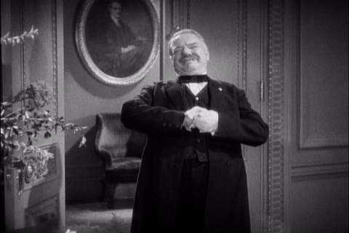
The end.

