Slide 1
The unpromising present of writing center studies
Louisa Mahoney
November 17th, 2017

Slide 2
Problems with Writing Center Scholarship
Prevalence of single-authored articles, “orphan citations”, and self-citations
  Threatens ideals of collaboration and collective knowledge building in the writing center
  Overly inward focus
Relevance of problem
      “In other words, at this moment in time, writing center scholarship can no longer afford primarily to be read by writing center scholars; we can no longer afford to embrace marginality”

Slide 3
“The flagship journal– over the course of its 30 year history– had by and large featured single-authored articles despite an ethos of collaborative work. Also consider that these articles either rely on citations that are not taken up by subsequent authors or refer to a set of “insider” readings that function largely to affirm established beliefs and run the risk of casting the field as largely talking to itself, not to be taken seriously by related and affiliated fields” (68).

Slide 4
Citation Practices Research
Examines the citations of articles from the Writing Center Journal
  From a data set of 241 articles
    4,095 citations
    Span of 30 years, 1980-2009
Analyzed articles looking at several different factors:
  Number of authors
  Frequency at which authors are published in WCJ
  Gender of authors
  Citations
    Number, frequency
Importance of citations
“Citation patterns represent a particular view of knowledge making” (93).

Slide 5
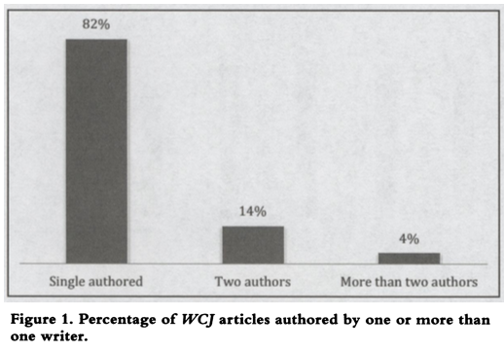
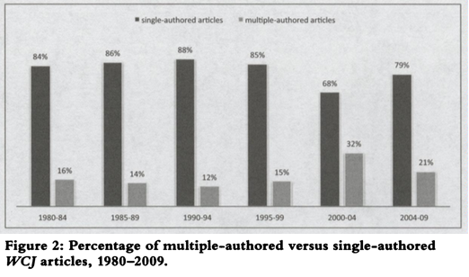

Slide 6
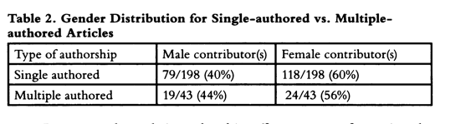

Slide 7
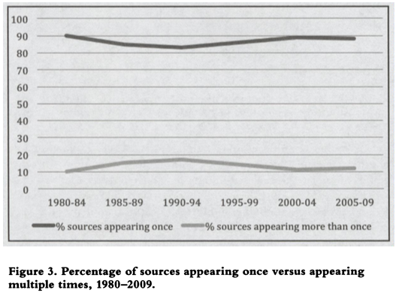
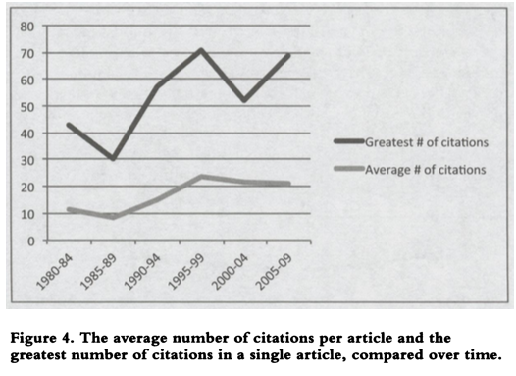

Slide 8
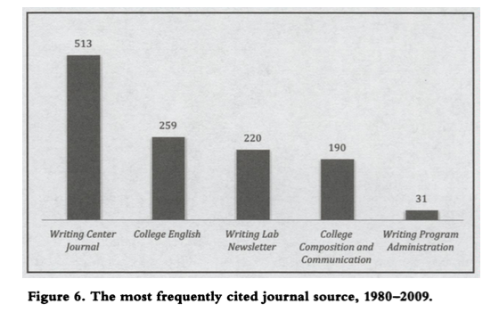
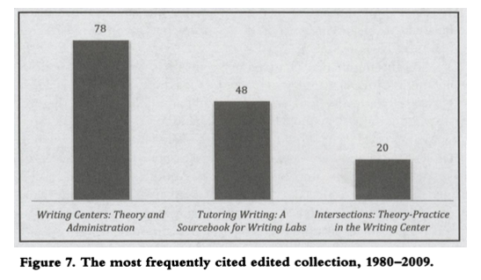

Slide 9
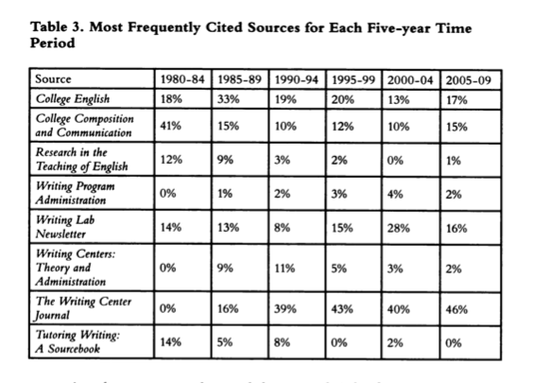
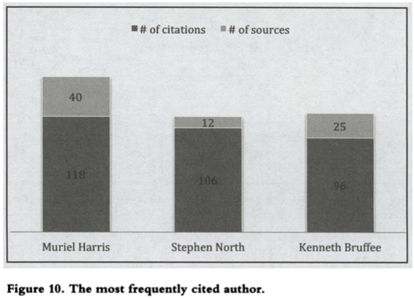

Slide 10
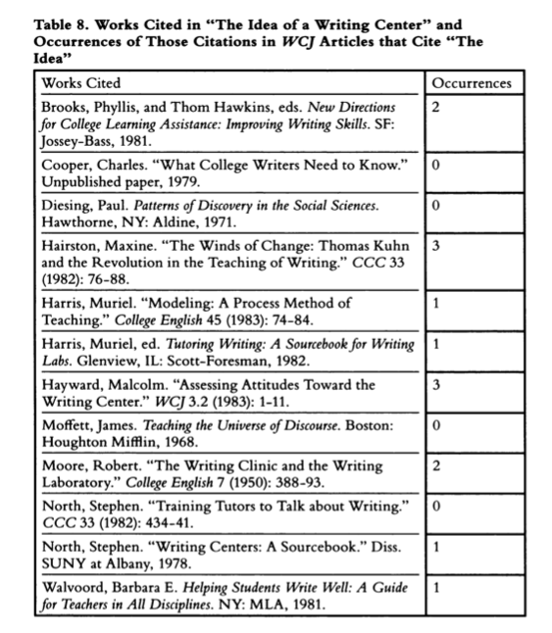
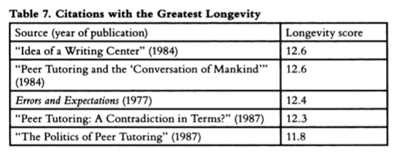

Slide 11
Lerner’s Conclusion
If scholarship continues to be single-authored and orphan articles, the field will remain narrow
  Limit potential impact
  Leads to ostracization of writing centers
    Seen in the decrease of articles about writing centers on Comppile.com

