Slide 1
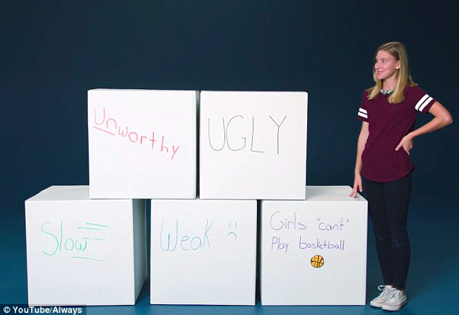
#LikeAGirl

Slide 2
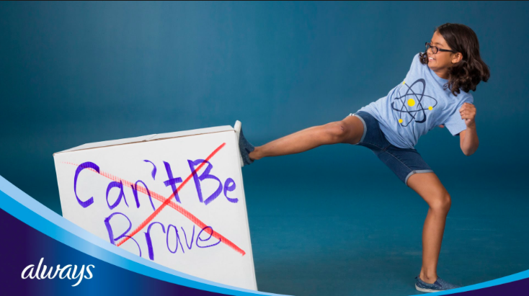
#LikeAGirl
Goal: To help girls maintain confidence throughout puberty.
As the most awarded ad of 2015 it is becoming apparent that #LikeAGirl is voicing a change worldwide for gender equality.

Slide 3
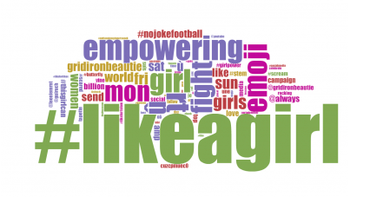
Word Cloud Key Findings

Slide 4
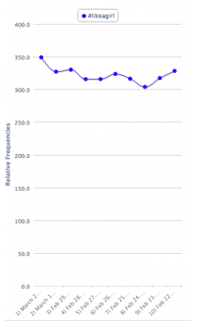
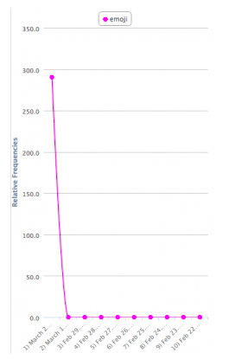
#LikeAGirl
Emoji
March 2-February 22

Slide 5
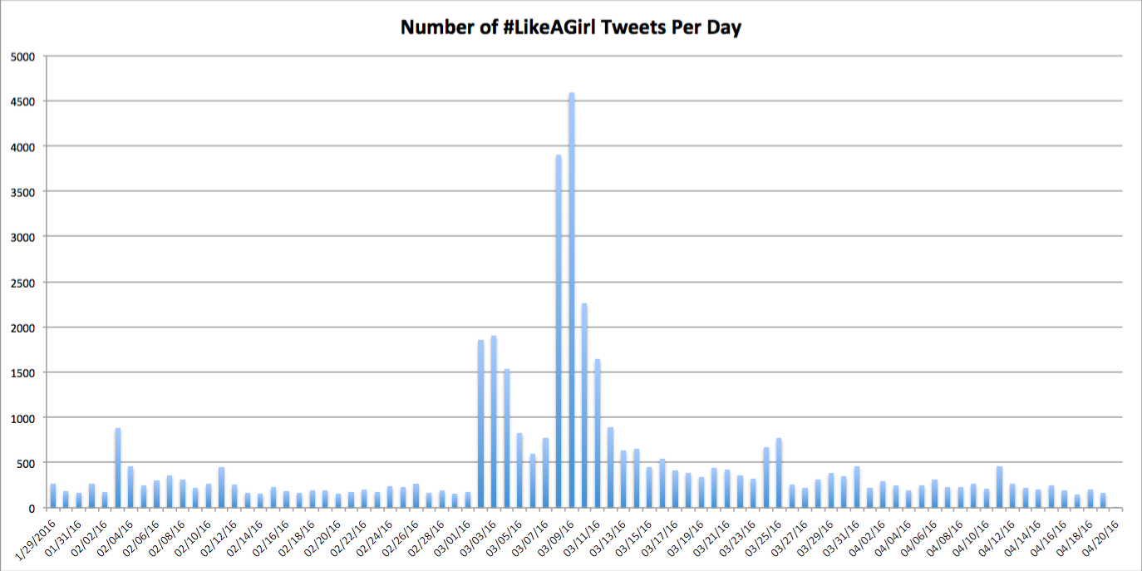

Slide 6
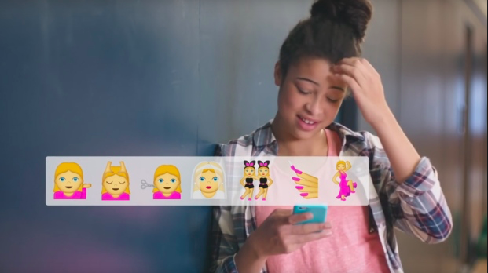
#LikeAGirl: Software-sorted Geography
-“…while such processes are necessarily multifaceted, multiscaled, complex and ambivalent, a great variety of ‘software-sorting’ techniques is now being widely applied in efforts to try to separate privileged and marginalized groups and places across a wide range of sectors and domains.” -Graham

Slide 7
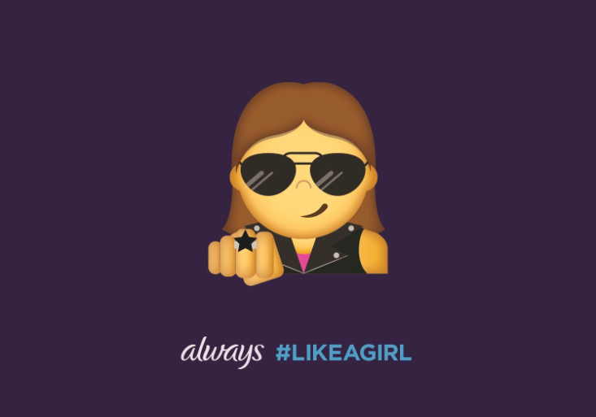
The End
In summary, my data collection for #LikeAGirl was particularly significant because of the time period that I collected it during.

Slide 8
Works Sited
Stephen D.N. Graham, Software-sorted Geographies (New York: Routledge, 2014) 134
Always #LikeAGirl." Video file. youtube.com. Posted June 26, 2014. Accessed April 30, 2016. https://www.youtube.com/watch?v=XjJQBjWYDTs.

