Slide 1
#Syria: A Global Issue
Charlie Minnetian

Slide 2
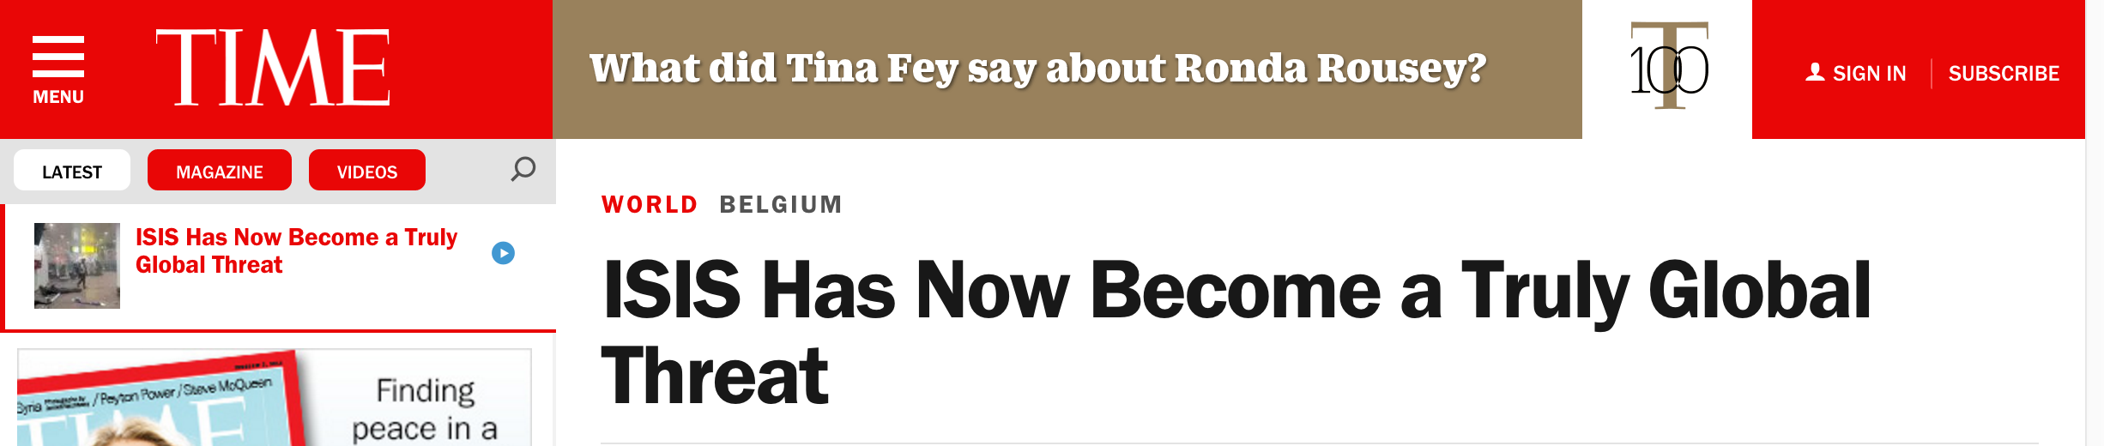
Why is #Syria Important?
Humanitarian Reasons
Global Politics

Slide 3
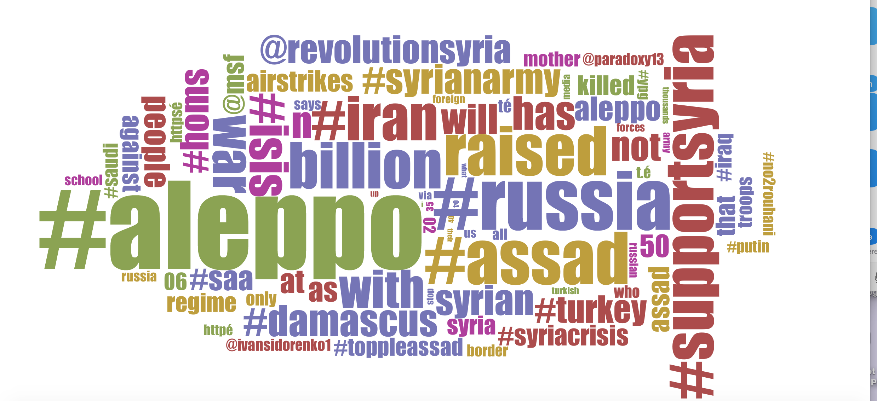
Key Findings: Tweets about Global Politics!
Most popular words: #aleppo, #russia, billion, raised, #assad
Nothing about refugees
Twitter’s political agenda??

Slide 4
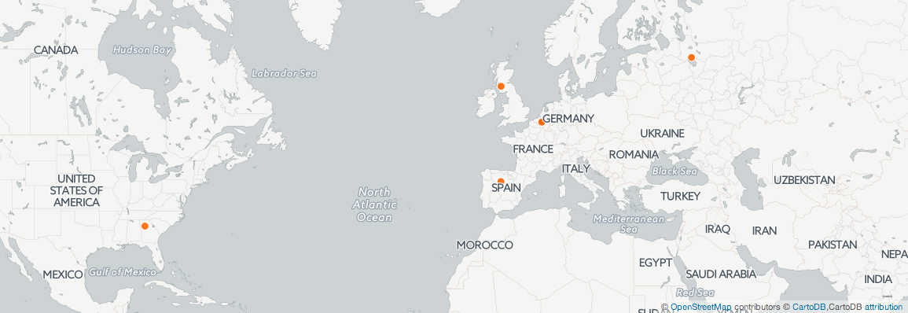
Key Findings: Global Tweets=Global Issue
-Widespread locations
-None from Middle East
-Global Implications

Slide 5
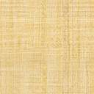

Is there Data Obfuscation in #Syria?
“the production of misleading, ambiguous and plausible but confusing information as an act of concealment or evasion”(Brunton and Nissenbaum, 164)
No Arabic tweets mapped
No pro-ISIS in word cloud
Twitter’s anti-ISIS agenda?

Slide 6

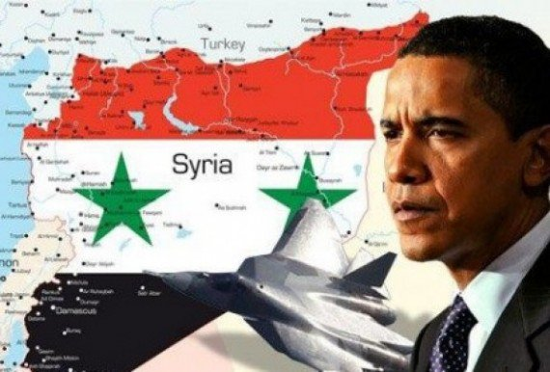
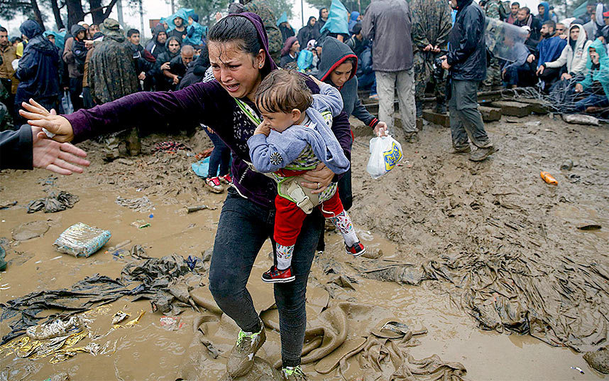
Conclusion
#Syria is a global issue
Word Cloud and Map show that
Twitter hiding Arabic, pro-ISIS tweets?

Slide 7
Works Cited
Bruton, Finn, and Helen Nissenbaum. "Political Restructuring in Europe."Political and Ethical Perspectives on Data Obfuscation (1993): n. pag. NYU.com. NYU. Web. 1 May 2016.
Corombos, Greg. Thousands of Syrians flood across the border into Iraq (Photo: U.N. High Commissioner for Refugees) Read more at http://www.wnd.com/2015/11/obama-admin-lied-about-vetting-syrian-refugees/#2ZtuHBYiVEqgBAzM.99. Digital image. WND. WND.com, 16 Nov. 2015. Web. 25 Apr. 2016. <http://www.wnd.com/2015/11/obama-admin-lied-about-vetting-syrian-refugees/>.
Google. Anti-ISIS Advertising. Digital image. Google to Push Anti-ISIS Ads Because ‘Murica. PRNewser, 6 Feb. 2016. Web. 1 May 2016.
ISIL Fighters in Anbar province, Iran. Digital image. Islamic State of Iraq and Syria. Wikipedia, n.d. Web. 25 Apr. 2016. https://en.wikipedia.org/wiki/Islamic_State_of_Iraq_and_the_Levant.
Malsin, Jared. "ISIS Has Now Become a Truly Global Threat." Time. Time, 22 Mar. 2016. Web. 01 May 2016.
Obama, Congress and the Coming War Against Syria. Digital image.Global Research. GlobalResearch.ca, n.d. Web. 1 May 2016.
WORLD NEWS»EUROPE Refugee Crisis: Thousands Hit by Torrential Rains and Thick Mud in Macedonia. Digital image. The Telegraph. Telegraph Media Group, 2016. Web. 1 May 2016.

