Slide 1

#Transgender: Exploring Media Representations and Personal Experiences
Sofia Safran
Data Driven Cultures
Professor Gieseking
Spring 2016

Slide 2
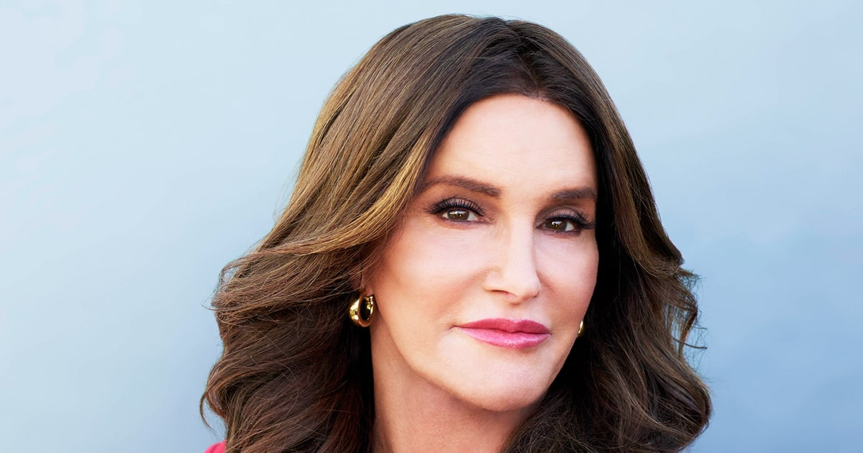
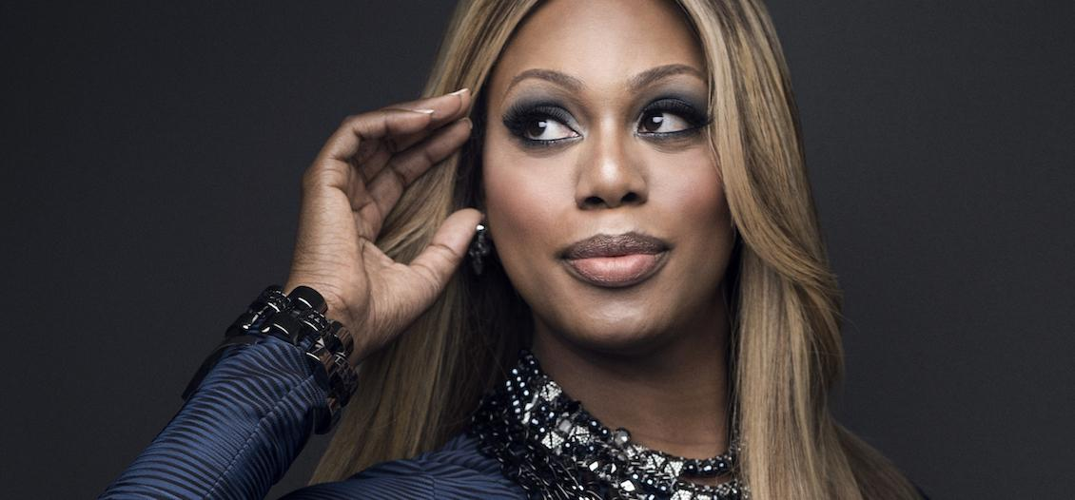

Why It’s Important
Transgender people live across the world but often not in high concentrations
Social media fosters many of the conversations about transgender issues
These conversations have become increasingly prevalent

Slide 3
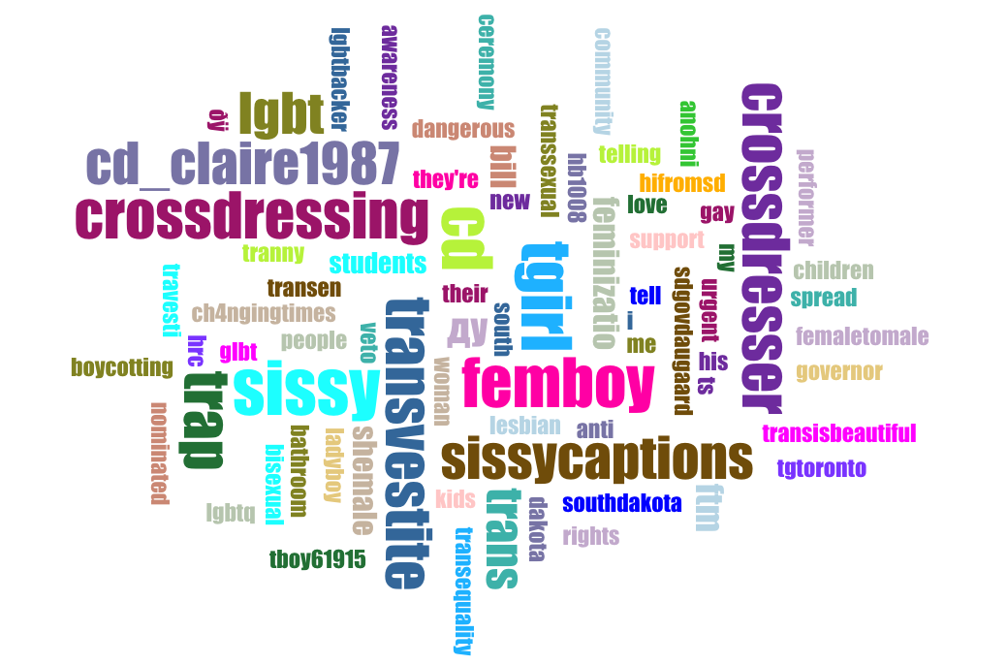
Same Size Terms
“#Transgender” is a uniting term
Representation of trans issues in the media
Personal experiences

Slide 4
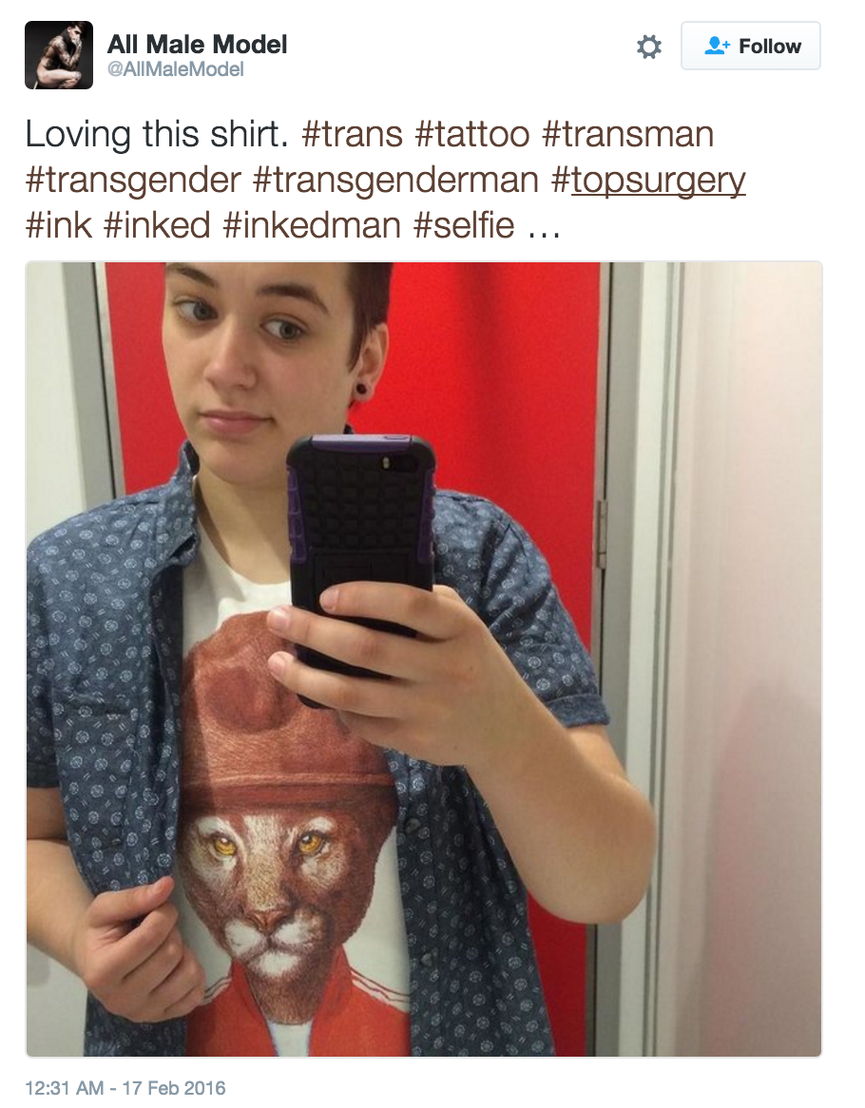
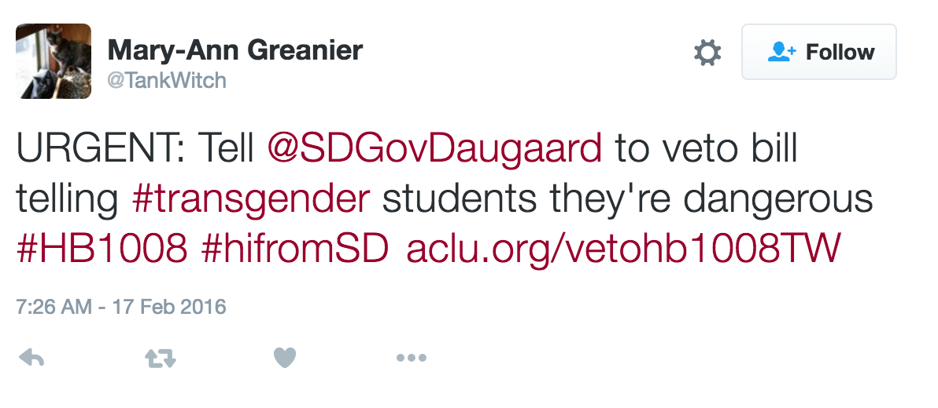
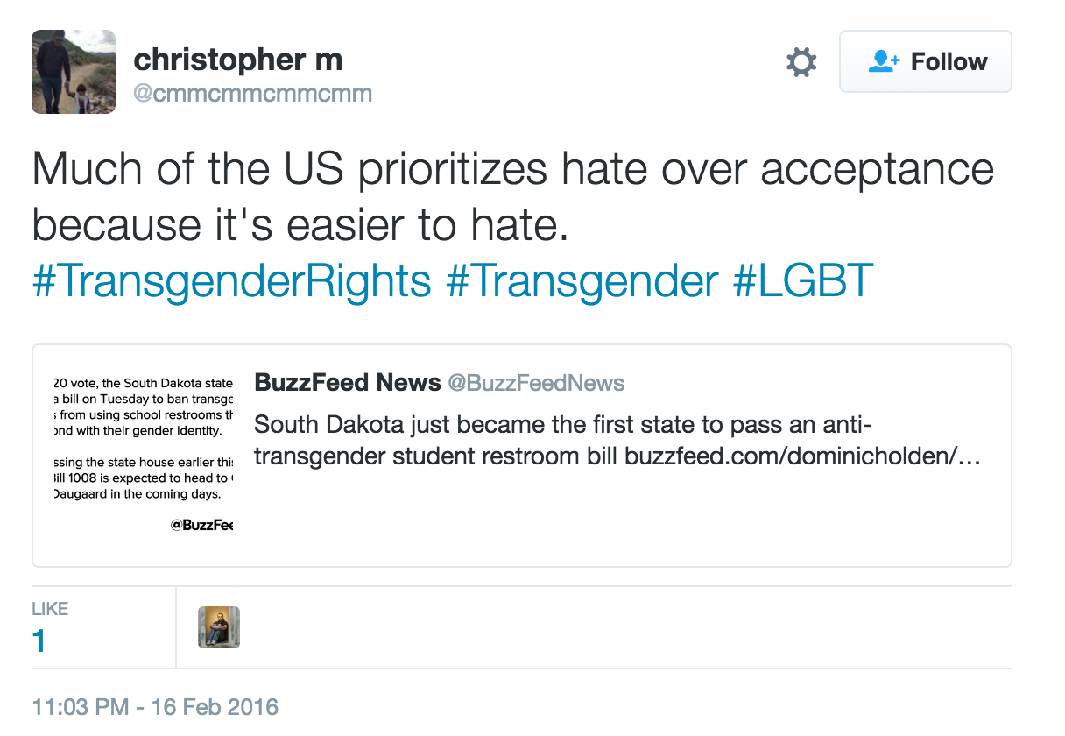
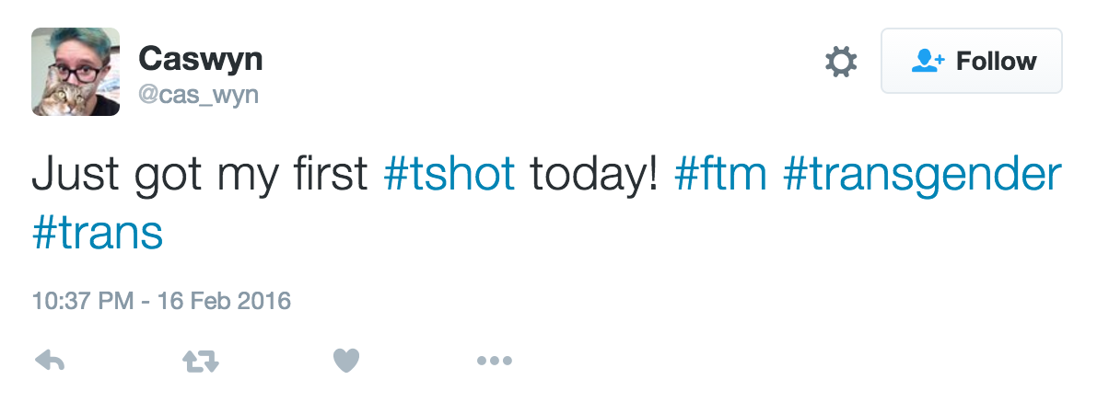
#transgender tweets from Twitter users

Slide 5
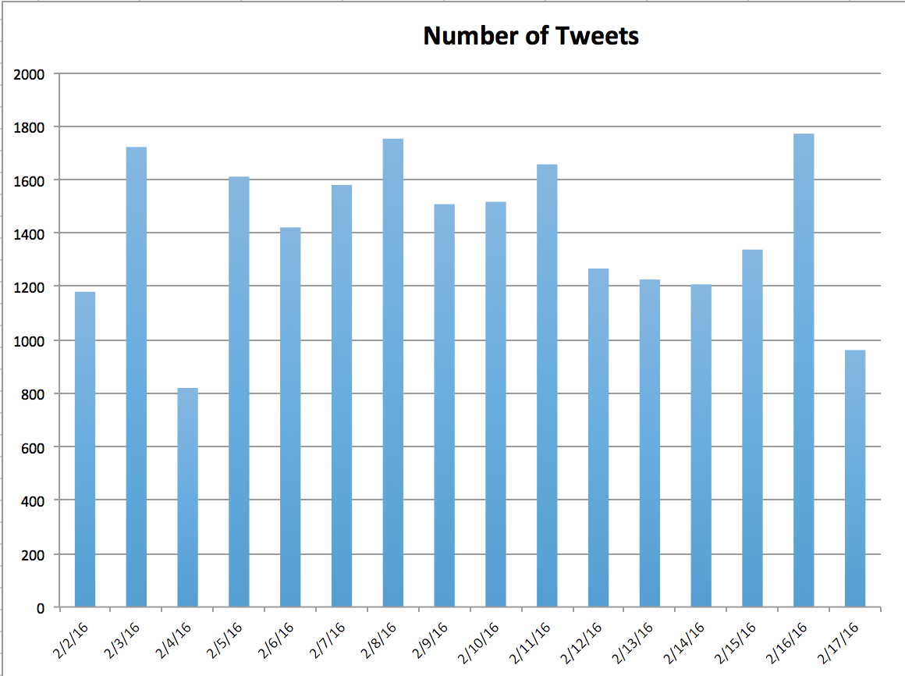
Tweets Per Day
Spikes on days with relevant events
Personal tweets keep the number at at least 800 per day

Slide 6
Findings in Terms of “Size Matters”
“most data collected about lesbian, gay, bisexual, trans*, and queer (lgbtq) people throughout history has only been used to pathologize and stigmatize” (2)
“Detailed notes on all 382 NYC-based [lgbtq] organizations… amount to, in the eyes of big data, a mere 789KB worth of data” (2)

Slide 7
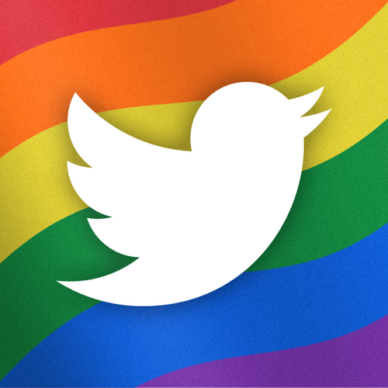
Conclusion
Twitter allows for the transgender community to make their voices heard
Issues faced are united within “#transgender”
Data produced from the hashtag combats stigmatization

Slide 8
Works Cited
Bever, Lindsay. 2016. “Transgender Girl Scout stands up to a bully who wouldn’t buy cookies from ‘a boy in a dress’.”
The Washington Post, February 2, sec. Morning Mix.
Browning, Bill. “Trans Man with Asperger’s Shot and Killed by Police in Arizona.” LGBTQ Nation. February 8, 2016.
Gieseking, J. 2016. “Size Matters to Lesbians Too: Queer Feminist Interventions into the Scale of Big Data.” ```````Professional Geographer.
Kennedy, John. “Civil Rights Protections for Gay, Transgender Floridians Fail.” The Palm Beach Post. February 8, 2016.
“Kris Jenner: Target Practice.” Harper’s BAZAAR. February 08, 2016. Steinmetz, Katy. “South Dakota May Pass ‘Bathroom Bill’ Affecting Students.” Time. February 16, 2016.
Webb, Shelby. “Board Splits on Transgender Bathroom Policy.” HeraldTribune.com. February 16, 2016.

