Slide 1
#Transgender conversations on Twitter
Naty Bush

Slide 2
Importance of #transgender
LGBT rights under risk of not being approved or of being rescinded
Murder rates of transgender individuals not dropping
  27 murdered in 2016, 9 murdered so far in 2017
      http://www.refinery29.com/2017/04/151401/transgender-women-murder-rate-us-2017
Transgender rights are on forefront of these rights
  Gavin Grimm named one of Time Magazine’s 100 most influential people of 2017
      https://www.lgbtqnation.com/2017/04/gavin-grimm-named-one-time-magazines-100-influential-people/

Slide 3

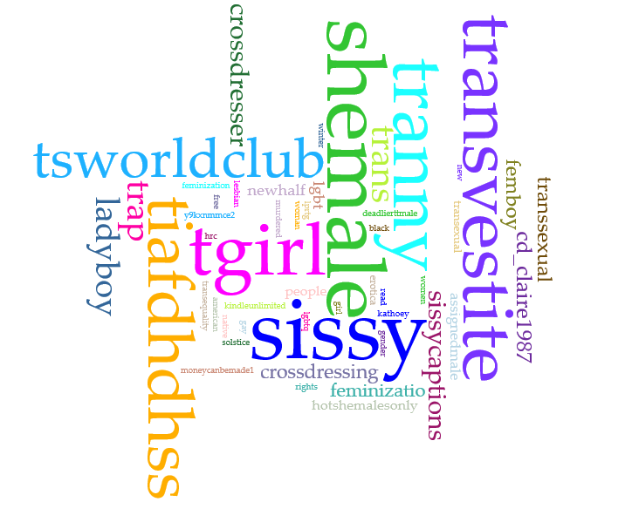
Word cloud
Mostly derogatory terms
User accounts are primarily pornography
  Related hashtags primarily used on those accounts
Nearly all male-to-female

Slide 4
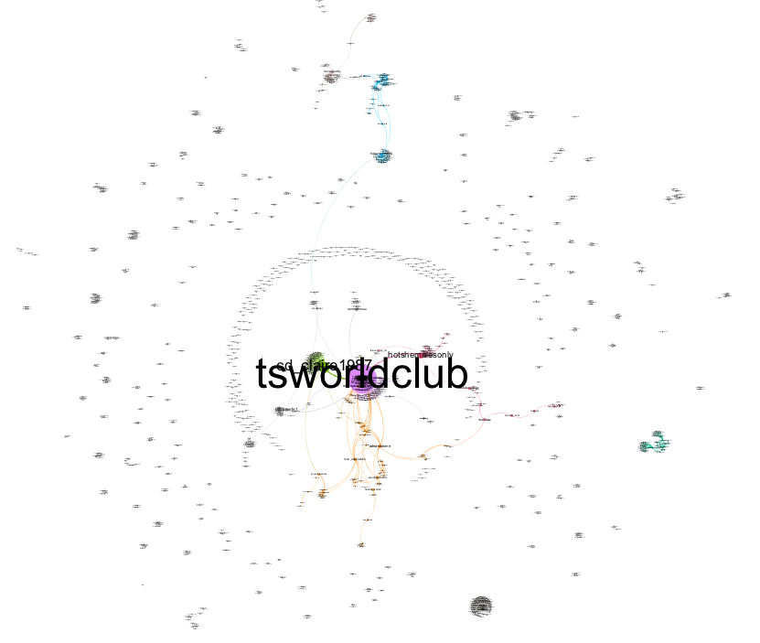
Networking cloud
Not much conversation
  None relating to LGBT rights

Slide 5
Connection to Readings
Female gamers often targeted for sexism and discrimination
Women often represent themselves as men online to avoid discrimination
    A Conspiracy of Fishes, or, How We Learned to Stop Worrying about #GamerGate and Embrace Hegemonic Masculinity (Shira Chess and Adrienne Shaw)
Transgender individuals in rural towns do not have many opportunities to express who they are
Wal-Mart is everywhere, often the only public area to be confident
    From Websites to Wal-Mart: Youth, Identity Work, and the Queering of Boundary Publics in Small Town, USA (Mary L. Gray)

Slide 6
Conclusion
Transgender rights discussions are generally nonexistent on social media
If #LGBT is also used, discussions are supportive and hardly derogatory
  Transgender hashtag must be directly related to LGBT
Transgender individuals are generally still not comfortable being public about their identity (Gray, Shess)
Clear display that further action must be made to promote equality

