Slide 1
Supporting Students with Accommodations
Lori Clapis, Coordinator of Accommodation Resources

Slide 2
Accommodations
Address barriers to full participation and learning – to provide all students the opportunity to thrive academically and personally at Trinity
academics (extra time on exams, reduced distraction setting, extra set of notes, typing, large font, foreign language substitution, alternate text: audio books, etc.)
housing- singles, air conditioning, emotional support animals (ugh!)
parking and building accessibility
dining– food allergies
My office also assists students with short term injuries—mobility impairments and with injuries affecting writing

Slide 3
How Students Obtain Accommodations
Students must submit an application and supporting medical and/or psychoeducational testing documentation to prove need
Accommodation Committee reviews application and documentation, and will give students a decision
It is an interactive process and there is an official appeal process

Slide 4
Student’s Responsibility: Notify Faculty
Within the first two weeks of the semester but must give a minimum notice of 10 days before an exam
Provide a hard copy of their official accommodation letter or email a PDF of their letter (cc to Lori Clapis)
Encouraged to meet with faculty to make a plan
Why do students hesitate? (the eternal question)

Slide 5
IDEA v. ADA
(Individuals with Disabilities Education Act v. Americans with Disabilities Act)
 | IDEA (K-12) | ADA (College)
Type of law: | Education, entitlement | Civil Rights statute, eligibility
Responsibility: | Parent and school | Student self identification
Ensures: | Success | Equal access
Services: | Evaluation, remediation, special accommodation | Reasonable accommodations
Focus: | Diagnostic label | Level of functional impairment
Disability: | One of 13 categories | Impairment in major life activity (including learning)
This slide is credited to College Autism Spectrum

Slide 7
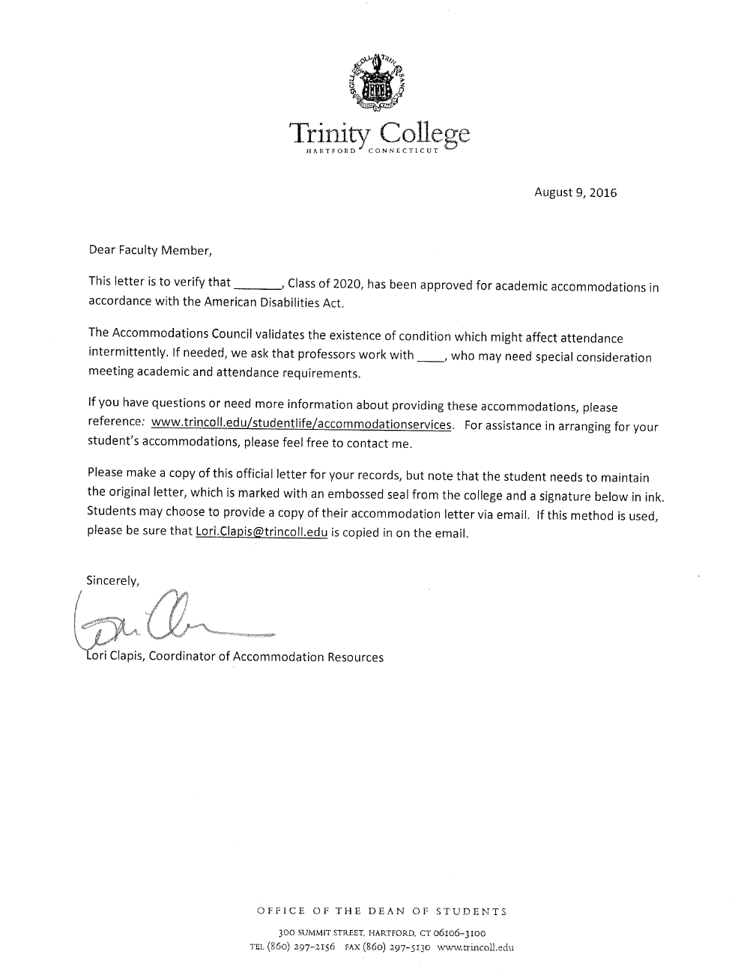

Slide 8
Responsibilities of Faculty
Provide academic accommodations listed on the Letter of Accommodation
Provide only the accommodations on the letter unless it is an accommodation that is offered to all students in the class
Work with Accommodation Resources and students to make reasonable accommodations in a timely manner – (Let’s review your class rosters)
Don’t overburden the student to remind you several times about their accommodations
Maintain confidentiality
don’t ask about diagnosis
use blind cc on emails (even if the students know each other)
don’t identify students with accommodations

Slide 9
Course Syllabus Checklist
*******Does the syllabus have a disability statement?*********
Students with Academic Accommodations
Trinity College complies with the Americans with Disabilities Act. If you have a documented disability and are approved for academic accommodations, please share your accommodations letter with me privately during the first two weeks of the semester. If you choose to email me a PDF copy of your letter, Lori Clapis must be copied on the email. If you do not have approval, but have a disability requiring academic accommodations, or have questions about applying for accommodations, please contact Lori Clapis, Coordinator of Accommodation Resources at 860-297-4025 or at Lori.Clapis@trincoll.edu.
Does the syllabus have a clear outline for course content and expectations including absence policies, participation, presentations?
Is the syllabus posted online?
Moodle and on the course description (for proactive course selection)

Slide 10
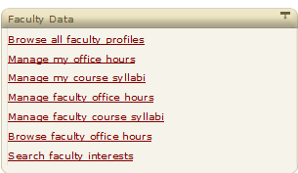
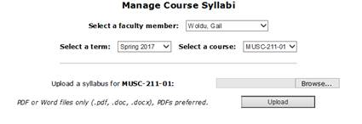

Slide 11
Absences, Deadline Extensions and the ADA
Faculty should not lower course expectations or fundamentally alter the nature of the course at the request of a student with a disability
ADA course requirement language is vague because only the professor can determine the course requirements
However, if a student presents a “consideration letter”, then faculty should take into consideration the student’s condition covered under the ADA
Popular accommodation request that we hardly ever approve: extensions on papers

Slide 12
Important Reminders
Trinity receives federal funding - we are legally obligated to comply with ADA
Student conduct rules apply equally to students with disabilities
Students with accommodations can be very successful in the workplace! [National Center for Education Statistics. (1999). Students with disabilities in postsecondary education: A profile of preparation, participation, and outcomes. (NCES 1999-187)]
You might not know a student’s specific diagnosis – that is OK--but the diagnosis matters far less than the student’s experience-- ask them about it
Disability information must be treated confidentially--identifying a student to peers or making comments about a student’s disability in class violates the student’s right to privacy

Slide 13
Language Use
Use “students with accommodations” not “special needs students”
Use “accessible” rather than “handicapped”
accessible parking, accessible buildings, accessible entry, accessible ramp
Place their personhood first, and their challenge second
“An individual with a disability” NOT: “a disabled individual”
“A person with dyslexia” NOT a “dyslexic”
If you are unsure how to refer to a person with a disability, ask their preference

Slide 14
When to refer students to the Counseling Center (or the Dean of Students Office)…
Significant change in academic functioning
Absences
Change in mood
Change in weight
Change in hygiene
If you suspect a learning disability
Other things?

Slide 15
Resources for Faculty
Dean of Students Office- including Nest Deans and Trinsition Fellows
Counseling Center/Health Center
Accommodation Resources

Slide 16
