Slide 1
Getting to know your brain
Session 1

Slide 2
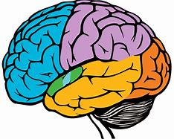
The Brain
The brain is the centre of the nervous system, and controls pretty much everything we do.
From breathing to seeing our brain does it all.

Slide 3
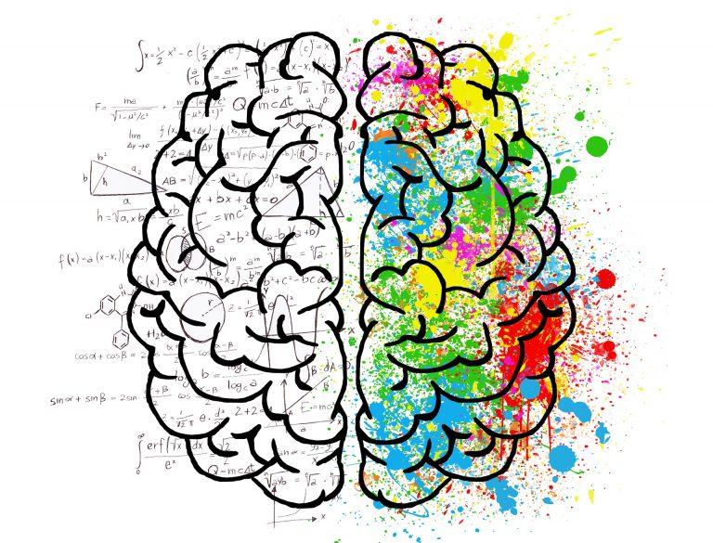
2 Hemispheres of the Brain
Left
Reading
Writing
Speaking
Right
Emotions
Relational
Spatial-like maps
There is no such thing as being “right-brained” or “left-brained”
We use both sides of our brain for everything we do

Slide 4
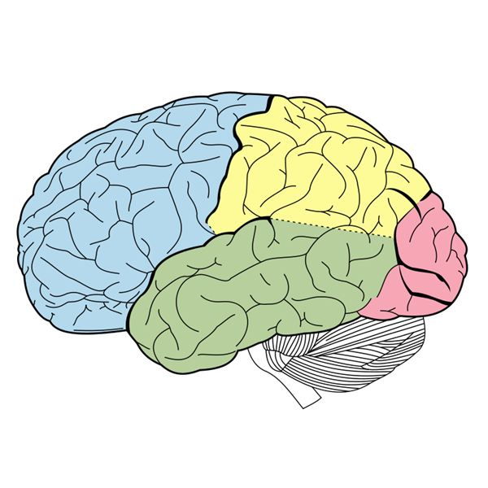
Major Parts of the Brain
Frontal Lobe
Temporal Lobe
Parietal Lobe
Occipital Lobe
Cerebellum
Brain Stem
But where are they located and what are their functions?

Slide 6
Frontal Lobe
Location: Frontal and upper area of brain.
Functions:
Problem Solving
Movement
Social Interaction
Our personality is formed here.
Frontal Lobe

Slide 7
Temporal Lobe
Location: Bottom middle part of the brain, behind the temples.
Functions:
Understanding Language
Memory
Hearing
Makes sense of all different sounds and pitches that we hear.
Temporal Lobe

Slide 8
Parietal Lobe
Location: Upper back part of the brain.
Functions:
Understanding Spatial Relationships
Knowing right from left
Sensations
Reading
Taste, temperature and touch are all processed here.
Parietal Lobe

Slide 9
Occipital Lobe
Location: Bottom, back part of the brain.
Function:
Processing visual information received from the eyes.
Occipital Lobe

Slide 10
Cerebellum
Location: Lower area of the brain.
Functions:
Balance
Coordination
Fine Muscle Control
Important for performing voluntary tasks.
Cerebellum

Slide 11
Brain Stem
Location: At the bottom of the brain connected to the spinal cord.
Breathing
Blood Pressure
Heartbeat
Swallowing
Alertness/Sleep
Body Temperature
Digestion
Controls basic functions for survival
Brain Stem

Slide 12
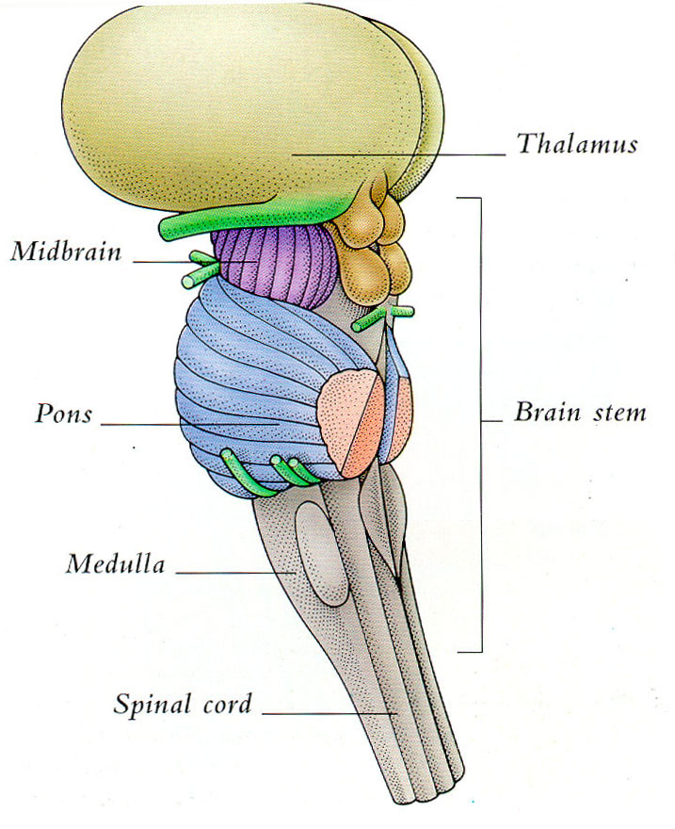
Parts of the Brain Stem
Pons
Involved in sleeping and waking
Medulla
Controls breathing and heart rate.
Midbrain
Responsible for our reflexes.

Slide 13
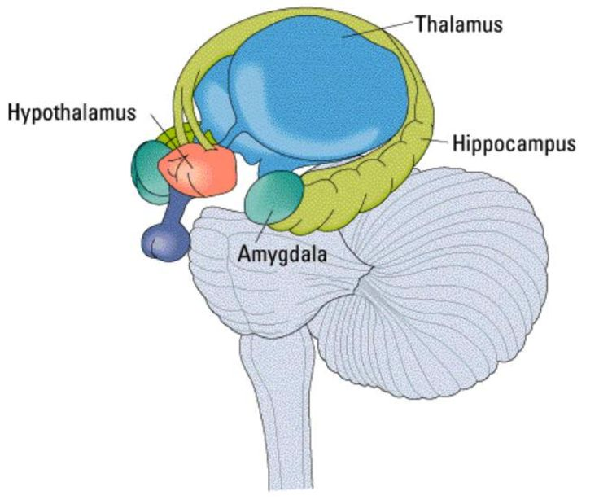
The Limbic System
Structures that all deal with emotions and memory.
4 main structures
Hypothalamus
Amygdala
Thalamus
Hippocampus

Slide 15
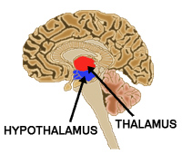
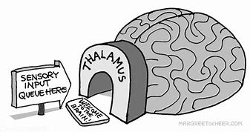
Thalamus
Location: The centre of the brain.
Function: Handles incoming and outgoing signals and redirects them to the correct place.

Slide 16
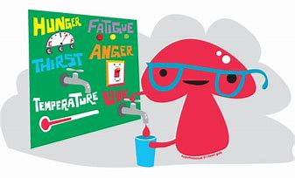
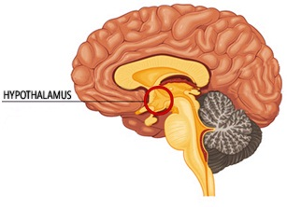
Hypothalamus
Location: Below the thalamus.
Function: Regulates basic biological needs: Hunger, thirst, temperature. Controls hormone release to maintain homeostasis.

Slide 17
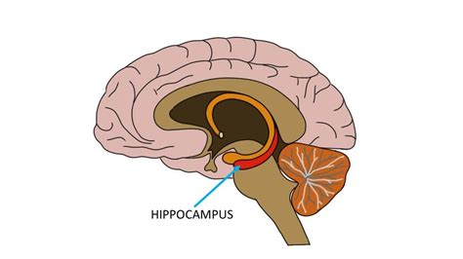
Hippocampus
Location: Medial temporal lobe.
Function: Involved in learning and memory. Changes short term memory to long term memory.

Slide 18
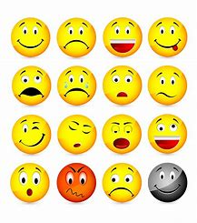
Amygdala
Location: Almond shaped structure found in the temporal lobe.
Function: Regulation of emotion.

Slide 19
Question Time!
Using the google form provided, try your best to answer the following questions and see how much you have learnt today!
https://goo.gl/forms/QB1P683g0MJQorxD3

