Slide 1
Neuroanatomy
Session 2

Slide 2
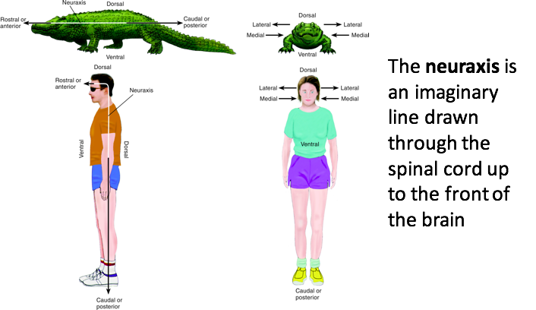
What is the neuraxis?

Slide 3
Anatomical Locations

Slide 4
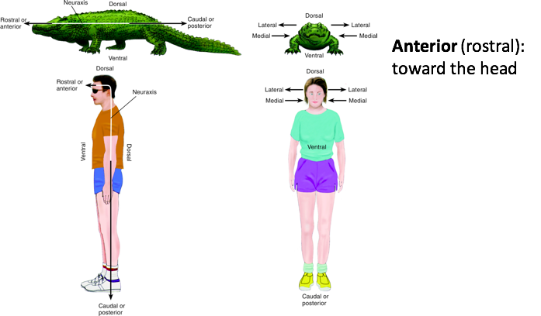

Slide 8
Question Set One
https://docs.google.com/forms/d/e/1FAIpQLScHb4uiN2DRXNBMqPxmPqOoi6oKux1e-GNlm8xE_AITn3FtIg/viewform?usp=sf_link
Follow the above link to take a short quiz on the material you just learned.

Slide 9
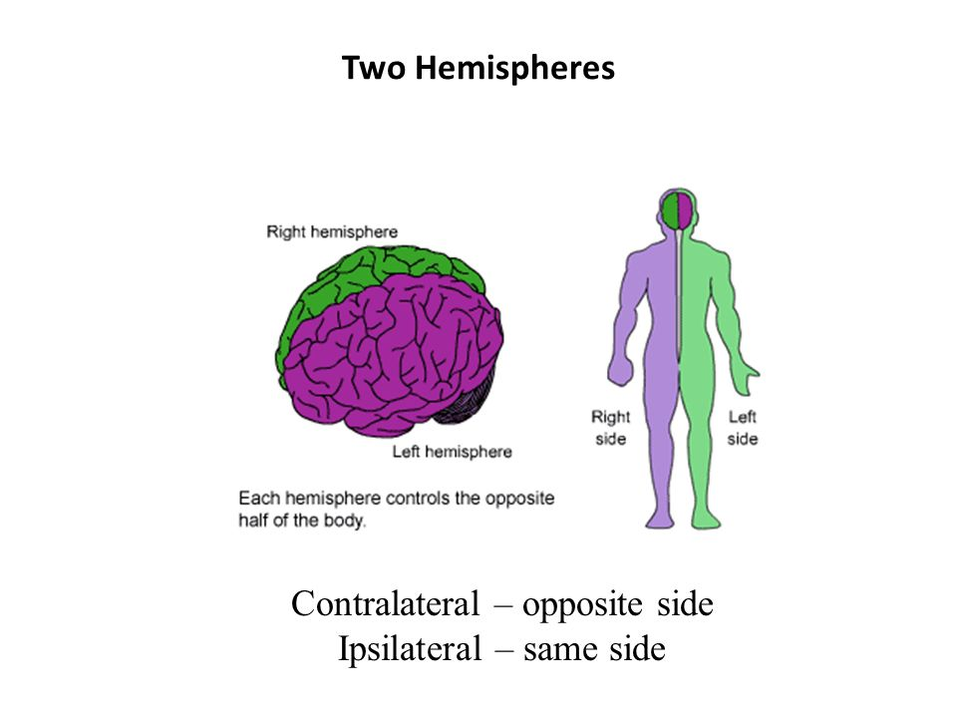
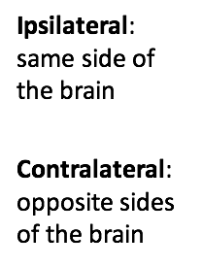
How do you describe location?

Slide 10
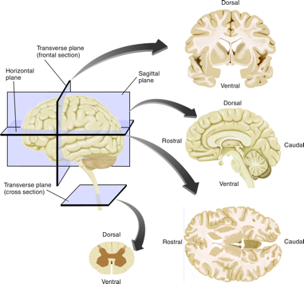
Views of the Brain
Please study the picture to the left carefully and look for the following sectional views of the brain.
Sagittal
Coronal (transverse)
Horizontal

Slide 11
Question Set Two
https://docs.google.com/forms/d/e/1FAIpQLSc-o6DcZPe6jUPZZ9j0xqvx4kFNClwza3KYiMCqAIC_tA0X_w/viewform?usp=sf_link
Follow the above link to take a short quiz on the material you just learned.

Slide 12
Two Nervous Systems
Notes:
Make next slide for the video – too much on this slide

Slide 14
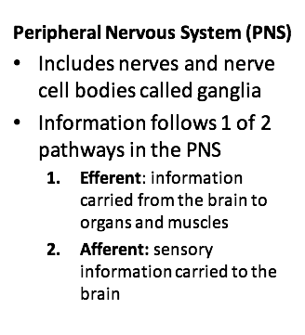
Two Nervous Systems
Notes:
Same here – make new slide for the video and link

Slide 16
Question Set Three
https://docs.google.com/forms/d/e/1FAIpQLSfQPYeE6CgjO9U82tgQbQ104Eckoh22zHSplvWS8kp8eNwbvQ/viewform?usp=sf_link
Follow the above link to take a short quiz on the material you just learned.

Slide 17
Meninges Animation
http://media.pearsoncmg.com/ab/ab_lefton_psychology_8/media/carlson/animations/ACT_03_1_Meninges.html

Slide 18
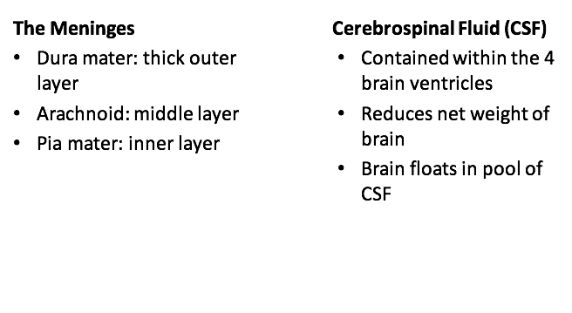
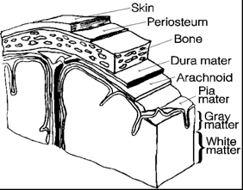
Protection

Slide 20
Question Set Four
https://docs.google.com/forms/d/e/1FAIpQLSdPjNl6R7WUoI0H4l0zRKhDRJqJPFyi58S9xrlU0rzcW-z55w/viewform?usp=sf_link
Follow the above link to take a short quiz on the material you just learned.

Slide 21
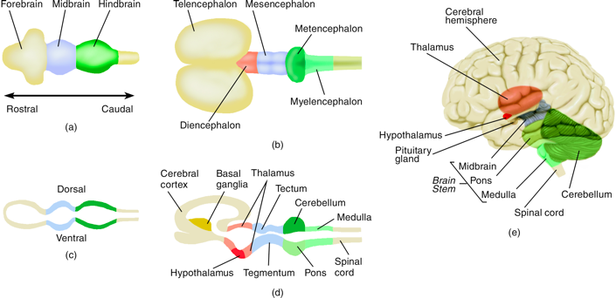
Brain Development

Slide 22
Question Set Five
https://docs.google.com/forms/d/e/1FAIpQLScvE3tT6wNB0qFbHxDxVwedpMz4hQmLZZJFDJ_DAwe12TpDBA/viewform?usp=sf_link
Follow the above link to take a short quiz on the material you just learned.

