Slide 1
Neurophysiology
Session 4

Slide 2
Video 1
Watch this video.
Pay close attention, there will be a quiz after this video.
http://media.pearsoncmg.com/ab/ab_lefton_psychology_8/media/carlson//animations/ACT_02_1_Neurons.html

Slide 3
Questions 1
https://docs.google.com/forms/d/e/1FAIpQLSeFTomY0XSkS7K4EcPmgZRcMjHz8dwZUWilf5FlcgUganf4rA/viewform?usp=sf_link

Slide 4
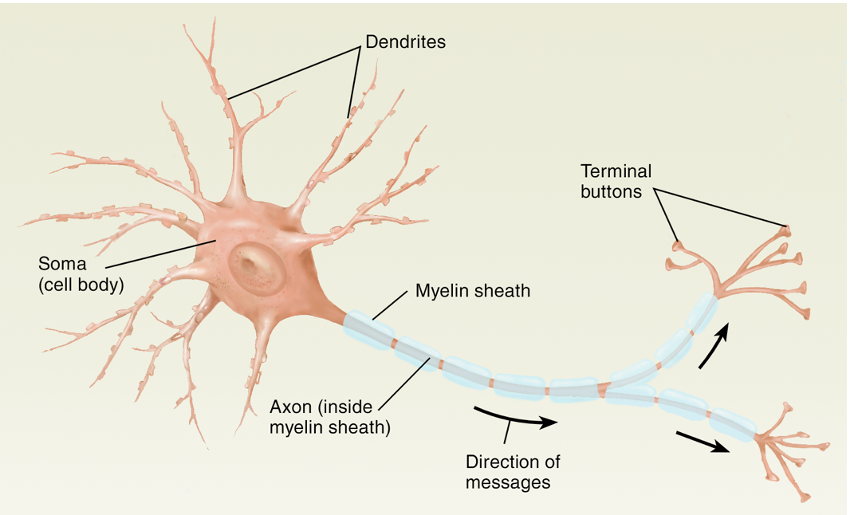
Neuron

Slide 5
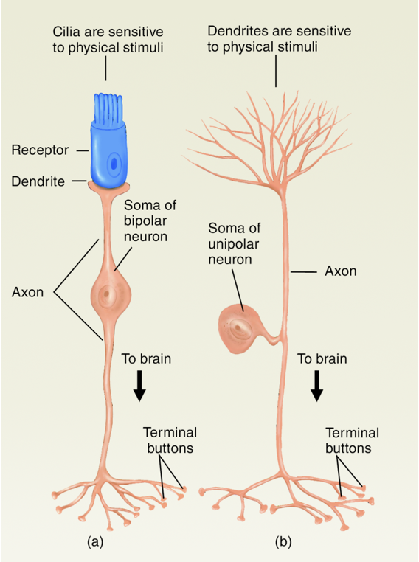
Neuron Classification Scheme:
Number of axon processes
Bipolar: 1 axon & 1 dendritic tree
Unipolar: single stalk that is split into 2 branches
Multipolar: 1 axon & many dendritic trees

Slide 6
Neuron Classification Scheme:
Function
1.Sensory Neurons: responsible for carrying messages toward the brain
2.Motor Neurons: responsible for carrying messages from the brain to muscles
3.Interneurons: neurons that connect other nerve cells

Slide 7
Neuron Classification Scheme:
Neurotransmitter (NT) used
•Neurotransmitters (NT) are chemical messengers in the nervous system
–Examples: glutamate, dopamine, serotonin, etc..
NTs released from neuron can cause an excitatory or inhibitory effect on other neurons
Glutamatergic neurons
Dopaminergic neurons
Serotonergic neurons

Slide 8
Nervous System Support Cells
Central Nervous System
•Neuroglia
–Physical support
–Mediating nutrient flow
–Phagocytosis
•Astrocytes
•Microglia
–Brain immune function
–Phagocytosis
•Oligodendroglia
Peripheral Nervous System
•Schwann Cells

Slide 9
How do neurons communicate?
Electrochemical signals
1.Receptors on dendrites receive chemical message from surrounding cells
2.Activated receptors open ion channels
3.Movement of ions in and out of cell through these channels alters membrane potential
4.Action potential (AP) may result
•AP is transmitted down the axon membrane
•AP causes release of transmitter (chemical message) from axon terminals

Slide 10
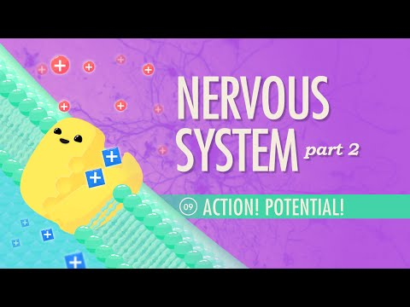
Video 2
https://youtu.be/OZG8M_ldA1M
Watch this video.
Pay close attention, there will be a quiz after this video.

Slide 11
Questions
https://docs.google.com/forms/d/e/1FAIpQLSeHx0K7MmYc1VAAmHKpycB8MtCVCFFP4FLhPEbJOBf3C-kHVg/viewform?usp=sf_link

Slide 12
Video 3
Watch this video.
Pay close attention, there will be a quiz after this video.
http://media.pearsoncmg.com/ab/ab_lefton_psychology_8/media/carlson/animations/ACT_02_2_ActionPotential.html

Slide 13
Questions
https://docs.google.com/forms/d/e/1FAIpQLScuikuH2rEbTY4KweAy12773-l-_AJcMas1yEm3KlpRmnitIw/viewform?usp=sf_link

