Slide 1
Neurochemistry
Session 5

Slide 2
What is a Neurotransmitter?
A chemical substance that marks the transfer of one nerve impulse to another nerve fiber or structure

Slide 3
Neurotransmitters
Neurotransmitters travel from one neuron to another causing changes to occur in the receiving neuron’s membrane.
The ultimate effect is either:
Excitatory: the probability that the receiving neuron will fire increases
Inhibitory: the probability that the receiving neuron will fire decreases

Slide 4
How Drugs and Other Chemicals Alter Neurotransmitters
Agonists: molecules that mimic the actions of neurotransmitters by stimulating receptors in the brain
Antagonists: molecules that block receptors

Slide 5
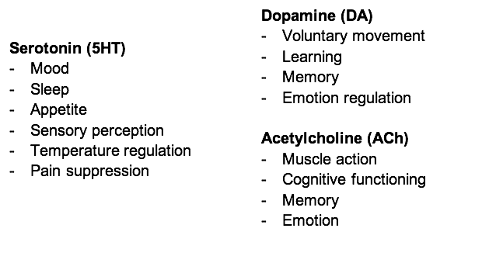
Neurotransmitters

Slide 6
Hormones as Neurotransmitters
Norepinephrine
Increased heart rate and slowing of intestinal activity during stress
Learning and memory
Dreaming and waking from sleep
Emotion
Insulin
Regulates the body’s use of glucose and affects appetite

Slide 7
Hormones
Melatonin
Helps to regulate daily biological rhythms and promotes sleep
Sex Hormones
Androgens: Masculinizing hormones
Estrogens: Feminizing hormones

Slide 9
Question Set 1
https://docs.google.com/forms/d/e/1FAIpQLSe2GTiSRuAl--P0Z3G_VzU09XHckJblGhajGeb-KLP3eXL_Wg/viewform?usp=sf_link
Follow the above link to take a short quiz on the material you just learned.

Slide 10
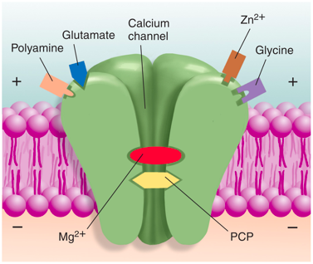
Glutamate
The most important excitatory neurotransmitter in the brain

Slide 11
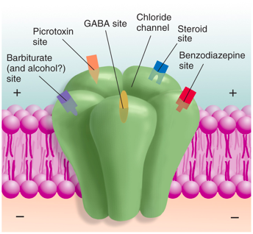
Gama-aminobutyic Acid (GABA)
GABA is the major inhibitory neurotransmitter in the central nervous system

Slide 12
Depressants
Alcohol
Tranquilizers
Opioids

Slide 13
Stimulants
Cocaine
Nicotine
Caffiene

Slide 14
Hallucinogens
Marijuana
LSD

Slide 15
Question Set 2
https://docs.google.com/forms/d/e/1FAIpQLScAzv8QES0dM71R4PQ3WJ8DtsIF08lC-Wxn2x0Wo-rw1rCrmg/viewform?usp=sf_link
Follow the above link to take a short quiz on the material you just learned.

Slide 16
Principles of Psychopharmacology
There are many various ways to inject substances into the body like into a muscle (intramuscular injection) or through a vein (intravenous injection).
There are also different methods for drug administration via mouth, under tongue, or rectum.

Slide 17
Principles of Psychopharmacology
Lipid solubility is very important!
Blood-brain barrier keeps out only water-soluble molecules
Lipids are fatty acids and are insoluble in water (oils, waxes, steroids).
Molecules that are soluble in lipids pass through the cells that line the blood vessels in the central nervous system, and they rapidly distribute themselves throughout the brain

Slide 18
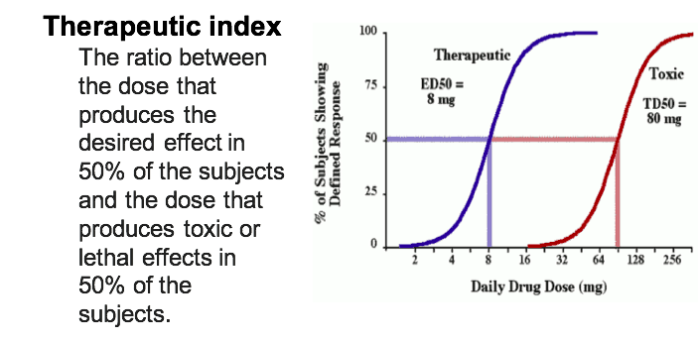
Principles of Psychopharmacology

Slide 19
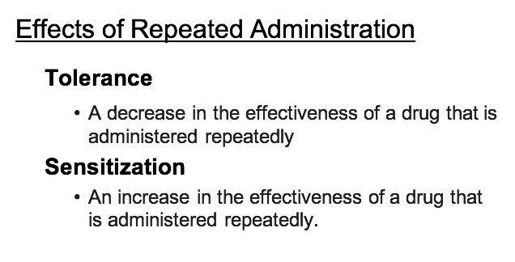
Principles of Psychopharmacology

Slide 20
Principles of Psychopharmacology

Slide 21
Question Set 3
https://docs.google.com/forms/d/e/1FAIpQLSfmFUzmxZfLbCUGLblGo7U3BWjJm8cdkVHwUfq2nHdws7gQCw/viewform?usp=sf_link
Follow the above link to take a short quiz on the material you just learned.

