Slide 1
Brain injuries and Their effects

Slide 2
ABI’s

Slide 3
What is an ABI?
An ABI, acquired brain injury, is an injury to the brain that occurs after birth
By this, an ABI is not caused by genetics being passed down, a disease diagnosed at or trauma during birth, or other degenerative diseases

Slide 4
What are the types of ABI’s?
There are two types of ABI’s; a traumatic brain injury, TBI, and a non traumatic brain injury
An easy way to tell the difference between the two is that a TBI is caused by external forces (such as a hit to the head) while a non traumatic brain injury is due to internal forces (such as a tumor).
There is also such a thing as an mTBI or a mild TBI, which is what a concussion is considered as, and is the most common type of TBI

Slide 5
Causes of TBI’s and non-traumatic brain injuries
TBI | Non-Traumatic Brain Injuries | mTBI / Concussion
- Falls | - Strokes (Blood Clot or Hemorrhage* (bleeding in brain)) | - Direct blow to head
- Assaults | - Tumors | - Violent shaking of the head
- Motor Vehicle Accidents | - Lack of Oxygen (Drowning, Hypoxia/Anoxia, or Choking)
- Sports/Recreation Injuries | Neurotoxic Poisoning (Lead, Carbon Monoxide exposure)
- Workplace Injuries
*A hemorrhage could be considered a TBI if it occurs from the brain moving inside the scull due to an external factor

Slide 6
How are ABI’s different from other bodily injuries
Unlike a broken limb or sprained ankle which only limits the use of that specific part of the body, an ABI can change your personality depending on the area affected, and mental abilities can also change drastically.
In addition, brain injuries do no heal like other injuries and no two ABI’s are the same. Therefore recovery for one person can be drastically different from the recovery of another with an ABI of the same nature.

Slide 7
Effects of ABI’s

Slide 8
Location specific
When referring to the effects of ABI’s, the effects differ depending on which brain lobe is affected
This is because each lobe, and even each side of the brain, functions differently and controls different things

Slide 9
ABI’s in the Frontal Lobe
Damage to the frontal lobe can result in:
Inability to carry out multi-stepped task
Inability to express language (Broca’s Aphasia)
Shortened attention and focus on task
Changes in personality and social behavior
Difficulty problem solving

Slide 10
Abi’s in the Occipital Lobe
Damage to the occipital lobe can result in:
Difficulty identifying colors (Color Agnosia)
Production of hallucinations
Difficulty with reading and writing
Difficulty in recognizing drawn objects

Slide 11
ABI’s in the temporal lobe
Damage to the temporal lobe can result in:
Difficulty in understanding spoken words
Difficulty in recognizing faces
Persistent talking
Difficulty with identification and categorization of objects
Impaired factual and long-term memory

Slide 12
Abi’s in the parietal lobe
Damage to the parietal lobe can result in:
Difficulty with drawing object
Lack of awareness of certain body parts and/or surrounding space
Problems with reading (Alexia)
Inability to communicate through writing (Agraphia)

Slide 13
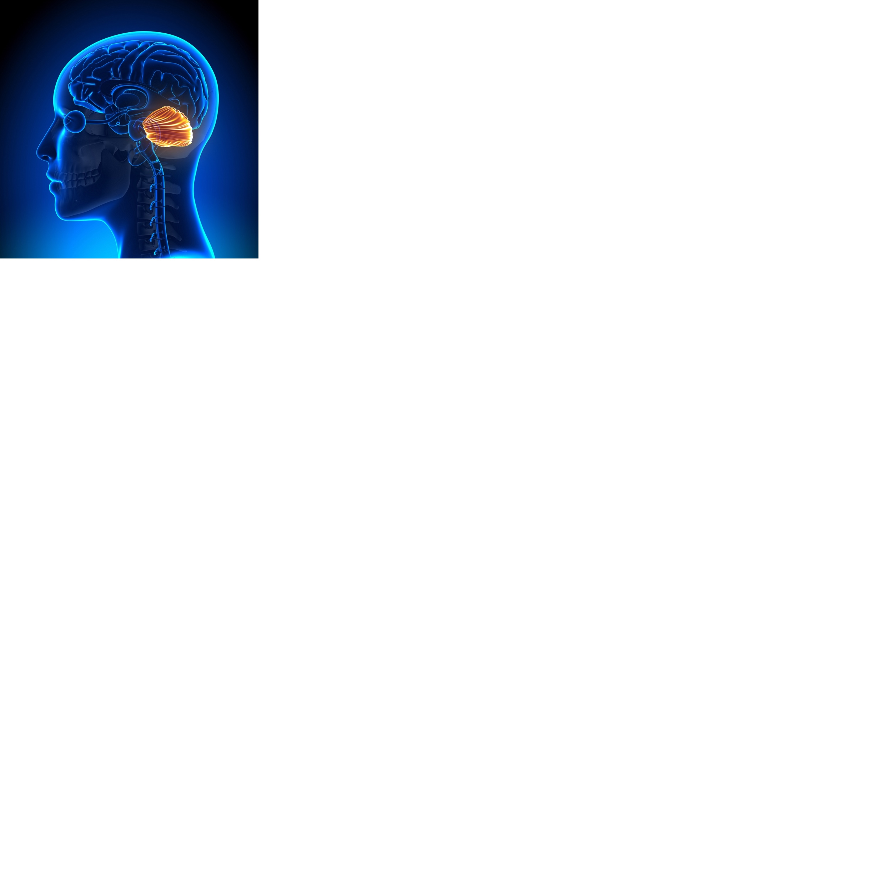
Abi’s in the cerebellum
Damage to the cerebellum can result in:
Tremors
Extreme dizziness (Vertigo)
Slurred speech
Loss of ability to co-ordinate fine movements

Slide 14
Abi’s in the brain stem
Damage to the brain stem can result in:
Decreased vital capacity in breathing
Locked-in syndrome (loss of movement in entire body except for eyes)
Sleeping difficulties (insomnia, sleep apnea)
Death

Slide 15
Test your knowledge
Quiz

