Slide 1
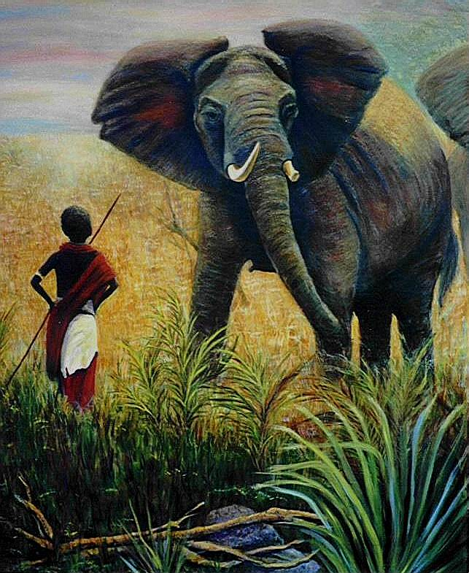
The Economics of
Endangered
Species

Slide 2
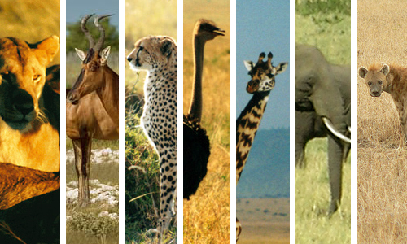
Endangered Species
An endangered species is a population of an organism which is at risk of becoming extinct because it is either few in number, or threatened by changing environmental or predation parameters.

Slide 3
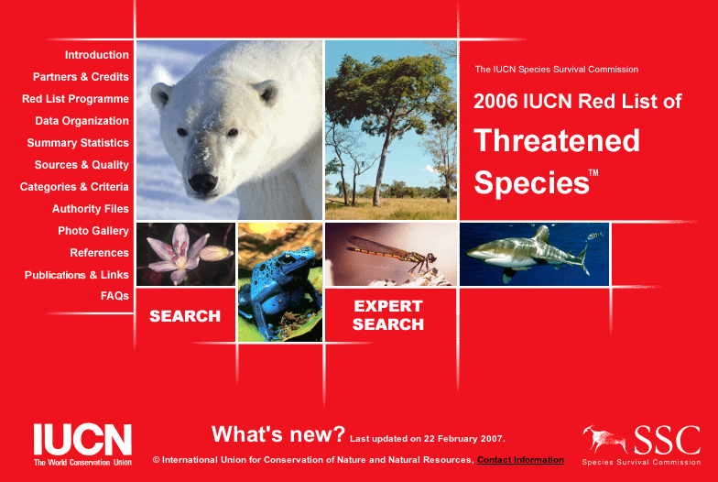
IUCN Red List
IUCN Red List of Threatened Species (www.redlist.org)
  Critically endangered, endangered, vulnerable
  Extinct, extinct in the wild
Endangered species constitute 40% of all organisms based on the sample of species that have been evaluated through 2006.

Slide 4
Conservation Efforts
In many countries, governments impose laws that offer protection to endangered species, e.g., forbidding hunting or restricting land development.
Conservation efforts face several challenges particularly in developing countries.

Slide 5
Purpose
Use economic analysis to understand the problem of endangered species:
  Why are certain species endangered?
  Why is government intervention needed to protect endangered species?
  What are the challenges that face less developed countries in preserving endangered species?

Slide 6
Economic concepts
Externalities
Property rights
Common resources
Nash equilibrium

Slide 7
Four Types of Goods
one person’s use diminishes other people’s use
Rival in consumption?
Yes
No
Private Goods
Collective Goods
Yes
•
Ice-cream cones
•
Clothing
•
Cable TV
Excludable?
Common Resources
Public Goods
No
•
Fish in the ocean
•
Street Lighting
•
The environment
•
Crime Prevention
Can prevent another person from consuming it

Slide 8
Common Resources
Wild animals are examples of common resources
Ownership of common resources is not well defined. They are not owned by an individual or a specific group and thus are available for everyone to make use of.

Slide 9
Hunting and the Social Optimum
$
Marginal Social cost (MSC)
Demand (MPB)=MSB
For an individual hunter the cost of killing an extra gorilla is zero
Optimum
Marginal Private Cost
(MPC)
0
Q_{WELFARE}
Number of
Gorillas killed in a year

Slide 10
Tragedy of the Commons
Optimal use of common resources allows them to be renewed.
In a market system common resources tend to be overused because individuals are not charged for their usage. This may lead to their extinction
The Tragedy of the Commons is a parable that illustrates why common resources get used more than is desirable from the standpoint of society as a whole.

Slide 11
Tragedy of the Commons: Example
Fisherman B
Nash
Equilibrium
High use
Low use
Fisherman B
gets 50
Fisherman B
gets 10
High use
Fisherman
A
Fisherman A gets 50
Fisherman A gets150
Fisherman B
gets 150
Fisherman B
gets100
Low use
Fisherman A gets 10
Fisherman A gets 100
If they both limit their use they can be better off

Slide 12
Challenges Facing Developing Countries
For many of the developing countries, policies aimed at fostering growth are incompatible with a sustainable wildlife.

Slide 13
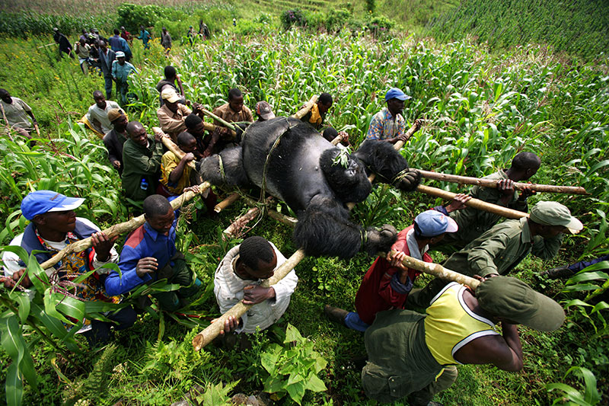
Cry of the Wild
Sharon Begley, Newsweek, August 6, 2007

Slide 14
Causes of extinction
Possible Causes of extinction:
  Overhunting
  Overconsumption
  Extinction of a prey
  Habitat loss
  Pollution
  Population growth
Which of these represents the major threat for extinction of the mountain gorillas?
“Hunting, especially in Central and West Africa, is much more serious than we imagined,” says Russel Mittermeier, president of Conservation International.

Slide 15
Why is overhunting the major threat?
Several economic changes that took place in Congo contributed to the problem:
  Opening of forests to mining and Logging
  Construction of roads that connect once impenetrable places to towns. Hunters and weapons follow. Three weeks after opening up a Congo forest, animal density fell by 25%.

Slide 16
Why is overhunting the major threat?
Several economic changes that took place in Congo contributed to the problem:
  Globalization and increased access to international markets. Meat, fur skin and other animal parts are sold on a wide scale worldwide.
  Increased demand for bushmeat. 13,000 lbs of bushmeat arrive every month in 7 North American and European cities.

Slide 17
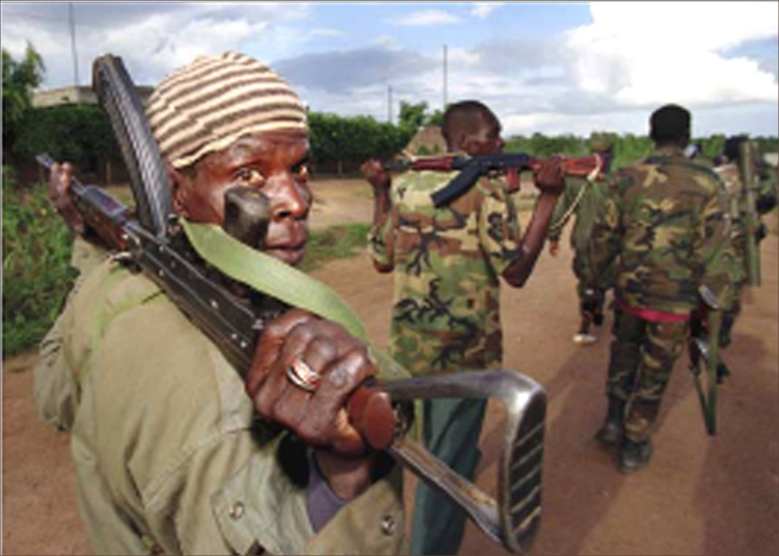
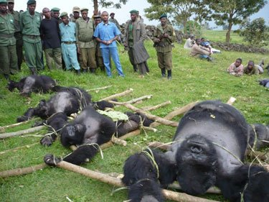
Why is overhunting the major threat?
Several economic changes that took place in Congo contributed to the problem:
  Weak governments. Setting aside parks and conservation areas requires government enforcement.

