Slide 1
Appendix
Tools of Microeconomics

Slide 2
1. The Marginal Principle
Simple decision making rule
We first define:
  Marginal benefit (MB): the benefit of an extra unit of an activity
  Marginal cost (MC): the cost of an extra unit of an activity
RULE: Do more of an activity if its MB exceeds its MC. If possible, pick the level of activity at which MB=MC

Slide 3
1. Marginal Principle
When undertaking an activity the objective is to maximize the net benefit.
This will be achieved when choosing the level of activity where MB=MC

Slide 4
Total v. Net Benefits
Net Marginal
Benefit
Benefit of a unit of the activity
(MB)
-
Its cost
(MC)

Slide 5
Total Benefit
Marginal benefit of the first unit
Marginal benefit of the second unit
Marginal benefit of the third unit
Marginal benefit of the fourth unit
1
2
3
4

Slide 6
Total Benefit and Net Benefit
Rational self interested agents (consumers/ firms) maximize their net benefit (utility / profit)
The objective is to make a choice to maximize net benefit.

Slide 7
Total vs. Net Benefits
Net Marginal Benefit of unit 1
Net Marginal Benefit of unit 2
Net Marginal Benefit of unit 3
Net loss of unit 4
Marginal cost of unit 4
Marginal cost of unit 3
Marginal cost of unit 2
Marginal cost of unit 1
1
2
3
4

Slide 8
Net Benefit or Net Surplus
Undertake only 3 units of the activity. The net benefit is the light blue area
Net Benefit of 3 units
1
2
3
4

Slide 9
2. Equilibrium in a product market
The model of supply and demand determines the equilibrium price and quantity

Slide 10
What is a Market?
Buyers determine demand.
Sellers determine supply.
Notes:
4

Slide 11
The Equilibrium of Supply and Demand
Price of
Ice-Cream
Cone
Supply
Equilibrium price
Equilibrium
P*
2.00
Equilibrium
Demand
quantity
0
1
2
3
4
5
6
7
8
9
10
11
12
13
Quantity of Ice-Cream Cones

Slide 12
Shifting the curves: hot weather
Price of
Ice-Cream
1. Hot weather increases
Cone
the demand for ice cream . . .
Supply
$2.50
New equilibrium
2.00
2. . . . resulting
Initial
in a higher
equilibrium
price . . .
D
D
0
7
10
Quantity of
3.
. . .
and a higher
Ice-Cream Cones
quantity sold.

Slide 13
Shifting the curves: Higher price of sugar
Price of
Ice-Cream
1. An increase in the
Cone
price of sugar reduces
S₂
the supply of ice cream. . .
S₁
New
$2.50
equilibrium
2.00
Initial equilibrium
2. . . . resulting
in a higher
price of ice
cream . . .
Demand
0
4
7
Quantity of
3.
. . .
and a lower
Ice-Cream Cones
quantity sold.

Slide 14
3. Market Surplus
It is a measure of the total value to consumers and producers from a market
The area between the marginal cost and the marginal benefit represents the market surplus, the gains to consumers and producers from trade.
Demand curve is a marginal benefit curve
Supply curve is a marginal cost curve
Market surplus=Consumer surplus + Producer surplus

Slide 15
CONSUMER SURPLUS
Willingness to pay is the maximum amount that a buyer will pay for a good.
It measures how much the buyer values the good or service.
Consumer surplus is the buyer’s willingness to pay for a good minus the amount the buyer actually pays for it.

Slide 16
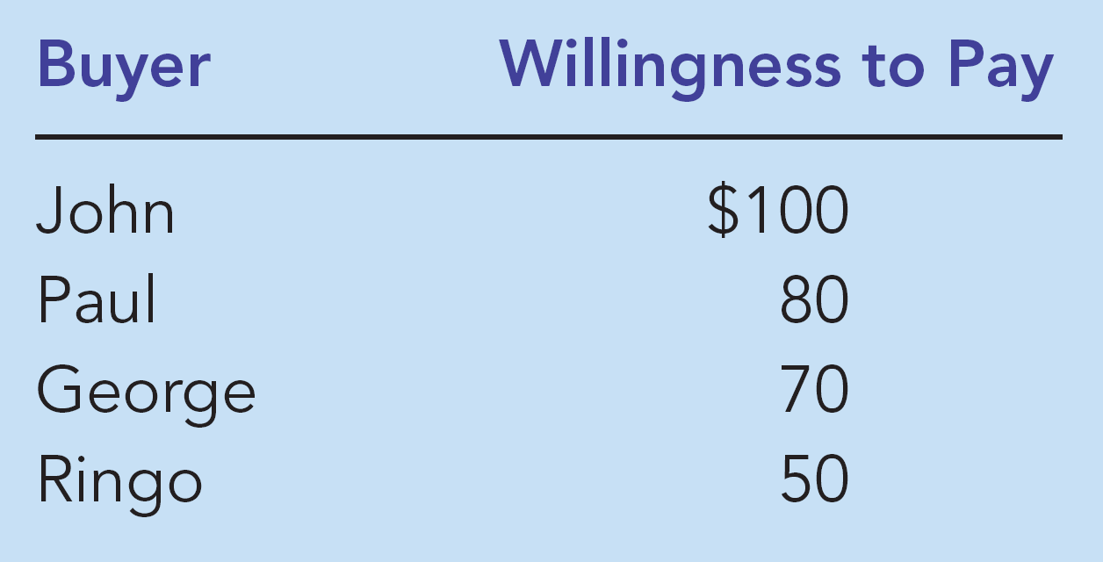
Four Possible Buyers’ Willingness to Pay

Slide 17




The Demand Schedule and the Demand Curve

Slide 18




The Demand Curve
Price of
Album
$100
John
’
s willingness to pay
80
Paul
’
s willingness to pay
70
George
’
s willingness to pay
50
Ringo
’
s willingness to pay
Demand
0
1
2
3
4
Quantity of
Albums

Slide 19
Measuring Consumer Surplus with the Demand Curve
(a) Price = $80
Price of
Album
$100
John
’
s consumer surplus ($20)
80
70
50
Demand
0
1
2
3
4
Quantity of
Albums

Slide 20

Measuring Consumer Surplus with the Demand Curve
(b) Price = $70
Price of
Album
$100
John
’
s consumer surplus ($30)
80
Paul
’
s consumer
70
surplus ($10)
Total
50
consumer
surplus ($40)
Demand
0
1
2
3
4
Quantity of
Albums

Slide 21
How the Price Affects Consumer Surplus
(a) Consumer Surplus at Price
P
Price
A
The area below the demand curve and above the price measures the consumer surplus in the market
Consumer
surplus
P₁
B
C
Demand
0
Q₁
Quantity

Slide 22
PRODUCER SURPLUS
Producer surplus is the amount a seller is paid for a good minus the seller’s cost.
It measures the benefit to sellers participating in a market.

Slide 23
The Costs of Four Possible Sellers

Slide 24
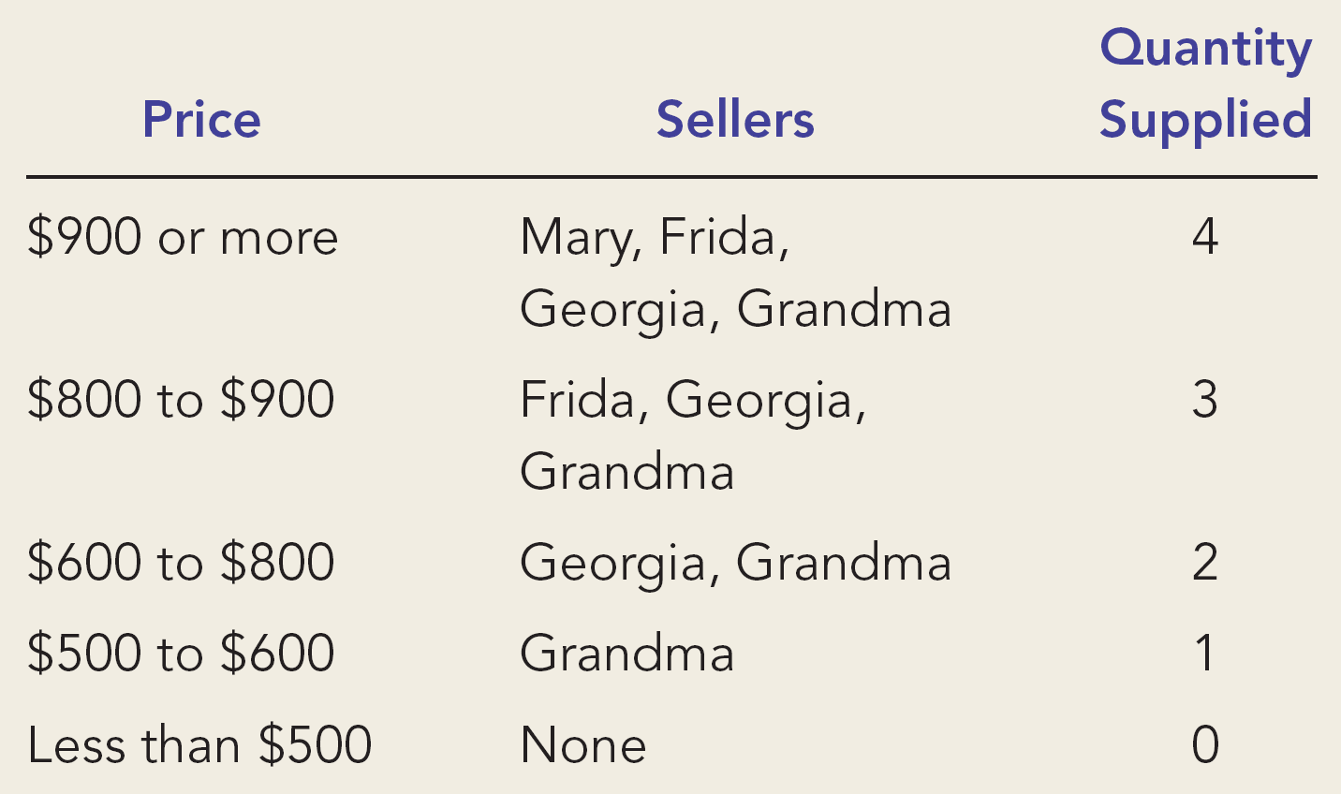
The Supply Curve

Slide 25
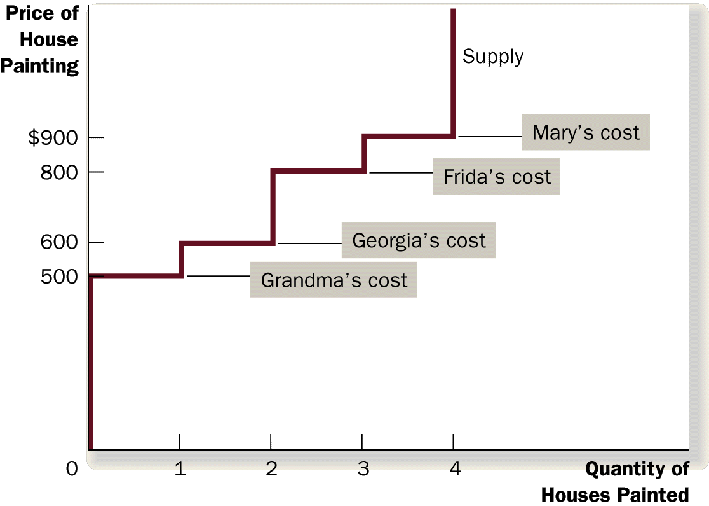
The Supply Curve

Slide 26
Measuring Producer Surplus
(a) Price = $600
Price of
House
Painting
Supply
$900
800
600
500
Grandma
’
s producer
surplus ($100)
0
1
2
3
4
Quantity of
Houses Painted

Slide 27
Measuring Producer Surplus with the Supply Curve
(b) Price = $800
Price of
House
Painting
Supply
Total
producer
$900
surplus ($500)
800
600
Georgia
’
s producer
500
surplus ($200)
Grandma
’
s producer
surplus ($300)
0
1
2
3
4
Quantity of
Houses Painted

Slide 28
How the Price Affects Producer Surplus
(a) Producer Surplus at Price
P
Price
Supply
The area below the price and above the supply curve measures the producer surplus in a market.
P₁
B
C
Producer
surplus
A
0
Q₁
Quantity

Slide 29
Consumer and Producer Surplus
Price
A
Supply
D
Does the market system maximize market (social) surplus?
Point E gives the maximum surplus
Any other point would result in a lower surplus
Therefore, the market is efficient. The market is a good way to organize economic activity
Consumer
surplus
Equilibrium
E
price
Producer
surplus
B
Demand
C
0
Equilibrium
Quantity
quantity

Slide 30
4. Externalities and market inefficiency
An externality refers to benefits or costs borne by a third party.
Who is the first or second party?
  The first and second parties are the buyers and sellers of a good.
  The third party is, therefore, someone not involved in the transaction.

Slide 31
Positive vs. Negative Externalities
When the impact on the bystander is adverse (beneficial), i.e. when costs are imposed on a third party, the externality is called a negative (positive) externality.

Slide 32
EXTERNALITIES AND MARKET INEFFICIENCY
Negative Externalities
  Automobile exhaust
  Cigarette smoking
  Barking dogs (loud pets)
  Loud stereos in an apartment building

Slide 33
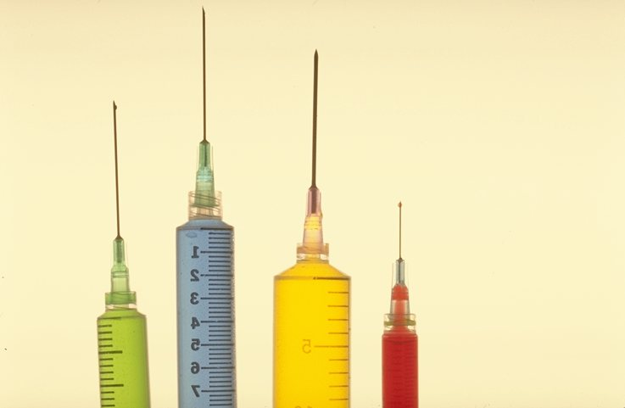
EXTERNALITIES AND MARKET INEFFICIENCY
Positive Externalities
  Immunizations
  Restored historic buildings
  Education

Slide 34
EXTERNALITIES AND MARKET INEFFICIENCY
Externalities cause markets to fail, i.e., fail to produce the quantity that yields the maximum social surplus.
Positive (Negative) externalities lead markets to produce a smaller (Larger) quantity than is socially desirable.
In the presence of externalities markets do not work well, i.e. they are inefficient

Slide 35
Example: Aluminum Production
The Market for Aluminum
  Assume that aluminum production results in emission of toxic wastes that are dumped in a nearby river. The factory does not bear the clean up cost.
  The full cost of producing aluminum is not borne by the seller, i.e., there is an external cost.
How does the externality affect social welfare?

Slide 36
Pollution and the Social Optimum
Price of
Marginal Social cost =marginal private cost +external cost
Aluminum
External Cost
Supply
(marginal private cost)
Social
Optimum
Equilibrium
Demand
Marginal Benefit
0
Q_{WELFARE}
Q_{MARKET}
Quantity of
Aluminum

Slide 37
Social Welfare in the absence of the externality
Price of
Marginal Social cost =marginal private cost +external cost
Aluminum
Supply
(marginal private cost)
+
Social
Optimum
If Q_{WELFARE} was produced
Equilibrium
Demand
(marginal private benefit
=marginal social benefit)
0
Q_{WELFARE}
Q_{MARKET}
Quantity of
Aluminum

Slide 38
Social Welfare with the externality
Price of
Marginal Social cost =
Aluminum
Supply
+
-
Social
Optimum
When Q_{MARKET} is produced
Equilibrium
Demand
0
Q_{WELFARE}
Q_{MARKET}
Quantity of
Aluminum

