Slide 1
Overview of Urban Economics

Slide 2
Urban Economics
Urban economics combines both economics and geography:
  Economics explores how people make decisions under scarcity, while
  Geography explains where human activity occurs.
Urban economics explores the location choices of maximizing agents.
An urban area has a high population density relative to surrounding areas.

Slide 3
Urban Economics
Market forces and the development of cities
Urban transportation
Crime and Public Policy
Education
Pollution
Housing and public policy
Local government expenditure and taxes

Slide 4
For a city to develop
Three conditions have to be satisfied for a city to develop
Agricultural surplus
    The rural dwellers must produce enough food to provide for themselves as well as city dwellers.
Urban production
    City dwellers must produce something to exchange with rural people for the food they grow.
Transportation for exchange
    An efficient network of transportation has to exist to facilitate the exchange of food and urban products.

Slide 5
1. Trading Cities
Cities developed because of economies of scale, decline in unit cost as more goods are produced at a given point
Trading cities develop when comparative advantage is combined with scale economies in transport and exchange.
Exchange takes place through a centralized location where goods are collected and distributed
A lot of economic activities take place in this centralized location
Historically, firms in the trading city provided insurance, credit, banking and legal services.

Slide 6
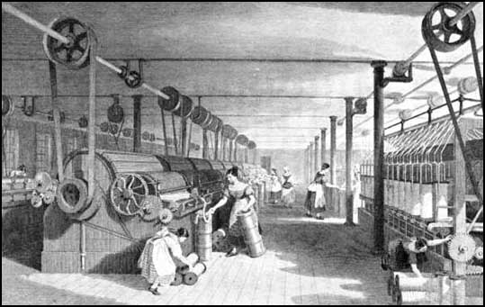
the Factory Town
Factory towns developed because of economies of scale in production
The 19th century industrial revolution resulted in innovations that shifted production from the home and the small shop to the factory.
  Indivisible/ expensive input
  Concentration of work in one location
  Close monitoring and supervision

Slide 7
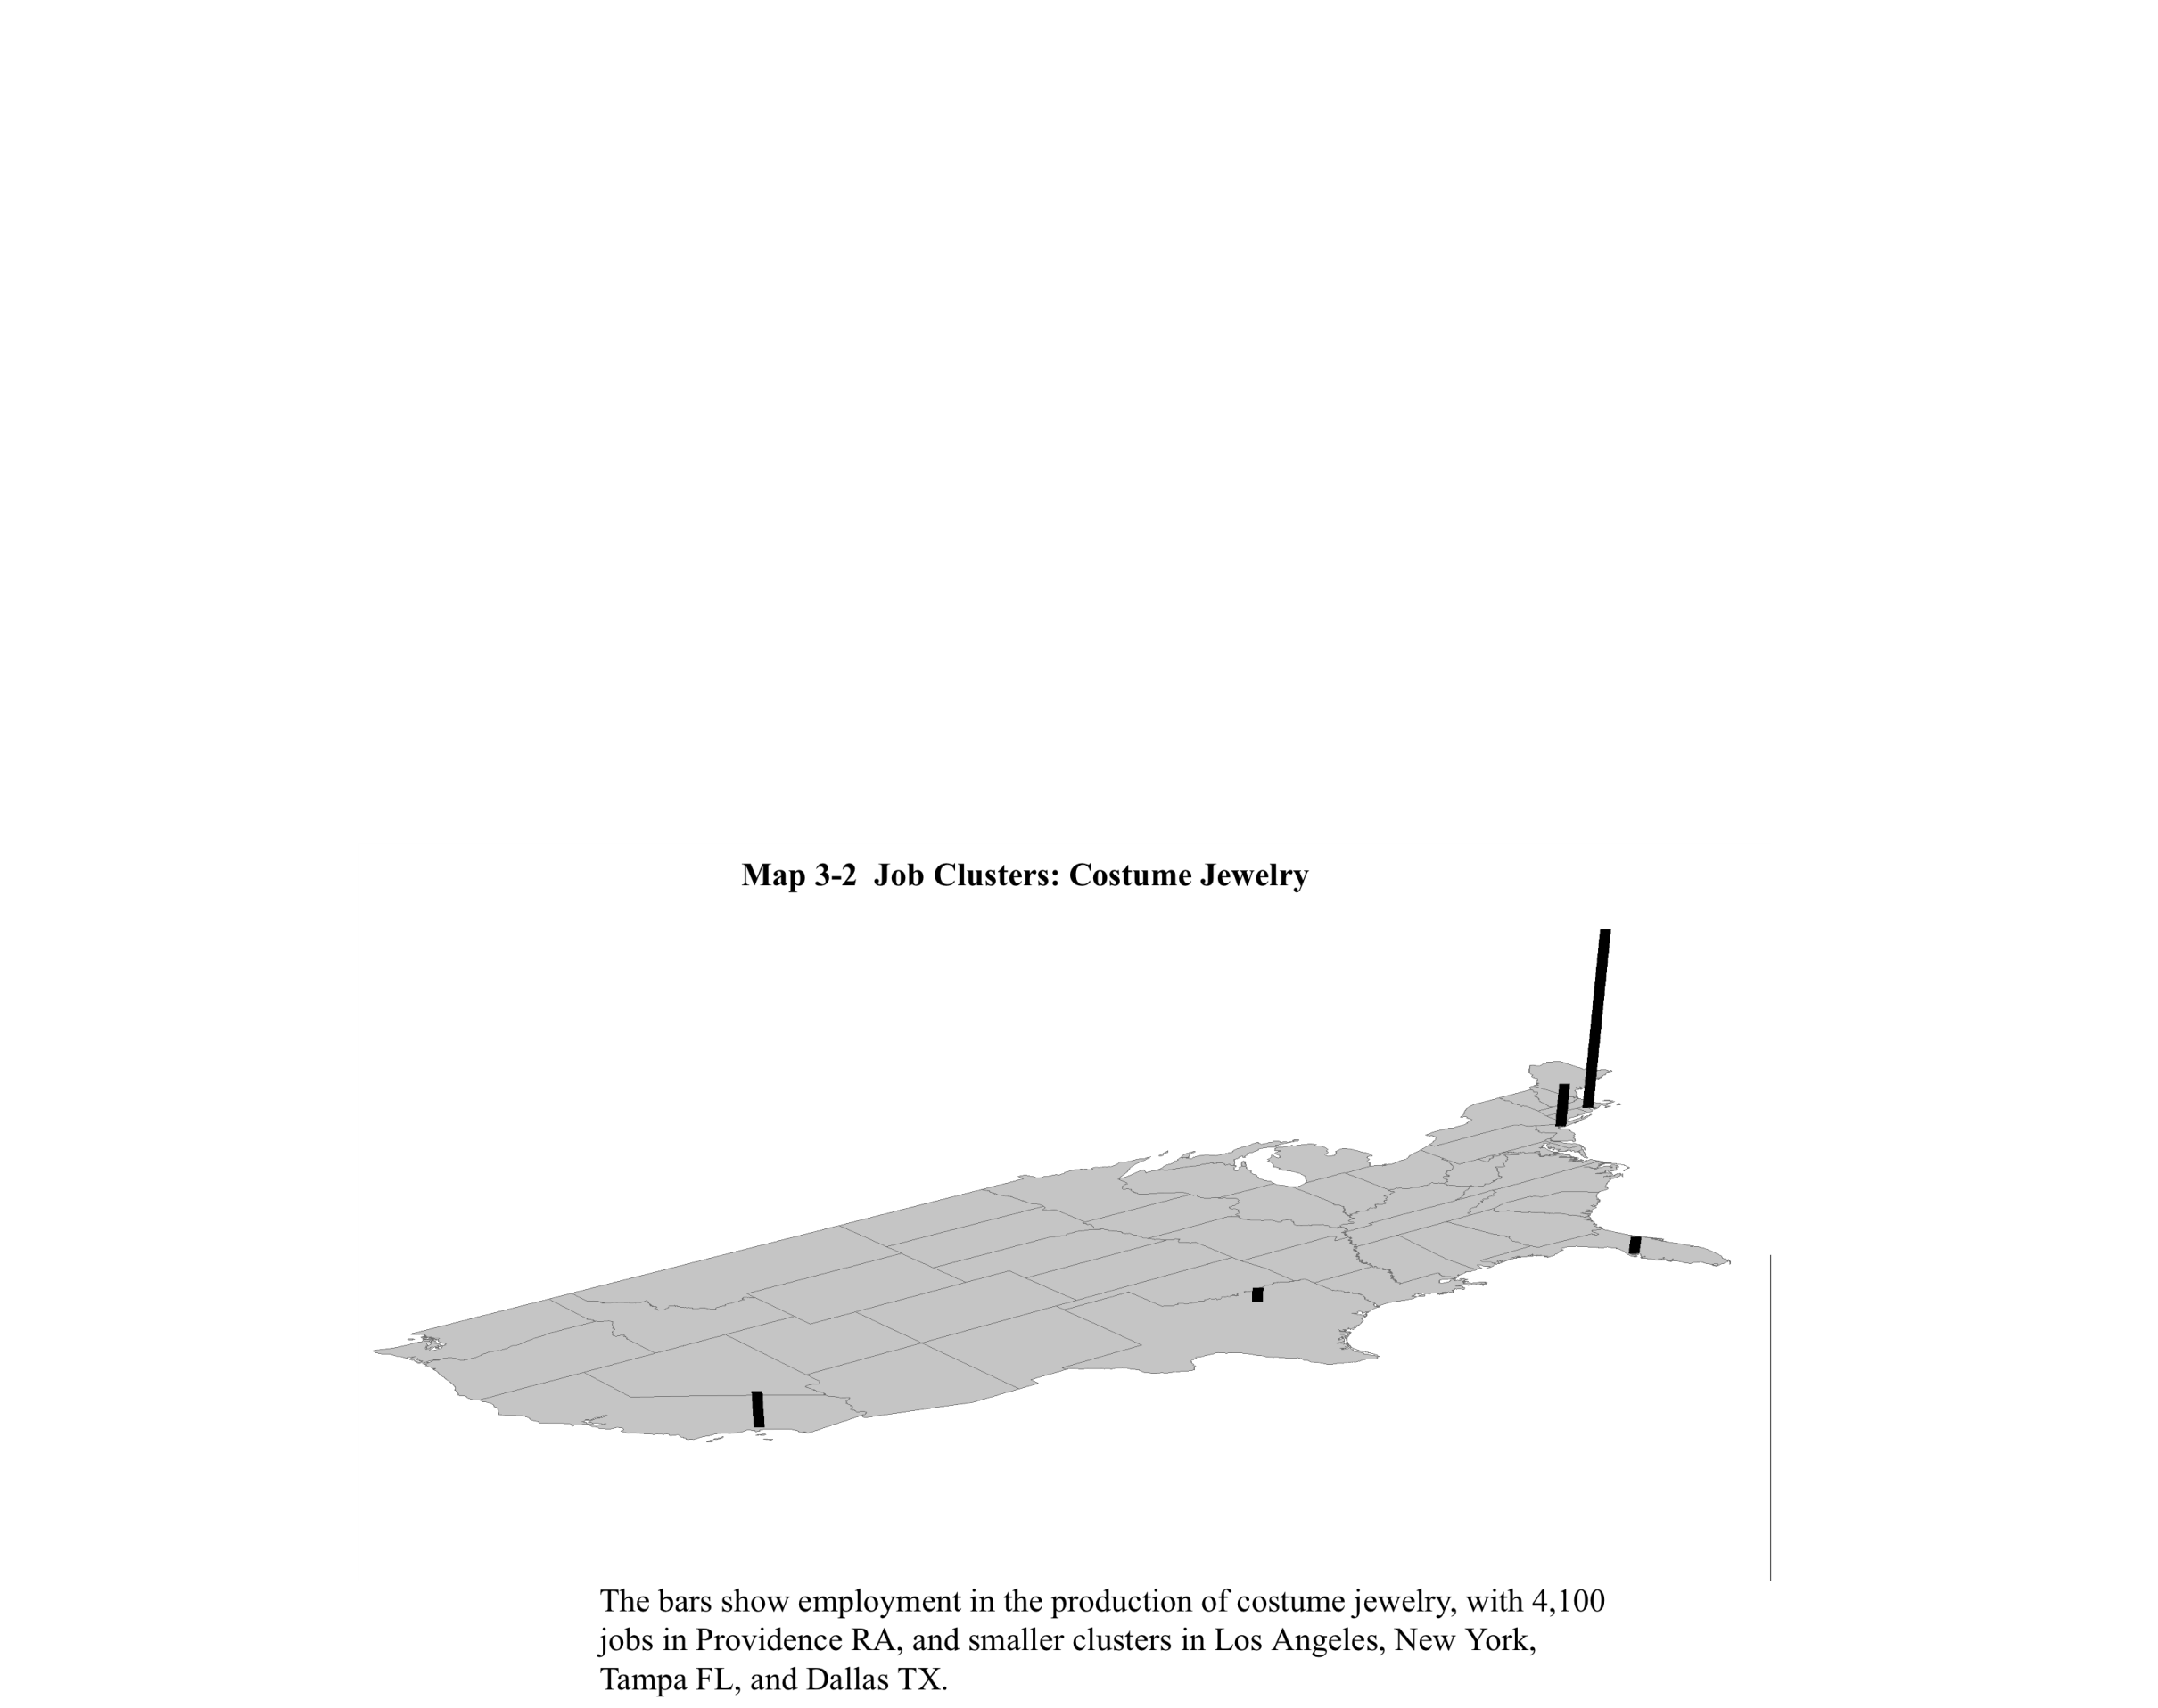
2.Concentration of Economic ACTIVITY
Industry: Costume Jewelry

Slide 8
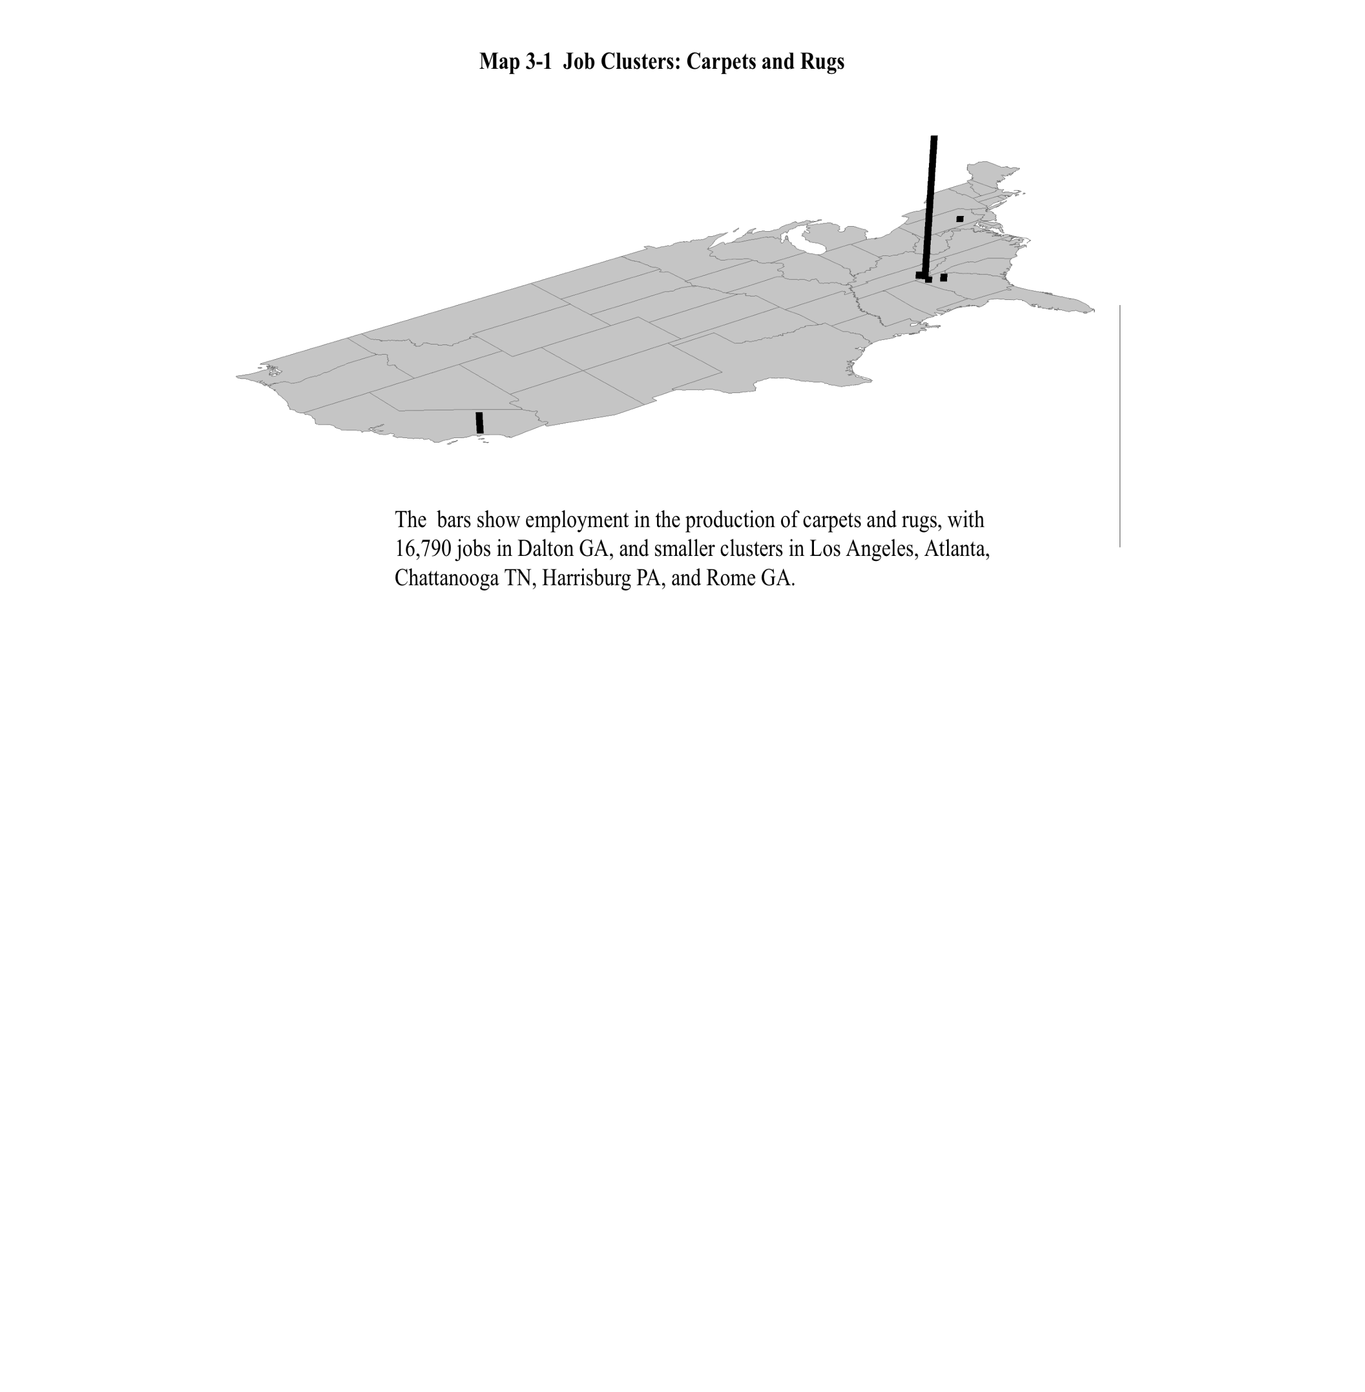
Industry: Carpets and Rugs

Slide 9
Economies from Location
  Localization Economies: refers to cost savings when firms of a given industry locate together.
  Urbanization Economies: refers to cost saving from locating together of firms across different industries. The location of one industry attracts another.
  Urbanization economies leads to the development of large diverse cities.
  Urbanization and localization economies are termed agglomeration economies

Slide 10
Why do Firms Cluster?
1. Sharing Intermediate Inputs
  The increased demand for the intermediate input as firms cluster allows its manufacturer to benefit from economies of scale
2. Sharing A labor Pool
  Sharing a labor pool is beneficial to firms given significant variation in demand facing each firm, e.g., Software & TV programs.
3. Labor Matching
  Firms and workers not always perfectly matched.
  Mismatches require training costs to eliminate skill gap.
  A larger city allows better matches
4. Knowledge Spillovers
  Firms in an industry share ideas and knowledge
  mysteries of trade are “in the air”
  innovations are promptly discussed, improved, and adopted

Slide 11
3.City Size
Small and large cities
Cities growing or shrinking over time
What determines the size of a city?
  Need to consider the utility per worker in all cities in a given region
  Workers will migrate from one city to another until utility per worker is equalized

Slide 12
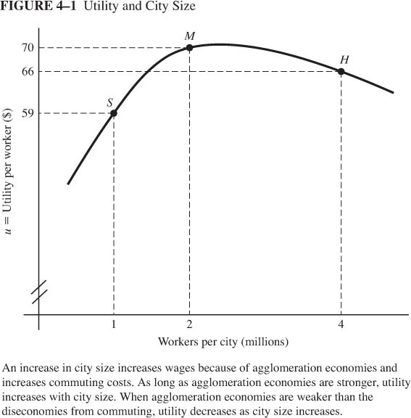
Moving from a city of 1m to 2m increases utility of a typical worker. The agglomeration economies are stronger than the diseconomies from commuting.
Moving from a city of 2m to 4m decreases utility of a typical worker. The agglomeration economies are weaker than the diseconomies from commuting.
This implies there is an optimal city size, the size at which utility per worker is maximized

Slide 13
Technological Innovation
Innovation within a city affects its per capita income
Consider a region with 12 m workers and two identical cities.
Each city experiences technological innovation that results in a higher wage

Slide 14
Region wide Innovation (both cities)
No change in city size, however utility per worker increases
80
Utility per worker
70
6
Workers per city

Slide 15
City Specific Innovation
Suppose instead that only one of the two cities experiences technological progress.
How will this change affect each city?

Slide 16
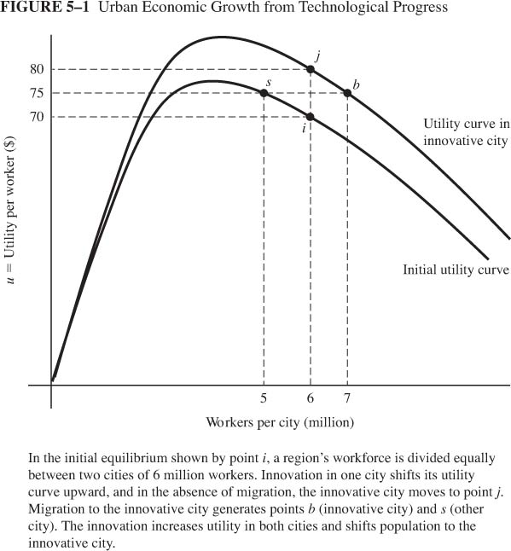
Each city is at point i
Workers migrate in response to the utility gap
The innovative city moves to a higher utility curve at point j. This outcome is not a locational equilibrium
The utility in the innovative city falls to 75
The utility in the other city rises to 75

Slide 17
Small and large cities
Equilibrium in cities with differences in agglomeration economies:
What is the equilibrium size of each city?
M: large localization
B: large urbanization
Utility must be equal across cities
Utility/worker
Each city has to be on the negatively sloped side of the utility curve
S: small localization
1
3
6
workers

Slide 18
4. Rise and demise of the Monocentric City
Cities looked very different 100 years ago:
  Cities had a unique center
  Jobs were concentrated near the city center
  Manufacturing firms locates near railroad terminals
  Office firms clustered in the CBD
  Workers lived in city center and commuted by foot or in the suburbs and rode street cars

Slide 19
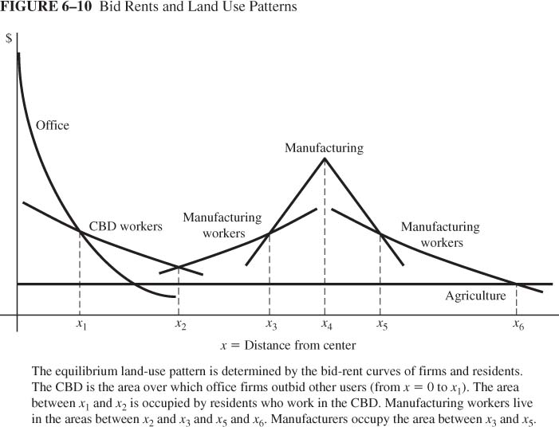
Land Use Patterns

Slide 20
Demise of the Monocentric City
Since then, the spatial distribution of employment and population started to change
Define
  A central city is the territory of the municipality at the center of the metropolitan area.
  A Suburban area is the rest of the metropolitan area

Slide 21
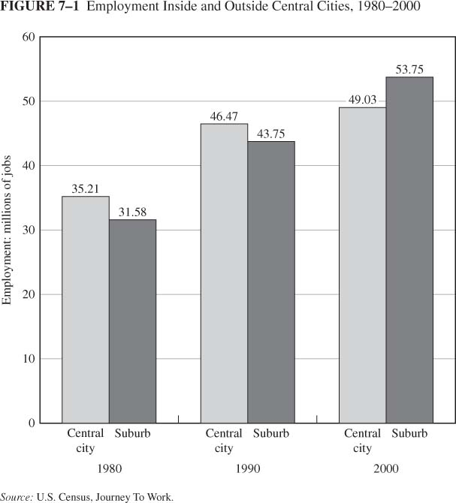
The Spatial Distribution of Jobs and People
Distribution of Employment
Employment decentralization
In 1948 jobs in central city were twice those in suburban areas

Slide 22
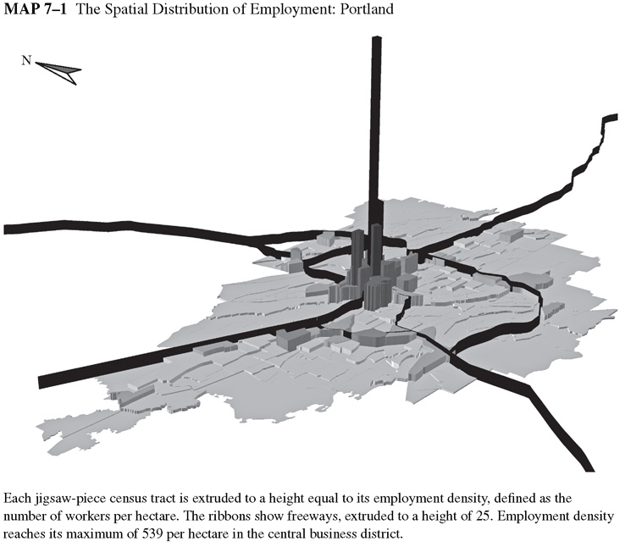

Slide 23
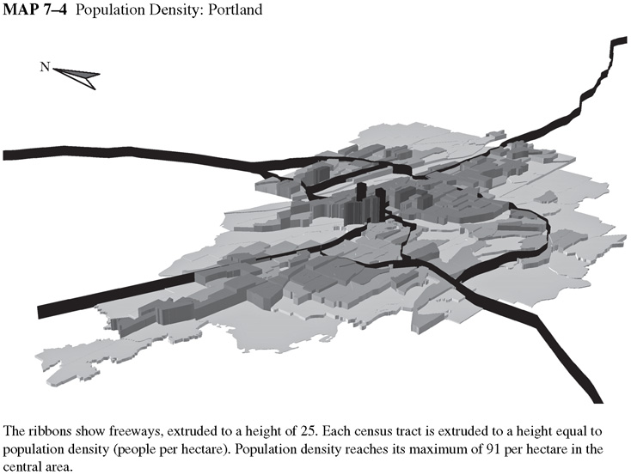

Slide 24
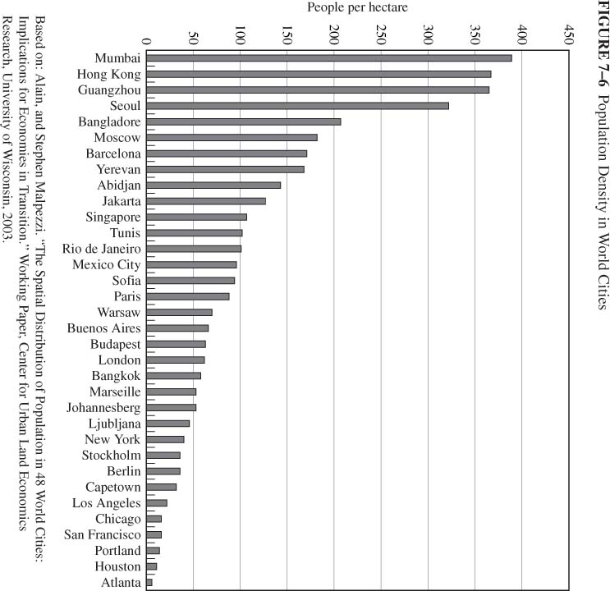
Urban Density Worldwide
Cities are defined as areas of high population density
Variation in density of world cities
US cities rank lowest

Slide 25
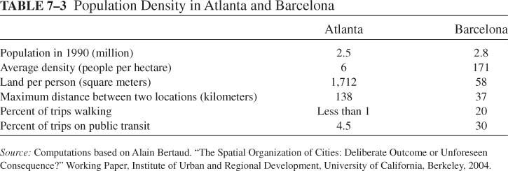
Urban Sprawl
Sprawl Facts
1950 - 1990: urban land increased 245%; urban population increased 92%

Slide 26
Urban Sprawl
The role of public policy
  Under pricing of commuting encourages long commutes
  Mortgage subsidy increases housing consumption
  Under pricing of fringe infrastructure
  Zoning: Minimum lot sizes to exclude high-density housing

Slide 27
Consequences of Sprawl
Environmental consequences
Increased consumption of fossil fuels
Increased demand for public goods, e.g., highways and schools
Inefficient to provide mass transit
Depletion of world reserves of fossil fuels results in a non sustainable life style

