Slide 1

Welfare Analysis

Slide 2
Ranking Economic systems
Objective: to find a criteria that allows us to rank different systems or allocations of resources.
This criteria will allow us to answer a question like:
  Although the minimum wage law creates winners and loser, is it better than the free market?

Slide 3
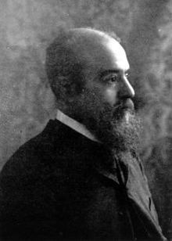
Pareto Efficiency
According to the Pareto criteria system A is better than system B if
  System A makes some people better off, and
  No one is worse off under A than B
  We say a movement from B to A is a Pareto improvement
Vilfredo Pareto
1848- 1923

Slide 4
Pareto Efficiency
System A is Pareto efficient if
  There exists no other system that makes some people better off without hurting others
Vilfredo Pareto
1848- 1923

Slide 5
Consumers, Producers and Welfare Economics
Welfare Economics can be used to answer the following
  What is the right amount of the good that should be produced?
  Can the market system ensure that this amount is produced?
  If not, can government policy give us the right amount of production?

Slide 6
What are the “RIGHT” quantities?
Society has to decide:
  What goods will be produced using the scarce resources.

Slide 7
What are the “RIGHT” quantities?
  Society realizes a benefit from consumption of a given amount of a good.
  Society bears a cost as a result of producing that good.

Slide 8
Society’s Objective??
Objective: Maximize the well being of individuals in society, i.e., maximize Social Welfare or Social Surplus
Therefore, the RIGHT amount of a certain good is the quantity that gives the highest amount of social welfare.
Social Welfare
x

Slide 9
How to calculate social welfare?
Social Welfare is the difference between the benefit to society from a given amount of the good and the cost of producing that amount
SW(x) = Benefit(x) – Cost (x)
Need to find x that
  Gives the highest amount of SW
  Maximizes the difference between benefits and costs of a good

Slide 10
Marginal Analysis
We can find x using marginal analysis
Each extra unit of production results in
  Marginal benefit (MB): additional benefits to society
  Marginal costs (MC): Additional costs to society
To maximize social welfare, society should expand production until the additional benefit exactly equals the additional cost from production.

Slide 11
  Marginal benefit (MB): additional benefits to society
$100
Total benefit of 4 units
80
70
Marginal Benefit
50
0
1
2
3
4
Quantity of x

Slide 12
  Marginal costs (MC): Additional costs to society
Total cost to society of producing 4 units
Marginal Cost
$80
70
40
30
0
1
2
3
4
Quantity of x

Slide 13
The “RIGHT” quantity
Social welfare (or Social Surplus) is maximized at x where MB=MC, i.e., at x=3
At x=3, social welfare=…..
Compare that to social welfare for x=1 or x=4.
$100
Marginal
cost
$80
70
40
30
Marginal Benefit
curve
0
1
2
3
4
Quantity of x

Slide 14
In General…..
Marginal
cost
The RIGHT quantity is also referred to as the efficient quantity.
Efficiency is achieved if social surplus is maximized
A system that achieves Q* is said to be efficient
Value
Cost
Cost
Value
Marginal
Benefit
0
Q*
Quantity
Value is greater
Value is less
than cost.
than cost.

Slide 15
System 1: The Benevolent Social Planner
Lets consider a system where decisions are made by a benevolent social planner
His objective: maximizing welfare of society
Is that system efficient?

Slide 16
System 1: The Benevolent Social Planner
Assume the social planner has all relevant information
He uses marginal analysis:
  A unit is produced when the benefit it yields is higher than or equal to its cost
  The Benevolent Social Planner is efficient

Slide 17
System 2: The Market System
Is the allocation of resources determined by free markets in any way desirable?
Can the market system produce the output level that maximizes social welfare?

Slide 18
System 2: The Market System
In a market system quantities are determined by the market, the interaction of demand and supply.
Demand: reflects the benefit to consumers from the goods
Supply reflects the costs of production

Slide 19
Demand and Willingness to Pay
Willingness to pay is the maximum amount that an individual will pay for a good.
It measures how much he values the good or service, i.e., his benefit from the good.

Slide 20
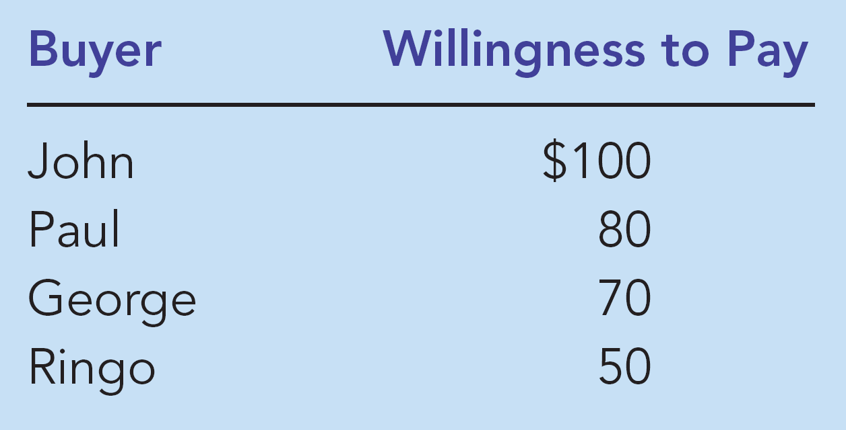

Four Individuals’ Willingness to Pay for a Housing Unit

Slide 21
The Marginal Benefit Curve
$100
John
’
s willingness to pay
80
Paul
’
s willingness to pay
70
George
’
s willingness to pay
50
Ringo
’
s willingness to pay
Marginal Benefit line
0
1
2
3
4
Quantity of
Housing

Slide 22
Demand as the Marginal Benefit curve
$100
80
70
50
Demand
0
1
2
3
4
Quantity of Housing

Slide 23
On the production side:
Marginal Cost
Seller | Cost
Builder 1 | 30
Builder 2 | 40
Builder 3 | 70
Builder 4 | 80

Slide 24
Supply as the marginal cost curve
Cost of
Housing
Supply
Seller | Cost
Builder 1 | 30
Builder 2 | 40
Builder 3 | 70
Builder 4 | 80
$80
70
40
30
0
1
2
3
4
Quantity of
Housing

Slide 25
Is the Market System Efficient?
X=3 is the equilibrium under a free market system
At the market equilibrium:
  Demand= Supply
  MB=MC
Therefore, the market system is efficient.
$100
Supply
Marginal
cost
$80
70
40
30
Demand
Marginal Benefit
0
1
2
3
4
Quantity of x

Slide 26
Efficiency of Markets
Price
Marginal cost
Supply
Q* is an equilibrium point under the free market system
The market system is efficient
The market system maximizes social surplus.
Value
Cost
to
to
buyers
sellers
Cost
Value
to
to
sellers
buyers
Marginal Benefit
Demand
0
Q*
Quantity
Value to buyers is greater
Value to buyers is less
than cost to sellers.
than cost to sellers.

Slide 27
Conclusion
The market system is efficient when there are:
  No external benefits (the demand is the marginal benefit to society)
  No external costs (the supply curve is the marginal cost to society)
The planned system is efficient provided that the social planner is benevolent and has all the required information
The efficiency of the market system does not depend on benevolence but rather on self interest.

Slide 28
Social Surplus: Consumers and Producers
  Social Surplus or Social Welfare measure net gains from trade, i.e., the satisfaction derived by consumers and producers from participating in a market
  Social Surplus=
  Consumers Surplus+ Producers Surplus

Slide 29
Consumer Surplus
  Consumer surplus measures economic welfare from the buyer’s side.
Consumer surplus is the buyer’s willingness to pay for a good minus the amount the buyer actually pays for it

Slide 30
Measuring Consumer Surplus with the Demand Curve
(a) Price = $80
Price of
Housing
$100
John
’
s consumer surplus ($20)
80
70
50
Marginal Benefit
or Demand
0
1
2
3
4
Quantity of
Housing

Slide 31
Measuring Consumer Surplus with the Demand Curve
(b) Price = $70
Price
$100
John
’
s consumer surplus ($30)
80
Paul
’
s consumer
70
surplus ($10)
Total
50
consumer
surplus ($40)
Demand
0
1
2
3
4
Quantity of
Housing

Slide 32
How the Price Affects Consumer Surplus
(a) Consumer Surplus at Price
P
Price
A
Consumer
surplus
P₁
B
C
Demand
0
Q₁
Quantity

Slide 33
PRODUCER SURPLUS
Producer surplus is the amount a seller is paid for a good minus the seller’s cost.
It measures the economic welfare from the seller’s side.

Slide 34
Measuring Producer Surplus with the Supply Curve
(a) Price = $600
Price
Supply
$900
800
600
500
producer
surplus ($100)
0
1
2
3
4
Quantity of Houses

Slide 35
Measuring Producer Surplus with the Supply Curve
(b) Price = $800
Price
Supply
Total
producer
$900
surplus ($500)
800
600
Builder 2’
s producer
500
surplus ($200)
Builder 1’
s producer
surplus ($300)
0
1
2
3
4
Quantity of Houses

Slide 36
How the Price Affects Producer Surplus
(a) Producer Surplus at Price
P
Price
Supply
P₁
B
C
Producer
surplus
A
0
Q₁
Quantity

Slide 37
Social Surplus
Consumer Surplus
= Value to buyers – Amount paid by buyers
and
Producer Surplus
= Amount received by sellers – Cost to sellers

Slide 38
Total Surplus
Total surplus
= Consumer surplus + Producer surplus
or
Total surplus
= Value to buyers – Cost to sellers
Thus, the price paid by buyers will not affect total surplus although it will affect the distribution of surplus between consumers and producers.

