Slide 1
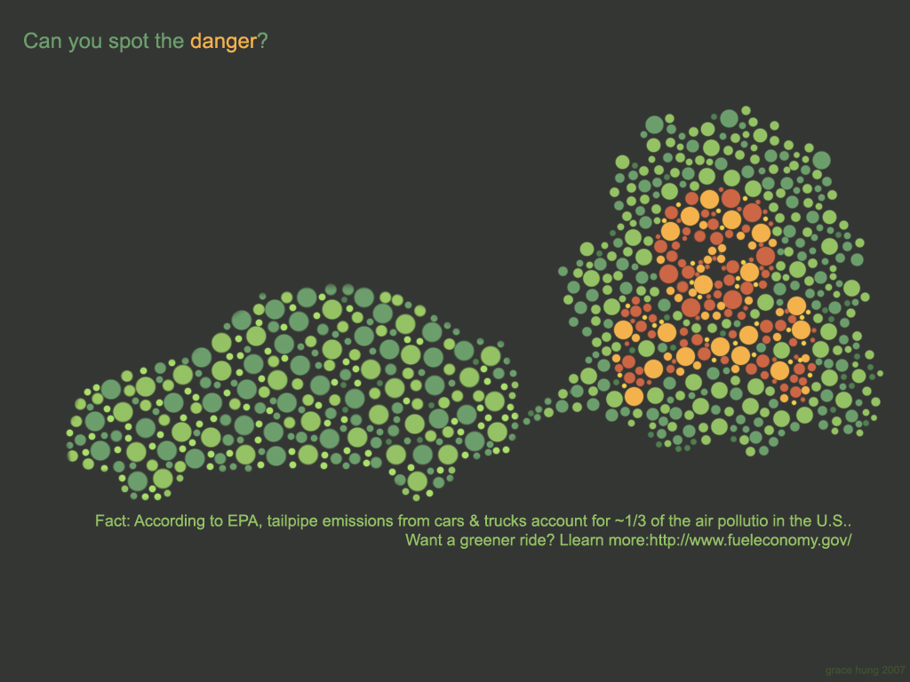

4
Pollution Problems

Slide 2
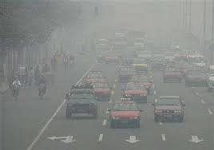
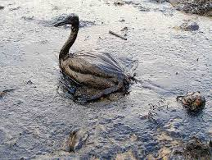
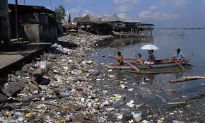

Slide 3

Economics of Pollution
People use the environment in several ways:
  Consumption of resources to produce goods or generate energy
  Emissions of wastes from production or consumption

Slide 4
Economics of Pollution
Pollution can be defined as excessive use of the environment.
Pollution results because the environment is a common resource
  Property rights over environmental resources, in general, are non existent
  Hard to monitor or control use

Slide 5
Economics of Pollution
As a result, individuals perceive the environment as free while its use imposes a cost on society
Individuals ignore the costs they impose on society from misusing the environment
Pollution represents a market failure

Slide 6
The Hidden Cost of Fossil Fuels
Fossil fuels—coal, oil, and natural gas—are America's primary source of energy, accounting for 85 percent of current US fuel use. Some of the costs of using these fuels are obvious, such as the cost of labor to mine for coal or drill for oil, of labor and materials to build energy-generating plants, and of transportation of coal and oil to the plants. These costs are included in our electricity bills or in the purchase price of gasoline for cars.
But some energy costs are not included in consumer utility or gas bills, nor are they paid for by the companies that produce or sell the energy. These include human health problems caused by air pollution from the burning of coal and oil; damage to land from coal mining and to miners from black lung disease; environmental degradation caused by global warming, acid rain, and water pollution; and national security costs, such as protecting foreign sources of oil.
Since such costs are indirect and difficult to determine, they have traditionally remained external to the energy pricing system, and are thus often referred to as externalities. And since the producers and the users of energy do not pay for these costs, society as a whole must pay for them. But this pricing system masks the true costs of fossil fuels and results in damage to human health, the environment, and the economy.
Available at: http://www.ucsusa.org/clean_energy/technology_and_impacts/impacts/the-hidden-cost-of-fossil.html

Slide 7
When the market works as it should…
The invisible hand of the marketplace leads self-interested buyers and sellers to maximize the net benefit that society can derive from a market.
Is this always the case?

Slide 8
When the market fails……
Market failure refers to the situation when the market mechanism does not successfully maximize social welfare
Conditions under which the market system fails:
  Monopolies
  Public Goods
  Imperfect Information
  Externalities

Slide 9
Externalities and Market Inefficiency
An externality refers to uncompensated benefits or costs borne by a third party.
Who is the first or second party?
  The first and second parties are the buyers and sellers of a good.
  The third party is, therefore, someone not involved in the transaction.

Slide 10
When markets do not work as they should.
An externality refers to the uncompensated impact of one person’s actions on the well-being of a bystander.
Externalities cause markets to be inefficient, and thus fail to maximize total surplus.

Slide 11
Positive vs. Negative Externalities
When the impact on the bystander is adverse, i.e., when costs are imposed on a third party, the externality is negative.
When the impact on the bystander is beneficial, i.e. when benefits are imposed on a third party, the externality is positive.

Slide 12
EXTERNALITIES AND MARKET INEFFICIENCY
Negative Externalities
  Automobile exhaust
  Cigarette smoking
  Barking dogs (loud pets)
  Loud stereos in an apartment building

Slide 13
EXTERNALITIES AND MARKET INEFFICIENCY
Positive Externalities
  Immunizations
  Restored historic buildings
  Education

Slide 14
EXTERNALITIES AND MARKET INEFFICIENCY
Externalities lead markets not to produce the right amounts:
  Negative externalities lead markets to produce a larger quantity than is socially desirable.
  Positive externalities lead markets to produce a smaller quantity than is socially desirable.

Slide 15
Private Benefits and Costs
Need to distinguish between private and social benefits/costs
The demand (supply) curve represents the marginal private benefit (cost)
At the equilibrium quantity these two are equal

Slide 16
Social Costs
Marginal Social Costs (MSC) marginal costs accruing to society as a whole from production of a given good. It includes
  marginal costs borne by the producer
  as well as costs borne by all other individuals who are not producers.
Marginal Social Costs = Marginal Private cost + External Cost.

Slide 17





Green Production: No Externality
$10
$0
$0
$0
$0
$0
The MPC=$10 The MSC=$10

Slide 18
Polluting Production: With Externalities
$10
$2
$2
$2
$2
$2
The MPC=$10 The MSC=$20

Slide 19
In the Absence of Externalities:
Adam Smith’s Invisible Hand: The market system maximizes
social welfare
Price
Supply (marginal
private cost)
=marginal social cost
Equilibrium
Demand (marginal
private benefit)
=marginal social benefit
0
Q _{Market}
Quantity
Q _{Welfare}

Slide 20
Production Externality
Consider as an example the paper industry,
  The firm dumps the wastes generated from production in a nearby river
  The firm’s MPC curve accounts for costs of resources the firm uses and pays for
  The firm uses clean water from the river but does not pay for the cost of using it

Slide 21
Production Externality
Consider as an example the paper industry,
  The MSC includes the private costs as well as the cost of using the clean water from the river
  MSC > MPC

Slide 22
The private and social cost
$10
$2
$2
$2
$2
$2
The MPC=$10 The MSC=$20

Slide 23
Social Welfare
The output level that maximizes social welfare is where:
Marginal Social costs= Marginal Social Benefits

Slide 24
Pollution and the Social Optimum
Price of
Marginal Social Cost (MPC + external cost)
Paper
External Cost
Supply
(MPC)
Optimum
Equilibrium
Demand
(MPB)
Marginal social Benefit
0
Q_{WELFARE}
Q_{MARKET}
Quantity of
Paper
overproduction

Slide 25
Impact on Welfare
Price of
Marginal Social Cost (MPC + external cost)
Paper
External Cost
Supply
(MPC)
Optimum
Dead Weight Loss
Equilibrium
Demand
(MPB)
Marginal social Benefit
0
Q_{WELFARE}
Q_{MARKET}
Quantity of
Paper
overproduction

Slide 26
Optimal Pollution
Should we eliminate all pollution?
$
Marginal
Cost
Optimal
Marginal
Benefit
0
Q _{Welfare}
Quantity of
Pollution

Slide 27
PUBLIC POLICIES TOWARD EXTERNALITIES
When externalities are significant, government may attempt to solve the problem through . . .
  Direct Controls policies(sometimes called command-and-control policies).
  market-based policies.

Slide 28
Command-and-Control Policies:
Usually take the form of regulations:
  Forbid certain behaviors.
  Require certain behaviors.
  Example:
    Banning the use of certain chemicals.
    Setting a maximum on pollution emission levels.

Slide 29
Market-Based Policy:
Corrective Taxes
Government uses taxes to align private incentives with social efficiency, i.e. to internalize the externality.
Corrective taxes are taxes enacted to correct the effects of a negative externality.
  Also called Pigouvian taxes

Slide 30
Corrective Tax
Price of
Marginal Social cost
paper
Tax= External cost
Supply
(marginal private cost)
Optimum
Equilibrium
Demand (marginal
private benefit
(marginal social benefit)
0
Q_{WELFARE}
Q_{MARKET}
Quantity of
paper

Slide 31
Review of equilibrium and welfare effects of a unit tax

Slide 32
A Tax on Sellers
Price
Price sellers accept with the tax
A tax on sellers
S₂
shifts the supply
curve upward
S₁
by the amount of
$3.30
the tax ($0.50).
Tax ($0.50)
2.80
Price
Sellers accept
before the tax
0
90
Quantity of
Ice-Cream Cones

Slide 33
A Tax on Sellers
Price of
Ice-Cream
A tax on sellers
Price
Cone
S₂
shifts the supply
buyers
curve upward
pay
by the amount of
$3.30
S₁
Tax ($0.50)
the tax ($0.50).
Price
3.00
without
2.80
tax
Price
sellers
receive
Demand,
D₁
0
90
100
Quantity of
Ice-Cream Cones

Slide 34
Effects of a tax
Price
The Tax affects both buyers and sellers regardless of who the tax is imposed on
The tax results in a reduction in quantity
In the absence of market failures, the tax, therefore, results in a welfare loss
S
Price buyers
pay ($3.3)
Tax wedge
($0.5)
Price
without tax
Price sellers
Receive
($2.8)
D
0
Qt
Quantity

Slide 35
Welfare Effects
Price
CS
S
(Marginal Social Cost)
Dead Weight
Loss
Price buyers
pay ($3.3)
The Tax distorts the market and results in a welfare loss
How is the corrective tax different?
Tax Revenue
Tax wedge
($0.5)
Price
without tax
Price sellers
Receive
($2.8)
PS
D
(Marginal Social Benefit)
0
Qt
Q Welfare
Quantity

