Slide 1

Private Solutions To Market Failures

Slide 2
Introduction
When the market fails to achieve an efficient allocation of resources, government intervention can potentially remedy the problem.
However, government intervention may result in more inefficiency
Under certain conditions individuals may be able to remedy the market failure

Slide 3
Government Failure
Occurs when a government policy results in more inefficient allocation of resources than would exist in its absence.

Slide 4
Government Failure
Some causes of government failure:
  Imperfect information
  Lack of information on benefits and costs of certain actions
Subsidy
MSB
MSB
MPB

Slide 5
Government Failure
Some causes of government failure:
  Self interested policy makers
  Tendency to make decisions in their own best interest. Adopting short term solutions and policies that are politically feasible, e.g. CAFE vs. gas tax

Slide 6
Government Failure
Some causes of government failure:
  Inefficiency of Voting
  Decisions based on the voting outcome are not necessarily efficient
 | Mark | Ann | Joe | Tom
Outcome A | 10 | 10 | 10 | 10
Outcome B | 5 | 5 | 5 | 35
Outcome A wins, while outcome B is efficient

Slide 7
Government Failure
Some causes of government failure:
  Disincentives from regulation
  Regulation aimed at redistribution can reduce incentives to work

Slide 8
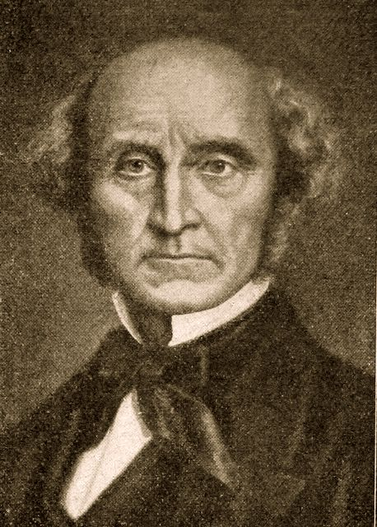
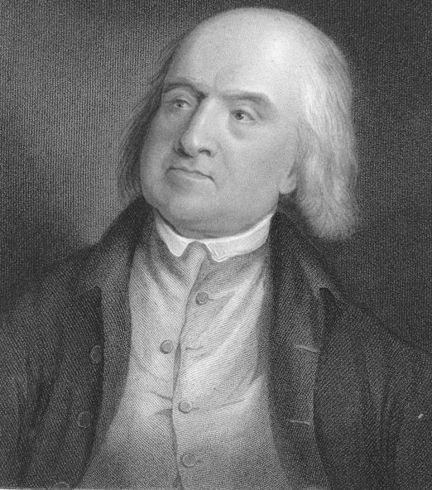
1. Utilitarianism
Utilitarianism is the political philosophy according to which the government should choose policies to maximize the total utility of everyone in society.
The founders of utilitarianism are the English philosophers Jeremy Bentham and John Stuart Mill.
John Stuart Mill
Jeremy Bentham

Slide 9
1. Utilitarianism
The utilitarian case for redistributing income is based on the assumption of diminishing marginal utility.
  An extra dollar of income to a poor person provides him with more utility, or well-being, than does an extra dollar to a rich person.
  Hence, income redistribution from the rich to the poor can raise overall utility

Slide 10
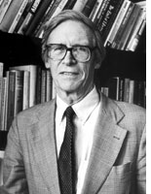
2. Liberalism
Liberalism is the political philosophy according to which the government should choose policies deemed to be be just
A self-interested rational person behind the “Veil of Ignorance” would not want to belong to a race or gender or any group that turns out to be discriminated-against. Thus, individuals prefer equal distribution of resources
John Rawls

Slide 11
2. Liberalism
Public policy should be based on the maximin criterion, which seeks to maximize the utility or well-being of the worst-off person in society rather than maximizing the sum of everyone’s utility
This idea would allow for the consideration of the redistribution of income as a form of social insurance.

Slide 12
3. Libertarianism
Libertarianism is the political philosophy according to which the government should punish crimes and protect property rights, but should not redistribute income:
  Income redistribution distorts incentives
  Income redistributed independent of effort level creates less incentive to work
  Trade off between equality and efficiency. Redistribution results in less total income and lower utility
Libertarians argue that equality of opportunity is more important than equality of income.

Slide 13
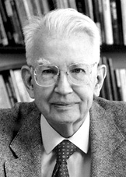
Coase Theorem
A Chicago economist with a firm belief in markets
Believes that government intervention is not the only solution to market failures
Inefficiencies result because of missing markets
Roland Coase,
1910-

Slide 14
Coase Theorem
Bargaining between private agents will lead to an efficient outcome provided:
  Property rights are well defined
  Low transaction costs
This will be true regardless of the initial allocation of property rights.

Slide 15
Coase Theorem: Example
Factory and the residents
Technology: the factory creates a unit of emissions for each unit of production
The external cost of each unit of emissions is $2,000

Slide 16
From the factory’s perspective….
$
MSC
MPC (Supply)
$12,000
P
$8,000
$6,000
1
2
3
4
5
6
Quantity
0

Slide 17
From the residents’ perspective…..
$
MSC
MPC (Supply)
$12,000
P
The marginal external cost borne by the residents is $2000
$8,000
$6,000
1
2
3
4
5
6
Quantity
0

Slide 18
Coase Theorem: Example
Alternative property rights system:
  The factory has the right to pollute
  The residents have the right to clean air

Slide 19
The residents have the right to clean air
$
MSC
MPC (Supply)
$12,000
P
The gain to the factory exceeds the external cost borne by the residents
$8,000
$6,000
1
2
3
4
5
6
Quantity
0

Slide 20
The residents have the right to clean air
The factory pays the residents for each unit of resulting emissions
The factory produces up to 4 units

Slide 21
The factory has the right to pollute
$
MSC
MPC (Supply)
$12,000
P
The external cost borne by the residents exceeds the gain to the factory
$8,000
$6,000
1
2
3
4
5
6
Quantity
0

Slide 22
The factory has the right to pollute
The residents pay the factory to reduce its production (and emissions as well)
The factory produces up to 4 units

Slide 23
The Efficient Outcome
The efficient outcome is achieved regardless of the specific legal system that defines property rights
However, the specific legal system chosen will determine income distribution
Note that the efficient outcome can be achieved through a tax

Slide 24
Tradable pollution permits
When the government has an emissions reduction target, it can achieve it through a quota system that limits emissions of each firm to a certain level
However, when the cost of abatement differs among firms, a uniform quota will not be efficient
A system of tradable permits is a cost effective way to achieve a pollution reduction target

Slide 25
Tradable Permit Game
SO2 Trading Game
You are one firm in a market that makes a profit of $38
You generate 3 units of SO2 emissions
Your abatement cost is $20/ unit of emissions.
You will comply with the environmental regulation announced with the minimum cost
If you incur losses, you exit the industry. The winner is the firm that realizes the maximum profit.
SO2 Trading Game
You are one firm in a market that makes a profit of $38
You generate 3 units of SO2 emissions
Your abatement cost is $10/ unit of emissions.
You will comply with the environmental regulation announced with the minimum cost
If you incur losses, you exit the industry. The winner is the firm that realizes the maximum profit.

Slide 26
Tradable Permit Game
Polluters with the low cost of abatement will choose to abate and sell the permits to firms with the high cost of abatement
The permit system, encourages technological innovation to achieve pollution reduction, in comparison to a command and control mechanism

Slide 27

Towards a Theory of Property Rights
Ownership as a bundle of property rights.
Property rights convey the right to benefit or harm oneself or others. Thus, the relationship between property rights and externalities.
Internalizing an externality refers to a change or redefinition of property rights that is welfare improving
This will be true in the absence of transactions costs
Example: Military draft, smoke
Harold Demsetz
1930-

Slide 28
Towards a Theory of Property Rights
A change in property rights will emerge as the external benefits or costs change (property rights over land among American Indians)
Demsetz was the first to propose emissions trading as a way of giving polluters an economic incentive to reduce their pollution
Harold Demsetz
1930-

Slide 29
What do Institutions of property rights do?
Identify ownership of resources, goods and services, and thus
Enable the transfer of ownership from one individual to another (or from the government) and
Protect private property rights.

Slide 30
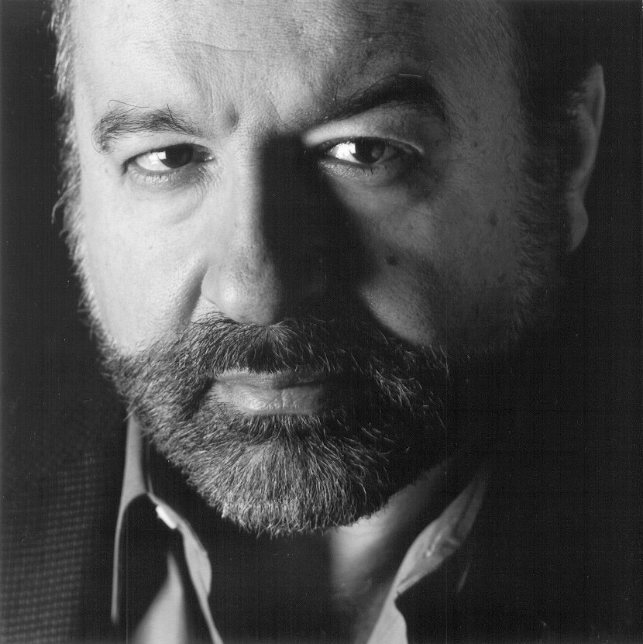
The Mystery of Capital
Challenges facing less developed countries :
  Poverty per se not the problem
  Property not owned in a way to generate value
  Weak legal system that cannot define ownership over assets
  Economy resembles the Wild West
Industrial revolution and the rural urban migration
  Immigrants faced walls that barred them from legality
  Becoming legally recognized is costly and time consuming
Hernando De Soto
Soto, H. (2000). The Mystery of Capital. Basic Books

Slide 31
Dead Capital
Capital is created through saving or borrowing
While the benefit from capital investment (in terms of production created over time) can exceed the cost, lenders are reluctant to lend money for capital investment in the absence of a collateral
In developed countries, assets (or properties) lead two parallel lives. They serve an immediate purpose and they act as collateral for loans
In developing countries assets can not create capital because of undefined property rights.
The result is $9.3 trillions in dead capital
Soto, H. (2000). The Mystery of Capital. Basic Books

Slide 32
Informal Ownership
Why not have a property rights system?
Government bureaucracy makes it costly for individuals and businesses to obtain legal property rights
The high cost of access to the legal system results in the poor operating in the extralegal system where land and goods are owned informally
Soto, H. (2000). The Mystery of Capital. Basic Books

Slide 33
Extra Legal Sector
Extra legal businesses refers to those that are pushed to the underground economy.
Extralegal businesses suffer because of
  Inability to grow by selling shares
  High risks – no limited liability, no insurance
  Inability to use property as collateral for loan
  Distorting incentives to invest
  Many businesses operating at a small scale and thus unable to benefit from economies of scale
Soto, H. (2000). The Mystery of Capital. Basic Books

