Slide 1
Public Policy and Financial Crises

Slide 2
Purpose
In this section we consider:
the nature and causes of financial crises
The recessionary effect of financial crises
Market Failure associated with crises
The role of regulation

Slide 3
Definition
A variety of situations in which some financial institutions or assets suddenly lose a large part of their value.

Slide 4
Types of Financial Crises
Banking Crises
Speculative Bubble
Sovereign default
International Financial Crises

Slide 5
Financial Markets
Financial markets play an important role in economic growth
Financial institutions act as middlemen between
  Savers: those willing to supply loanable funds for a return
  Borrowers: demanders for loanable funds for capital investment

Slide 6
Asymmetric Information
In order to effectively perform its role, financial institutions need to deal with asymmetric information problems
Asymmetric information: one party to a transaction has more information than the other
Asymmetric information leads to:
  Adverse Selection
  Moral Hazard

Slide 7

Adverse Selection
When the quality of products cannot be determined at purchase, high quality products will be driven out of the market

Slide 8
Adverse Selection: The Market for Lemons
P of high quality | 100
P of low quality | 60
The buyer does not know the quality of the product, but knows the quality distribution in the market
The buyer’s willingness to pay will always be less than the price of the high quality good driving them out of the market
With a 50% chance of getting a high quality good and risk averse or risk neutral buyers, the willingness to pay will not exceed $80
Not high enough for the high quality goods to be traded

Slide 9
Adverse Selection and Financial Markets
Borrowers vary in terms of the risks they undertake
Higher return involves higher risk
Potential bad credit risks are the ones who most actively seek out a loan
If the interest rate rises to match the average risk in the market, risky borrowers will still want to take out a loan, i.e., more lemons will be attracted

Slide 10




Adverse Selection and Financial Markets
The bank is willing to lend to the safe borrower at an interest rate =8%, and to the risky borrower at 16%
However, the bank does not know what type a borrower is.
If 50% of the borrowers are the safe type, then the bank is willing to lend at 12%
Only risky borrowers will be selected
Borrower 1 (Safe project) | Borrower 2 (risky project)
8% | 16%

Slide 11
Moral Hazard
A problem that arises after the transaction takes place
A change in incentives where one party to a transaction is more likely to engage in the less desirable actions
Example: insurance provision
  Once a person buys insurance, he has less incentives to invest in care

Slide 12
Moral Hazard and Financial Markets
A borrower has incentive to undertake more risk after the loan is agreed upon
The higher risk is associated with higher return if the project succeeds. But there is a chance that the project fails
The borrower may be less concerned about failure especially when the lender bears a larger proportion of the risk

Slide 13
Asymmetric Information and Market Failure
In the presence of asymmetric information problems the market outcome is suboptimal.
High quality goods will not be traded although there are buyers willing to pay a higher price for higher quality.
Lenders will lend less than otherwise, negatively affecting investment and growth

Slide 14
Financial Institutions and information problems
Financial institutions can mitigate some of the information problems through:
  Collecting information about borrowers
  Monitoring borrower’s behavior at low cost
  Requesting a Collateral
  Extending future loans conditional on borrowers’ risk taking behavior

Slide 15
Financial Instability
Economic changes can make asymmetric information problems more severe, resulting in a higher risk of a crisis
A financial crisis becomes more likely, where financial institutions lose a large part of their value
In that case the financial system will not be able to channel funds effectively to productive investments

Slide 16
Risk Factors
Financial Institutions
  Over leveraging combined with limited liability
  Using Short term debt to finance long term investments
Borrowers:
  Excessive borrowing and risk taking
Government
  Failure to regulate risk taking behavior and failure to react to financial instability

Slide 17
1. Bank Failure
Bank Failure: a situation where a bank fails to pay its depositors back
Banks that are poorly managed can fail
  Borrowing short and lending long
  A bank takes deposits that can be withdrawn on demand and gives loans to be repaid over a longer period of time. This is a risky behavior especially during periods where interest rates rise; borrowing short becomes more costly and may result in a bank defaulting.

Slide 18
1. Bank Failure
Bank Failure: a situation where a bank fails to pay its depositors back
Banks that are poorly managed can fail
  Lack of sufficient diversification of lending among different sectors.
  For example in the 1980s several banks in states with a large farming or oil sector could not collect many of their loans due to falling prices. Moral hazard problems became severe.

Slide 19
1. Bank Failure
Bank Failure: a situation where a bank fails to pay its depositors back
Banks that are poorly managed can fail
  Excessive lending due to deposit accumulation
  Accumulation of deposits will cause banks to lend to risky investors who otherwise would not get a loan. Thus, adverse selection is more likely

Slide 20
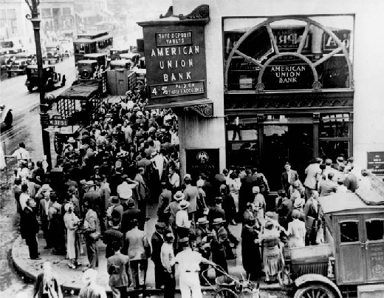
History of US banking
Bank Failures
  In a free market economy bank failure is a problem.
  Bank failure can cause a bank panic through imposing a negative externality on other banks
  In a bank panic depositors fear that other banks will fail as well. They rush to withdraw their deposits.
  This will cause even banks that are properly run to fail.

Slide 21
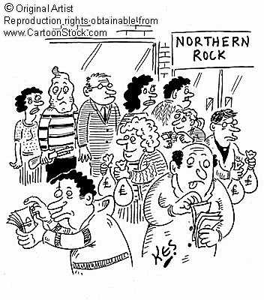
History of US banking
Bank Failures
  A bank failure affects other banks that normally would not have a problem.
  Banks that are properly managed will not be able to pay all depositors, i.e., banks are illiquid.
  As banks are forced to liquidate their assets, they do so at a loss which causes them eventually to fail.

Slide 22

History of US banking
Bank Failures
  FDIC is a US government corporation created by the Glass-Steagall Act of 1933.
  It was established to provide deposit insurance, currently up to $250,000, and prevent bank panics.

Slide 23
2. East Asian Financial Crisis
East Asian countries: Thailand, Korea, Malaysia, Indonesia and Philippines
High economic growth rates
This growth was largely driven by inflows of foreign investment

Slide 24
2. East Asian Financial Crisis
To encourage the flow of foreign investments the government adopted a fixed exchange regime.
The value of foreign investments would fall with a depreciation of the currency
A fixed exchange rate assures investors that this is unlikely

Slide 25
The Foreign Exchange Market
The market of the Philippine Peso
Demand for the peso is driven by demand for imports, or by FDI or by demand for financial assets
The increased capital inflows resulted in an appreciation of the domestic currency
$
S1
D
D
0

Slide 26
The Foreign Exchange Market
The market of the Philippine Peso
The government committed to keeping a fixed value for the peso
The overvalued currency will result in lower import prices which would help domestic producers that rely on imported inputs
$
S1
D
0

Slide 27
The Foreign Exchange Market
The market of the Philippine Peso
The peg results in a surplus of pesos
To keep the peg, the government has to buy the surplus pesos and supply dollars
The government needs a sufficient amount of dollar reserves.
$
S1
D
0

Slide 28
The Onset of the crisis
Large inflows of capital fueled by high interest rates and fixed exchange regime
Financial liberalization led to expanded lending to domestic investors and excessive risk taking resulting in loan losses
Weak financial regulation and supervision that cannot effectively limit moral hazards

Slide 29
The Onset of the crisis
High level of uncertainty due to
  A fall in stock prices
  Several corporations declared bankruptcy
  Burst of real estate bubble
Inability of central bank to act as a lender of last resort
Capital outflows as foreign investors lose confidence
Speculative attacks

Slide 30
The Currency Crisis
The market of the Philippine Peso
Capital outflows with increased uncertainty reduces the demand for pesos
Speculators selling pesos in anticipation of depreciation
The government was forced to devalue the currency, Thai baht, Indonesian rupiah, the Philippine peso and the Korean won collapsed in 1997.
$
S1
D
0

Slide 31
From the Currency Crisis to the Financial Crisis
Two features of the debt contracts
  Short term borrowing
  Foreign denominated debt:
    even healthy firms can be bankrupt as the value of their debt increases
    Deterioration in bank balance sheets: increase in bad debts resulting in a decline in its assets, and increase in liabilities as its debt multiplies
Financial system cannot channel funds to those with productive investment opportunities

Slide 32
US Financial Crisis 2007- ?
Housing prices increase during 2000-2005, followed by a levelling off and price decline
Increase in the default and foreclosure rates beginning in the second half of 2006
Collapse of major investment banks in 2008
Collapse of stock prices in 2008
An economy wide contraction in economic activity

Slide 33

US Financial Crisis 2007- ?
U.S. housing policies are the root cause of the current financial crisis. Other players-- “greedy” investment bankers; foolish investors; imprudent bankers; incompetent rating agencies; irresponsible housing speculators; short-sighted homeowners; and predatory mortgage brokers, lenders, and borrowers--all played a part, but they were only following the economic incentives that government policy laid out for them.
Peter J. Wallison

Slide 34
Identifying a Housing Bubble
In 2002 Dean Baker identified a housing bubble. From 1953 to 1995 house prices had tracked inflation, but from 1995 onwards house prices showed a marked deviation above inflation rates
However, it was hard to convince policy makers of the potential crisis and that action is needed

Slide 35
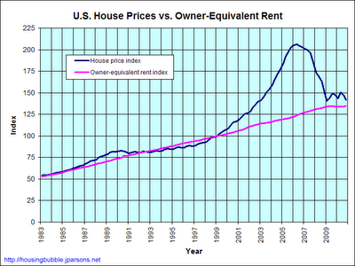
Identifying a Housing Bubble
Also Up to 2001 housing prices closely followed the equivalent rent
After 2001 housing prices far exceeded the equivalent rent

Slide 36
From the Housing Bubble to the Recession
Burst of the Housing Bubble
Homeowners defaulting on mortgages
Sudden reduction in assets of financial institutions resulting in their failure
Loss of wealth, credit crunch, reduction in investment, a recession

Slide 37
A Significant Impact on the Economy
Why did the housing bubble have a significant impact on the economy?
What contributed to the growth of the housing sector?
Government policies
Developments in the financial markets

Slide 38
Government Policies
Low interest rates
Erosion of lending standards
Deregulation of Fannie Mae and Freddie Mac

Slide 39
Government Policies
Low interest rates led to high demand for housing before the crisis
  Fed's prolonged Low-Interest Rate Policy of 2002-2004 increased demand for, and price of, housing.
  The low short-term interest rates made adjustable rate loans with low down payments highly attractive.
  Availability of finance to subprime borrowers and often with no down payment

Slide 40
Government Policies
Erosion of lending standards
  1995 regulations stemming from an extension of the Community Reinvestment Act required banks to extend loans in proportion to the share of minority population in their market area. Conventional lending standards were reduced to meet these goals.

Slide 41
Government Policies
Deregulation of Freddie Mac and Fannie Mae
  Fannie Mae and Freddie Mac hold a huge share of American mortgages. Misperception: supported by the US government
  In 1995, HUD required Fannie Mae and Freddie Mac to increase their holdings of loans to low and moderate income borrowers.
  In 1999 HUD required Fannie and Freddie to accept more loans with little or no down payment.
  From 2002 onwards these institutions became highly leveraged

Slide 42
Developments in the financial market
Development of shadow banking
Securitization of mortgages
Credit Default Swaps

Slide 43
Developments in the financial market
Development of shadow banking
  Refers to financial intermediaries , like Bear Stearns, Lehman Brothers, Goldman Sachs and Morgan Stanley, that perform a variety of services.
  They are not subject to regulations like banks since they do not accept deposits.
  Loans for residential housing could be leveraged by as much as 25 to 1, and as much as 60 to 1, when bundled together.

Slide 44
Developments in the financial market
Securitization of mortgages
  Fannie Mae, Freddie Mac and investment banks pooled housing mortgages and sold them as securities to the public. Rated AAA securities due to the sustained rise in housing prices

Slide 45
Developments in the financial market
Credit Default Swaps (CDS)
  A contract between two parties. The buyer makes periodic payments to the seller, and in return receives a compensation if an underlying bond or loan defaults. Used for speculative purposes besides hedging risk. CDSs bought to hedge the risk that mortgage backed securities fail, thus increasing the moral hazard problem.

Slide 46
Regulatory response
The federal takeover of Fannie Mae and Freddie Mac
Greater regulation of investment banks. Fed Chairman, Ben Bernanke, calls for liquidation of failing firms like Bear Stearns and correction of "moral hazard" in multi-party credit and default swaps.

