Slide 1
Oligopoly

Slide 2
BETWEEN MONOPOLY AND PERFECT COMPETITION
Imperfect competition refers to those market structures that fall between perfect competition and pure monopoly.
Imperfect competition includes industries in which firms have competitors but do not face so much competition.

Slide 3
Four Types of Market Structure
Number of Firms?
Many
firms
Type of Products?
One
Few
Differentiated
Identical
firm
firms
products
products
Monopolistic
Perfect
Monopoly
Oligopoly
Competition
Competition
•
Breakfast Cereal
•
Novels
•
Wheat
•
Cable TV
•
Crude oil
•
Movies
•
Milk

Slide 4
MARKETS WITH FEW SELLERS
Characteristics of an Oligopoly Market
    Few sellers offering similar or or identical products
    Interdependent firms
    Best off cooperating and acting like a monopolist by producing a small quantity of output and charging a price above marginal cost

Slide 5

A Duopoly Example:
A duopoly is an oligopoly with only two members. It is the simplest type of oligopoly.
We will look first at an example where two firms compete by choosing quantity.
This type of competition is called Cournot competition

Slide 6
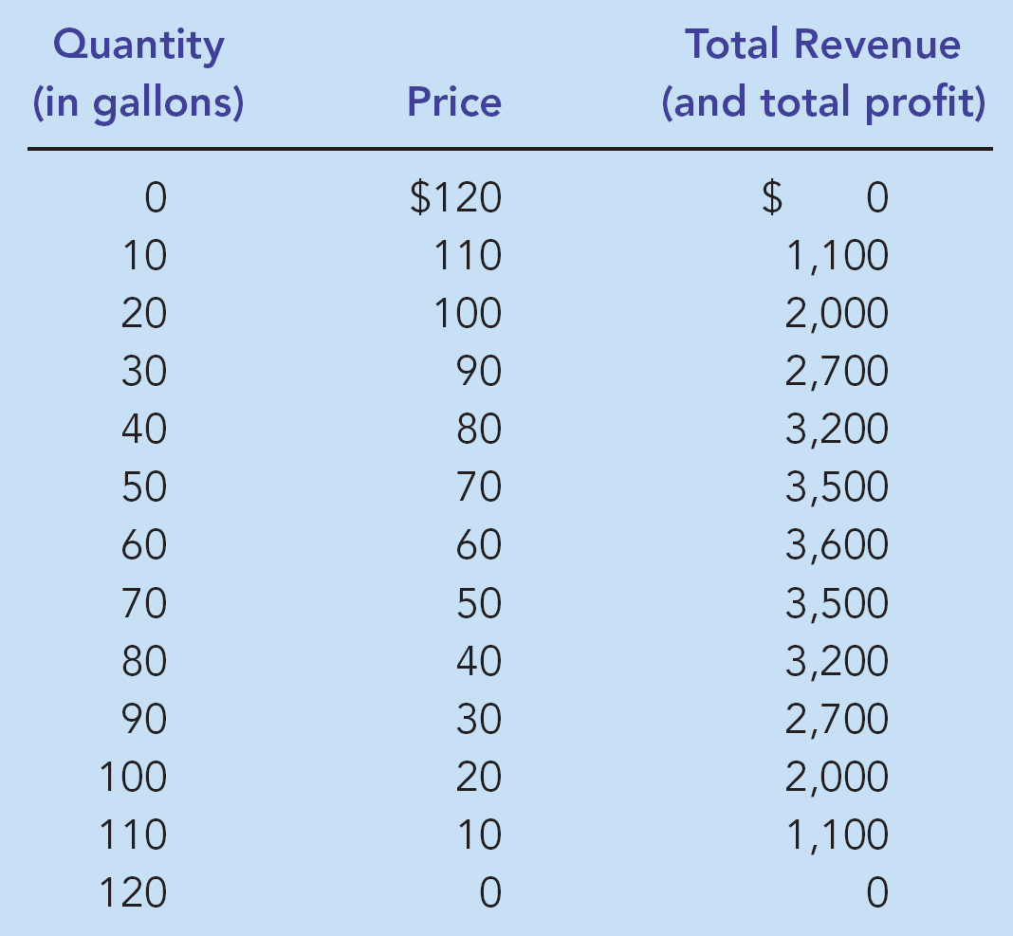
Demand for Water
Demand: P=120-Q
Assume that the cost of water is zero
How many units will be produced if this was a monopoly market?
PC market outcome

Slide 7
If a Monopoly Market…
The price and quantity in a monopoly market would be where total profit is maximized:
    P = $60
    Q = 60 gallons

Slide 8
What will the duopoly outcome be?
Demand: P=120-Q, where Q=q1+q2
Start from the monopoly equilibrium. Assume each firm produces 30.
Each gets half the monopoly profit
q1 | q2 | P | Firm profit
0 | 0 | 120 | 0
5 | 5 | 110 | 550
10 | 10 | 100 | 1000
15 | 15 | 90 | 1350
20 | 20 | 80 | 1600
25 | 25 | 70 | 1750
30 | 30 | 60 | 1800
35 | 35 | 50 | 1750
40 | 40 | 40 | 1600
45 | 45 | 30 | 1350
50 | 50 | 20 | 1000
55 | 55 | 10 | 550
60 | 60 | 0 | 0

Slide 9
Is this an equilibrium outcome?
Demand: P=120-Q, where Q=q1+q2
Assume firm 1 does not change its output. Does firm 2 benefit by increasing production?
q1 | q2 | P | Firm profit
0 | 0 | 120 | 0
5 | 5 | 110 | 550
10 | 10 | 100 | 1000
15 | 15 | 90 | 1350
20 | 20 | 80 | 1600
25 | 25 | 70 | 1750
30 | 30 | 60 | 1800
35 | 35 | 50 | 1750
40 | 40 | 40 | 1600
45 | 45 | 30 | 1350
50 | 50 | 20 | 1000
55 | 55 | 10 | 550
60 | 60 | 0 | 0
Firm 2’s profit=$ 2000
Firm 1’s profit=$1500
40
50
Yes. The monopoly outcome is not an equilibrium when there are 2 firms in the market

Slide 10
A Duopoly Example
The price and quantity in a duopoly market would be when no firm can gain by changing its output:
    P = $40
    q1= 40 gallons and q2= 40 gallons
    Firm profit= $1600, which is less than the profit each firm could have made if they split the monopoly output.
    Note that neither outcome is socially efficient

Slide 11
Bertrand Competition
Alternatively, firms may compete by choosing price instead.
The firm with the lowest price attracts all buyers.
What would the equilibrium price in this market be?

Slide 12
Cartels
The duopolists may agree on a monopoly outcome.
  Collusion
    An agreement among firms in a market about quantities to produce or prices to charge.
  Cartel
    A group of firms acting in unison.

Slide 13
GAME THEORY AND THE ECONOMICS OF COOPERATION
Game theory is the study of how people behave in strategic situations.
Strategic decisions are those in which each person, in deciding what actions to take, must consider how others might respond to that action.

Slide 14
GAME THEORY AND THE ECONOMICS OF COOPERATION
Because the number of firms in an oligopoly market is small, each firm must act strategically.
Each firm knows that its profit depends not only on how much it produces but also on how much the other firms produce.

Slide 15
Games
A game is comprised of players, strategies and payoffs.
Strategies refers to the set of actions for all possible outcomes.
Payoffs are the rewards to each player based on both players actions.

Slide 16

The Nash Equilibrium
A Nash equilibrium is a situation in which economic actors interacting with one another each choose their best strategy given the strategies that all the others have chosen.
Each agent is satisfied with (i.e., does not want to change) his strategy (or action) given the strategies of all other agents.
John Forbes Nash, Jr.
June 13, 1928 --

Slide 17
Example 1: Find the Nash Equilibrium.
Ann’ s Decision
right
left
Ann gets 8
Ann gets 10
Up
Jane’s
Jane gets 2
Jane gets 0
Decision
Ann gets 0
Ann gets 10
Down
Jane gets 0
Jane gets 6

Slide 18
Example 2: Coordination game
Ann’ s Decision
Ballet
Opera
Ann gets 8
Ann gets 0
Ballet
Jane’s
Jane gets 8
Jane gets 0
Decision
Ann gets 0
Ann gets 10
Opera
Jane gets 0
Jane gets 10

Slide 19
Example 3: The Prisoners’ Dilemma
The prisoners’ dilemma provides insight into the difficulty of maintaining cooperation.
Often people (firms) fail to cooperate with one another even when cooperation would make them better off.

Slide 20
The Prisoners’ Dilemma
The prisoners’ dilemma is a particular “game” between two captured prisoners that illustrates why cooperation is difficult to maintain even when it is mutually beneficial.

Slide 21
The Prisoners’ Dilemma
Two people committed a crime and are being interrogated separately.
The are offered the following terms:
  If both confessed, each spends 8 years in jail.
  If both remained silent, each spends 1 year in jail.
  If only one confessed, he will be set free while the other spends 20 years in jail.

Slide 22
The Prisoners’ Dilemma Game
Ben’ s Decision
Confess
Remain Silent
Ben gets 8 years
Ben gets 20 years
Confess
Kyle’s
Kyle gets 8 years
Kyle goes free
Decision
Ben goes free
Ben gets 1 year
Remain
Silent
Kyle gets 20 years
Kyle gets 1 year

Slide 23
Dominant Strategy
A dominant strategy is a strategy that is always a best response (i.e., does better) to all the opponent’s possible actions.
If a player has a dominant strategy then he will choose it in equilibrium
Not all games have dominant strategies

Slide 24
Does Kyle have a dominant strategy?
Ben’ s Decision
Confess
Remain Silent
Ben gets 8 years
Ben gets 20 years
Confess
Kyle’s
Kyle gets 8 years
Kyle goes free
Decision
Ben goes free
Ben gets 1 year
r
Remain
Silent
Kyle gets 20 years
Kyle gets 1 year
Confessing is a dominant strategy for both players

Slide 25
Does Kyle have a dominant strategy?
If Ben confesses, Kyle is better off confessing
If Ben does not confess, Kyle is better off confessing
Kyle is better off confessing regardless of what Ben does.
Therefore, Kyle has a dominant strategy to confess

Slide 26
The Nash Equilibrium
Ben’ s Decision
Confess
Remain Silent
Ben gets 8 years
Ben gets 20 years
Confess
Kyle’s
Kyle gets 8 years
Kyle goes free
Decision
Ben goes free
Ben gets 1 year
r
Remain
Silent
Kyle gets 20 years
Kyle gets 1 year

Slide 27
Is the equilibrium outcome optimum for the prisoners?
Ben’ s Decision
Confess
Remain Silent
Ben gets 8 years
Ben gets 20 years
Confess
Kyle’s
Kyle gets 8 years
Kyle goes free
Decision
Ben goes free
Ben gets 1 year
r
Remain
Silent
Kyle gets 20 years
Kyle gets 1 year
If they both cooperate to remain silent they can be better off

Slide 28
Oligopolies as a Prisoners’ Dilemma
Self-interest makes it difficult for the oligopoly to maintain a cooperative outcome with low production, high prices, and monopoly profits

Slide 29
Jack and Jill’s Duopoly Game
Jack’s
Decision
High Production: 40 gal.
Low Production: 30 gal.
Jack gets $1,600 profit
Jack gets $1,500 profit
High
Production
40 gal.
Jill’s
Jill gets $1,600 profit
Jill gets $2,000 profit
Decision
Jack gets $2,000 profit
Jack gets $1,800 profit
Low
Production
30 gal.
Jill gets $1,500 profit
Jill gets $1,800 profit

Slide 30
Jack and Jill Price War Game
Jack’s
Decision
Low Price
High Price
Jack gets $160 profit
Jack gets $0 profit
Low
Price
Jill’s
Jill gets $160 profit
Jill gets $300 profit
Decision
Jack gets $300 profit
Jack gets $180 profit
High
Price
Jill gets $0 profit
Jill gets $180 profit

Slide 31
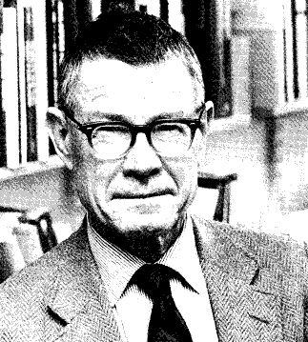
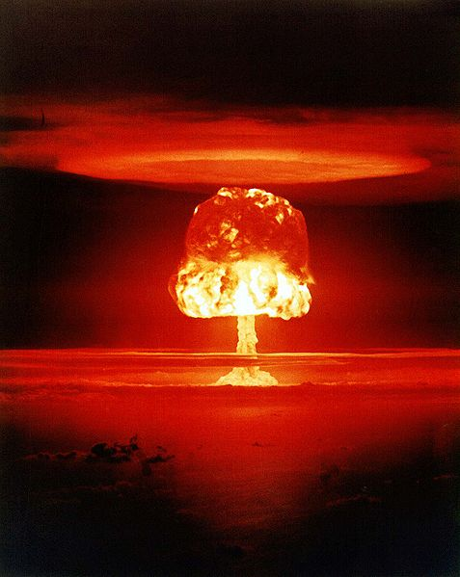
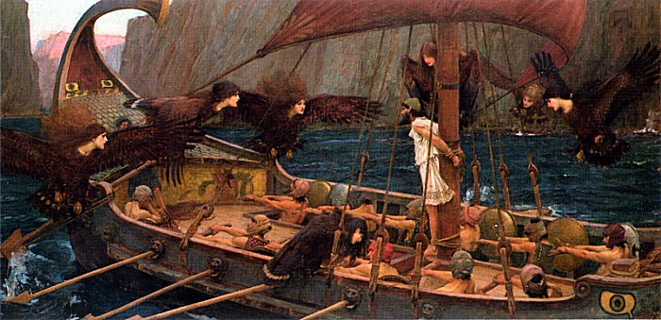
Credible Commitment
To make a threat (promise) credible, a player must make an irreversible commitment that changes his or her incentives or constrains his or her action
Ulysses and the Sirens.
The Doomsday Device.
Thomas C. Schelling, 1921-
Hypothetical doomsday device
Ulysses and the Sirens by John William Waterhouse
(British, 1849-1917), National Gallery of Victoria, Melbourne, Australia.
Notes:
30

Slide 32
Jack and Jill Price War Game
Jack’s
Decision
Low Price
High Price
Jack gets $160 profit
Jack gets $0 profit
Low
Price
Jill’s
Jill gets $160 profit
Jill gets $300 profit
Decision
Jack gets $300 profit
Jack gets $180 profit
High
Price
Jill gets $0 profit
Jill gets $180 profit

Slide 33
Facilitating Practices
Firms can commit to:
  Most Favored Customer treatment: if a firm offers a low price to one customer it has to do so to all other customers.
  Match Prices: if a competitor offers a lower price, the firm matches it.
These commitments are credible and facilitate collusion

Slide 34
How can firms cooperate?
Firms that care about future profits will cooperate in repeated games rather than cheat to achieve a one-time gain
Regulation can sometimes facilitate collusion (there is one example in the readings). In that case the government commits firms to (or forbids them from) certain actions

Slide 35
PUBLIC POLICY TOWARD OLIGOPOLIES
Although firms in an oligopoly market would like to form cartels to earn monopoly profits, often it is not possible.
Antitrust laws prohibit explicit agreements among firms.
Cooperation among firms is undesirable from the standpoint of society as a whole because it leads to production that is too low and prices that are too high.

Slide 36
Restraint of Trade and the Antitrust Laws
Antitrust laws make it illegal to restrain trade or attempt to monopolize a market.
  Sherman Antitrust Act of 1890
  Clayton Antitrust Act of 1914

Slide 37
Controversies over Antitrust Policy
Antitrust policies sometimes may not allow business practices that have potentially positive effects:
  Resale price maintenance
  Predatory pricing
  Tying

Slide 38
Controversies over Antitrust Policy
Resale Price Maintenance (or fair trade)
  occurs when suppliers (like wholesalers) require retailers to charge a specific amount
Predatory Pricing
  occurs when a large firm begins to cut the price of its product(s) with the intent of driving its competitor(s) out of the market
Tying
  when a firm offers two (or more) of its products together at a single price, rather than separately

Slide 39
The FTC and the
Effectiveness of Cigarette Advertising Regulations
The public’s interest?
Historically
  1953: Sloan-Kettering report
  1955: voluntary advertising guidelines
  1960: FTC applied guidelines to tar and nicotine content
  1962: report showing filtered cigarettes are safer
  1966:FTC exempts claims on tar and nicotine content
  1971: broadcast ban

Slide 40
The FTC and the
Effectiveness of Cigarette Advertising Regulations
Effect of advertising ban on:
  Information provision
  Filtered/safer cigarettes sales
  Competition

