Slide 1
Challenges Facing Cities Worldwide

Slide 2
America’s Urban Origins
Cities played a different role in the 18th, 19th and 20th centuries
Technological change has been an important factor in determining the role and importance of cities across time

Slide 3
America’s Urban Origins
Significance of getting access to raw materials and getting goods to markets
Cities grew around transport hubs. Major cities were on waterways

Slide 4
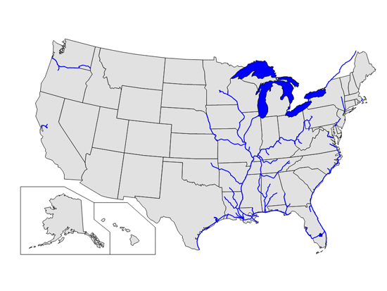
America’s Urban Origins

Slide 5
America’s Urban Origins
Boston:
  development of an export sector, where basic commodities were traded with the south
  Growth in the beginning of the 19th century due to its stock of mercantile and sailing knowledge
  A major port due to the development of the hub and spoke shipping system as ships grew larger

Slide 6
America’s Urban Origins
New York:
  Was larger than Boston by 1790.
  Better access to a network of rivers, deep water ports, direct access to the sea, less ice water
  Natural hub for the cross Atlantic trade

Slide 7
Manufacturing
The advent of the industrial revolution brought manufacturing to cities
  From small workshops to centralized factories
  Examples: garment industry in New York and Cars in Detroit
  Growth of cities through mainly the creation of unskilled jobs
  Goods were shipped to markets through rivers or railroads

Slide 8
Exodus of Urban Manufacturing
By mid 20th century, manufacturing left US cities
Introduction of trucks and cars
Firms locating in suburbs for cheaper land and labor
Established modes of production meant reduced returns to knowledge and reduced the importance of proximity
Globalization
Most US cities troubled

Slide 9
Exodus of Urban Manufacturing
By 1975 major US cities looked troubled
Loss of jobs
Exodus of the middle income
Weak tax base
Higher crime rate
Reduction in urban amenities

Slide 10
What role can US cities play?
Produce goods or produce ideas?
Comparative advantage?
The rise of the skilled city

Slide 11
Death of Distance
Rise of Los Angeles
  Weather advantage not proximity to ports or rivers
  Development of trucks, planes automobiles
  Agglomeration of smart people
  Developed around the car
  Relatively less dense (sprawl)
Decline of Detroit
  Reduced significance of location
  Exodus of urban manufacturing
  Urban decline and social distress

Slide 12
The skilled city
Rise of the skilled city:
  Location advantage less significant with the death of distance
  Skill level is a predictor of economic success
    Share of adult population with college degrees
  Attract smart people to a given location to generate ideas, e.g., New York
    Interaction between academia and practitioners
    Better techniques to evaluate risk
    Development of financial instruments, e.g., MBS
  Universities play an important role in idea generation
    E.g., Silicon Valley

Slide 13
Globalization and the skilled city
Globalization has two effects on the role of cities
  Decline in manufacturing city: developing countries have a comparative advantage in manufacturing goods
  Rise of the skilled city: return to ideas increases since they will be used worldwide. This creates incentives for the skilled to locate with other skilled people

Slide 14
Importance of Proximity
Since proximity is important
  to idea generation:
    Centralization of idea generation within a firm
    Agglomeration of firm in one location
  To consumption of services
    E.g., legal, health care education
    Will technological innovation in communication reduce the need for proximity?

Slide 15
Barry Bluestone, “The Struggle for Skilled Workers”
Main point/ Questions raised
Policy prescription/ Solution
Key words:
  Aging
  Affordable housing
  Jobs
  What is the relationship between them?

Slide 16
1. The Wonder and Paradox of Urban Life
Advantages and disadvantages of cities
Advantages and disadvantages of suburbs

Slide 17
Density and Externalities
Metropolitan areas function in ways that are different in Kind not just of degree
Externalities are more prevalent

Slide 18
Metropolitan Dynamics
How to explain the death of cities?
  Demographic shifts
  Industrial transformation
  Spatial Relocation
  Public Policy
Self reinforcing effects generate extreme outcomes

Slide 19
2. The Micro Empirics of Agglomeration
Concentration of economic activities
Concentration of individual industries
  Mature vs. developing industries
Questions:
  What industries offer agglomeration economies?
  How widespread geographically?
  Does the effect of agglomeration economies depend on firm size?

Slide 20
A city’s size and diversity contributes to agglomeration economies through:
  Domestic complementarity (mining and textile)
  Risk reduction

Slide 21
Empirical Analysis
Several economists tried to test the existence of agglomeration economies:
Production function:
Y=g(A).f(l,n,m,k)
where l,n,m and k represent land, labor, materials and capital
A: environment, city size or industry size

Slide 22
Empirical Results
Henderson (1986), Nakamura(1985) and Moomaw (1983) find stronger evidence for localization economies than for urbanization economies
Glaeser and Mare(2001) estimate urbanization economies by examining the urban wage premium
Rosenthal and Strange(2003) examine the location decision of new firms
Difficult to be certain about causality
Agglomeration economies attenuate with distance
Some industries more sensitive than others

Slide 23
Policy Implications
Different aspects of a location matter to different industries
Attracting a critical mass
Threats to leave a cluster are empty

Slide 24
1968: US Cities in decline?
Manufacturing jobs leaving the city
Urban poor trapped in the city
Highway expansion and the exit of the middle class
Weak tax base
Limited educational opportunities for inner city children
Weaker police presence
Higher crime rates

Slide 25
Making Cities Work
Manufacturing city to idea driven city
Efficient transportation
Consumer city and amenities
Housing
Urban Poverty
Immigration and labor skill

Slide 26
4. Glaeser, Death and Life of Cities
Growing and dying cities
U(wage, Amenities, Housing)
Wages increase due to agglomeration economies
Sources of agglomeration economies:
  Reduced transportation costs due to proximity
  Innovation due to proximity to others
Will innovation in communication reduce the importance of proximity?

Slide 27
3.City Prospects, City Policies
The importance of cities in the high speed communication age
Proximity provides
  Face time communication in specialized production
  Efficient consumption of services e.g., legal, health, education
  Opportunities for innovation
  Opportunities to meet new people
Innovation in commuication changes the benefits from proximity and the effect on proximity is ambiguous

Slide 28
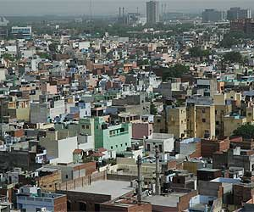
Urbanization and the Less Developed Countries

Slide 29
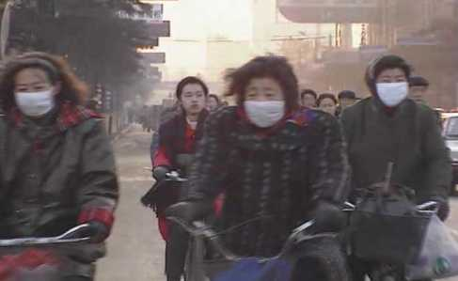
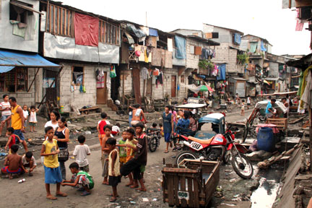
Urbanization in the developing world
Urbanization: the increase in the population share living in urban areas
Division: Traditional/rural sector vs. Urban/ modern sector
Perception: Urbanization going too fast
  Prevalence of pollution, congestion and crime problems

Slide 30
Successful Examples
East Asian Cities in India, China and Korea
  Sriperumbudur
    Small village to a city of 100, 000
    Hyundai produced one million cars there
  Shenzen
    Fishing village to a city of 7 million
    Great port
  Seoul
    Slum ridden place to a city of 7 million
    Largest originator of patents after US, Germany, Japan and Taiwan by 2006

Slide 31
Questions
Why do people migrate from rural to urban areas?
Is the urbanization rate in LDCs optimal?
Should the government control rural to urban migration?
What are some successful urbanization strategies?
How does globalization affect cities in developing countries?

Slide 32
Stylized facts about urbanization
Demographic transition
  High birth and death rates – low migration
  High birth and low death – high migration
  Low birth and low death – low migration
About 40% of urban growth due to migration, the rest due to natural causes
Migration due to better economic opportunities
Improvement in Agricultural productivity requires less workers on farms
Urbanization is the road to economic progress
Most urbanization happens before a country gets to $5000 per capita income
urbanization places a large financial burden on urban governments

Slide 33
Urbanization DCs vs LDCs
Today’s urbanization is not unprecedented, followed a similar pattern in DCs 1750 to 1950 (First Wave):
  Decline in death rates
  Decline in rural population
However, urbanization in LDCs is different from the past experience of DCs in the following
  Faster
  Larger population
  Lower income levels
  Fewer opportunities to colonize new frontiers

Slide 34
Is the current rate of urbanization inefficient?
The pattern of urbanization in LDCs regarded with dismay:
  Misguided entrepreneurs that concentrate generation of output
  Rural migrants who overestimate the income opportunities, misguided by the bright lights of the city
  High demand for urban infrastructure that could cheaply be provided elsewhere

Slide 35
Urban Size in LDCs
The theoretical literature is limited
Identify externalities in migration decision
  Individuals ignore the external cost of their migration
  Cities tend to be large
  Effect magnified by political access and political power of the urban masses that subsidizes urban living

Slide 36
What policies?
What are some policy responses of the leaders of LDCs?
  Limit size of urban areas
  Control migration
  Limit the provision of urban infrastructure
  Eliminate slums
What should a successful urbanization strategy do?

Slide 37
What is Good about Slums?
Cities as places of inequality and deprivation??
Urban Poverty represents the transition from rural to urban prosperity
Cities attract rural poor
Mega cities are not too big and limiting their growth would cause more harm than gain
Policy makers should not attempt to eliminate slums but rather allow the poor access to urban opportunities

Slide 38
What is Good about Slums?
Migration stresses urban infrastructure, but
  Migrants bring new ideas (external gains)
  Migrants realize private gains
Ghettos in America
  19th century
  Irish immigrants and African American
  Walls barring people access to the city
  Segregation persists

Slide 39

The Mystery of Capital
Challenges facing less developed countries :
  Poverty per se not the problem
  Property not owned in a way to generate value
  Weak legal system that cannot define ownership over assets
  Economy resembles the Wild West
Industrial revolution and the rural urban migration
  Immigrants faced walls that barred them from legality
  Becoming legally recognized is costly and time consuming
Hernando De Soto
Soto, H. (2000). The Mystery of Capital. Basic Books

Slide 40
Dead Capital
Capital is created through saving or borrowing
While the benefit from capital investment (in terms of production created over time) can exceed the cost, lenders are reluctant to lend money for capital investment in the absence of a collateral
In developed countries, assets (or properties) lead two parallel lives. They serve an immediate purpose and they act as collateral for loans
In developing countries assets can not create capital because of undefined property rights.
The result is $9.3 trillions in dead capital
Soto, H. (2000). The Mystery of Capital. Basic Books

Slide 41
Informal Ownership
Why not have a property rights system?
Government bureaucracy makes it costly for individuals and businesses to obtain legal property rights
The high cost of access to the legal system results in the poor operating in the extralegal system where land and goods are owned informally
Soto, H. (2000). The Mystery of Capital. Basic Books

Slide 42
Extra Legal Sector
Extra legal businesses refers to those that are pushed to the underground economy.
Extralegal businesses suffer because of
  Inability to grow by selling shares
  High risks – no limited liability, no insurance
  Inability to use property as collateral for loan
  Distorting incentives to invest
  Many businesses operating at a small scale and thus unable to benefit from economies of scale
Soto, H. (2000). The Mystery of Capital. Basic Books

Slide 43
Unsuccessful Examples
The Arab Countries
  Population doubled between 1980 and 2010
  High rates of urbanization
  Corrupt governments and weak institutions

Slide 44
Brief overview of Egypt
Gained independence from the British rule in 1952
Military rule 1952- 2011
Corrupt rulers and politicians: very limited competition on the political front
Deterioration in living conditions especially for the poor
Growing gap between the rich and poor

Slide 45
Arab Spring
A result of frustration with urban policies
Started in Tunisia and spread to other countries in the region, e.g., Syria, Yemen, Libya, Saudi Arabia and Bahrain
Revolution controlled in Saudi Arabia and Bahrain
President ousted in Egypt, Tunisia, Libya and Yemen

Slide 46

Democratic Government
Egypt builds a civilian/ democratic government:
  Election of a new president, Muhammad Morsi
  Involving all different segments of society in writing the Constitution
  Electing Parliament members was in progress
Egypt combats corruption and seeks reform
  Re electing cabinet members
  Previous government and affiliated businessmen were put to trial for corrupt practices
  Economic and political reform

Slide 47
Military Coup June 2013
Deep roots of the old corrupt regime
  Remnants of the old regime
  Allies of the old regime controlling the media
Foreign interests in bringing down the democratic regime
  Fear that the liberation and reform spread to other countries, e.g., United Arab Emirates and Saudi Arabia
  Powerful businesses men would lose a lot from enforcing the law
  Fear that an Islamic state flourishes

Slide 48

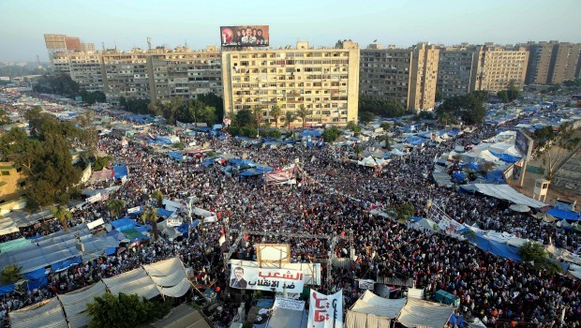
Rabi3a
Supporters of the democratic government gathered in Rabi3a Square (Rabi3 in Arabic means four)

Slide 49
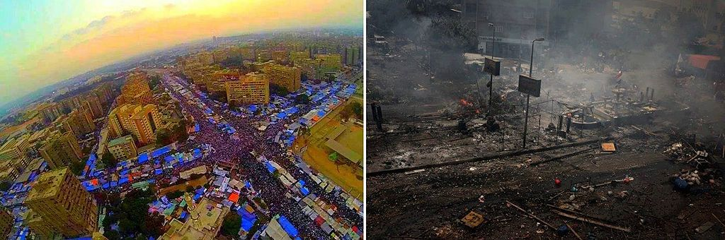
Rabi3a
About 2.5 million people for more than a month
The military officers decided to clear this cite of protestors

Slide 50
Rabi3a
2600 people were killed on August 14 the deadliest day in Egypt’s history
  Peaceful protestors including women, children and old people were bombed
  Some of the injured protestors were burnt alive others were denied any medical care by hospitals
According to the Human Right Watch this was “the most serious incident of mass unlawful killing in modern Egyptian history”

Slide 51
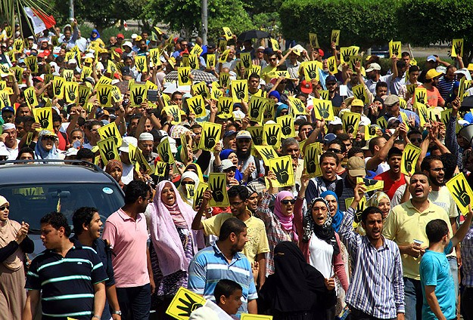
The Revolution Continues
Democracy for Egypt

