Slide 1
Part 2
Housing Policies

Slide 2
Outline
Why is housing different?
Inefficiencies in the housing market
The effect of the housing market on
  Urban development
  Segregation
  Job Access
  Sprawl
  Environment
The Rise of the suburb

Slide 3
Outline
Housing Policies targeting
  low income households
    Public Housing
    Vouchers
    Supply side incentives
  Middle and High income households
    Promoting homeownership
Effectiveness of housing policies

Slide 4
How is Housing different?
A lot of wealth tied up in housing; value of US housing stock $11 trillion in 2000
Durable: provides services over years
Deterioration rate depends on maintenance and repair decisions
Costly Moving: Households adjust their housing consumption when gap between ideal and actual housing consumption is large enough

Slide 5
How is Housing Different
A house as a bundle of attributes
  size, layout, neighborhood, quality of interior and exterior.
Housing stock is highly heterogeneous: dwellings differ in size, age, style, features, location
Inefficiencies in housing market:
  Imperfect information
  Heterogeneous stock

Slide 6
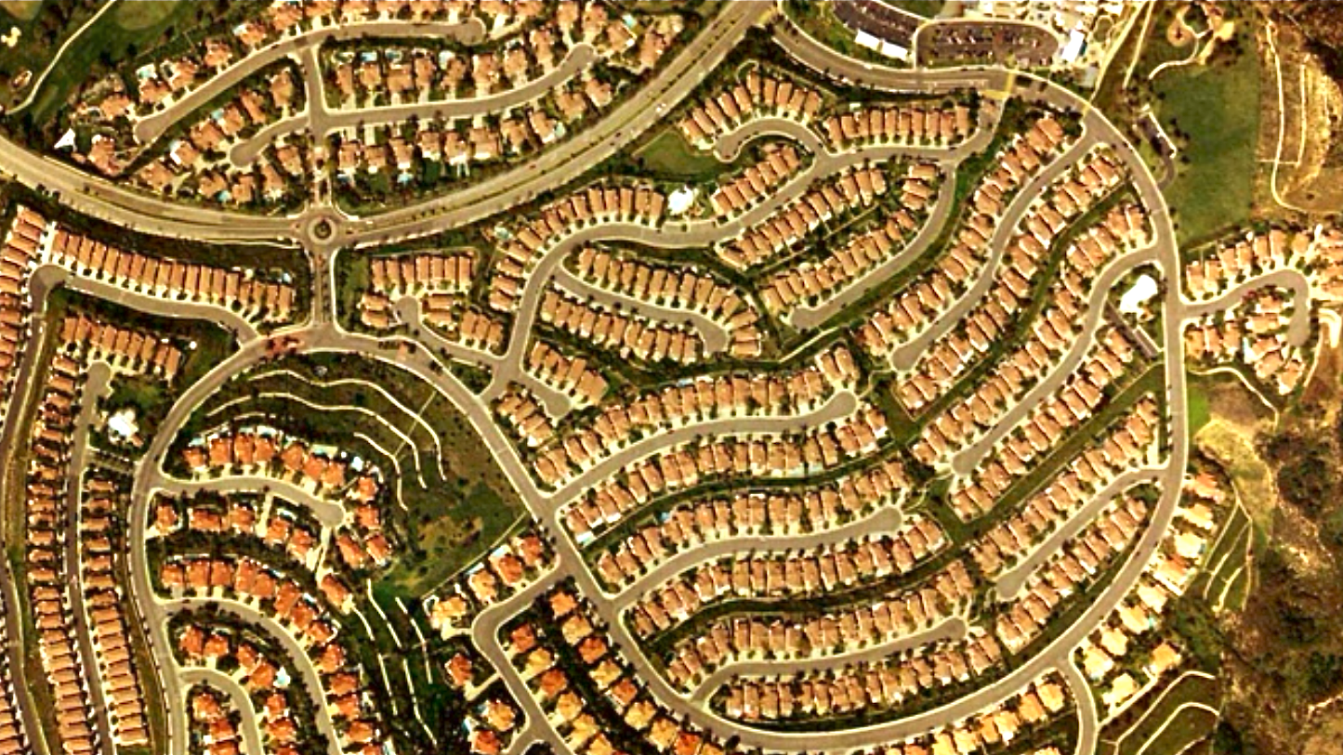
Rise of the Suburb

Slide 7
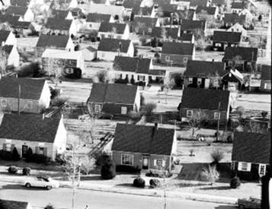
the Suburb: facts
Suburbs – An outlaying district of a city, generally a residential one
First came into prominence after WW2
1890- 1940 home ownership rate 44% to 48%

Slide 8
the Suburb: facts
In the 1960 homeownership rate 62%

Slide 9
Rise of the Suburb: why?
Demographic changes after WWII
  Increase in household savings; limited goods to buy and available over paying jobs
  Soldiers Came Home, increase in family size; baby boomers
  76 Million births between 1946 to 1964
  Family size increased reaching 3.77 children per family
  This generation is about to start retiring, which will effect current and future housing policy

Slide 10
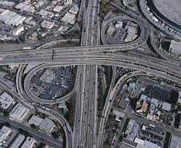
Rise of the Suburb: Why?
Availability of complementary goods
  Increasing Automobile Ownership
  Improved Highway system
  Interstate Highway System (Federal-Aid Highway Act of 1956)
1905 | 8,000
1915 | 2,332,426
1925 | 17,481,001
1935 | 22,567,827
1945 | 25,793,493
1955 | 52,135,583
1975 | 106,713,000
U.S. Automobile Registrations by Year

Slide 11
Rise of the Suburb: Why?
The government promoting homeownership
  Rationale:

Slide 12
Rise of the Suburb: Why?
The government promoting homeownership
  Mortgage subsidy
  National Housing Act of 1934
    Established Federal Housing Association
    Insures lenders allowing people to own with favorable loan terms
  Servicemen's Readjustment Act of 1944 (GI Bill)
  Housing Act of 1949
    Broadened the role of FHA

Slide 13
Segregation
What is the extent of segregation in US metropolitan areas?
To what extent is segregation driven by underlying discriminatory practices?
How did it change over time?
What role did housing policies play?
Why is an integrated society more desirable?
Will segregation lead to the death of cities?

Slide 14

Segregation and Homeownership
Minority groups had limited access to financial markets thus homeownership for minorities lagged behind. In 2003
  Whites 72%
  Blacks 48%
  Hispanics 46%
This can be explained by
  income differences
  Zoning regulations and restrictive covenants
  racial discrimination and business practices of real estate companies and mortgage lenders

Slide 15
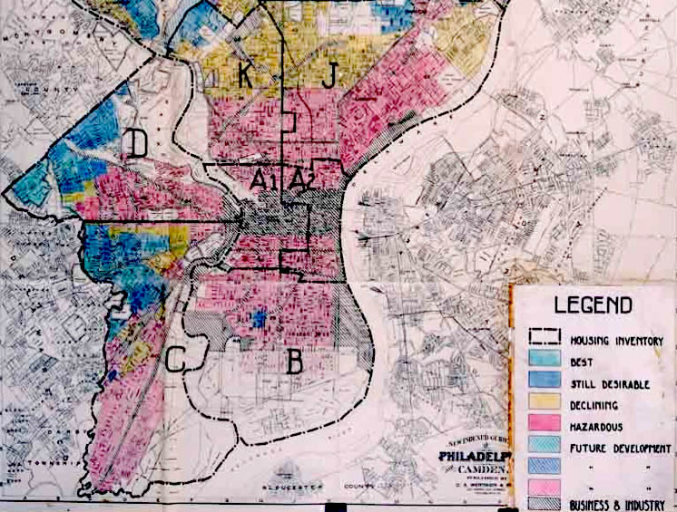
Redlining
The practice of denying, or increasing the cost of loans and mortgages, to residents in racial neighborhoods
Red areas on the map indicated less secure areas for banks to invest in.
Many minority groups in cities were ineligible to receive financing.
The maps were based on assumptions about the community, not individuals

Slide 16
Redlining
The Fair Housing Act of 1968 and the Community Reinvestment Act of 1977 were both enacted in an effort to combat this practice

Slide 17
Restrictive covenants
Zoning regulations and restrictive covenants have limited minority access to suburbs
  racial discrimination
  business practices of real estate companies

Slide 18

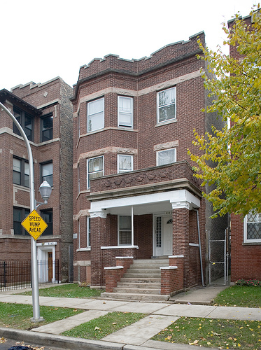
Hansberry vs Lee
Hansberry’s father was a wealthy, real estate broker in segregated Chicago
In 1937, her father purchased a home in the Washington Park Subdivision
  Washington Park had a restrictive covenant that said no black person could live in or own a home in the subdivision
Washington Park fought Hansberry and they went to court in 1937

Slide 19

Hansberry vs Lee
Judge orders the Hansberry’s eviction on August 19, 1938
Hansberry appeals to the Supreme Court of Illinois
The case of Hansberry, et al vs. Lee, et al goes all the way to the Supreme Court of the United States on October 25, 1940
  The U.S. Supreme Court deems restrictive covenants non-existent

Slide 20
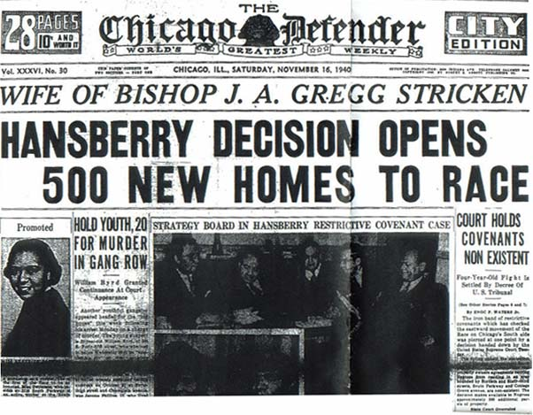
“Hansberry Decision Opens 500 New Homes to Race”
The Chicago Defender, Saturday, November 16, 1940

Slide 21
History of Racial Segregation
Segregation of African Americans is higher than that of any other group.
The great migration of African Americans from the rural south to the northeast and Midwest
By 1970 the population of African Americans reached 4 million and segregation increased
Moved into predominantly African American neighborhoods
Price premium in African American neighborhoods until 1970

Slide 22
History of Racial Segregation
Realtors often exploited the price difference using “Block busting”
Studies from 1970 tend to find little evidence of price premium in African American neighborhoods
Gradual improvements for minorities during the last few decades

Slide 23
The Rise and Decline of the American Ghetto
Cutler, Glaeser and Vigdor (1999) investigate the causes of white black segregation:
  Ghettos as an adjustment mechanism for migrants. Since 1970 black migrants from the South are 10 percent more likely to belong to an all-black church than native Northern blacks, and are 24 percent more likely to prefer a segregated neighborhood
  Collective action racism: such as restrictive covenants, racial zoning, policy instruments, and threats of violence which were widespread before 1960. The authors find a much higher use of restrictive real estate covenants in cities that are more segregated.
  Decentralized racism: in which whites simply pay more to live in areas with other whites; a privilege that is worth more to whites than to blacks. This explains the persistent segregation we experience today decades after equal housing laws were enacted.

Slide 24
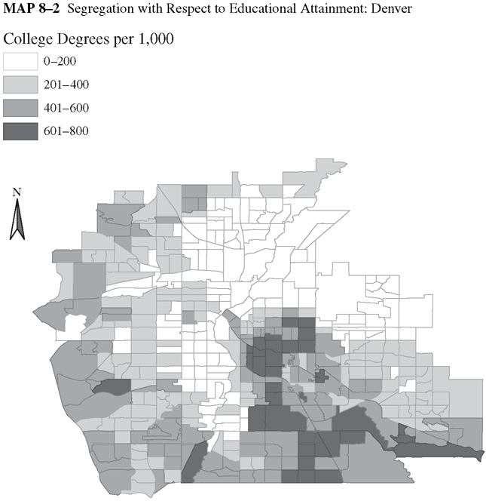
segregation
Educational Attainment in Denver by census tract
Are census tracts for each attainment class clustered or randomly distributed?

Slide 25
Diversity versus Segregation
Household differ in
  Income
  Race
  Ethnicity
  Education
A diverse neighborhood: different households have an equal representation.
Segregated neighborhoods: a given type of household is a majority.

Slide 26
A model of segregation
Externalities from proximity to the “preferred” group (high income):
Kid Imitation
  Positive adult role models for kids
  Classmates in school: focused vs. disruptive
Adult externalities:
  Job information
  drug use
Positive externalities increase with income and education level.
Who gets the desirable neighbors?

Slide 27
A Model of Neighborhood Choice
Two neighborhoods differ in their income mixes
All households prefer high income neighborhoods
Households compete by bidding for land and housing
Model setup
  Two neighborhoods, each with 100 lots
  Two income groups (high and low), each with 100 households
Only difference between neighborhoods is income mix.

Slide 28
A Model of Neighborhood Choice
High income
Low income
Neighborhood A
Neighborhood B
Because the neighborhoods have an identical mix of high and low income households, rent in A=rent in B

Slide 29
Rent Premium
Rent premium for A=rent in A- rent in B, is defined as the extra amount of rent a household is willing to pay for neighborhood A,
Rent premium with 50-50 mix will be zero since both neighborhoods are identical.
Rent premium increases with the number of high income households

Slide 30
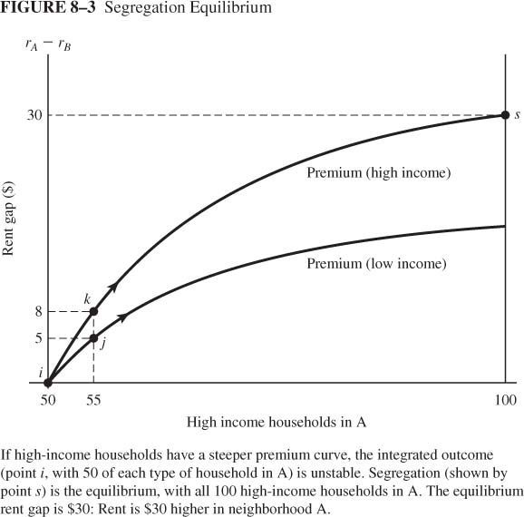
Premium Curves
Point j: Premium of low-income household (55 high, 45 low) = $5
Point k: Premium of high-income household (55 high, 45 low) = $8
The premium curve for the high income household is higher than that of the low income household

Slide 31
Unstable equilibrium
Equilibrium requires that everyone in the same neighborhood pay the same rent.
Point i is an integrated equilibrium since households pay the same amount for each neighborhood
Point i is unstable equilibrium since a movement of population will generate a different equilibrium

Slide 32
Segregated Equilibrium
The premium for the high income is higher than that for the low income household.
High income households outbid low income households so that they displace low income households in area A
This increases the mix of high income households moving away from point i
Point s is the new equilibrium with segregated neighborhoods. Self Reinforcing Effects lead to extreme outcomes

Slide 33
Segregated Equilibrium
High income
Low income
Neighborhood A
Neighborhood B
All high income households locate in one neighborhood

Slide 34
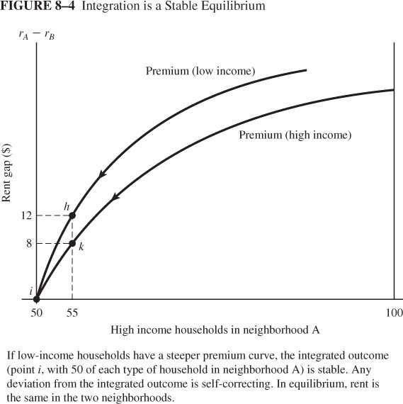
Integrated Equilibrium
We get a stable integrated equilibrium if the premium curve for the low income households is steeper than that of the high income households

Slide 35
Housing Policy
Low-Income Housing Policy: $30 billion per year
    Supply side policies: Public housing, subsidized private housing, low income housing tax credits
    Demand side policies: vouchers
Middle and High income housing: $66 billion per year to subsidize home ownership

Slide 36
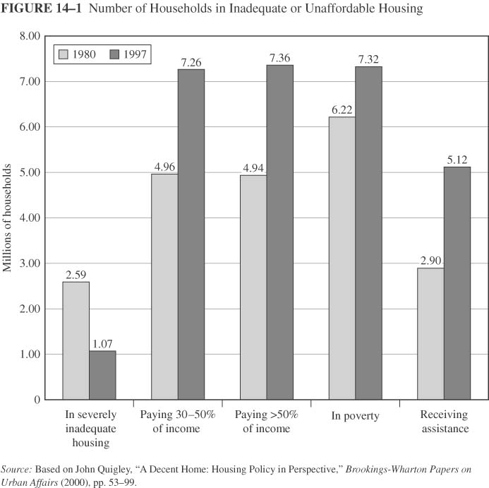
Inadequate or Unaffordable Housing
Affordability is more frequent problem
Source of the affordability problem:
  Poverty
  Imperfection in housing market
Overall, 30% of eligible households receive assistance

Slide 37
Housing and Poverty
“Having a safe, stable place allows people to work on their other problems. You can’t improve your life if you’re living out of a shelter, checking in and out every day, sleeping with bedbugs, having your things stolen, and possibly experiencing sexual or physical violence—those aren’t optimal conditions for finding and keeping a job or stabilizing mental illness. Recent evidence from Seattle shows that people who move from the street into stable housing do improve their lives—for example, they may start drinking less.” (The Urban Institute,2009)

Slide 38
Low Income Housing Policy
I. Public Housing
The government acts as a supplier of low income housing
About 1.3 million households
The budgetary cost about $7 billion in subsidies and maintenance
Managed by local housing authorities
Rent no greater than 30% of recipient income

Slide 39
Public Housing and Recipient Welfare
Evaluate the efficiency of public housing programs: Can the same welfare level be achieved at a lower cost?
Assumptions and numbers
  Income = $800
  housing price = $1 per unit of service
  Rent on public housing = 30% of income

Slide 40
Without Public Housing
Indifference curves of a typical household
Budget line
All Other Goods
800
500
i
Without public housing:
Point i maximizes initial utility: (h = 300; A = $500)
300
800
Quality of Housing

Slide 41
Public Housing An Option
The government offers housing service=540 at a price equal to 30% of income
Rent is 30% of income = 0.3* 800=$240
A = $800 - $240 = 560
Public housing adds point j to budget set
Is the consumer better off? Higher utility: U1 > U0
All Other Goods
800
560
j
500
i
U1
U0
300
540
800
Quality of Housing

Slide 42
Value of public housing to recipient
An alternative: a cash transfer
How much money would make him indifferent to the public housing?
Income Cash transfer of $200 gets recipient to U1
Same utility level but less housing (360) and more other ($700)
Subsidy = $300 = $540 (market value of 540-unit dwelling) - $240 rent
Value to recipient ( $200) is 2/3 of subsidy, consistent with studies
1000
All Other Goods
800
k
640
j
560
i
500
U1
U0
300
360
540
800
Quality of Housing

Slide 43
public housing FACTs
Facts:
  Located in neighborhoods with low median incomes, disproportionate share of minorities
  Mostly female headed households
  High school dropout rates and low student achievement
  Often its location does not offer access to public transportation or other city resources
  High crime rates

Slide 44
Solutions
Dispersal policies:
  1960s part of the fair housing movement aimed at addressing racial discrimination
  1990s focused on de concentrating poverty in American cities
Attempts to demolish public housing and adopt alternative policies have shown mixed results:
  Relocating the poor does not reduce crime but moves it around
  Suburban resistance
  Resistance by low income groups

Slide 45
Middle and High Income Housing Policy: Mortgage Subsidy
Tax breaks to homeowners: deduct mortgage interest payment from gross income when paying income taxes
Benefit increases with income

Slide 46
Mortgage Subsidy & Home Ownership
Assumptions about housing
  Identical rock houses with market value = $100,000
  Perfect competition: Interest payment=rent
  Annual rent = $8,000 = $100,000 • 8% interest rate
Effect of switch from renter to owner-occupied
  Pay $8,000 in mortgage interest instead of $8,000 rent
  Deduct $8,000 mortgage interest from income
  Income tax drops by $t.8000
  Since t increases with income, the income tax saving increases with income

Slide 47
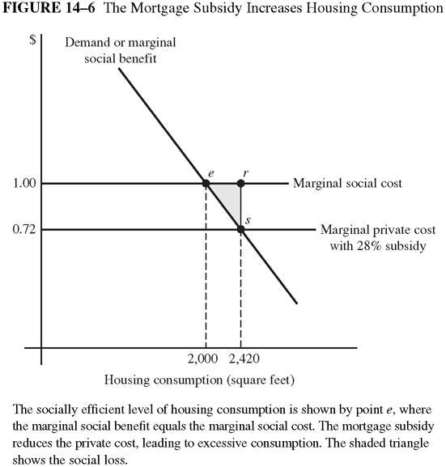
Mortgage Subsidy and Efficiency
With the mortgage subsidy: MSC>MSB from housing consumption
Overconsumption of Housing, resulting in DWL

Slide 48
Rationale for Mortgage Subsidy?
Neighborhood effects
Community stability from ownership

Slide 49
How to promote homeownership
Tax incentives
Low interest rates
Extending credit to low income groups
Reduce down payment requirement
Secondary mortgage markets

Slide 50
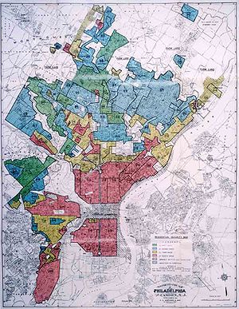
The Community Reinvestment Act
CRA was passed in 1977 as a result of national pressure to address the deteriorating conditions of American cities—particularly lower-income and minority neighborhoods shortages of credit available to low- and moderate-income neighborhoods

Slide 51
Community Reinvestment act
In 1996, HUD set a goal for Fannie Mae and Freddie Mac that at least 42% of the mortgages they purchase be issued to borrowers whose household income was below the median in their area. This target was increased to 50% in 2000 and 52% in 2005
The Act encouraged lending to subprime borrowers. Amendments to the CRA in the mid-1990s, raised the amount of mortgages issued to otherwise unqualified low-income borrowers

Slide 52
Subprime lending
  Sub-prime or non prime
  Lending to people who otherwise would have no access to credit markets
  Approximately 80% of U.S. mortgages issued to subprime borrowers were adjustable rate mortgages
  Availability of finance to subprime borrowers and often with no down payment
  The low short-term interest rates made adjustable rate loans with low down payments highly attractive.

Slide 53
Subprime lending
  Subprime loans more likely to result in foreclosure
  In 2006, % African American who received subprime loans was 3 times that of whites
  Been, Ellen, and Madar (2008) show that people are more likely to get subprime loans if they live in racially segregated communities
    Segregation increases poverty
    Segregation limits access to financial information
    Segregation makes neighborhoods more prone to redlining

Slide 54
From the Housing Bubble to the Recession
Burst of the Housing Bubble
Homeowners defaulting on mortgages
Sudden reduction in assets of financial institutions resulting in their failure
Loss of wealth and reduction in investments due to the credit crunch which results in a recession

