Slide 1
Economics of Crime and its Prevention
How Much is too Much?

Slide 2
Purpose
What is a criminal act?
What is the cost of crime?
How is crime prevention provided?
What is the optimal crime rate?
What are the benefits and costs of illegalizing trade?

Slide 3
What is a crime?
A criminal act is one that society has decided it is better off without

Slide 4
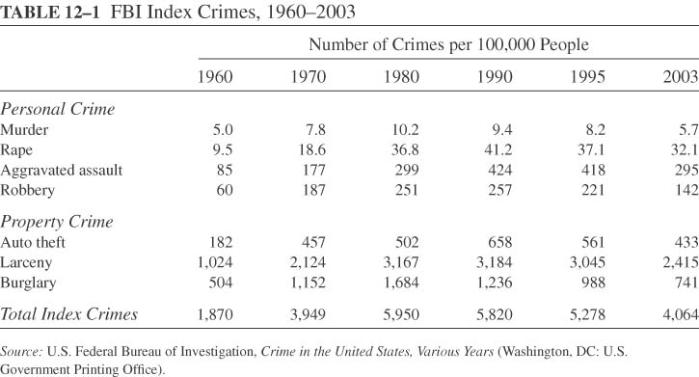
Classification
victim in physical danger
crimes of stealth rather than force

Slide 5
Crime and Inefficiency
Seizing individual property is a criminal act
  A property crime is a transfer of valuable property from its owner to someone else
  The transfer per se may not be inefficient
  However, the transfer usually involves a cost in terms of loss in value of the transferred property, or harm to the property owner

Slide 6
Crime and Inefficiency
Seizing individual property is a criminal act
  It also weakens the property rights system
  Increased incidence of property crime undermines the authority of the government to protect private property rights.
  This may lead to undermining incentives to invest and negatively affecting economic growth.

Slide 7
Crime and Inefficiency
When trade/consumption of certain goods results in negative externalities, society may decide it is illegal.
  Example: Trade/ consumption of illegal drugs promotes crime, spreads disease and exacerbates poverty
  This may give rise to illegal trading, which is costly to society

Slide 8

Cost of Crime
Spending on crime prevention
  Spending on the court system and police authority
  Private spending on protection from crime: locks, guards, home insurance,…

Slide 9
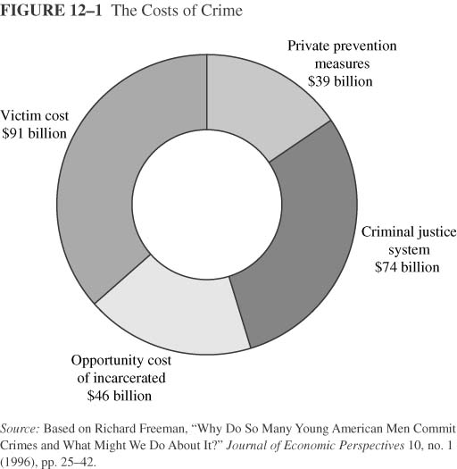
Costs of Crime
Victim cost ($91 billion): lost property, medical expenses, opportunity cost of lost work time, value of lives cut short
Private prevention ($39 billion): locks, guards
Criminal justice system ($74 billion): police, courts, correction facilities
Opportunity cost of 1.35 million in prison = $46 billion
Total = $250 billion (3.8% of GDP)

Slide 10
Crime Prevention as a public good
To avoid some of the costs of crime, it is important to allocate resources to prevent crime
Should crime prevention be provided by the government?
What are the special features of crime prevention?

Slide 11
THE DIFFERENT KINDS OF GOODS
When thinking about the various goods in the economy, it is useful to group them according to two characteristics:
  Is the good excludable?
  Is the good rival?

Slide 12
THE DIFFERENT KINDS OF GOODS
Is the good rival in consumption?
  Can the good be consumed by more than one person and give each the same value as when consumed individually.
Is the good excludable?
  Refers to the potential of excluding some people from using it.

Slide 13
Four Types of Goods
Rival in consumption?
Yes
No
Private Goods
Collective Goods
Yes
•
Ice-cream cones
•
Clothing
•
Cable TV
Excludable?
Common Resources
Public Goods
No
•
Fish in the ocean
•
Street Lighting
•
The environment
•
Crime Prevention

Slide 14

Externality from Consumption
Consumer
2
2
2
2
10
MSB>MPB
Semi private good

Slide 15
Non Rivalry in Consumption
Consumer
10
10
10
10
10
MSB>MPB

Slide 16
Public Goods
The benefit from consumption of a private good is confined to the buyer
Public goods generate external benefits, and thus markets cannot ensure that the good is produced in the proper amounts
Reaching an agreement between individuals to provide and finance the public good is costly:
  People differ in the valuation of the public good
  Information about valuation not provided
The government can potentially provide the public good at a lower cost.

Slide 17
Problems of public goods provision
A free-rider is a person who receives the benefit of a good but avoids paying for it.
Individuals free ride because
  Their contribution to finance the public good is small, especially in large groups
  The good is non excludable

Slide 18
The Free-Rider Problem
Solving the Free-Rider Problem
  The government provides the optimal amount of the public good
  The government finances the public good by taxing individuals:
    Tax proportional to willingness to pay, or
    Head tax
    Income tax

Slide 19
Optimal amount of Crime Prevention
Crime Prevention Units | MB to Henry ($)
1 | 49
2 | 40
3 | 35
4 | 30
5 | 28
6 | 20
MB to Mark ($)
35
30
25
20
18
10
MB to Lewis ($)
30
25
20
15
14
5
How do we construct demand for crime prevention
?

Slide 20
Optimal amount of Crime Prevention
Crime Prevention Units | MB to Henry ($) | MB to Mark ($) | MB to Louis ($) | MB to society ($)
1 | 49 | 35 | 30
2 | 40 | 30 | 25
3 | 35 | 25 | 20
4 | 30 | 20 | 15
5 | 28 | 18 | 14
6 | 20 | 10 | 5
What is the socially optimum number of units if the cost is $60 each
114
95
80
65
60
35
?

Slide 21
Optimal Amount of Crime Prevention
$
60
MC
Demand
Marginal Social
Benefit
5
Quantity
0

Slide 22
Individual choice
Crime Prevention Units | MB to Henry ($)
1 | 49
2 | 40
3 | 35
4 | 30
5 | 28
6 | 20
MB to Mark ($)
35
30
25
20
18
10
MB to Lewis ($)
30
25
20
15
14
5
If the cost of a unit is shared equally, how many units would each choose?

Slide 23
Problems of public goods provision
Individuals vary in terms of their valuation of the public good
How much of the public good should be provided?

Slide 24
Majority Rule
Suppose we use majority voting to choose crime prevention units
According to the Median Voter Rule, the voting outcome will match the preferences of the median voter
The median voter is the person whose preferences lie in the middle of all preferences

Slide 25
Majority Rule
Suppose we use majority rule to determine between 3, 4 and 6 units
  Hold elections between any two options
  Hold elections between the preferred option and the remaining option
Result: median voter always wins
Two of the three citizens are left with a suboptimal choice
 | H | M | L | win
3 vs. 4 | 4 | 4 | 3 | 4
4 vs. 6 | 6 | 4 | 4 | 4
4

Slide 26
Formation of Municipalities
One alternative is to form municipalities each providing different crime prevention units
By voting with their feet, individuals can pick the optimal municipality
This results in
  segregation by preferences (possibly by education or race)
  Segregation by income if local taxes are based on property values

Slide 27
Resource Allocation and crime prevention
Different crime prevention activities
How to allocate expenditure among the different facets of crime prevention:
  Courts, judges and prosecutors
  Correction, rehabilitation and punishment.

Slide 28
Resource Allocation and crime prevention
MSC
In the absence of a budget constraint, resources would be allocated such that MSB=MSC from each facet
This allocation will determine the optimal budget.
MSC
MSC
MSB
MSB
MSB
Judges
Courts
Police officers

Slide 29
Resource Allocation and crime prevention
P=$20 |  |  | P=$10 |  |  | P=$30
Police |  |  | Courts |  |  | Correction Units
Units | MSB |  | Units | MSB |  | Units | MSB
1 | 200 |  | 1 | 200 |  | 1 | 150
2 | 100 |  | 2 | 150 |  | 2 | 90
3 | 50 |  | 3 | 50 |  | 3 | 60
4 | 10 |  | 4 | 30 |  | 4 | 30
5 | 2 |  | 5 | 20 |  | 5 | 9
6 | 0 |  | 6 | 10 |  | 6 | 0

Slide 30
Limited Crime Prevention Budget
A limited budget for crime prevention
Equi-marginal principle:
  The crime budget should be allocated among the different crime prevention activities such that the last dollar spent on any one activity yields the same marginal benefit

Slide 31
Example: How would a crime prevention budget of $100 be allocated?
P=$20 |  |  |  | P=$10 |  |  |  | P=$30
Police |  |  |  | Courts |  |  |  | Correction Units
Units | MSB | MSB/P |  | Units | MSB | MSB/P |  | Units | MSB | MSB/P
1 | 200 |  |  | 1 | 200 |  |  | 1 | 150
2 | 100 |  |  | 2 | 150 |  |  | 2 | 90
3 | 50 |  |  | 3 | 50 |  |  | 3 | 60
4 | 10 |  |  | 4 | 30 |  |  | 4 | 30
5 | 2 |  |  | 5 | 20 |  |  | 5 | 9
6 | 0 |  |  | 6 | 10 |  |  | 6 | 0

Slide 32
Allocating a Limited Budget
Step 1: Calculate MSB/$ for all activities.
Step 2: Spend on activities with the highest MSB/$.
Step 3: Stop when the total expenditure equals the budget limit.

Slide 33
Example: How would a crime prevention budget of $100 be allocated?
P=$20 |  |  |  | P=$10 |  |  |  | P=$30
Police |  |  |  | Courts |  |  |  | Correction Units
Units | MSB | MSB/P |  | Units | MSB | MSB/P |  | Units | MSB | MSB/P
1 | 200 | 10 |  | 1 | 200 | 20 |  | 1 | 150 | 5
2 | 100 | 5 |  | 2 | 150 | 15 |  | 2 | 90 | 3
3 | 50 | 2.5 |  | 3 | 50 | 5 |  | 3 | 60 | 2
4 | 10 | 0.5 |  | 4 | 30 | 3 |  | 4 | 30 | 1
5 | 2 | 0.1 |  | 5 | 20 | 2 |  | 5 | 9 | 0.3
6 | 0 | 0 |  | 6 | 10 | 1 |  | 6 | 0 | 0
*
*
*
*
*
*

Slide 34
To maximize benefit from the crime prevention budget
If the MSB/$ is not equal among all facets, then social welfare can increase by substituting towards the facets with higher MSB/$.

