Slide 1
Chapter 15
Housing Policy

Slide 2
Introduction
A. Low-Income Housing Policy: $30 billion per year
    Supply side policies: Public housing, subsidized private housing, low income housing tax credits
    Demand side policies: vouchers
B. Middle and High income housing: $66 billion per year to subsidize home ownership

Slide 3
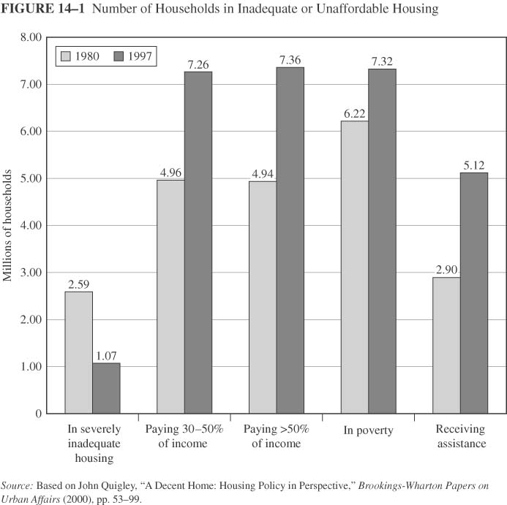
Inadequate or Unaffordable Housing
Number of households with a high rent burden
Number receiving assistance

Slide 4
Why Housing?
Affordable housing as an amenity in attracting skilled labor
Segregation as an outcome of the housing market
Student achievement and housing security

Slide 5
Housing and Poverty
“Having a safe, stable place allows people to work on their other problems. You can’t improve your life if you’re living out of a shelter, checking in and out every day, sleeping with bedbugs, having your things stolen, and possibly experiencing sexual or physical violence—those aren’t optimal conditions for finding and keeping a job or stabilizing mental illness. Recent evidence from Seattle shows that people who move from the street into stable housing do improve their lives—for example, they may start drinking less.” (The Urban Institute,2009)

Slide 6
A. Low Income Housing Policy
I. Public Housing
The government acts as a supplier of low income housing
About 1.3 million households in 1998
The budgetary cost about $7 billion in subsidies and maintenance
Managed by local housing authorities
Rent no greater than 30% of recipient income

Slide 7
Public Housing and Recipient Welfare
Evaluate the efficiency of public housing programs: Can the same welfare level be achieved at a lower cost?
Assumptions and numbers
  Income = $800
  housing price = $1 per unit of service
  Rent on public housing = 30% of income

Slide 8
Without Public Housing
Indifferrence curves of a typical household
Budget line
All Other Goods
800
500
i
Without public housing:
Point i maximizes initial utility: (h = 300; A = $500)
300
800
Quality of Housing

Slide 9
Public Housing An Option
The government offers housing service=540 at a price equal to 30% of income
Rent is 30% of income = 0.3* 800=$240
A = $800 - $240 = 560
Public housing adds point j to budget set
Is the consumer better off? Higher utility: U1 > U0
All Other Goods
800
560
j
500
i
U1
U0
300
540
800
Quality of Housing

Slide 10
Value of public housing to recipient
An alternative: a cash transfer
How much money would make him indifferent to the public housing?
Income Cash transfer of $200 gets recipient to U1
Same utility level but less housing (360) and more other ($700)
Subsidy = $300 = $540 (market value of 540-unit dwelling) - $240 rent
Value to recipient ( $200) is 2/3 of subsidy, consistent with studies
1000
All Other Goods
800
k
640
j
560
i
500
U1
U0
300
360
540
800
Quality of Housing

Slide 11


Efficiency of Public Housing
Public housing is costly because:
  new (in comparison to used housing)
  public (inefficient production)
To assess efficiency:
  Production efficiency = Market value / production cost
  Bang per buck=recipient value/budgetary cost
Tax money used to build public housing =$1080
Value to the recipient= $200
Market Value = $540
Production efficiency =540/1080=0.5
Bang per buck=200/(1080-240) =0.24

Slide 12
Discussion: Problems with public Housing
What are some of the problems associated with provision of public Housing?
  Segregation
  Poverty concentration
  Crimes, drugs, school dropout rate.
Possible solutions:
  Demolitions and relocation programs (problems: political opposition)
  Housing vouchers (problems: affects housing prices, spread of crime)

Slide 13
Problems with public housing
Location:
  neighborhoods with low median incomes, disproportionate share of minorities
  does not offer access to public transportation or other city resources
  Mostly female headed households
  Poverty concentration results in
    High school dropout rates and low student achievement
    High crime rates

Slide 14
Problems of Public Housing
“Low-income families that live in distressed, high-poverty neighborhoods face especially daunting challenges as they attempt to leave welfare, find jobs, earn an adequate living, and raise their children. In these neighborhoods, crime and violence are common, jobs are scarce, schools are often ineffective, and young people see few opportunities for success. A growing body of social science research indicates that living in these high-poverty communities undermines the long-term life chances of families. Historically, federally subsidized rental housing projects have intensified the concentration of poor people—especially minorities—in distressed inner-city neighborhoods.” (The Urban Institute, 2009)

Slide 15
II. Subsidies for Private Housing
The government encourages the private sector to supply low income housing through a system of subsidies
Features of Section 236 and Section 8-Project Based
  Tenant pays 30% of income as rent (R)
  Fair market rent (F) determined by cost or prevailing rent
  Government pays owner subsidy: S = F - R
  Example: Income = $800; F = $500; S = $500 - $240 = $260

Slide 16
Low Income Housing Tax Credit
Tax credits create incentives for investments in affordable housing
Set-asides: fraction of dwellings restricted
  Rent restricted: maximum rent (30% of qualifying income)
  Occupant restricted: maximum income
  20/50 test: at least 20% of dwellings occupied by households with income no greater than 50% of median area income
  40/60 test: at least 40% of dwellings; 60% of median income

Slide 17
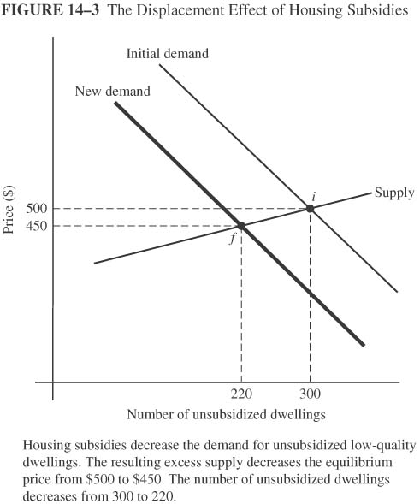
Effects of Subsidy on Housing Stock
Displacement effects: Effects on unsubsidized housing
  If subsidies generate 100 new housing units, demand for unsubsidized dwellings decreases by 100
  Leftward shift of the demand curve
  decreases price and equilibrium quantity of unsubsidized dwellings (300 to 220)

Slide 18
III. Housing Vouchers
Demand side policy that , like food stamps, allows recipients to choose
Recipient must occupy dwelling meeting minimum standard
Face value = Fair market rent - 0.30 • Income
Fair market rent = 45th percentile of rent in metropolitan area

Slide 19
Vouchers and Consumer Welfare
How will a voucher of $300 change the budget line?
The consumer can choose H=300 and spend $800 on all other goods
Any H<300, will give him a maximum of $800 to spend on all other goods
All Other Goods
800
500
i
300
800
Quality of Housing

Slide 20
Vouchers and Consumer Welfare
Household maximizes utility at point v: (h=400, A = $700)
Voucher generates higher utility than public housing (point j) because it gives more options
Bang per buck of voucher = 1 (versus 0.24 for public housing)
1100
All Other Goods
800
700
v
560
j
500
300
400
540
800
Quality of Housing

Slide 21
B. Middle and High Income Housing Policy: Mortgage Subsidy
Tax breaks to homeowners: deduct mortgage interest payment from gross income when paying income taxes
Benefit increases with income

Slide 22
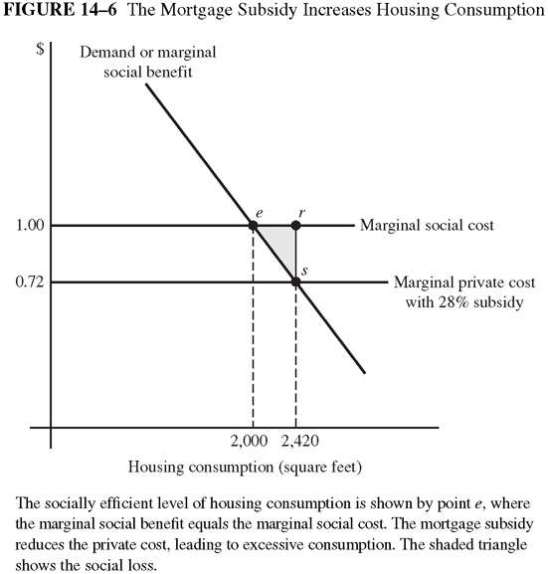
Mortgage Subsidy and Efficiency
With the mortgage subsidy: MSC>MSB from housing consumption
Overconsumption of Housing, resulting in DWL

Slide 23
Mortgage Subsidy & Home Ownership
Assumptions about housing
  Identical rock houses with market value = $100,000
  Perfect competition: Interest payment=rent
  Annual rent = $8,000 = $100,000 • 8% interest rate
Effect of switch from renter to owner-occupier
  Pay $8,000 in mortgage interest instead of $8,000 rent
  Deduct $8,000 mortgage interest from income and income tax drops

Slide 24
Bias Toward Ownership
Subsidy decreases cost of ownership relative to renting
Eliminate bias by eliminating deduction?
Eliminating bias by having owner declare imputed rental income (IRI)
  IRI: Money that could be earned by renting dwelling to someone else
  Bedrock example: $8,000 = annual rent

Slide 25
Rationale for Mortgage Subsidy?
Neighborhood effects?
Community stability from ownership?
What about low-income households?

Slide 26
Assignment
Questions: 3, 5, 6 and 8.

