Slide 1
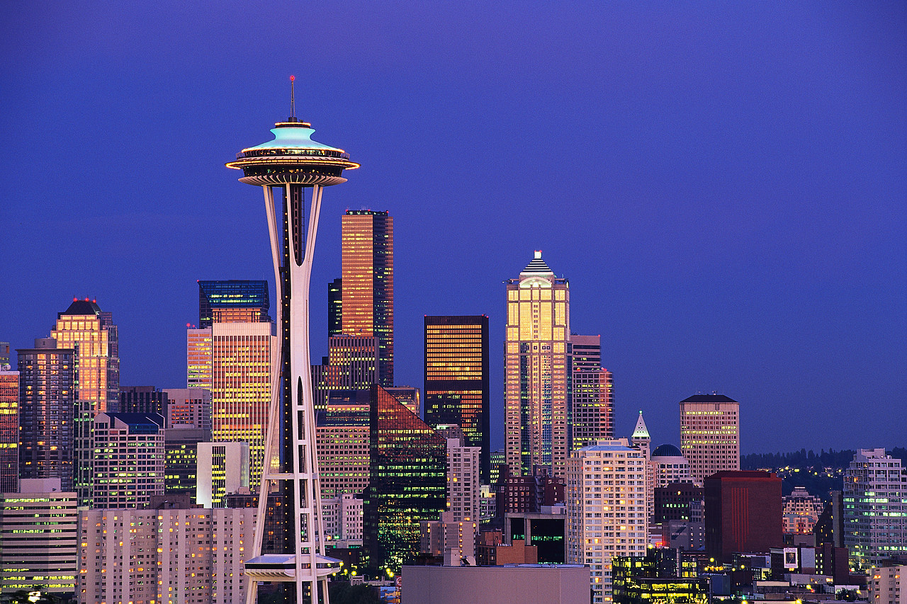
Chapter 3
Why Do Firms Cluster?

Slide 2
Purpose
In the factory town model of chapter 1, firms were not attracted to locations where other competitors operated.
However, most firms are attracted to the locations of other firms. In this chapter we explore the forces that cause firms to locate close to one another in clusters.
When firms realize cost savings from concentration they locate close to one another.

Slide 3
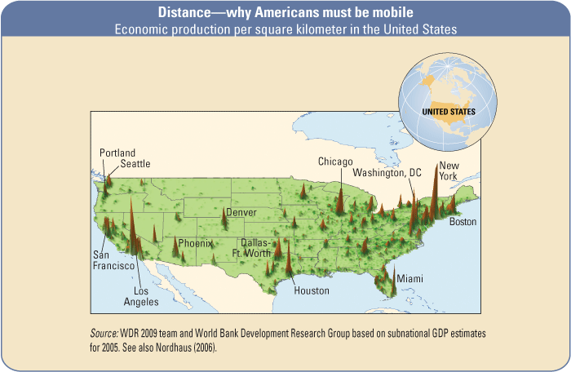
Clustering of Economic Activity
Economic Production Per Square Kilometer in the United States

Slide 4
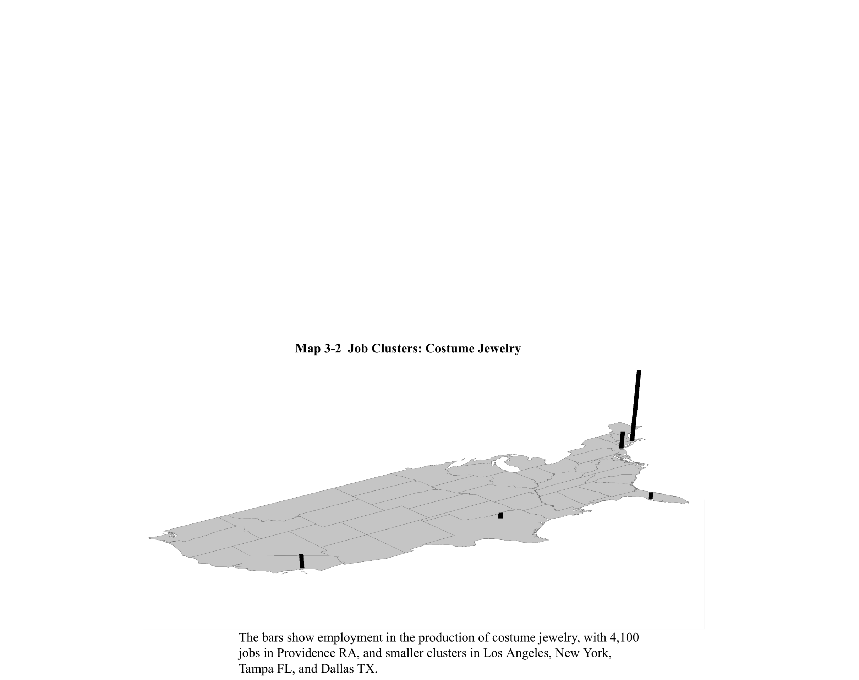
How do firms of a given industry locate?
Industry: Costume Jewelry

Slide 5
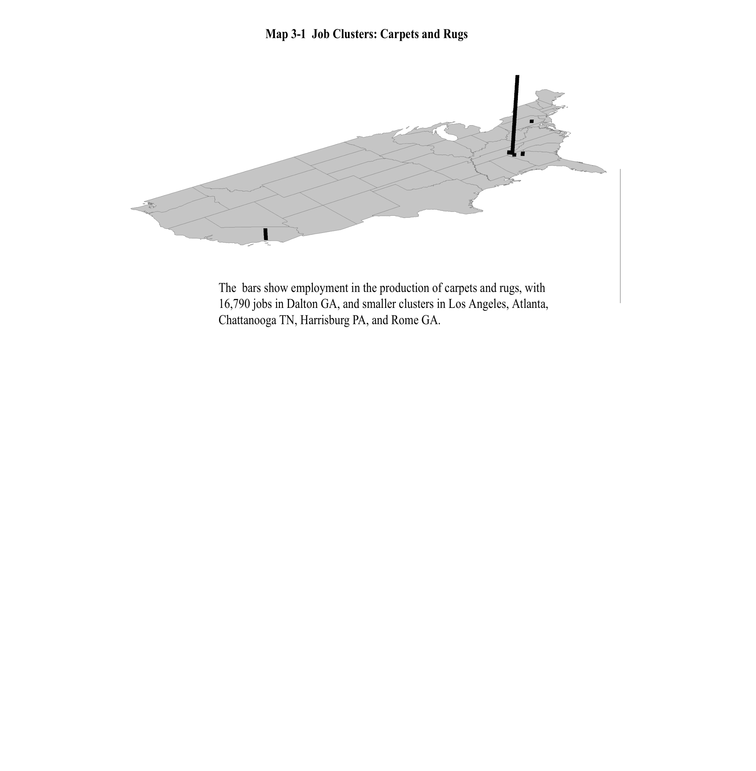
How do firms of a given industry locate?
Industry: Carpets and Rugs

Slide 6
Economies from Location
  Localization Economies: refers to cost savings when firms of a given industry locate together.
  Urbanization Economies: refers to cost saving from locating together of firms across different industries. The location of one industry attracts another.
  Urbanization economies leads to the development of large diverse cities.
  Urbanization and localization economies are termed agglomeration economies

Slide 7
Why do Firms Cluster?
1. Sharing Intermediate Inputs
  The Button-Dress model:
    Button making is subject to economies of scale. Dress makers will not make their own buttons. They will buy them from a few independent button makers who can realize cost savings as they face a large demand. (why?)

Slide 8
Economies of Scale in Button Making
..
The cost of a button produced by a dress maker
..
..
10
Cost of one button
The cost of a button manufactured by a button producer
3
1
20
buttons

Slide 9
Model features
  Firms producing high fashion dresses: small and nimble.
  Scale economies in producing buttons large relative to demand of single dressmaker.
  Face time require to design and fabricate buttons to fit dresses.
  Modification cost: dress maker pays an extra cost to modify the button to fit his need
  Variety in types of buttons demanded (shape, finish, color).

Slide 10
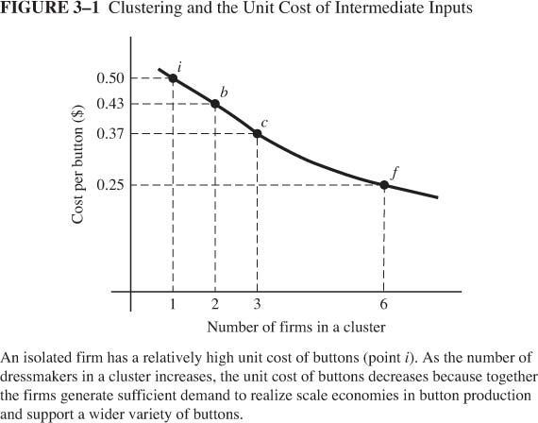
The more firms in a cluster, the lower will be the unit cost of buttons

Slide 11
Cost Saving in a cluster
Button cost lower in cluster: Figure 3.1
  Higher total demand for buttons allow button maker to realize economies of scale.
  Button makers can specialize in types of buttons, reducing modification costs

Slide 12
Self-Reinforcing Effects of Clustering
The Tradeoffs
  Benefit: Localization economies reduce cost of intermediate input
  Cost: Competition for workers increases labor cost
Starting with isolated firms, will a cluster of firms form?
How big will the cluster be?
Notes:
Who is the decision maker? What is he choosing?

Slide 13
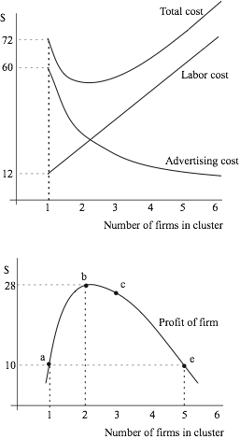

Slide 14

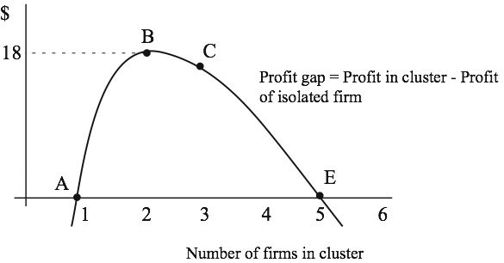

Slide 15
Another Example: High-Technology Firms
Rapidly changing products necessitates intermediate inputs
  Electronic components
  Testing facilities
Firms share intermediate input suppliers to exploit scale economies
Face time in design and fabrication requires proximity and cluster

Slide 16
Why do Firms Cluster?
2. Sharing A labor Pool
  Sharing a labor pool is beneficial to firms given significant variation in demand facing each firm, e.g., Software & TV programs.
  Industry-wide demand is constant: zero-sum changes in demands facing individual firms
  A cluster of firms facilitates the transfer of workers from unsuccessful firms to successful ones.

Slide 17
Cluster vs. Isolated Site
A firm has two choices. Either to locate in:
  an isolated site or
  in a cluster?
  Which option does the firm prefer?
    This will depend on the labor cost under each.
  How does the labor supply curve look like in each case?

Slide 18
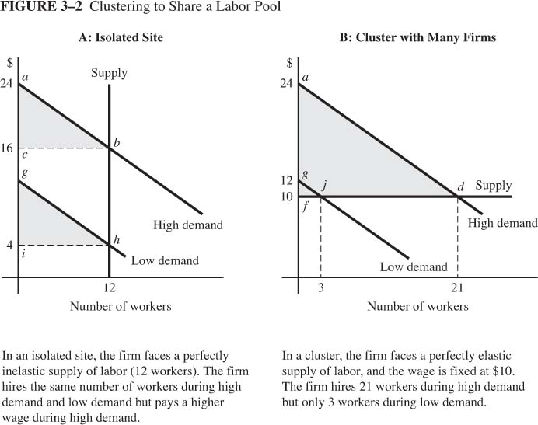
What would the wage be in the cluster to ensure locational equilibrium?

Slide 19
To achieve locational equilibrium, the wage in the cluster should equal the expected wage in the isolated Site.
EW= ½ *16 + ½ *4 = 10

Slide 20
Which location results in a higher profit?
How can we represent firm profit graphically?
  Remember: Labor demand is the marginal revenue product (MRP); the dollar value created by the extra worker.
  Example:
$
40
Price of final product=$2
Worker | Marginal Product | Value of Marginal Product (MRP)
1 | 20
2 | 15
3 | 10
4 | 5
30
40
30
20
10
20
10
MRP
1
2
3
4
Quantity of Labor

Slide 21
Which location results in a higher profit?
How can we represent firm profit graphically?
  The wage line is the cost of hiring an extra worker
  Assume the wage is $20
  Firm profit is the
  difference between MRP
  and the wage.
$
40
30
20
Labor
Demand
10
MRP
1
2
3
4
Quantity of Labor

Slide 22
Move to Cluster Increases Expected Profit
$48
$147
12
$3
$48
Expected profit in an isolated site= ½ .48 + ½ .48 =$48
Expected profit in an isolated site= ½ .147 + ½ .3 =$75

Slide 23
Why do Firms Cluster?
3. Labor Matching
  Firms and workers not always perfectly matched.
  Mismatches require training costs to eliminate skill gap.
  Show that larger city allows better matches

Slide 24
A Model of Labor Matching
Each firm enters market with skill requirement
Firms compete for workers driving profit to zero
Each firm offers a wage of $12
Each firm hires 2 workers
Workers have varying skills on unit circle
Workers incur training cost to close gap
Workers accept highest net wage

Slide 25
Skills Matching
1. Assume a market with 2 firms
3. The skill gap is 1/8.
W1
0
1/8
3. The worker incurs a training cost proportional to the skill gap.
Training cost= skill gap * unit training cost.
W4
6/8
2/8
W2
2. …and 4 workers with skills that are evenly distributed around a unit circle
5/8
4/8
W3

Slide 26
Net Wage
The worker incurs the training cost.
Training cost=skill gap x unit training cost.
Net wage = Gross wage- training cost.
Suppose the gross wage=$12, the unit training cost is 24 (which is the training cost for a unit of skill difference), then can you calculate the net wage?

Slide 27
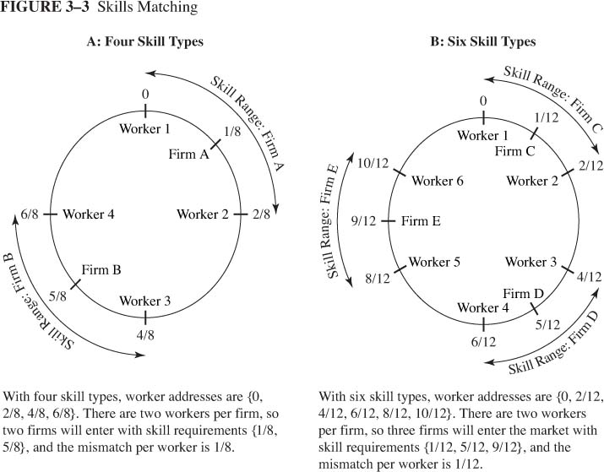
More Skill Types
1. The wage gap declines from 1/8 to 1/12
As the number of workers increases to 6.
2. Workers incur a lower training cost
3. What is the net wage?

Slide 28
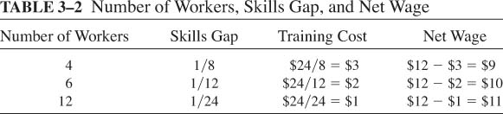
Net Wage

Slide 29
Agglomeration economies
Workers are better off in a cluster of workers.
Are firms better off?
The higher net wage attracts more workers to live in large numbers in cities, which attracts more firms that compete for workers.

Slide 30
Why do Firms Cluster?
4. Knowledge Spillovers
  Firms in an industry share ideas and knowledge
    mysteries of trade are “in the air”
    innovations are promptly discussed, improved, and adopted
“... a close relationship, almost a partnership, grows up among related firms in a given geographical area. The ability, for example, of members of the group to meet without inconvenience to discuss common problems and matters of mutual interest is not an inconsiderable advantage of close geographical association.” (Estall and Buchanan 1961: 109)

Slide 31
Why do Firms Cluster?
4. Knowledge Spillovers
  Detroit: The motor city
  “…there was an explosion in automotive entrepreneurship in Detroit in 1900. Detroit seemed to have had a budding automotive genius on every street corner. Ford Ransom Olds, the Dodge brothers, David Dunbar Buick and the Fisher brothers all worked in the Motor City…..Ford was able to open a new company with backing from the Dodge brothers who were making engine and chasis components. They supplied Ford with both financing and parts.” Glaeser (2011)

Slide 32
Evidence of Localization Economies: Productivity & Births
Higher Labor Productivity
  Henderson: Elasticity (output per worker, industry output) = 0.02 to 0.11
  Mun & Huchinson: Productivity elasticity = 0.27
Firm Births
  Carlton: Elasticity (births, industry output) = 0.43
  Head, Reis, Swenson: Japanese plants cluster
  Rosenthal & Strange: births more numerous in locations close to industry concentrations

Slide 33
Evidence of Localization Economies: Employment Growth
Henderson, Kuncor, Turner: growth more rapid close to existing concentrations
Rosenthal & Strange: rapid growth close to locations with existing jobs
Localization economies attenuate rapidly with distance

Slide 34
Urbanization Economies
Cost savings from the clustering of firms from different industries.
These happen for the same reasons mentioned before.

Slide 35
Urbanization Economies and Knowledge Spillovers
Diverse city is fertile ground for new ideas
Bulk of patents issued to people in large cities
Evidence of Urbanization Economies
  Elasticity of productivity w.r.t. population is 0.03 to 0.08
  Diversity promotes employment growth, especially in innovative industries

Slide 36
Specialized and Diverse Cities
Specialized (diverse) cities develop because of localization (urbanization) economies
Both cities are important for firms at different stages of product development
  Young firms benefit from proximity to a diversity of economic activities.
  Specialized cities attract mature firms
Both cities are important for different divisions within a firm. With improvements in communication
  Headquarters are located in diverse cities
  Production units locate in specialized cities

Slide 37
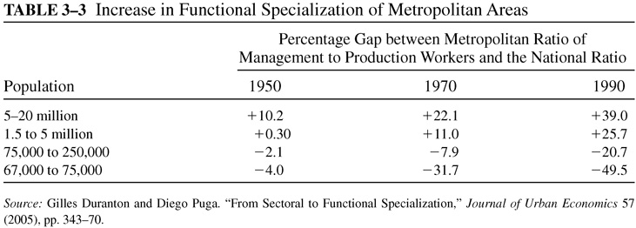
Corporate HQ and Functional Specialization
Corporate headquarters cluster in cities to share firms providing business services
Large cities increasingly specialized in managerial functions
Small cities increasingly specialized in production

Slide 38
Other Benefits of Urban Size
Joint Labor Supply
  Large cities offer better job opportunities for two-earner families
  History: metal-processing firms (men) located close to textile mills (women)
  Current: power couples attracted to cities, with better employment matches
Learning Opportunities
  Human capital increased by learning through imitation
  The skill and experience acquired in large cities results in a permanent increase in wage
Social Opportunities: Better matches of social interest in large city

Slide 39
Assignment
Discussion question: Check the list of ten dead U.S. cities. Which of these are specialized cities? What does this imply about the costs or benefits of specialized cities?

