Slide 1
Chapter 15
Neighborhoods

Slide 2
Objective
  Understand the formation of neighborhoods
    Why do people segregate into different neighborhoods?
    What are the consequences of segregation?

Slide 3
Diversity versus Segregation
Household differ in
  Income
  Race
  Ethnicity
  Education
Integrated neighborhood: different households have an equal representation.
Segregated neighborhood: a given type of household is a majority.

Slide 4
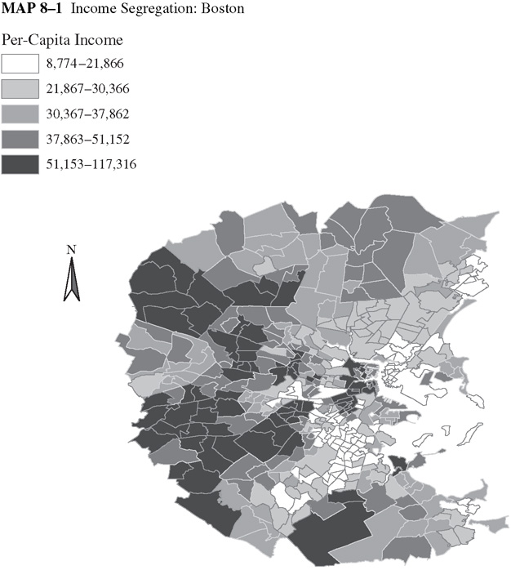
Per capita income in Boston by census tract
How equal is income distribution?

Slide 5
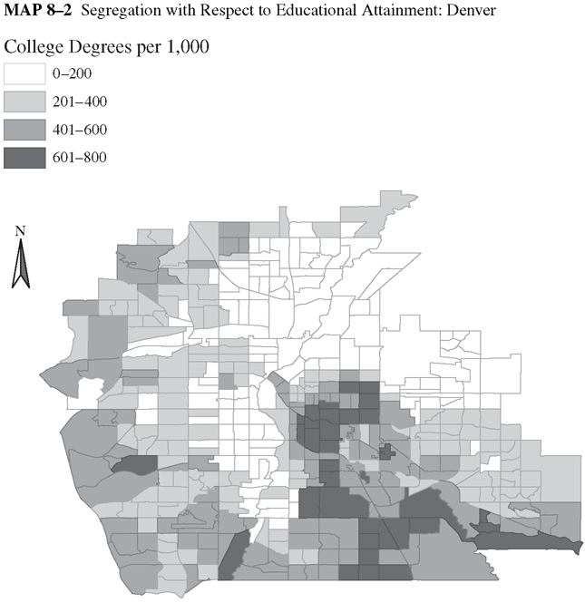
Educational Attainment in Denver by census tract
Are census tracts with high education attainment clustered or randomly distributed?

Slide 6

Residential Choice
In this chapter we extend the model of residential choice to account for other factors besides proximity to work

Slide 7
Residential Choice
People value neighborhood attributes, e.g., school, park space, safety, referred to as local public goods
People differ in their preferences
These attributes differ from one neighborhood to another

Slide 8
Local Public Goods
Local- Goods available for people living in a certain locality to consumer
Public Goods-They are:
  Non rival in consumption- consumption by one does not limit the value to others
  Non excludable – no mechanism to exclude people from consuming

Slide 9

Rival in Consumption
Consumer
0
0
0
0
10
MSB=MPB

Slide 10
Non Rivalry in Consumption
Consumer
10
10
10
10
10
MSB>MPB

Slide 11
Externality from Consumption
Consumer
2
2
2
2
10
MSB>MPB
Semi private good

Slide 12
Local Public Goods
Are goods that can be consumed by everyone living in a certain locality- non excludable
They tend to be public in nature- consumption of one does not diminish the value to another- non rival

Slide 13
Financing local Public Goods
It is not easy to charge people based on use.
Local public goods are financed through
  A head tax: equal amount paid by all
  A property tax: tax levied on the property value
Each tax system creates different incentives for household to locate (potentially creating segregated neighborhoods?)

Slide 14
1. Local Public Goods and Segregation
We first explore the role of local public goods in neighborhood segregation.
Do differences in household characteristics or preferences over local public goods generate diverse or segregated neighborhoods?

Slide 15
1. Local Public Goods and Segregation
Local public goods: a park.
Three individuals and different preferences
  High
  Medium
  Low
Park financed through a head tax

Slide 16
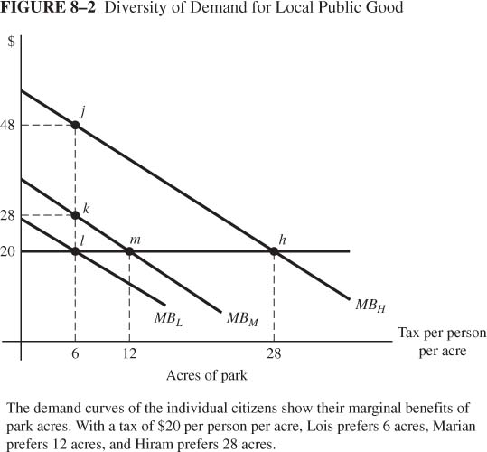
Differences in Demand for Park
Shown are the demand curves for acres of park for each of three individuals
The cost per acre is $60. The MC is $20 since the cost will be shared equally.
How many acres of park does each one choose?
Variation in demand creates disagreement about how large the park should be

Slide 17
Majority Rule
Suppose we use majority voting to choose between different park sizes.
According to the Median Voter Rule, the voting outcome will match the preferences of the median voter.
The median voter is the person whose preferences lie in the middle of all preferences.

Slide 18
Majority Rule
Suppose we use majority rule to determine between 6, 12 and 28 acres of park.
Hold elections between pairs of different park sizes.
The median voter always wins.
Two of the three citizens are left with a suboptimal choice
 | H | M | L | win
6 vs. 12 | 12 | 12 | 6 | 12
12 vs. 28 | 28 | 12 | 12 | 12
12

Slide 19
Formation of Municipalities
Since a given park size does not satisfy all three groups, they form three municipalities with citizens with similar park preferences
By voting with their feet, citizens sort themselves into homogenous communities and each gets his preferred park size.
Causes of segregated neighborhoods:
1.Variation in demand for local public goods

Slide 20
2. Variation in the taxed good
Assume instead that property taxes were used to finance provision of the park
For simplicity, lets consider individuals with low park demand
Assume they have different property values.

Slide 21
2. Variation in the taxed good
The cost of providing a 6 acre park is $360(=$60x6).
What should the property tax rate be?
(t*240+t*100+t*20=360)
Property value | $ (000) | Tax payment
High | 240 | 240
Medium | 100 | 100
Low | 20 | 20
?

Slide 22
2. Variation in the taxed good
High valued property owners have an incentive to form a municipality of only high valued properties and pay $120 instead of $240.
Property value | $ (000) | Tax payment
 |  | Mixed Municipality | High only
High | 240 | 240 | 120
Medium | 100 | 100 | -
Low | 20 | 20 | -

Slide 23
2. Variation in Consumption of the taxed good
The difference in tax amounts creates incentives for people within the same demand group to segregate:
  The high value property owners form their own municiaplty
  The medium value property owners prefer to live in their own municipality rather than live with the low

Slide 24
2. Variation in Consumption of the taxed good
With three types of preferences and three property values:
High Demand High property value | High Demand Medium property value | High Demand Low property value
Medium Demand High property value | Medium Demand Medium property value | Medium Demand Low property value
Low Demand High property value | Low Demand Medium property value | Low Demand Low property value
Causes of segregated neighborhoods:
2.Variation in the taxed good

Slide 25
3.Neighborhood Externalities
Types of externalities:
Kid Imitation
  Positive adult role models for kids
  Classmates in school: focused vs. disruptive
Adult externalities:
  Job information
  drug use
Positive externalities increase with income and education level.
Who gets the desirable neighbors?

Slide 26
A Model of Neighborhood Choice
Two neighborhoods differ in their income mixes.
All households prefer high income neighborhoods
Households compete by bidding for land and housing.

Slide 27
A Model of Neighborhood Choice
Model setup
  Two neighborhoods, each with 100 lots
  Two income groups (high and low), each with 100 households
Only difference between neighborhoods is income mix.

Slide 28
A Model of Neighborhood Choice
High income
Low income
Neighborhood A
Neighborhood B
Because the neighborhoods have an identical mix of high and low income households, rent in A=rent in B

Slide 29
Rent Premium
Rent premium for A= rent in A- rent in B, is defined as the extra amount of rent a household is willing to pay for neighborhood A,
Rent premium with 50-50 mix will be zero since both neighborhoods are identical.
Rent premium increases with the number of high income households

Slide 30
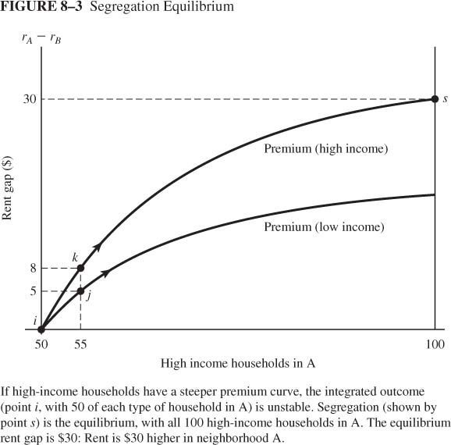
Premium Curves
Point j: Premium of low-income household (55 high, 45 low) = $5
Point k: Premium of high-income household (55 high, 45 low) = $8
The premium curve for the high income household is higher than that of the low income household

Slide 31
Unstable equilibrium
Equilibrium requires that everyone in the same neighborhood pay the same rent.
Point i is an integrated equilibrium. Households pay the same amount for each neighborhood
Point i is unstable equilibrium since a movement of population will generate a different equilibrium

Slide 32
Segregated Equilibrium
High income
Low income
Neighborhood A
Neighborhood B
Neighborhood A becomes more desirable, therefore the rent premium with the new mix will be positive.

Slide 33
Segregated Equilibrium
The premium for the high income is higher than that for the low income household.
High income households outbid low income households so that they displace low income households in area A
This increases the mix of high income households moving away from point i
Point s is the new equilibrium with segregated neighborhoods. Self Reinforcing Effects lead to extreme outcomes

Slide 34
Segregated Equilibrium
High income
Low income
Neighborhood A
Neighborhood B
All high income households locate in one neighborhood

Slide 35
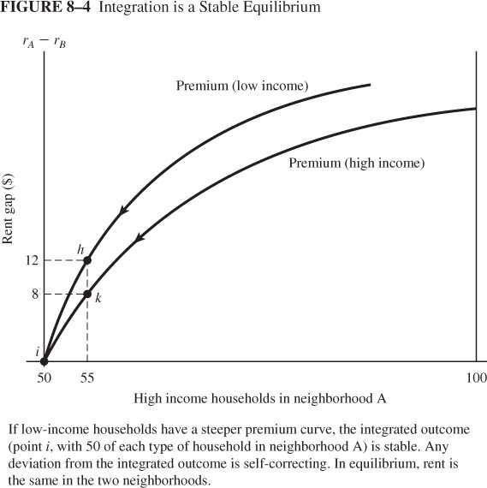
Integrated Equilibrium
Here, the integrated equilibrium is stable because the premium curve for the low income households is steeper than that of the high income households

Slide 36
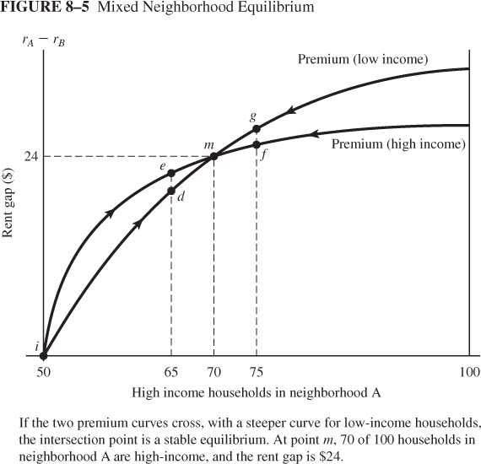
Mixed Neighborhoods
A third possibility is a mixed neighborhood. Point m is a stable equilibrium since a deviation away from m results in a movement back to it.

Slide 37
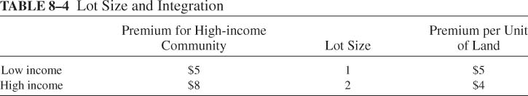
The Role of Lot Size
When variation in land consumption is allowed integration is more likely.
Landowner perspective: high-income household with larger premium loses bidding war against two low-income households
$5
$8
$5

Slide 38
Minimum Lot Size Zoning
Sometimes governments specify a minimum lot size for residential development.
Under Minimum Lot Size (MLS) zoning low income households are more likely to be outbid by high income households
The goal is to exclude households whose tax contribution falls short of their consumption of the public good

Slide 39

Minimum Lot Size Zoning
What are the implications of MLS zoning on
  Neighborhood segregation?
  Low income neighborhoods?
  Population density and urban sprawl?

