Slide 1

Technology

Slide 2
Mass Production and Big box competition
We can use the model of spatial competition to understand the impact of big box entry into an urban area
  prices
  Number of downtown stores
  Consumers
  Jobs and wages

Slide 3
Spatial Competition
When location of consumers and firms is taken into account, competition between firms yields different results
  Consumers do not necessarily shop from the cheaper firm
  Products are differentiated by location
  Firms with higher cost can still compete
  The result: monopolistic competitive market

Slide 4
Mass Production and Big box competition
Ahmed, Visser and Stater (2013) show that entry of the big box
  Reduces prices downtown
  Induces exit of downtown firms
The empirical evidence on the effect of big box entry

Slide 5
Outline
Advances in technology of production
Advances in technology of communication
Advances in transportation technology and urban areas
  Overall advances that led to a reduction in transport cost and improved connection
    Urban expansion
    Increased density
  Introduction of new choices of modes of transit that led to qualitatively different changes
  Government policy biases

Slide 6
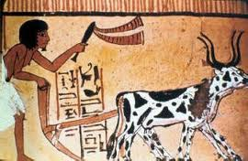

Technological Advances
Domestication of animals
  Easier to transport food
Wheels

Slide 7
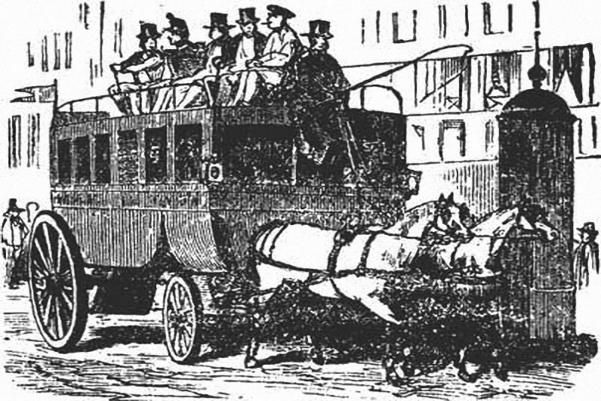
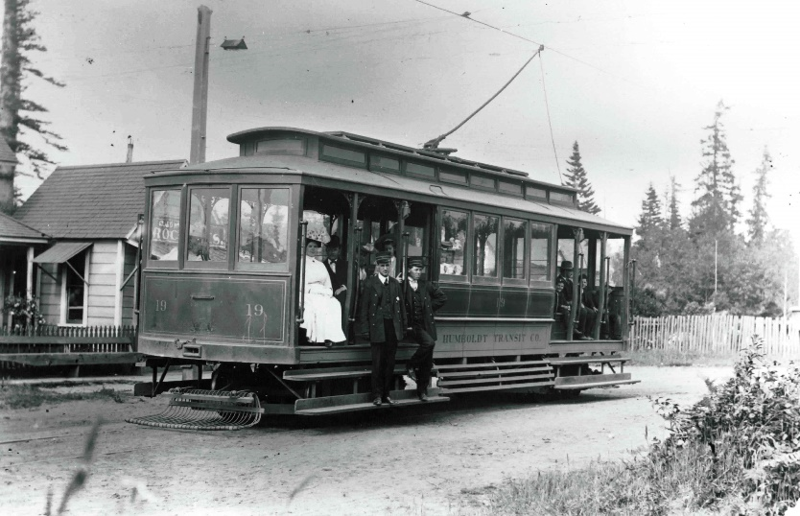
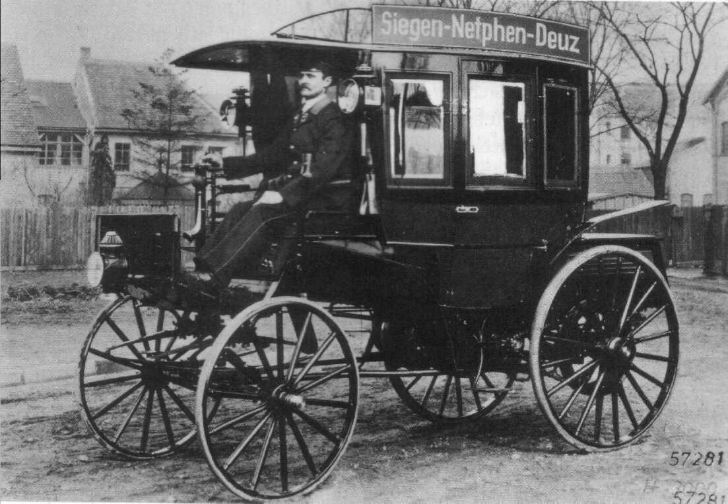
Technological Advances
Omni bus: A passenger-carrying vehicle, originally an enclosed horse-drawn one
Cable cars 1983
The first internal combustion omnibus of 1895

Slide 8
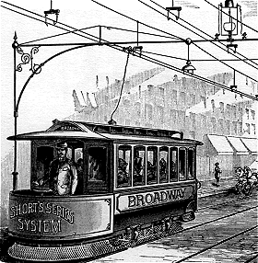
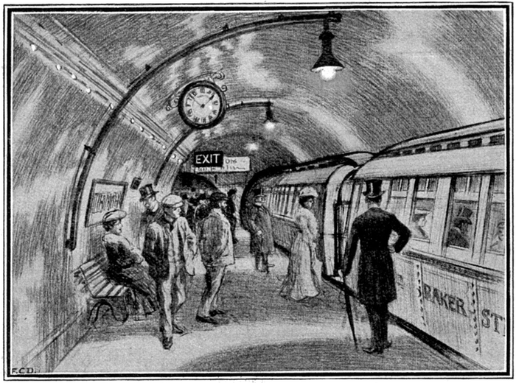
Technological Advances
Electric Trolley 1886
  Frank Sprague
  Two networks
Elevated rail networks
Subway 1895
  Building at city level took up valuable land
  Steam engines in tunnel
Electric train
  Less pollution and exhaust

Slide 9
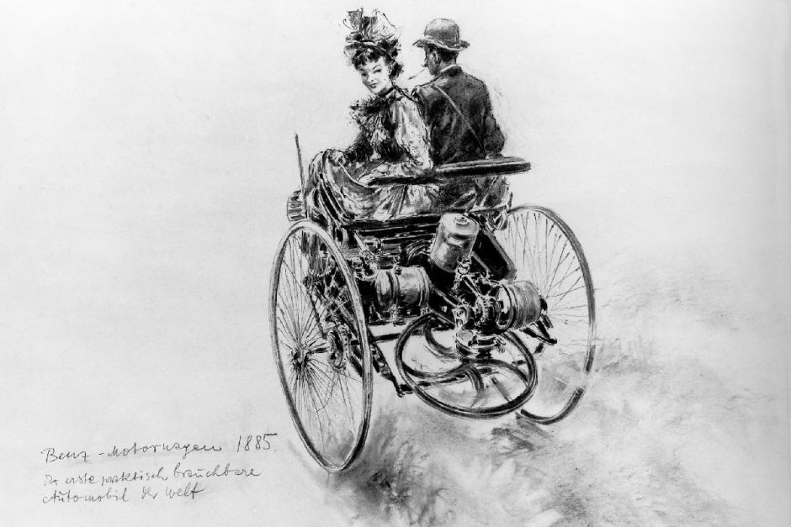
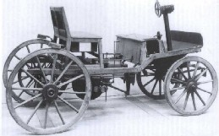
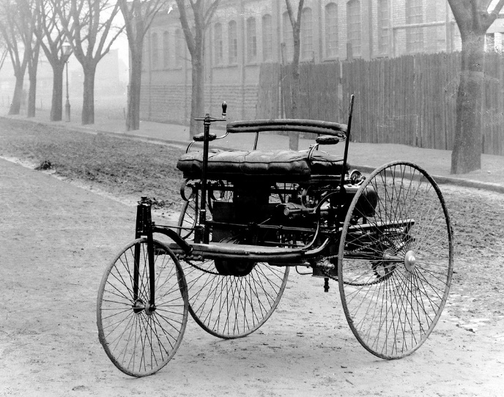
The Automobile
the first automobile (1885) The first stationary gasoline engine developed by Karl Benz was a one-cylinder two-stroke unit
Ford and mass production
  23 million cars by 1920
  Federal Highway Act 1921

Slide 10
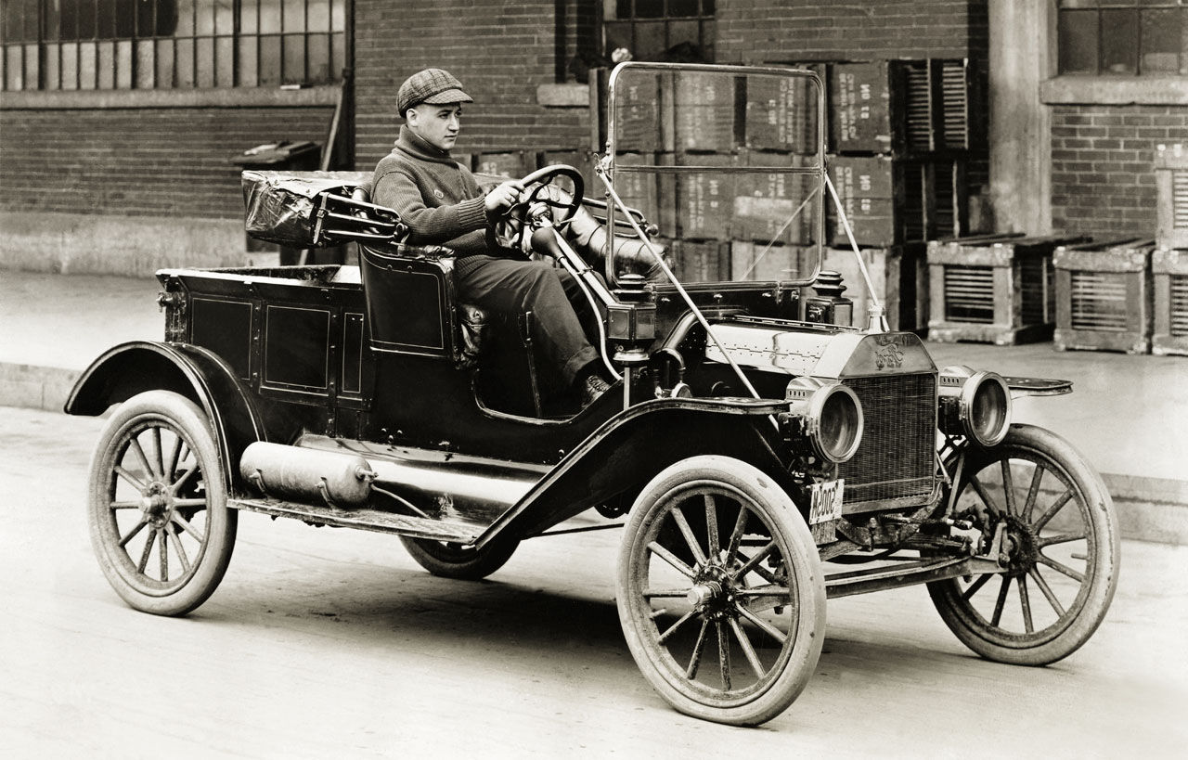
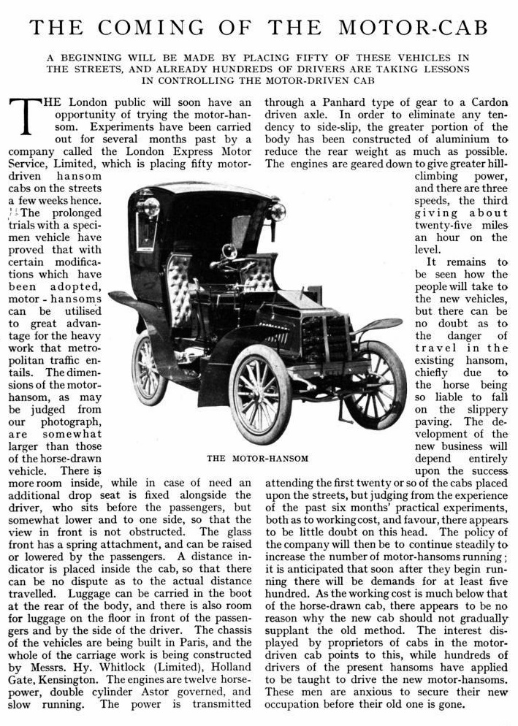
Automobiles

Slide 11
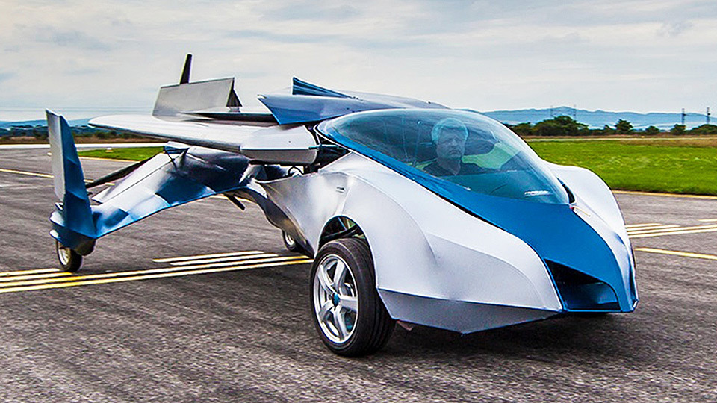
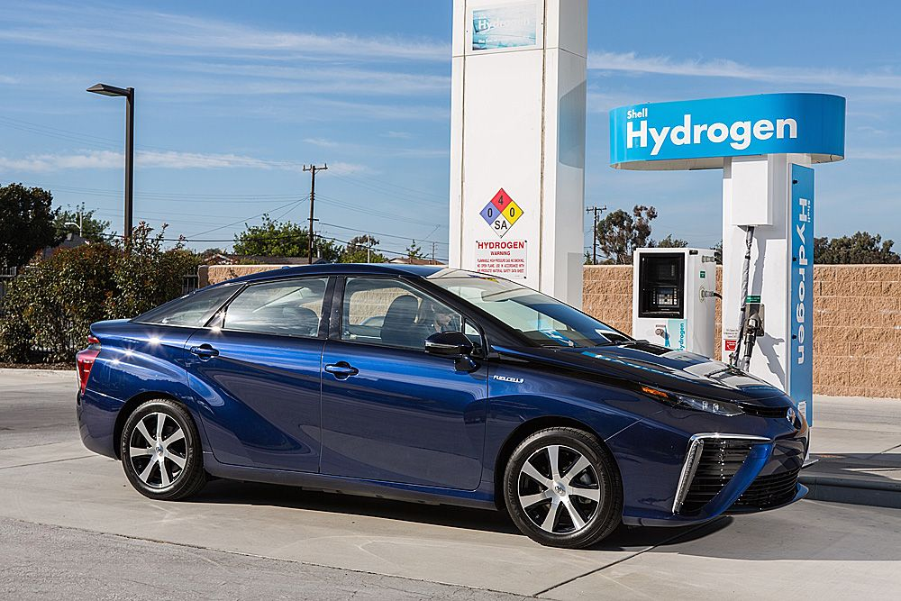
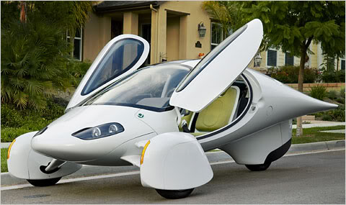
The Future?

Slide 12
Specific topics
More efficient modes of transit
Automobiles and suburban expansion
  Automobiles, spatial mismatch, urban poverty
Challenges in provision of Public transportation
Externalities from automobiles and policy responses
  Traffic congestion and road pricing
  Emissions regulation
    US
    Europe
    Worldwide

Slide 13
Transportation for trade
  An efficient network of transportation has to exist to facilitate the exchange of food and urban products.

Slide 14
A transformation
Cities looked very different 100 years ago:
  Cities had a unique center
  Jobs were concentrated near the city center
  Manufacturing firms located near railroad terminals
  Office firms clustered in the CBD
  Workers lived in the city center and commuted by foot or in the suburbs and rode street cars

Slide 15
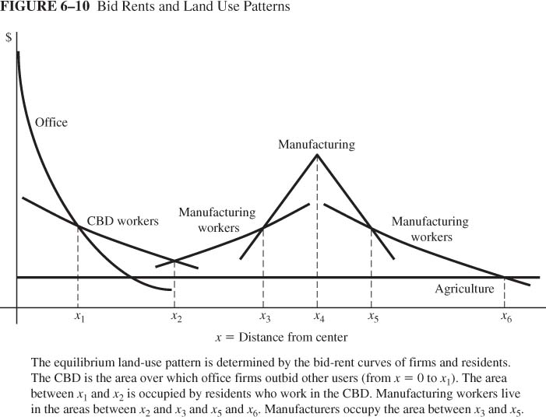
A Monocentic City

Slide 16
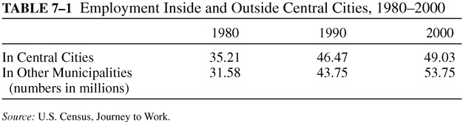
Demise of the Monocentric City
100 years ago, the spatial distribution of employment and population started to change
Define
  A central city is the territory of the municipality at the center of the metropolitan area.
  A Suburban area is the rest of the metropolitan area

Slide 17
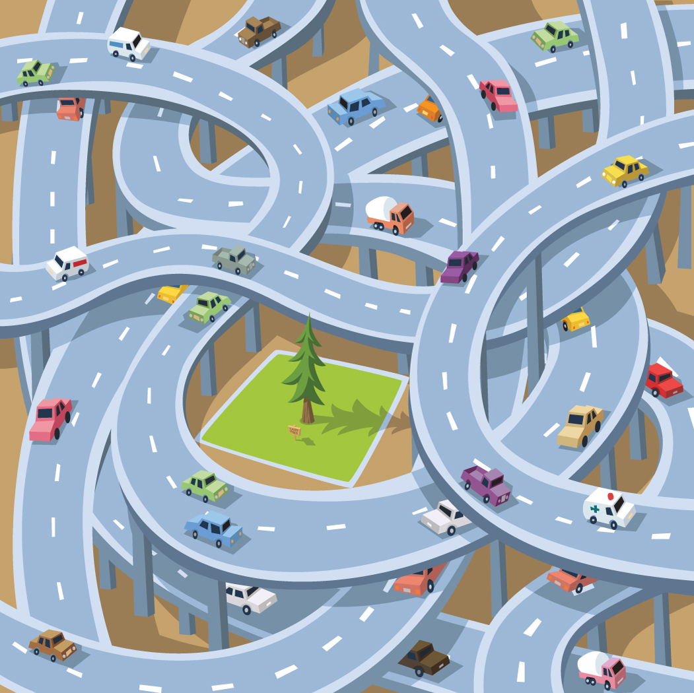
The demise of the monocentric city
Decentralization of Manufacturing: Trucks and Highways
  The intracity truck (1910). Twice as fast and half as costly as horse wagon. 1910 - 1920: Number of trucks in Chicago increased 800 to 23,000
  Tipping the balance away from central location. Truck decreased cost of moving output relative to the cost of moving workers. Firms moved closer to low-wage suburbs
  The intercity truck (1930s). Long-distance travel became feasible. Improvement of intercity highways facilitated truck transport. Truck freight grew at expense of shipping and rail freight. Most manufactures oriented to highways, not rail terminal or port

Slide 18
The demise of the monocentric city
Other Factors in Decentralization of manufacturing
  Automobile replace streetcars, increasing access outside streetcar hub; highway sites accessible to entire metropolitan area
  Single-story manufacturing plants cheaper in low-rent suburbs
  Air freight: orientation toward suburban airports

Slide 19
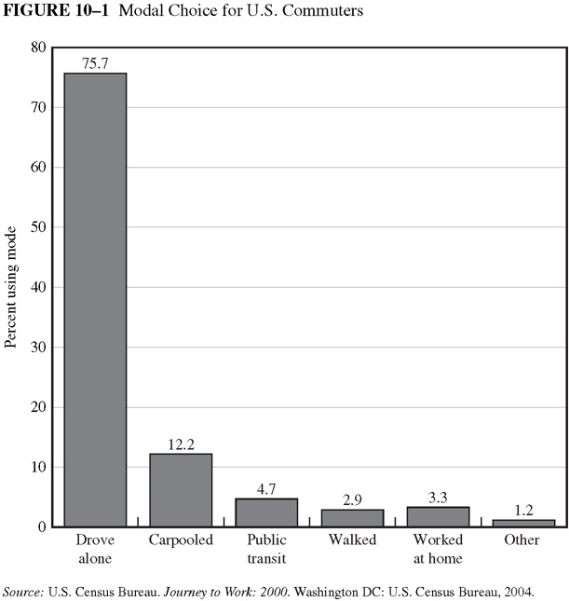

Slide 20
Cost of the suburban lifestyle
The rise of the suburb has significantly increased energy consumption in the US:
  Larger sized houses built in the suburb consume more energy
  The increased travel distance with automobiles
  Inefficiency of public transit
The demise of downtown culture
  Exodus of high and middle class from central cities reduced demand for down town shopping

Slide 21
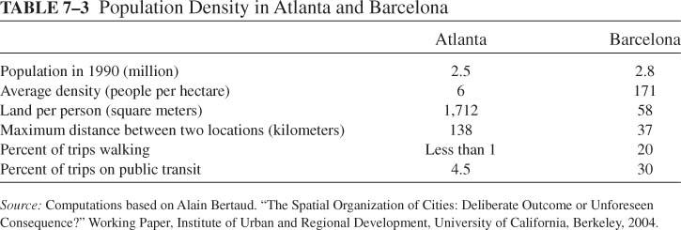

Slide 22
The challenge of public transportation
Why is public transportation important?
A successful transit system can
  Reduces congestion from automobile use
  Improve access of low income households to jobs
  Supporting large employment clusters
  Reduce fatalities and pollution associated with overdriving

Slide 23
Provision of public transportation
Economies of scale: average cost declines with usage, i.e., the new user costs less than the average
  Savings in operating costs if vehicles become more utilized
  Savings in user access costs if service is increased

Slide 24
Provision of public transportation
Cost
With 20 users, the average cost is $7/unit
7
However with 40 users, the cost is $5/unit
5
ATC
0
20
40
Quantity of Output

Slide 25
Provision of public transportation
Cost
With High demand, the system operates at capacity and covers its cost
ATC
D
MC
0
Q high
Quantity

Slide 26
Provision of public transportation
Low demand for public transportation
  Underpricing of road travel by automobiles
  Decentralization of employment and residences
  Federal support for the highway system
  Housing policies favoring the suburb
  Zoning restrictions on high density housing
  Subsidized parking
  Low gasoline taxes

Slide 27
Provision of public transportation
Cost
With low demand, the system operates below capacity and a subsidy is needed
ATC
D
MC
0
Q low
Quantity

Slide 28
Automobile Externalities: Congestion

Slide 29
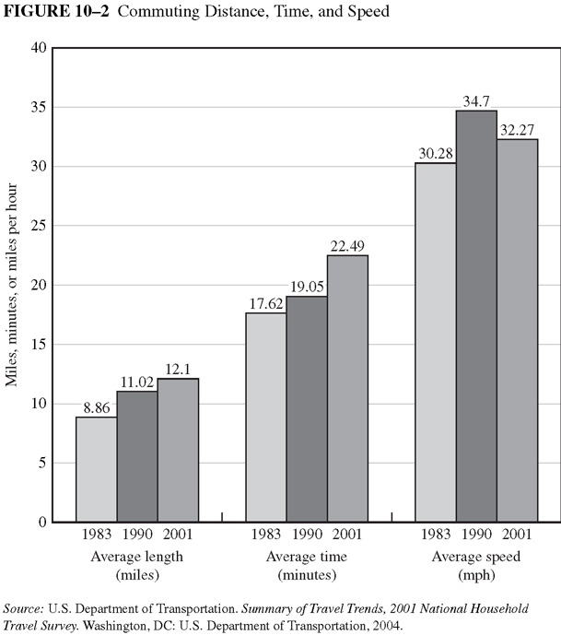

Slide 30
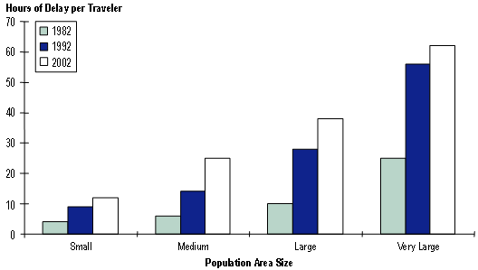
Congestion Facts (U.S.) Cont.
Congestion Levels Over The Last 20 Years
See a consistent rise in congestion regardless of city size.
Larger increase from 1982-1992.
http://ops.fhwa.dot.gov/congestion_report/chapter3.htm
Texas Transportation Institute

Slide 31
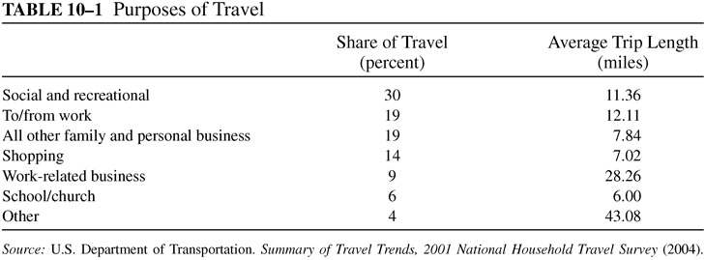

Slide 32
Congestion Cost (U.S.)
Congestion levels in 85 of the largest cities have grown consistently (1982-2003)
Travelers Average 47 extra hours a year on the road due to congestion (1993-2003)
Peak Trips take an average of 7% longer (1993-2003)
In addition to time lost, $5 billion of gasoline due to slow driving and delays

Slide 33
Congestion Facts (Worldwide)
London is the most congested city in Europe where the economy has foregone 2-4 billion pounds (3.2 – 6.5 billion dollars).
100 Km Traffic Jam in China over two weeks in August 2010 (A little over 62 miles).
Sao Paolo, Brazil loses 316 million man hours of labor a year due to congestion.

Slide 34
Factors Affecting Congestion
Number of cars on the road
Private benefits and costs
Each additional driver affects all other drivers.
2. Number of miles driven
Urban Sprawl leads to longer commutes, cars on the road longer.

Slide 35
Factors Affecting Congestion (Cont.)
Road Capacity
Number of lanes and width of lanes can affect congestion
4. Peak Time
Refer to times of day where people are more apt to drive.
Rush hours as peak
Early morning hours as non peak

Slide 36
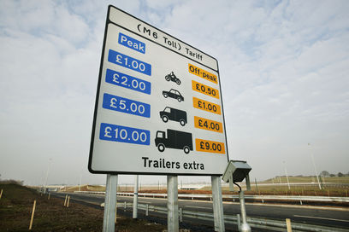
Road Pricing

Slide 37
How to reduce congestion?
Modal substitution: switch to carpool, transit
Time of travel: switch to off-peak travel
Travel route: switch to less congested route
Location choices: change residence or workplace, cutting travel distance

Slide 38
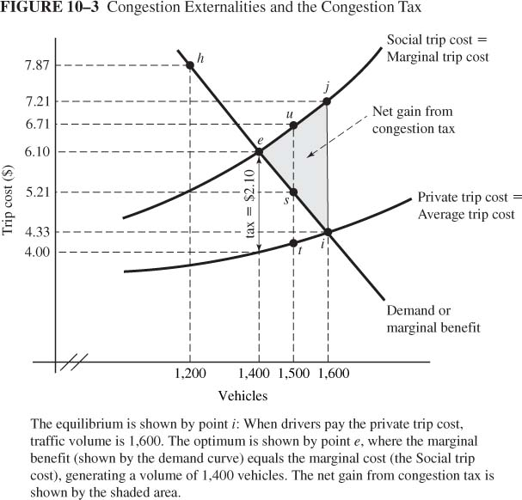
Congestion Tax
Tax = external trip cost at the optimum volume
Tax shifts the private trip cost curve upward
Volume decreases
e
i

Slide 39
Does the congestion tax make society better off?
Welfare is maximized when MSB=MSC for the last vehicle on the road
This is true at e
The tax improves welfare as it eliminates the deadweight loss
e
i

Slide 40
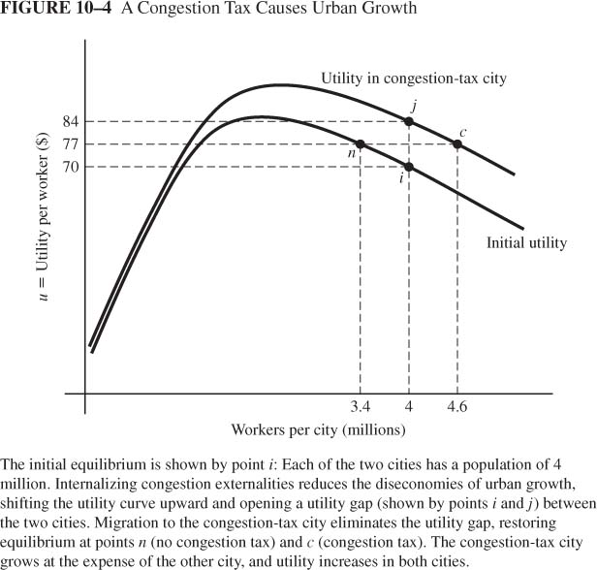
Congestion Taxes and Urban Growth
A region with 2 identical cities 4m workers each
Congestion tax reduces diseconomies of scale, shifting utility curve upward
Immediate effect is utility gap: points j and i
Migration to congestion-tax city cause movement j to c (tax city) and i to n (other city) until utility is equalized
Result: congestion tax city grows at expense of the other city, but both benefit from the congestion tax

Slide 41
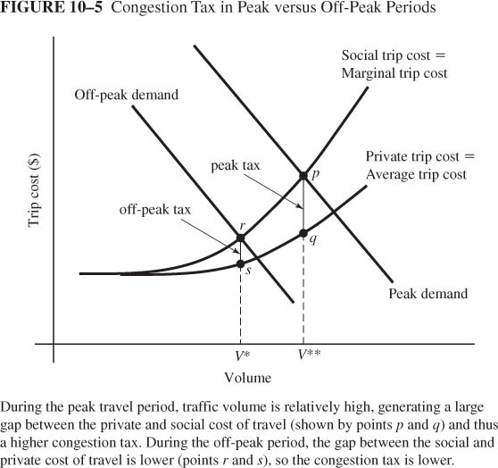
Congestion tax: peak vs. off peak
Demand for travel is higher in peak periods
This implies that the congestion tax will be higher in the peak period

Slide 42
Practicalities of the Congestion Tax
Peak versus Off-Peak Travel:
  Peak demand generates larger volume, larger gap between private and social trip cost, and larger congestion tax
  Peak period lasts many hours in modern cities
Estimates of Congestion Taxes
  San Francisco: $0.03 to $0.05/mile(off peak); $0.17 to $0.65/mile (peak)
  Minneapolis: average of $0.09/mile; up to $0.21/mile on most congested routes
  Los Angeles: $0.15/mile average for peak

Slide 43
Implementing the Congestion Tax
Vehicle identification system (VIS) allows tracking and billing
Singapore: Area licensing system had $2 fee for central zone; Electronic pricing uses debit card to impose variable charges
Toronto: Fees on Express Toll Road depend on time of day
Pricing HOT Lanes
  HOV: high-occupancy vehicle lane for carpools and buses
  HOT: high occupancy or toll; pay to use HOV lanes
  California HOT lanes: Toll varies with traffic volume
  Responses to pricing: carpooling, switch to transit, switch to off-peak travel, switch routes, combining trips

Slide 44
Other Policy Tools
Highway Capacity Enhancement
More lanes and/or wider lanes
  Traffic would flow more freely, loosen congestion
Problems:
  Necessity to use more land
  Very costly to add more lanes and maintain them
  Would encourage more people to use these roads
2. Gasoline Tax
Would create incentives to carpool, use public transportation or make fewer trips.
Problems:
  What is the proper amount of tax put on gas?
  Demand for gas is very inelastic so it would take time to adjust

Slide 45
Policy Tools (Cont.)
3. Limitation of License Plates
would limit a number of cars allowed to register every year
Problems:
  It would take a long time to see any significant difference
  Who would qualify for these fewer license plates?
  Most people against it

Slide 46
Implementation
Dealing with public opinion
Dealing with urban sprawl.
Aiming policy at more elastic forms of transportation

Slide 47
What is the U.S. Doing?
City planners look toward highway capacity enhancement.
May not be a viable solution as post WWII enhancements did not curb congestion.
Signal Timing, Freeway metering, carpool lanes and transit reorganization have made modest effects.

Slide 48
Houston Example
Houston has adopted HOT (High Occupancy Toll) lanes to combat HOV lane inefficiency.
Works to fill HOV lane space that is underutilized.
Cars are fitted with automatic toll transponders.
Closed during peak HOV lane hours.

Slide 49
What is Europe Doing?
Trans-European Public Transportation
- Efficient city to city public transit
Gasoline Tax
Congestion Tax
-London example
Marco Polo I and II
- Incentive to switch modes of transportation

Slide 50
London Example
Implemented a Congestion Tax in 2003.
Had public support from the start.
8 Euro tax for everyone, with a few exceptions: Motorcycles, taxis, buses and disabled persons amongst others.
Automobile congestion went down by 20%.
Issues with traffic spillovers, fairness, loss of privacy and possible market losses.

Slide 51
Singapore Example
Electronic Road Pricing (Congestion Tax)
Fully Automated, charges collected electronically.
Central District charged from 7AM to 7PM
Arterial roads and expressways from 7AM to 9:30PM.
Electronic Transponder with Charge Card.
Drop in weekday traffic by 24%.

Slide 52
What are Developing Nations Doing?
Congestion Problem is unique compared to the developed countries.
Large number of non-motorized vehicles.
High quality urban arterial roadways coupled with poor quality secondary roads.

Slide 53
Policy Examples
Chinese sales tax on small automobiles.
Beijing limits new license plates to 20,000 a month.
Potential Indian Congestion Tax using a Radio Frequency Identification (RFID).

Slide 54
Summary
If countries are smaller and have a higher population density it seems public transit is the best solution to curb traffic congestion.
Given urban sprawl it seems that a congestion tax or some other form of road pricing would be best.

Slide 55
2. Autos and Air Pollution
Types of pollutants: VOC, CO, NOx, SO2 generate smog and particulates
Transport responsible for 2/3 of CO, 1/2 of VOC, 2/5 of NOx
Poor air quality exacerbates respiratory problems & causes premature death
Greenhouse gases from automobiles

Slide 56
Internalizing the Externality
Economic approach is tax = marginal external cost
Gasoline Tax
  Increase cost per mile, decreasing mileage and emissions
  Does not provide incentives for cleaner cars since the tax is based on gasoline consumption not directly on emissions

Slide 57
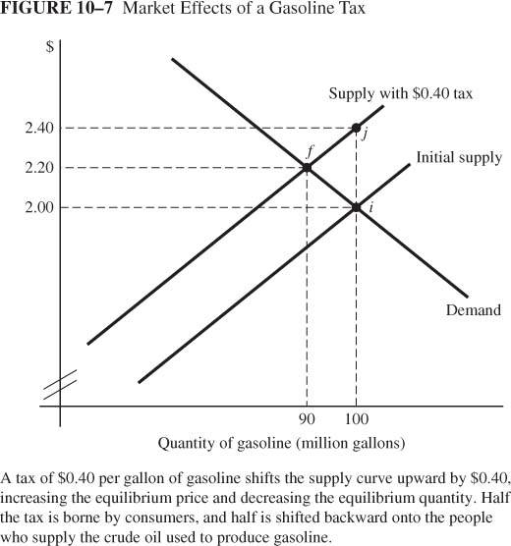
Gasoline Tax
Tax = $0.40 per gallon: Shifts supply curve (marginal-cost curve) upward by $0.40
Price increases by half the tax (from $2.00 to $2.20) as tax is partially shifted to supply side of market (owners of inputs whose prices fall as quantity falls--crude oil)

Slide 58
3. Motor Vehicle Accidents
Annual cost in U.S.: 3.1m injuries; 40k deaths; $300b per year
External cost of driving from collisions = 4.4 cents per mile (vs. 10 cents per mile for fuel)
Vehicle Safety Act of 1966: Mandated safety features
Seat-belt laws didn’t have expected effect
  Small reduction in death rates
  Increased death rates for pedestrians and bicyclists

Slide 59
Regulating Automobiles Emissions
In 1975 Congress passed the Energy Policy and Conservation Act which established Corporate Average Fuel Economy (CAFE) standards.
CAFE standards set miles per gallon (mpg) limit for new passenger cars sold in the US.
The standards are to be met on a fleet-wide average.

Slide 60
Regulating Automobiles Emissions
Flexibility: Firms can meet CAFE by improving fuel economy or increasing sales of the models that exceed the standard.
Since CAFE is an AES, it allows luxury models to exist, which is not possible under MES.
The initial standard was 18 mpg for model year 1978 and then was increased to 27.5 mpg in 1985.
The new energy bill requires automakers to boost their fuel economy to a fleet average of 35 mpg by 2016.
Despite concerns about the negative impact of CAFE on the automobiles market, policy makers continued to use CAFE as the main policy tool.

Slide 61
Welfare Impact of CAFE?
A trade off between environmental friendliness or energy efficiency and other quality attributes.
The National Academy of Science shows that the CAFE system has led to vehicle downsizing, potentially reducing safety.
In addition, it is believed that CAFE will always have a negative impact on firm profits. Kleit (2002) estimates that raising CAFE by 3mpg will result in losses to automakers of $1.124 billion.

Slide 62
Tradeoff: MPG and performance
Class | MPG | Size width*length in 10,000 square inches | HP 100 units | Price $
Small Car | 30.0 | 1.15 | 1.27 | 14,503
Compact Car | 26.2 | 1.26 | 1.46 | 16,482
Mid-size car | 23.5 | 1.37 | 1.83 | 20,737
Full size car | 23.0 | 1.49 | 2.03 | 22,565
Luxury car | 21.3 | 1.37 | 2.42 | 40,506
Source: Ward’s Automotive Digest (2009)

Slide 63
Welfare Impact of CAFE?
Why would the market not provide the “right” amount of fuel economy?
Helfand and Wolverton (2010) review the literature on the impact of automobile fuel economy and find a wide range of results.
  Questions: Should we force the market to provide more fuel economy using CAFE standards? How do consumers take fuel economy into consideration?
  Studies suggest that people are willing to pay between $0.74 to 25.97 for a $1 decrease per year in operating cost
  Conclude: fuel economy is correlated with other automobile attributes that are not all accounted for

Slide 64
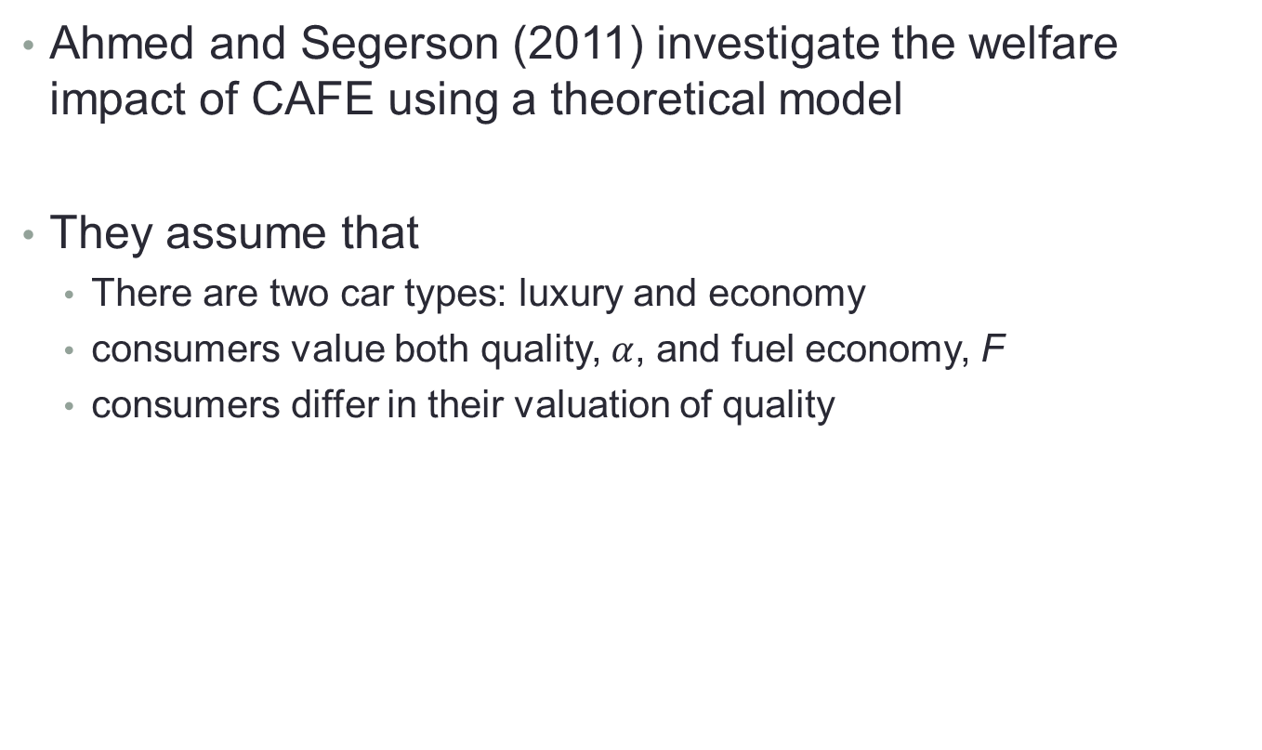
Can CAFE reduce Emissions?
Ahmed and Segerson (2011) investigate the welfare impact of CAFE using a theoretical model
They assume that
  There are two car types: luxury and economy
  consumers value both quality, $α$, and fuel economy, F
  consumers differ in their valuation of quality

Slide 65

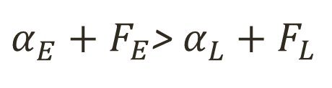



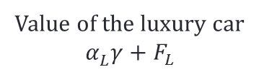
Case 1: Fuel economy cars preferred by all
$α_{E}^{}+F_{E}$> $α_{L}^{}+F_{L}$
Value of the economy car $α_{E}^{}γ+F_{E}$
Value of the luxury car
$$α_{L}^{}γ+F_{L}$$
$$F_{E}$$
$$F_{L}$$
1
$$γ$$

Slide 66

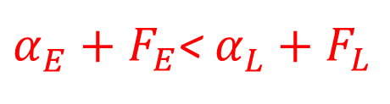


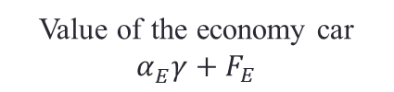
Case 2: Some consumers prefer the luxury car
$α_{E}^{}+F_{E}$< $α_{L}^{}+F_{L}$
Value of the luxury car
$$α_{L}^{}γ+F_{L}$$
Value of the economy car $α_{E}^{}γ+F_{E}$
$$F_{E}$$
$$F_{L}$$
$$γ$$

Slide 67
Is CAFE Effective?
CAFE creates incentives for automakers to increase production of luxury cars and reduce production of economy cars
If all consumers prefer economy cars over luxury cars, then CAFE:
  reduces car sales
  reduces emissions
  Can increase firm profit
If a significant number of consumers prefer the luxury car instead, then CAFE:
  increases total sales
  may increase emissions
  reduces firm profit

Slide 68
Is CAFE Effective?
The following can induce a shift from case 2 to case 1
  Rise in energy price
  Improved relative fuel economy of economy cars
  Improved relative quality of economy cars

