Slide 1
Chapter 18
Cars and Roads

Slide 2
Purpose
In this chapter we explore three sources of externalities generated by automobiles: congestion, pollution and collisions and the policy responses to each

Slide 3
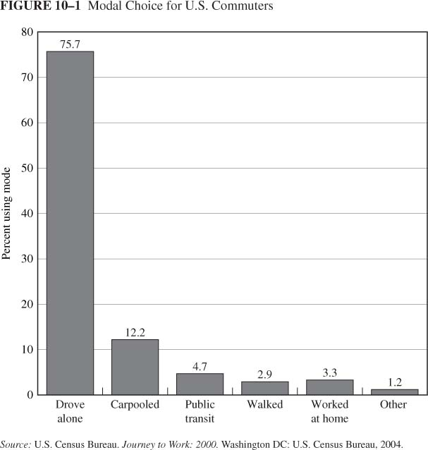
Modal Choice for US Consumers

Slide 4
Miles to Gasoline used to Emissions
Which is the policy target?
Relationship between them
E.g., better mileage cars, greener cars

Slide 5
1. Congestion Externalities
Axiom 3: Externalities cause inefficiency
  Automobile externalities: congestion, environmental damage, collisions
  Solution: Internalize the externalities with pricing (taxes).

Slide 6
Cost of Congestion
According to the Texas Transportation Institute an average US citizen wasted 47 hours/year because of congestion
In addition, gasoline wasted worth $5 billion due to slow driving and delays

Slide 7
A model of congestion externality
Each individual travels a route 10 miles long
Monetary cost of travel: 20 cents/mile
Time Cost: the opportunity cost of time is 10 cents/minute. (This will depend on how long the trip takes).
Private Trip Cost=2+0.1*m,
where m represents minutes taken

Slide 8
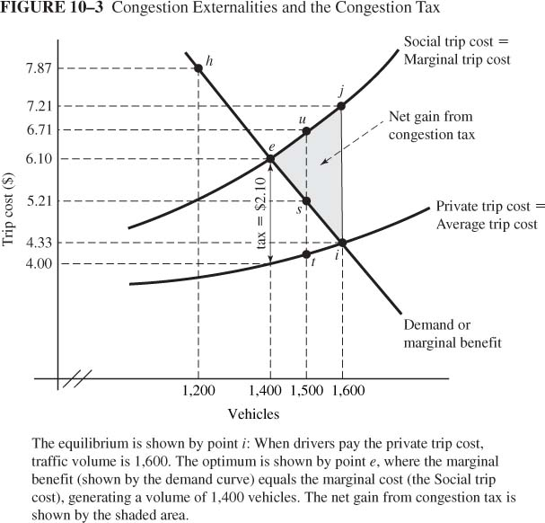
A model of congestion externalities
The Demand for Urban Travel:
  Negative slope: higher cost means smaller volume
  Each vehicle makes one trip
  Drivers vary with regards to the benefit they get from the trip
  Demand curve as marginal benefit curve

Slide 9
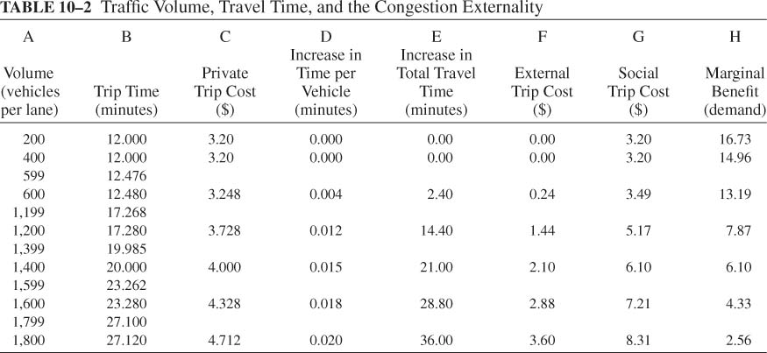
The Private and Social Costs of Travel
Trip time increases with traffic volume
Private trip cost = $2 + $0.10 • trip time
Social cost= private cost + external cost

Slide 10

In the absence of congestion
Driver #400
0
0
0
0
$3.2
The external cost =0
Social trip Cost= Private trip cost=$3.2

Slide 11
Equilibrium versus Optimum Traffic Volume
Private trip cost is the cost of the trip to each vehicle
The social trip cost is the total cost of undertaking the trip, =private trip cost+ external cost
Note: the two lines are not parallel (why?)
y
x

Slide 12
With congestion…
Driver #1200
0.0012
0.0012
0.0012
0.0012
$3.728
The external cost =1.44
Social trip Cost= Private trip cost + External cost

Slide 13
Equilibrium versus Optimum Traffic Volume
Drivers ignore congestion cost imposed on others
Lewis (#1,500) has mb = $5.21 (point s), private cost = $4.16 (point t), social cost = $6.71 (point u)
He uses the road because mb > private trip cost
Inefficient: he should not use the road because mb < social trip cost
e
i

Slide 14
Equilibrium versus Optimum Traffic Volume
Equilibrium: Demand (MB) intersects private trip cost at point i (V= 1,600)
Optimum: Demand (MB) intersects social trip cost at point e (V=1,400)
Equilibrium outcome is inefficient. There is a deadweight loss
e
i

Slide 15
Congestion Tax
Tax = external trip cost at the optimum volume = $2.10
Tax shifts the private trip cost curve upward by $2.10
Volume decreases to 1,400: for vehicles 1,401 through 1,600, marginal benefit now less than trip cost
e
i

Slide 16
Does the congestion tax make society better off?
Welfare is maximized when MB=MC for society for the last vehicle on the road
This is true at e
The dead weight loss at i is eliminated when the tax is in effect.
Therefore the tax improves welfare
e
i

Slide 17
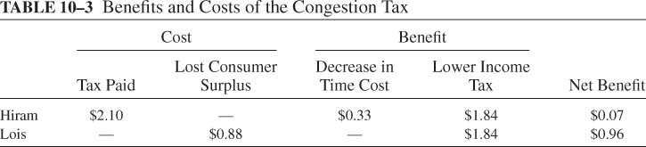
Is Society Better Off Under the Congestion Tax?
The government divides the tax revenue equally among all 1600 vehicles. Who benefits?
Hiram(still uses the road): Net Benefit = $0.33 + $1.84 - $2.10 = $0.07
Lewis (no longer use the road): Net Benefit = $1.84 - $0.88 = $0.96
Lewis

Slide 18
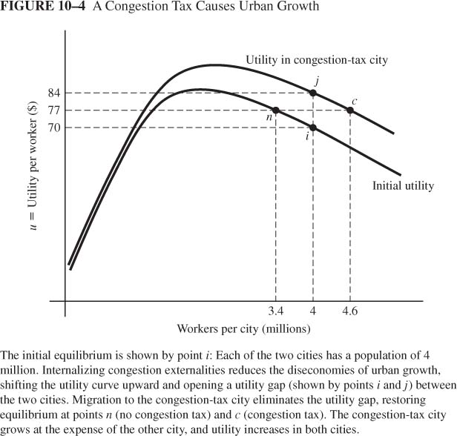
Congestion Taxes and Urban Growth
Point i: two identical cities
Congestion tax in one city reduces congestion, shifting utility curve upward
Immediate effect is utility gap: points j and i
Migration to congestion-tax city
Result: congestion tax city grows at expense of the other city, but both benefit from the congestion tax

Slide 19
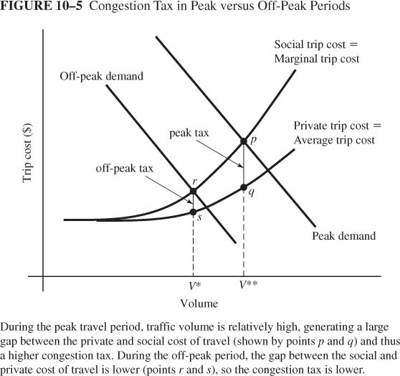
Congestion tax: peak vs. off peak
Demand for travel is higher in peak periods
This implies that the congestion tax will be higher in the peak period

Slide 20
Practicalities of the Congestion Tax
Peak versus Off-Peak Travel:
  Peak demand generates larger volume, larger gap between private and social trip cost, and larger congestion tax
  Peak period lasts many hours in modern cities
Estimates of Congestion Taxes
  San Francisco: $0.03 to $0.05/mile(off peak); $0.17 to $0.65/mile (peak)
  Minneapolis: average of $0.09/mile; up to $0.21/mile on most congested routes
  Los Angeles: $0.15/mile average for peak

Slide 21
Implementing the Congestion Tax
Vehicle identification system (VIS) allows tracking and billing
Singapore: Area licensing system had $2 fee for central zone; Electronic pricing uses debit card to impose variable charges
Toronto: Fees on Express Toll Road depend on time of day
Pricing HOT Lanes
  HOV: high-occupancy vehicle lane for carpools and buses
  HOT: high occupancy or toll; pay to use HOV lanes
  California HOT lanes: Toll varies with traffic volume
  Responses to pricing: carpooling, switch to transit, switch to off-peak travel, switch routes, combining trips

Slide 22
How to reduce congestion?
Modal substitution: switch to carpool, transit
Time of travel: switch to off-peak travel
Travel route: switch to less congested route
Location choices: change residence or workplace, cutting travel distance

Slide 23
How to reduce congestion?
 | Gas Tax | Subsidize mass transit | Eliminate parking subsidies
Modal substitution | Yes | Yes | Yes
Time of travel
Travel route
Location choices | Yes

Slide 24
The Road Capacity Decision
One way to reduce congestion is to impose a congestion tax
It may be optimal to expand the road size as well
The decision to do so will depend on whether the revenue from the congestion tax can cover the cost of building the road

Slide 25
The cost of travel
The following table shows the private trip cost at different volumes of traffic for a two lane road. The road costs $800 to construct. Calculate the average trip cost .
Vehicles | Private trip cost | Road cost per vehicle | Average total cost of travel
200 | 3.2
400 | 3.2
600 | 3.248
1200 | 3.728
1400 | 4
1600 | 4.328
1800 | 4.712
4 | 7.2
2 | 5.2
1.33 | 4.578
0.66 | 4.388
0.57 | 4.57
0.5 | 4.828
0.44 | 5.152

Slide 26
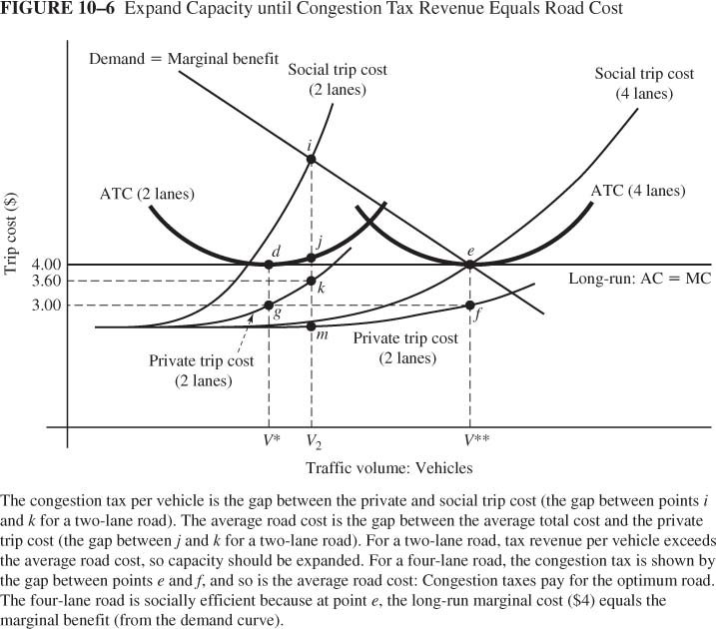
Cost with 2-Lane Road
The orange curve shows the ATC of travel
The yellow line shows the private trip cost
The vertical distance between them is the road cost per vehicle
As volume (V) increases
  ATC initially declines as the fixed costs are spread
  ATC then increases as the private trip cost rises due to congestion
ATC 2 lane
J.
.k
Private cost

Slide 27
The cost of travel
Two average cost curves: 2 lane road and 4 lane road
As we move to a 4 lane road PTC declines due to reduced congestion

Slide 28
The cost of travel
It is possible to build a 4 lane road?
This will result in
  less congestion and a decline in private trip cost
  And a decline in social trip cost
Social Trip Cost
(2 lanes)
Social Trip Cost
(4 lanes)
Trip Cost
Private cost
(2 lanes)
Private cost
(4 lanes)
Traffic Volume
Should society build a 4 lane road?

Slide 29
Equilibrium with 2-Lane Road
Equilibrium with a 2 lane road and a congestion tax: point i, where demand intersects social trip cost
Congestion tax: gap between point i and point k
Average road cost: gap between point j and point k
Tax > average road cost: Total tax revenue > Road cost
i
ATC 2 lane
J.
.k
Private cost

Slide 30
Widen the Road if Congestion Tax Revenue Exceeds the Cost
With the 4 lane road and the congestion tax, new equilibrium is point e
Congestion tax: gap between point e and point f
Average road cost: gap between point e and point f
Tax= average road cost: Total tax revenue = Road cost
For wider roads, marginal benefit < $4 as we move down the demand curve to volume > V**
e
.f
Private cost

Slide 31
2. Autos and Air Pollution
Types of pollutants: VOC, CO, NOx, SO2 generate smog and particulates
Transport responsible for 2/3 of CO, 1/2 of VOC, 2/5 of NOx
Poor air quality exacerbates respiratory problems & causes premature death
Greenhouse gases from automobiles

Slide 32
Internalizing the Externality
Economic approach is tax = marginal external cost
Emissions depend on miles driven and fuel economy of vehicle
Gasoline Tax
  Increase cost per mile, decreasing mileage and emissions
  Does not provide incentives for cleaner cars since the tax is based on gasoline consumption not directly on emissions

Slide 33
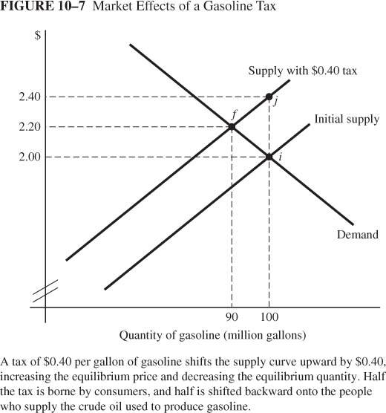
Gasoline Tax
Tax = $0.40 per gallon: Shifts supply curve (marginal-cost curve) upward by $0.40
Price increases by half the tax (from $2.00 to $2.20) as tax is partially shifted to supply side of market (owners of inputs whose prices fall as quantity falls--crude oil)

Slide 34

Gas Prices Around the World
Netherlands Amsterdam $6.48
Italy Milan $5.96
Denmark Copenhagen $5.93
Belgium Brussels $5.91
Sweden Stockholm $5.80
United Kingdom London $5.79
Germany Frankfurt $5.57
France Paris $5.54
Hungary Budapest $4.94
Luxembourg $4.82
Ireland Dublin $4.78
Switzerland Geneva $4.74
Spain Madrid $4.55
Japan Tokyo $4.24
Bulgaria Sofia $3.52
Brazil Brasilia $3.12
Cuba Havana $3.03
Taiwan Taipei $2.84
Lebanon Beirut $2.63
South Africa $2.62
Nicaragua $2.61
Panama City $2.19
Russia Moscow $2.10
Puerto Rico San Juan $1.74
Saudi Arabia Riyadh $0.91
Kuwait Kuwait City $0.78
Egypt Cairo $0.65
Nigeria Lagos $0.38
Venezuela Caracas $0.12
Source: CNN Money, March 2005

Slide 35
3. Motor Vehicle Accidents
Annual cost in U.S.: 3.1m injuries; 40k deaths; $300b per year
External cost of driving from collisions = 4.4 cents per mile (vs. 10 cents per mile for fuel)
External cost from collisions depends on:
  Miles driven
  Care (e.g., speed)
  Type of vehicle
  Road conditions

Slide 36
3. Motor Vehicle Accidents
Vehicle Safety Act of 1966: Mandated safety features
Seat-belt laws didn’t have expected effect
  Small reduction in death rates
  Increased death rates for pedestrians and bicyclists

Slide 37
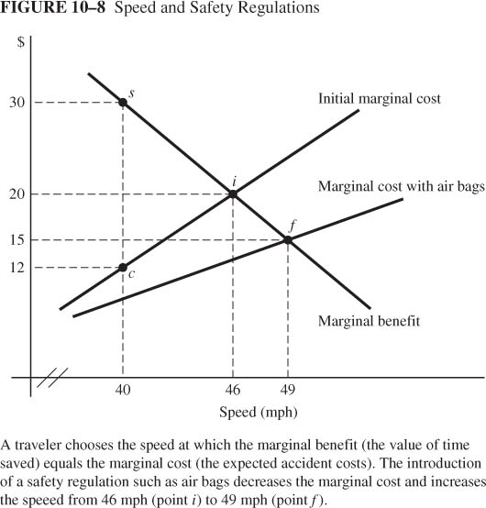
Why Do Drivers Speed?
Marginal benefit of speed: More time for other activities
Marginal cost of speed
  Increased likelihood of collision and injuries
  Increased severity of injuries
MC (40 mph) = $12; expected injury cost increases by $12 by driving at 40 mph versus 39 mph
Marginal cost increases with speed: expected injury cost increases at increasing rate
Initial equilibrium: Marginal principle satisfied at point i (46 mph)

Slide 38
Theory of Risk Compensation
Mandated safety equipment (air bags) decreases expected injury cost
Decrease in injury cost shifts marginal-cost curve downward
Rational response is to drive faster: 49 mph instead of 46 mph
Evidence for Risk Compensation
  Lower cost from injury increases the likelihood of injury
  Following safety regulations, higher collision rates and more pedestrian deaths
  Death rates for pedestrians and bicyclists increase with vehicle safety features

