Slide 1
Green Goods Markets
Opportunities and Challenges

Slide 2
Green v polluting products
Have you questioned the impact of goods you consume on others?
  Brown (polluting) goods: Many of the goods that we consume create negative environmental or social impacts either though their production processes or through the consumption
  No options? Yes there are
  Green goods: In many cases better alternatives emerged as substitutes to the existing brown versions

Slide 3
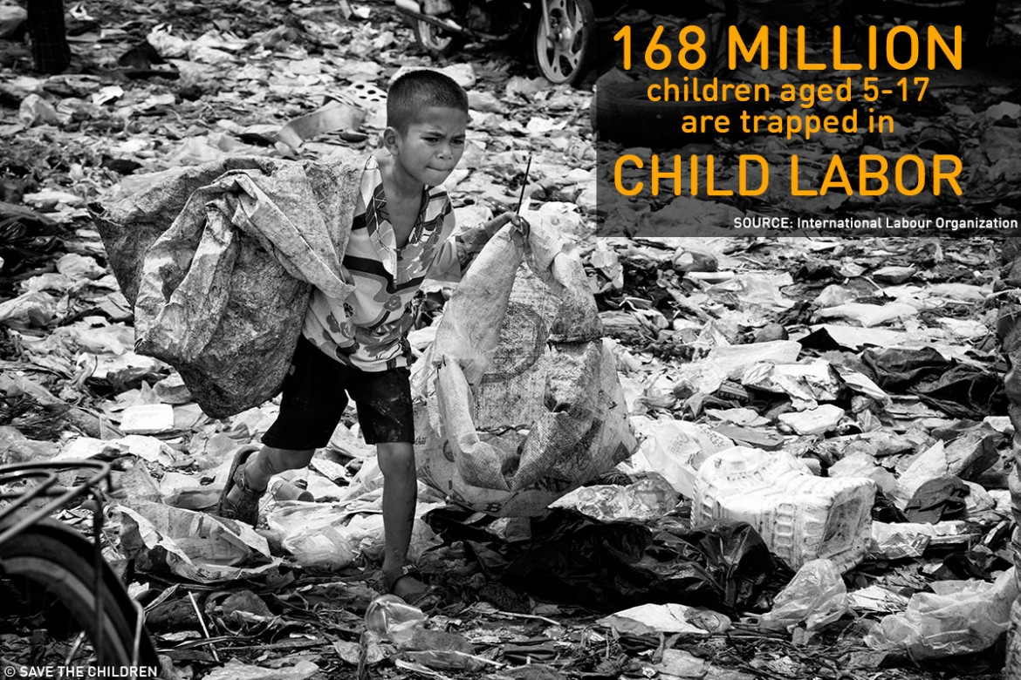

Slide 4
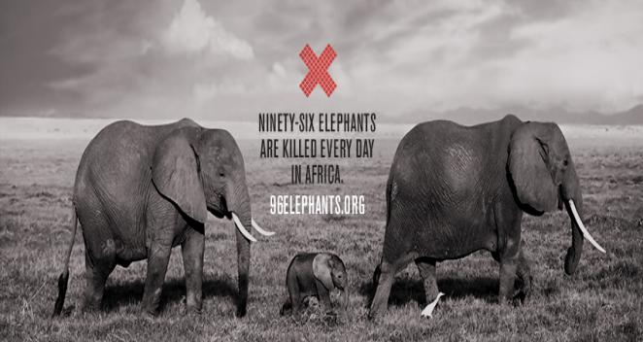

Slide 5
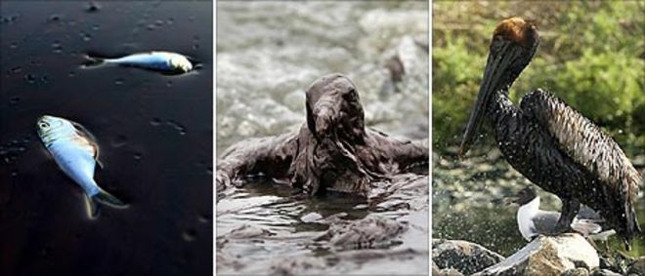

Slide 6
Green v polluting products
Have you questioned the impact of goods you consume on others?
  Still brown markets? The green goods have not entirely substituted brown goods
  Why? Many obstacles that require careful analysis to be able to make a change

Slide 7
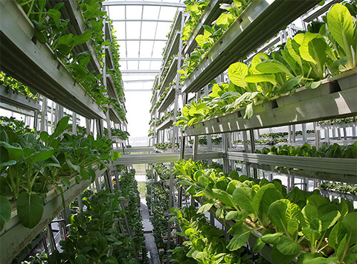

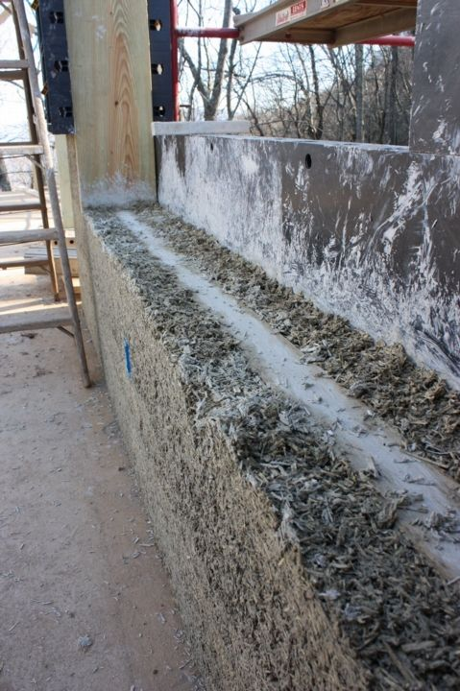
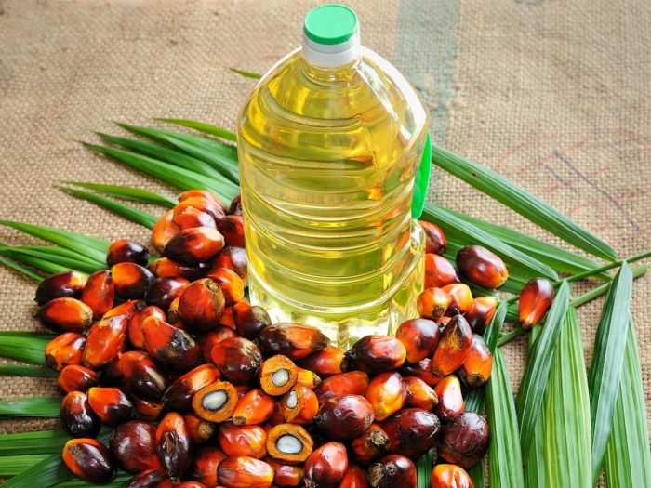
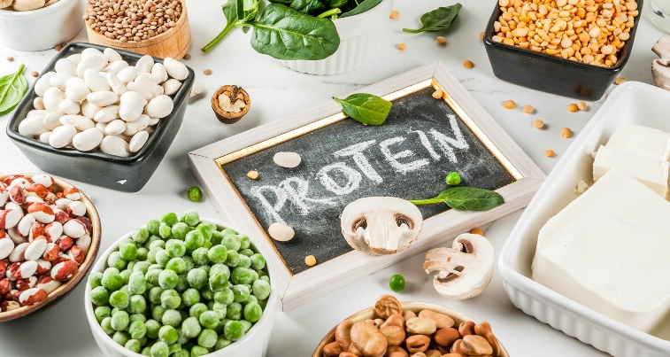
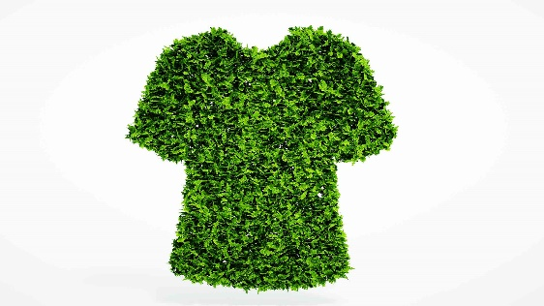


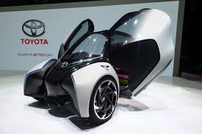

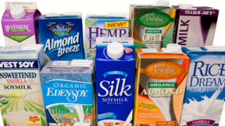
Green Goods

Slide 8
Course Objective
The course investigates issues pertaining to green goods markets. It will introduce students to the tools necessary to analyze market structure, competition, product design, product labelling, and the obstacles and the opportunities facing green goods markets.
The course lies at the intersection of environmental economics and industrial organization

Slide 9
Course Objective
What are the factors that contribute to/ hinder the growth of green goods markets?
  Green preferences
  Product Information
  Regulation v. Voluntary actions
  Tradeoffs quality v. environment

Slide 10
Environment and Scarcity
Self extinction premise
  Societies can germinate the seeds of their own destruction
  Historical example:
    Mayan Civilization
    Easter Island
  Contemporary one: climate change:
    The industrial revolution and increased generation of Green House Gases
    A change in the climate and disruptive changes to ecosystems

Slide 11
How will societies respond?
In general :
    Positive feedback loops: often called self reinforcing effects. Secondary effects reinforce the basic trend resulting in an extreme outcome
    Negative feedback loops: self correcting. Secondary effects correct the initial change restoring a state of balance
    Which one? Depends on the political and economic institutions

Slide 12
Role of Economics
Understand human behavior individually and collectively
Market failures: When human decisions are incompatible with environmental or social goals
Role of economic models

Slide 13
Self Correcting response: Green Goods
In the face of rising environmental damages, individual demand for a more environmentally conscious lifestyle result in technological advances that give rise to green goods.

Slide 14
The Environment
Define
We use the environment:
  For recreation
  As an input
  For waste disposal

Slide 15
Circular Flow Diagram
Firms
input
output
Households

Slide 16


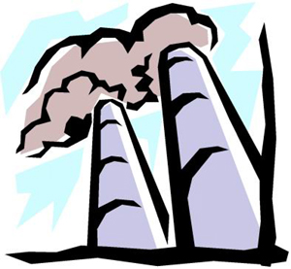




Circular Flow Diagram + Environment
Energy
Air
Raw Material
Water
Amenities
Firms
Air pollution
Solid Waste
Heat
Water Pollution
input
output
Households

Slide 17
Environment as an Asset
Raw material
Energy
Direct goods
Services

Slide 18
Sustainability
The intensity of use of the environmental resources
  Meet current demand, and
  Ensure the continued provision of environmental services to future generations
Should we stop all environmental uses?
  E.g. hunting, fishing, waste disposal, emissions of air and water pollutants, cutting forests, …
  Implications
  Efficiency

