Slide 1
Start with a graphic image on a PowerPoint slide. NOT in presentation mode.
Select the image
Double click on the middle.
line
Fill

Slide 2
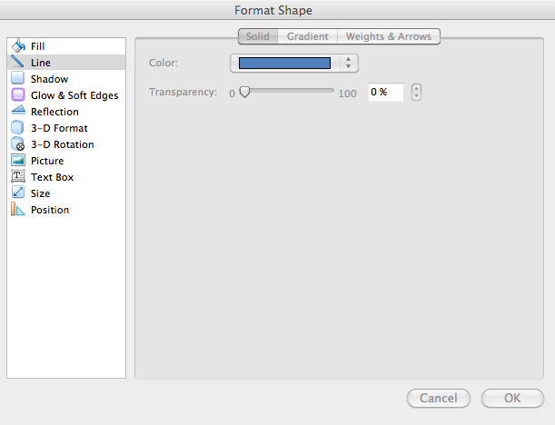
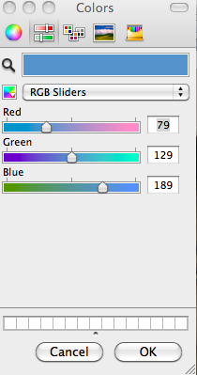
A solid shape, when selected, and clicked on, allows you to choose the color of both the outline [“Line”] and the “Fill.” If you have a line selected, you’ll get a similar window choice.
Then you’ll see this window.
Hold down the mouse key on the colored bar and select “More colors” at the bottom, under all the color boxes.

Slide 3
This is the slider format for looking at the
colors you can choose. It is selected by clicking on this second option at the top.
There are 4 choices in this window. The one shown here is option 2, RGB.
The 4th option is HSB, Hue, Saturation and Brightness. See that any color can be represented either way (actually all 4 ways). Go back and forth to see the RGB representation of a color, then the HSB representation of the same color. Your TV and computers use the RGB.
On your computers, the RGB values range from 0 to 255. These are computer codes for “least” to “most” color value. They are not direct physical specifications.

Slide 4
Perception Color Assignment -- Due electronically no later than Friday, Feb. 6
Part 1 of assignment --- Using PowerPoint or any other Microsoft office program, in the way that we indicated, adjust the red, green, and blue values to match the 6 sides of colored paper passed out to you in class.
On the next slide, mark the Y’s and N’s according to your knowledge. Leave a Y for Yes and an N for No if you can recognize this color by name. Then color the 6 squares to make the best match you can to the 6 pieces of colored paper that you were given in class. Make a PowerPoint file of this one slide and submit that only. Erase the other pages. For all files you submit for this course, please give it a NAME that BEGINS WITH YOUR LAST NAME, like Smithcolors.pptx. You have until Friday at 5 pm to put your answers on Moodle.
Aqua
Azure
Beige
Chartreuse
Cinnamon
Coral
Crimson
Fuchsia
Hot Pink
Indigo
Lavender
Lawn Green
Lime
Maroon
Navajo White
Navy
Olive
Orchid
Orange
Peach
Plumt
Sky blue
Slate gray
Tan
Teal
Turquoise
Wheat

Slide 5
Aqua Y N
Azure Y N
Chartreuse Y N
Cinnamon Y N
Coral Y N
Crimson Y N
Fuchsia Y N
Hot Pink Y N
Indigo Y N
Lavender Y N
Lawn Green Y N
Lime Y N
Maroon Y N
Navajo White Y N
Navy Y N
Olive Y N
Orchid Y N
Orange like the fruit Y N
Peach Y N
Plum Y N
Sky blue Y N
Slate gray Y N
Tan Y N
Teal Y N
Turquoise Y N
Wheat Y N
r=230 g= 130 b= 130
Color 2: r=220 g=130 b=130
Color 3: r=210 g=130 b=130
Color 4: r=200 g= 130 b=130
Color 5: r= 66 g= 187 b=84
Color 6: r= 63 g= 63 b=231

