Slide 1
To Students in Psychology 293-01 ---
Some of you have used part of at least one Trinity Day learning about color perception on your own.
The internet is filled with questions and commentary about the colors of a dress that was accidentally photographed to create an illusion.
In the photograph, a deep blue dress with black trim looks like a white dress with gold trim. Or not.
There’s a lot of Beau Lotto showmanship in the discussion, meaning that there is some misdirection of attention in order to emphasize the “gee whiz” experience.
What you would like to see would be a full video, moving around a little to see how this worked. At least Beau Lotto included video of himself standing up and walking around to show you that the “illusion” only occurred from a special point of view.
If you are reading this as a pdf and want to manipulate the images as suggested, then ask me for the PowerPoint version.

Slide 2
If you are one of the few people who have not looked at this photo, here are two versions, an original and a variant that I made by removing all of the background. For me, removing the background did not change very much.

Slide 3
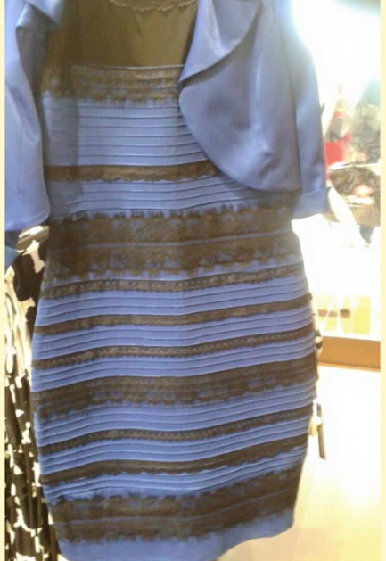
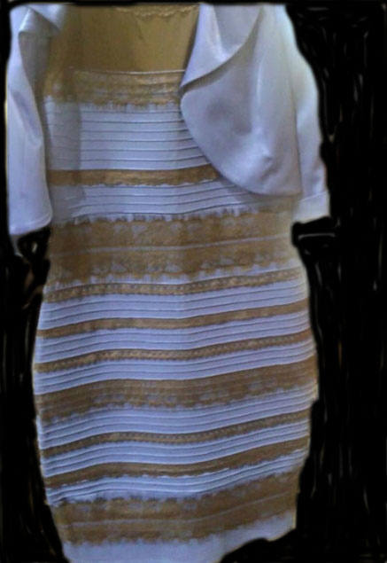
Dress image 2 -- background darkened
Dress image 1

Slide 4
On the next slide is the “true color” of the dress.

Slide 5
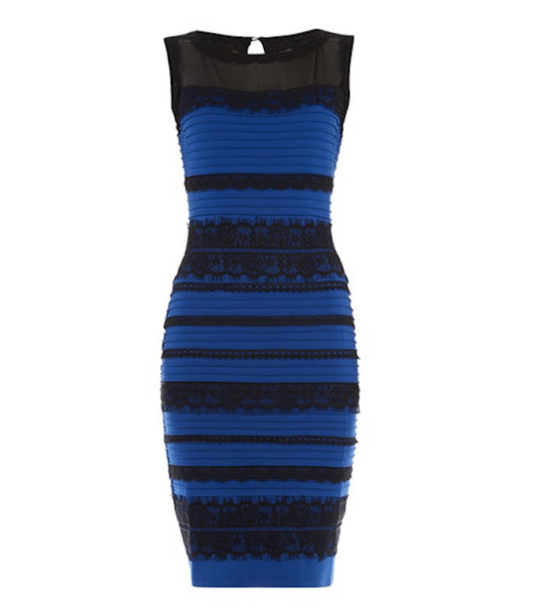
This may look the same to you as the first two images. Or it may not. The first two images may switch on you. This one should not.

Slide 6
Remember that I said there was some misdirection going on. The misdirection is concentrating on the color of the dress without talking about the lighting conditions.
If you see the dress as white and gold, then you ALSO are seeing it as in shadow.
If you see the dress as deep blue with black trim, then you are seeing the lighting conditions as “normal.”
On January 26 in the lecture portion of our class, I gave you this Purves figure in PowerPoint so that you could manipulate it.
The gray square in the upper left exactly matches the lighted dark stripe AND the shadowed white stripe.

Slide 7
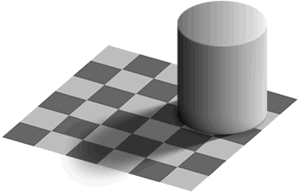
Here is a version of a very famous demonstration by Ted Adelson [Edward H. Adelson] of MIT. Adelson and Alan Gilchrist of Rutgers are two people who study these effects most.
These two squares are identical in terms of computer pixel values.

Slide 8
In the “real world,” which we have not arrived at systematically in the course yet, the wavelength and intensity of the light to the eye comes from two main factors, the illuminating light [called the incident light] and the surfaces the light reflects off of [the reflected light]. In the light ray as such there is no way to tell how much of its quality is caused by the surface color and how much is caused by the illumination quality. Both have played a role. [Compare the role of wavelength and intensity in bleaching the photopigment in a receptor]. Nevertheless, under most conditions, we can sort out these factors very well. To do this, requires sufficiently rich patterning all around. In the absence of enough patterning, lighting can be taken as reflectance and reflectance as lighting – or they can be ambiguous, and hence reversible.
Again, in the case of the dress image, the picture had an ambiguity in what was due to the colors of the materials and what was due to the lighting. But they go together, so a change in the appearance of the lighting (shadow or not?) must be accompanied by a change in the apparent colors of the material, because the pixel colors are a product of both.

Slide 9
If the variety of what you can see around you is insufficient, then the surface colors and illumination colors may not be so separable.
A sharp spotlight is illumination and does not change the color of the surfaces it shines on. But in isolation, you may not see it this way. Something whose surfaces are black, seen in bright light with nothing close by for comparison will look white. A bright, sharply defined light shined on a black wall can look like a white spot of paint on the wall and not a light.
There are two ways to darken an area that you can see: 1. By coloring it darker or 2. By shadowing it. If you see an area darkened by shadow, then you can see the colored material is not changing. This is called “lightness constancy.” In the Adelson display, you see lightness constancy in the checkerboard pattern. The darkening caused by shadowing is not seen as having an effect on the checkerboard colors.

Slide 10
Back to the dress colors
Again, notice that if you see the dress as white and gold, you also see it as in shadow. If you see it as deep blue and black, then you do not see it as in shadow. If you can see it either way, then the factors that control which way you see it are a different matter.
But if you switch how you see the dress, you switch between possibilities that are equally specified. I doubt that you can see this as a white and gold dress in bright light or a blue and black dress in shadow.

Slide 11
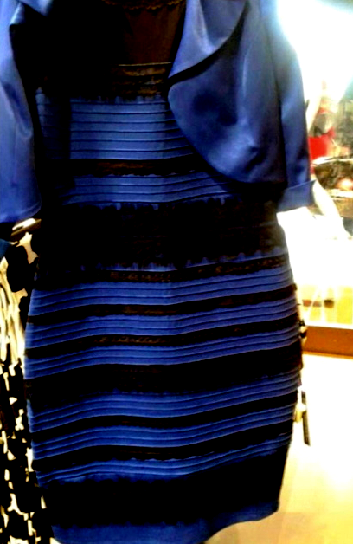
Here is a version of Dress Image 1 that I manipulated in Photoshop. I turned up the contrast and turned down the brightness. Notice that the dress does look blue and it does NOT look like it is in shadow.
You see some shadows but they are cast shadows of one part of the dress blocking light to another part.

Slide 12
If you want to explore the effects of some color change here on the computer, try this. [Use PowerPoint version]
Select the square and change colors like we did in the rgb class exercise.
Start with black and then add red and green (yellow) until you get a dark gold. Note the values of red and green.
Then start the square at pure blue (0 0 255) and add the same amount of red and green that you found made the gold.
That should give you a kind of purplish color that is a little like the shadowed white.
That would mimic the effects of illumination in the sense that uniform illumination has the same effect on all the lightnesses. You should see that the effect on black is similar to the effect on blue.

Slide 13
Summary: It is very straightforward to understand why there are two ways to see the dress. The lighting conditions are ambiguous, and the perceived colors of the dress (the reflectances) go with the lighting conditions. A on the scene could have been made to show the lighting conditions less ambiguously (like Beau Lotto standing up).
It is not so straightforward to understand why one sees it one way at one time and the other way at another time. Or why some people see it one way and other people see it another way. Or why some people are very flexible or even able to control the switching. Or whether or not those questions will lead to stable insights.
As with all ambiguous figures, one part of understanding the situation is to understand exactly what alternatives are allowed by the geometry.
After that, explaining which alternative one sees at a given time, is another matter.
The classic ambiguous figure is the Necker cube, on the left. The face that you see as closest to you can switch. Blinking is one way to get it to change. The main point is that the geometry constrains you to two alternatives, but they are equally well defined, so you can see it either way. Seeing it as an elephant battling a hippo is NOT one of the alternatives.

Slide 14
Final note
All the time I worked on this PowerPoint account, I saw the dress only as white and gold -- in shadow.
Just as I was closing up and saving the final files, I saw the original images as a blue dress with black trim. And I can’t see it any other way now. It really is a reversible figure.

Slide 15
Addendum
The following cut-outs from the original image can help you address the question: How much of the photo is necessary to get the effect?
If we can find some segments that work, and some segments that do not, it can help us understand what aspects of the original photo are necessary to get the effect.

Slide 16
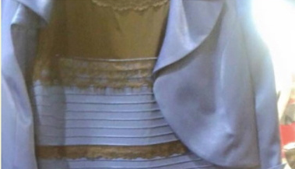
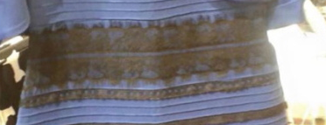
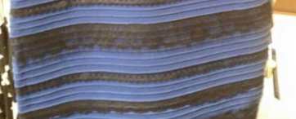

Slide 17
