Slide 1
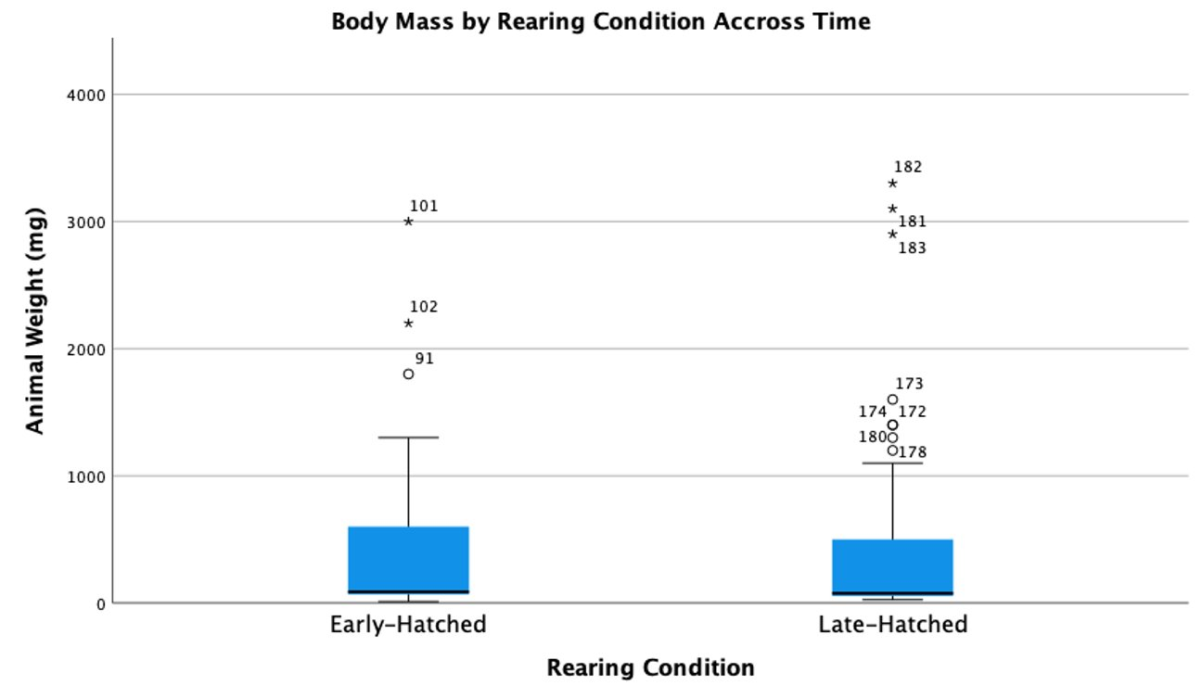
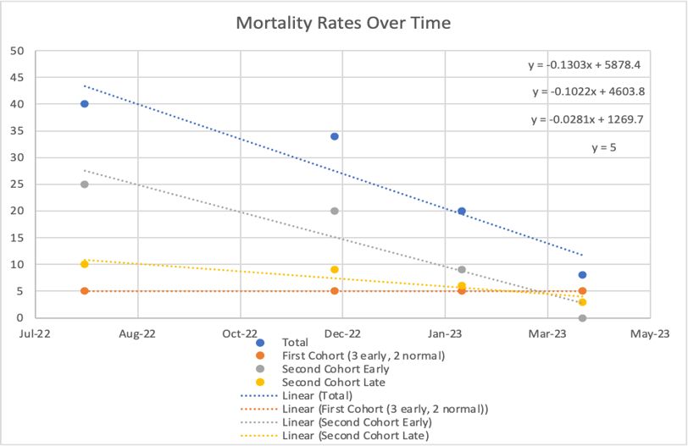
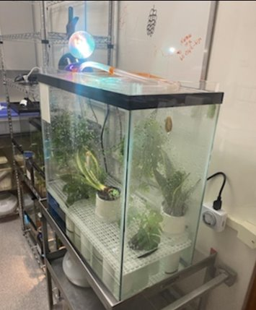
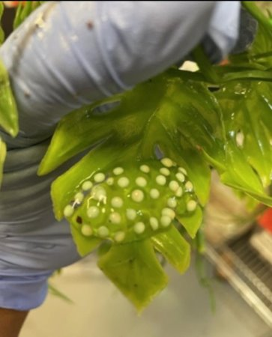
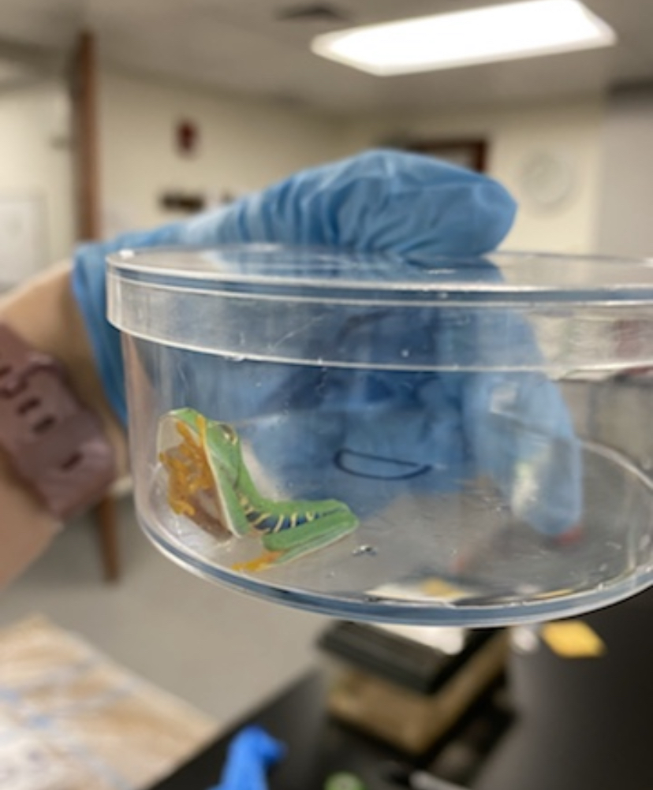
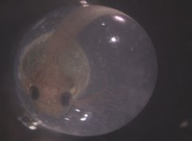
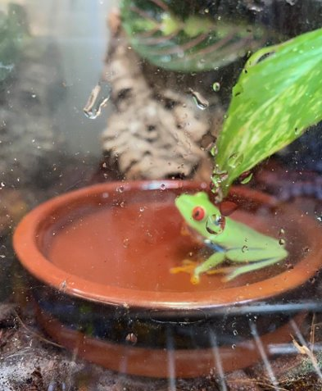
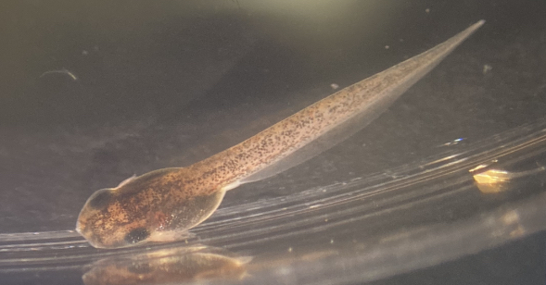
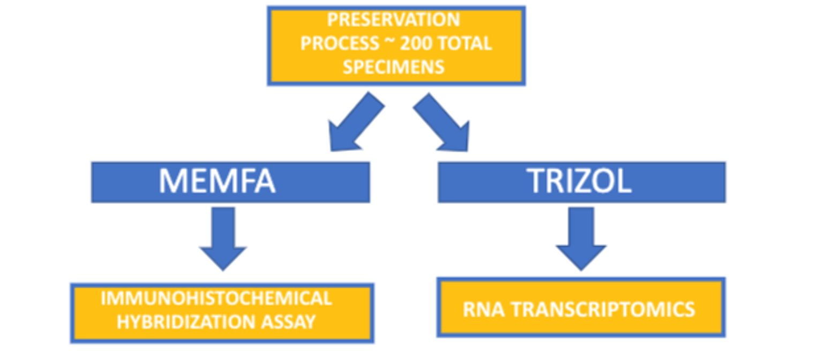
“Investigating the effects of early stress on neotropical red-eyed treefrog weight and mortality”
Anastasia Hanifin ‘23
Dr. Sally Seraphin, Neuroscience Program, Trinity College, Hartford CT
INTRODUCTION
METHODS
RESULTS
Adverse early childhood experiences (ACES) are prolonged instances of adversity experienced early in life and can lead to a higher risk of cardiovascular disease later in life as well as early pubertal timing in adolescents. 5/10 of the top leading causes of death in the United States are associated with ACES.
Life history theory is a branch of evolutionary theory that predicts changes in developmental timing with extreme stress, shifting the pattern of development and reproduction to accommodate immediate needs for reproduction. The red-eyed treefrogs ability to "escape-hatch" or hatch early presents with good potential for becoming a new biomedical model for ACES since they can niche shift to the next stage of development due to environmental stressors and stimuli. The Laboratory of Evolutionary Neuroscience is interested in learning about the timing and tempo of red-eyed treefrog development and health quality to see if it could eventually be applied to humans and metabolic or immunological dysfunction.
Red-eyed treefrogs were successfully bred in a lab for the first time in 20 years using a specially made rain-chamber to stimulate their natural mating cycles. After clutches were laid, each clutch was divided in half and assigned an experimental condition: early or late hatch and placed in a humidor to be kept safe and hydrated. The earlies were stimulated to hatch around 5-7 days post-laying while the lates were left to hatch on their own time. The frogs were then weighed at different time points to determine if there was any difference in overall weight. The frogs were also censused every time they were weighed to determine mortality rates.
Early
- stimulated to hatch around 5-7 days post laying
Late
- allowed to hatch without any interference, ~10 days post laying
*
Clutches
Graph 1. This graph depicts overall body mass by experimental condition over time.
Graph 2. This graph shows the overall mortality rates over time 0-200 days for tadpoles from each experimental condition.
Figure 3. Clutches were separated into the two experimental hatching conditions.
Table 1. This is a table from Azenta with the RNA Qubits highlighted, showing that there is a significant amount of good quality RNA in the Trizol preserved samples.
An independent t-test was conducted on the weights of both the early and late-hatched tadpoles separated by development phase. Although weights did not significantly differ between hatching conditions among younger tadpoles, older early-hatched frogs (M=96.97g, SD=51.50g) weighed less than their late-hatched (M=130.0g, SD=81.62g) counterparts [t(52)= -1.841, 1-tail,p<.05].
Graph 1 shows the results of an independent t-test on the overall body mass as a function of time for each experimental condition. A statistically significant difference was found between the weights with more upward variation for the late-hatched and a larger error bar for the early-hatched.
The early-hatched tadpoles appeared to have a greater mortality rate over time than the late-hatched, having a similar slope (m=-0.102) to the overall mortality rate (m=-0.130).
Figure 4. Rain chamber setup for red-eyed treefrog mating.
Figure 5. Full clutch laid on the underside of a leaf.
Figure 6. Container holding frog being weighed and censused.
CONCLUSIONS/FUTURE RESEARACH
Six Trizol preserved samples were sent to Azenta to perform a De Novo Transcriptomic analysis of the RNA in the samples. This was done to determine if there are any specific transcription factors or genes that are being expressed differently in early vs late-hatched tadpoles.
The weights did not appear to be statistically significantly different at 30 days post-hatching based on an independent t-test. ​
The growth metrics suggest a faster pace of development for the early hatchlings. ​
The mortality rates suggest that the early-hatched may use a portion of their metabolic reserve to hatch early leaving them will less reserve for stressors that could occur later in life such as metamorphosis.
Potential Human Connection: it could be possible for the transcriptomic results to eventually be mapped onto various risk factors for ACES survivors. ​
Figure 1. Red-eyed treefrog embryo.
Figure 3. Juvenile red-eyed treefrog.
ACKNOWLEDGEMENTS
Figure 2. Red-eyed treefrog tadpole.
Hypotheses
I would like to thank Dr. Sally B. Seraphin for her support and assistance as well as the Trinity College Neuroscience Department.
REFRENCES
We hypothesize that early compensatory growth will occur in the escape-hatched tadpoles, eventually evening out with the late-hatched groups.
Figure 7. A flowchart of preservation processes for ~200 specimens.
Bürgin D, O'Donovan A, d'Huart D, di Gallo A, Eckert A, Fegert J, Schmeck K, Schmid M, Boonmann C. Adverse Childhood Experiences and Telomere Length a Look Into the Heterogeneity of Findings-A Narrative Review. Front Neurosci. 2019 May 22;13:490. doi: 10.3389/fnins.2019.00490. PMID: 31191214; PMCID: PMC6541108.​
​Cdc newsroom. (2016, January 1). CDC. https://www.cdc.gov/media/releases/2019/t1105-aces.html
​Güell BA, Warkentin KM. When and where to hatch? Red-eyed treefrog embryos use light cues in two contexts. PeerJ. 2018 Dec 3;6:e6018. doi: 10.7717/peerj.6018. PMID: 30533307; PMCID: PMC6283037.
McDade, T. W. (2003). Life history theory and the immune system: Steps toward a human ecological immunology. American Journal of Physical Anthropology, 122(S37), 100–125. https://doi.org/10.1002/ajpa.10398
Warkentin KM, The development of behavioral defenses: a mechanistic analysis of vulnerability in red-eyed tree frog hatchlings, Behavioral Ecology, Volume 10, Issue 3, May 1999, Pages 251–262, https://doi.org/10.1093/beheco/10.3.251​
Notes:
-figures for pre mature timing
- tadpole picture
-comparing yield of pure RNA using manual vs automated, nanodrop
-all RNA sequence gene wiz
- immunohistochemical hydbriziation assay (memfa) --> staining / primers design informed by transcriptomics
-trizol (RNA transcriptomics)
-# specimens ~ 200 total
-weights over time paired t test – 2 way ANOVA
-or just second 2 weeks – indepdent t test early hatched vs late hatched
What are ACEs?
Strong frequent and prolonged adversity: neglect, emotional/physical abuse, disfunction
5 out of the 10 top leading causes of death in the United States are associated with ACEs (CDC.gov)
About 61% of adults surveyed across 25 states reported they had experienced at least one type of ACE before age 18
Minority and certain ethnic groups are at a greater risk
Adverse experience hinder emotional and behavioral development
Toxic stress accumulates with the rising number of ACEs
Inner and outer consequences: relationships, anxiety, depression, substance abuse, chronic illness, violence, altered perceptions
Associations between ACEs, amygdala damage/disfunction and reduced grey matter volume
Intrinsic and extrinsic factors
ACEs dosage: timing, quantity, quality
Early puberty- timing and tempo
ACEs exposure may affect female reproductive system especially familial disfunction and sexual abuse (before the age of 8)
Shortened telomeres
Growth development too quickly also leads to inability to reach full genetic potential in growth and height
Model Organism: Red Eye Tree Frogs- Agalychnis callidryas
Amphibian native to neotropical rainforests Mexico through Central America and Columbia
High humidity and warm day and night temperatures near a water source
Females are slightly larger
Carnivores, insect diet
Nictitating eye membrane for protection, camouflage, wet pads to stick onto leaves, good at jumping
Ambush predator and hunted by snakes and owls
Escape Hatching: embryo self-defense mechanism and phenotypic plasticity
Embryos (eggs laid on leaves above tropical ponds) escape many threats which can be sensed with mechanosensory ability : red eye tree frogs and glass frogs (80% escape rates); developing tadpoles dive to stay alive --> niche shifting/life history theory
Killifish develop rapidly in response of water level in the African Savannah
Hamsters
Glass frogs hatch prematurely in response to lack of paternal care (urine)
Physical disturbance of eggs, predator attack, hypoxia (flooding), egg killing fungus, dehydration, movements or vibrations can activate escape hatch response
Most undisturbed embryos hatch later to reduce changes of mortality
Embryos tremble in their eggs, release enzymes concentrated in hatching glands in their snouts to dissolve a hole in the gooey shell in one location to wiggle out (occurs in a few seconds much shorter than regular hatching)
Environmentally cued hatching- 3.5 days
Spontaneous hatching – 6-7 days Panama
Important development occurs between these two time periods
Early hatched tadpoles loose external gills and diverge in shape developing smaller tails
Why use red eye tree frogs as a model?
To assess a novel model for accelerated and delayed development following childhood adversity via escape hatching methods
More accessible than non-primate animals (due to COVID research demands), easier to work with
Unique and unexplored organisms for biomedical research fields
How does human development change with early stress?
Stressful experience become embedded in the child's neurobiology and behavioral responses
Overactivation of HPA axis: high blood levels and cortisol, inflammation and immune response impacted
Disrupt brain architecture and organ systems (over production of neuronal connections relating to fear and underproduction relating to reasoning)
Changes in gene expression: glucocorticoid receptor gene
Impairments in learning and memory
Disrupts neuronal plasticity, changes in prefrontal connectivity and differing volumes of certain parts of the brain
Similar mechanisms comparable with red eye tree frogs?
Tadpoles who hatch early are more likely to be killed by predators (not capable of escaping predators as well) and less likely to survive metamorphosis
Early hatching tadpoles are smaller and less developed; less active; unresponsiveness to future disturbance
May help organisms try out new phenotypes
Early stress induces changes in HPI axis
Goals: Understand through genetic, imaging techniques and neuroanatomical comparisons why early puberty may be occurring in humans

