Slide 1
Chapter 13
Spatial Distribution of Employment and residence

Slide 2
Trends
Decentralization of jobs
Decentralization of people

Slide 3
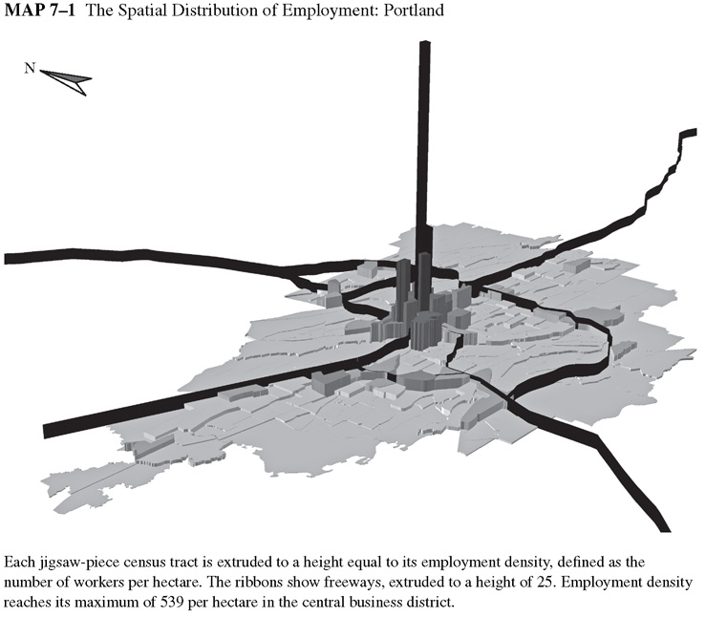

Slide 4
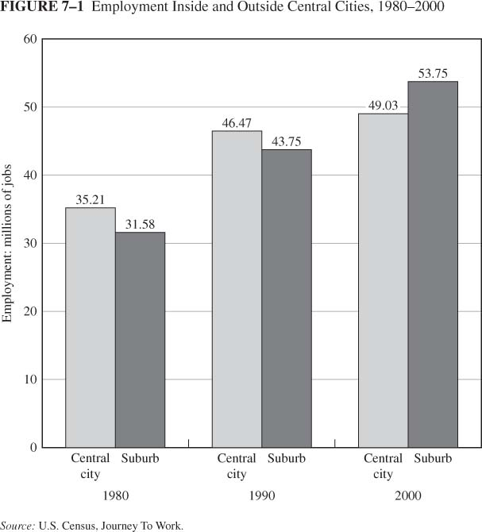
The Spatial Distribution of Jobs and People
Distribution of Employment
Employment decentralization
In 1948 jobs in central city were twice those in suburban areas

Slide 5
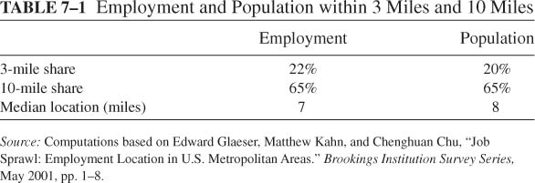
The Spatial Distribution of Population
Central city share is 36%
Suburban share is 64%
The table below shows that urban population is more decentralized than urban employment

Slide 7
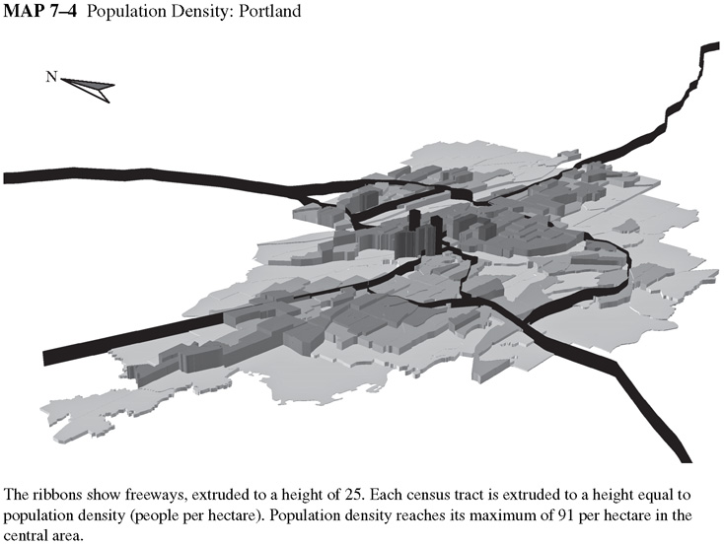

Slide 8
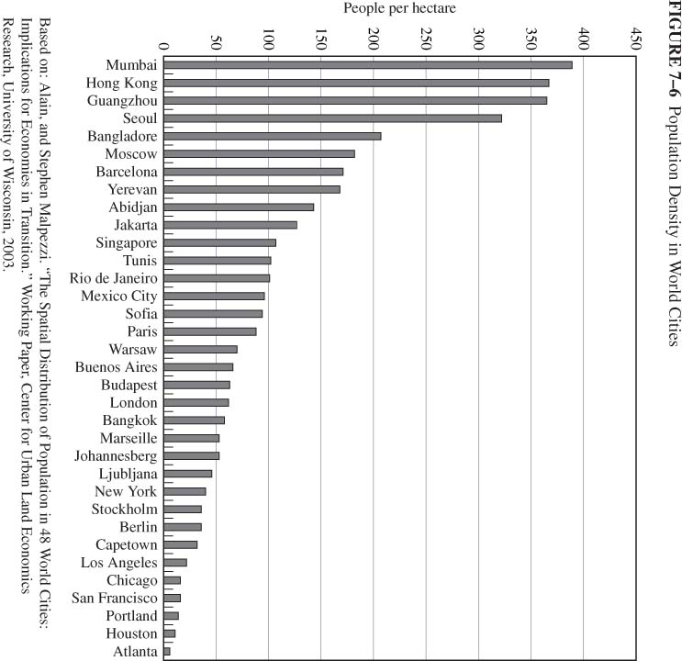
Urban Density Worldwide
Cities are defined as areas of high population density
Variation in density of world cities
US cities rank lowest

Slide 9
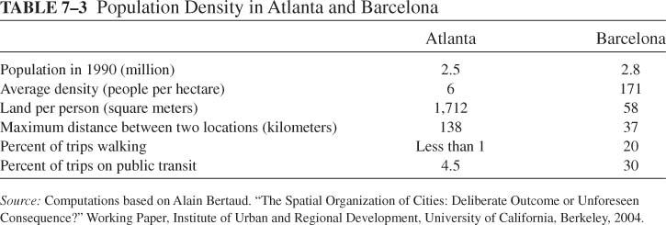
Urban Sprawl
Sprawl Facts
1950 - 1990: urban land increased 245%; urban population increased 92%

Slide 10
The demise of the monocentric city
Decentralization of population: Reasons
  Increase in income: ambiguous effect because higher income
    Increases the opportunity cost of commuting, but also
    Increases demand for housing and land, pulling people to low-price suburbs
  Lower commuting cost decreases the relative cost of suburban living
  Old housing in center
  Central-city fiscal problems
  Crime
  Education

Slide 11
Urban Sprawl
The role of public policy
  Under pricing of urban transportation encourages long commutes
  Mortgage subsidy increases housing consumption
  Under pricing of fringe infrastructure
  Zoning: Minimum lot sizes to exclude high-density housing

Slide 12
Consequences of Sprawl
Increased demand for public goods, e.g., highways and schools
Environmental consequences: more emissions from energy consumption
Political consequences: increased dependence on fossil fuels
Depletion of world reserves of fossil fuels results in a non sustainable life style
Loss of farmland can increase agriculture prices
Inefficient to provide mass transit
  To support intermediate bus service, need 31 people per hectare
  Only New York and Honolulu have this density
  60% of Barcelona residents within 600 meters of transit station, compared to 4% of Atlanta residents within 800 meters of transit station

Slide 13

Why is population density higher in Europe?
Higher cost of personal transportation
Higher gasoline taxes
Higher sales taxes on automobiles
Promote small neighborhood shops that facilitate high-density living
  Expensive electricity and freezers?
  Restrictions on location and prices of large retailers
Agriculture subsidies allow fringe farmers to outbid urban uses
Transportation infrastructure favors mass transit

Slide 14
The End of Suburbia
What were the factors that caused the rise of suburbia?
To what extent did government policies affect that rise?
Why are the transport options limited in the suburb?
What did Mathew Simmons mean by “US economic growth is not possible”?
According to this video, is suburban life sustainable?
How does suburban living affect the political system?
How viable are alternative fuels as a solution?
What is urban sprawl? Why is it a problem? How can government policy address it?

