Slide 1

Chapter 16
Urban Land Use Plicy

Slide 2
Purpose
This chapter explores
  the government’s control of land use
  The causes and consequences of zoning
  the winners and losers from zoning

Slide 3
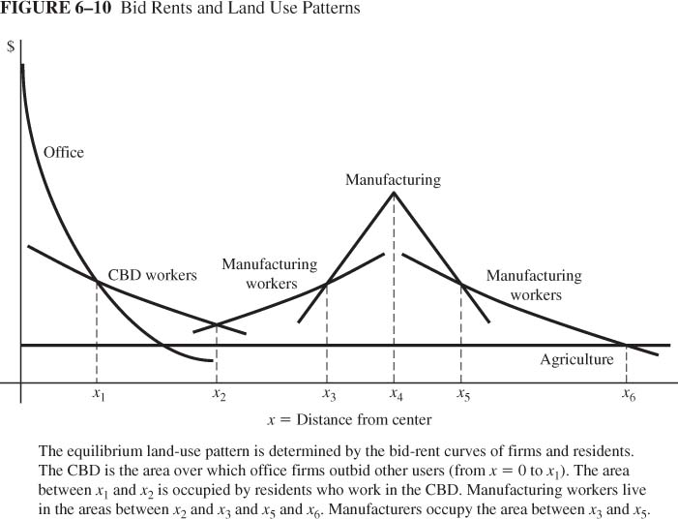
Unregulated Land Use Patterns
Absent any regulation, land goes to the highest bidder
Land is allocated to the highest bidder

Slide 4
Zoning
Zoning is the division of a community into districts or zones in which certain activities are prohibited.
Zoning is a series of rules that:
  Segregate different land uses
  Control population density
  Restrict kinds of buildings allowed
  Set limit on the size, height and location of buildings

Slide 5
Zoning
This can be achieved through:
  Taxing new developments
  Limiting the number of building permits
  Limit the provision of public services
  Imposing an urban growth boundary.

Slide 6
The Early History of Zoning
First used in Germany in 1870
Comprehensive zoning started in 1916 in New York city

Slide 7
Three Economic Problems
Reasons why New York zoning code was supported by key businesses:
  Need for sunlight
  Avoid new construction that would lower rent
  High toned stores would lose their image when working women shop around.

Slide 8
Why No Zoning Earlier?
The demise of monocentric city and the need for zoning
Innovations in transportation
  From Horse drawn to electric powered street car 1880: urban workers to live in exclusively residential districts and commute daily to central city. Increased demand for housing in suburbs.
  Intracity Truck: Industry became footloose. Moved away from export node towards suburban workers
  Passenger bus: low-income households in high-density housing to move between spokes of streetcar system, high density housing developed close to homeowners

Slide 9
Why No Zoning Earlier?
Need for zoning:
  Industrial zoning to separate industry from homes
  Residential zoning to separate high density housing from homeowners

Slide 10
Why Regulate Private Choice?
The economic rational for zoning is based on the existence of market failures
The existence of negative externalities from pollution, noise and congestion implies that decision makers do not take into account the benefit or cost that their actions impose on society
Thus, regulating private choice, in this case, can improve welfare

Slide 11
1. Zoning as Environmental Policy?
A pollution tax: imposes a cost on the polluter based on pollution generated. Under this uniform pollution tax, the polluter would reduce production to the socially optimal level
Industrial zoning: used when damages caused by pollution depends on the proximity of the pollution source to residential areas. In that case zoning moves pollution around without necessarily reducing it

Slide 12
1. Zoning as Environmental Policy?
Alternative approach to pollution control
  A non uniform pollution tax: the optimal policy is to use a pollution tax that depends on the magnitude of external damages. A high tax on pollution for firms close to residential areas and a lower tax rate for firms located further away.

Slide 13
1. Zoning as Environmental Policy?
Zoning can be used to control the location of
Retailers
  Externalities: congestion, pollution, noise, parking conflict
  Traditional zoning: confine retailers to zones
  More flexible: performance standards for traffic and noise
High density housing
  Externalities: congestion, parking conflict, blocked views
  Alternative to traditional zoning is set of performance standards for traffic, parking, views

Slide 14
2. Zoning To Generate Fiscal Surplus
Refers to the use of zoning to ensure that a land user’s tax bill exceeds the costs of providing services for a given area, i.e. a fiscal surplus
Taxes are based on property values.
Fiscal deficit: Tax contribution less than cost of public services
When a large household occupies a small dwelling, it is more likely to generate a fiscal deficit
That explains why some communities eagerly host firms that generate fiscal surplus

Slide 15
Minimum lot size zoning (MLS)
How to set a MLS?
Suppose the city breaks even on a house worth $200,000.
Rule: the property value is 5 times the land value
v*=5.r.s
v*: target property value
r: market value of land per unit area
s: land area
If r=$80,000 find the target lot size?
Target lot size: s = v* / (5 • r)= 0.50 acre

Slide 16
3. Zoning To Provide Open Space
Externality: larger lot generates more space and higher utility for neighbors
External benefit means that lots smaller than socially efficient size
MLS is one response to space externality: increase space and enforces reciprocity in space decisions

Slide 17
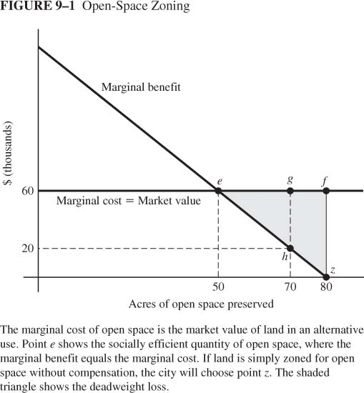
Problems with Zoning for Open Space
Do governments always provide the optimal amount of open space through zoning?
Marginal benefit curve shows willingness to pay for open space
Marginal cost curve shows opportunity cost of open space (value as developed land)
Optimal choice
MB = MC at point e (50 acres)

Slide 18
Problems with Zoning for Open Space
Inefficiency of zoning for open space
If zoning without compensation, then the regulator perceives MC = 0
MC=MB= 0 at point z (80 acres)
Therefore, Welfare loss shown by triangle efz
Regulator’s choice
MB = MC=0 at point z (80 acres)

Slide 19
Problems with Zoning for Open Space
Inefficiency of zoning for open space
If zoning with compensation, perceived MC=60
The regulator’s choice: MB=MC=60
Optimal area of open space achieved.
Socially Optimal choice
MB = MC=60 at point e (50 acres)

Slide 20
The Legal Environment of Zoning
Zoning laws and the power of governments
Zoning is considered legitimate if it promotes public health, safety and welfare. Three criteria:
  Substantive Due Process
  Equal Protection
  Just Compensation
The current zoning laws are the outcome of 60 years of legal decisions

Slide 21
1. Substantive Due Process
  Law must serve legitimate public purpose using reasonable means
  Euclid vs. Ambler (1924): Zoning promotes health, safety, morals, general welfare
  No consideration of cost, only benefit

Slide 22
2. Equal Protection
  The equal protection clause of the 14th Amendment requires that all laws be applied in a non discriminatory fashion
However, zoning is exclusionary as it will result in some groups being excluded from a city
  Example: Chinese laundries in San Francisco

Slide 23
2. Equal Protection
Federal courts: exclusionary zoning is constitutional
  Euclid: effects of zoning on outsiders unimportant
  Warth vs. Selden (1975): alleging that Penfield's zoning ordinances intentionally and wrongly excluded persons of low and moderate income from living there. Court: it is the consequence of the economics and housing market of the area rather than any wrong doing by the defendants
  Village of Arlington Heights vs. Metropolitan Housing Corporation: A zoning ordinance in a Chicago suburb barred the construction of a multi-family housing facility (i.e. apartment complex) in the center of the neighborhood. The plaintiff: in a practical way, the law barred families of various socio-economic, and ethno-racial backgrounds from residing in the neighborhood
  Result: discrimination on basis of income is OK

Slide 24
2. Equal Protection
State courts adopt more activist role
  Mount Laurel (NJ): City directed to accommodate its “fair share” of low-income residents
  Livermore (CA): Zoning must provide a reasonable accommodation of interests of insiders and outsiders

Slide 25
3. Just Compensation
Should property owners be compensated for losses in value from zoning?
If the government converts a piece of land into public use, the owner must be compensated.
What if zoning restricts private use?
Diminution of value rule: Compensation required if property value drops by sufficiently large amount; no guidance on what’s large enough; not widely applied
Harm prevention rule: If zoning prevents a harmful use of land then compensation is not required

Slide 26
How does Houston compare to cities with zoning?
Similar distribution of industry and retailers
More strip development along arterial routes
Low-income housing is more plentiful and less expensive
Apartment densities vary with income of occupants

Slide 27
Coase Theorem
According to Ronald Coase, externality problems do not necessarily require government intervention.
Once property rights are defined, bargaining can correct the problem assuming transactions costs are low.

Slide 28
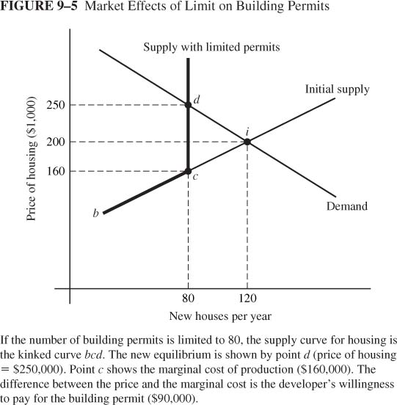
1. Limits on Building Permits
Limiting the number of permits for new housing to 80
Price of housing rises to 250
How to allocate the new permits?
If auctioned, what is its monetary value?

Slide 29
2. Development Taxes
Legally paid by the builder
Justification: money used to expand infrastructure
Builder and buyer share the burden
The graph shows a tax =$....
Builder’s burden=$........ Buyer’s burden= $........

Slide 30
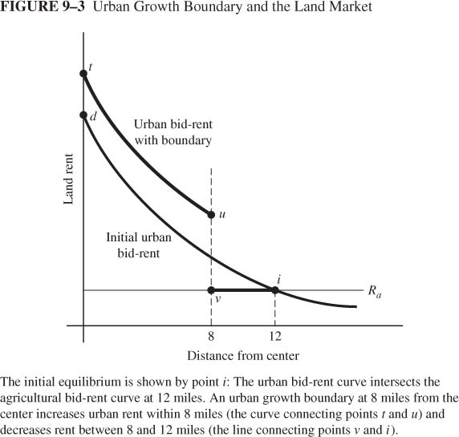
3. Growth boundary
Consider a growth boundary of 8 miles
Initial equilibrium: i.
Winners and losers:
  Urban dwellers
  Landlords 8-12 miles
  Landlords 0-8 miles
Rent inside the boundary increases.

Slide 31
Effects of growth control
On labor market
On land market
On housing market
On neighboring cities

Slide 32
On labor market
A growth boundary that limits residential units
  Raises the cost of housing
  S Shifts left as workers are less excited to work at the higher cost of living
  Movement up along demand as employers raise wage and hire less
Graph?

Slide 33
On land market
Given Business and residential bid rent
  Residential bid rent rises: more competition for limited housing space
  Business bid rent declines: Higher cost of labor, less profit, less bid
  Again landlords impacted differently
Graph?
Figure 16-8

Slide 34
On housing market
Growth boundary raises house prices
The Wharton regulatory index
  0 the average city
  Housing prices positively correlated with the index
Figure 16-7

Slide 35
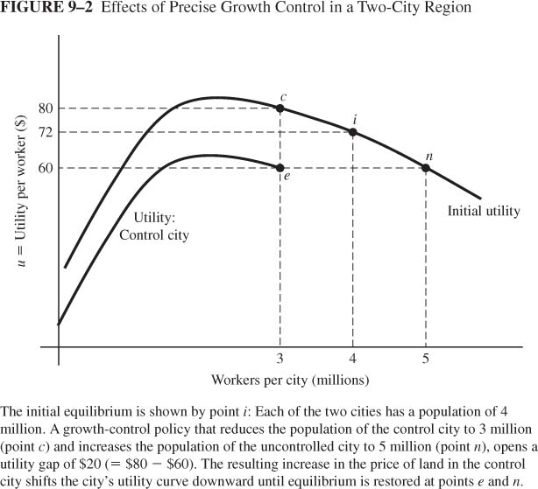
On Neighboring Cities
Two identical cities each with a population of 4m.
One city, through MLS and fixing total area, caps the number of workers at 3m.
Utility gap: 80-60
Will this utility gap persist?

Slide 36
Land Market
MLS such that only 3 units of housing possible.
The restricted supply of lots raises rent which lowers the utility level in the controlled city.
1m people displaced to city B.
The benefit of living in a small city are fully offset by higher rent
City A
City B

Slide 37
Assignment
Chapter 16: 2, 4, 5 and 6.

